Slide 1
Application Management (Installation & Configuration)– Chapter 3
Deepak KC

Slide 2
Objectives
Default program settings
Modify file associations
Windows Store

Slide 3
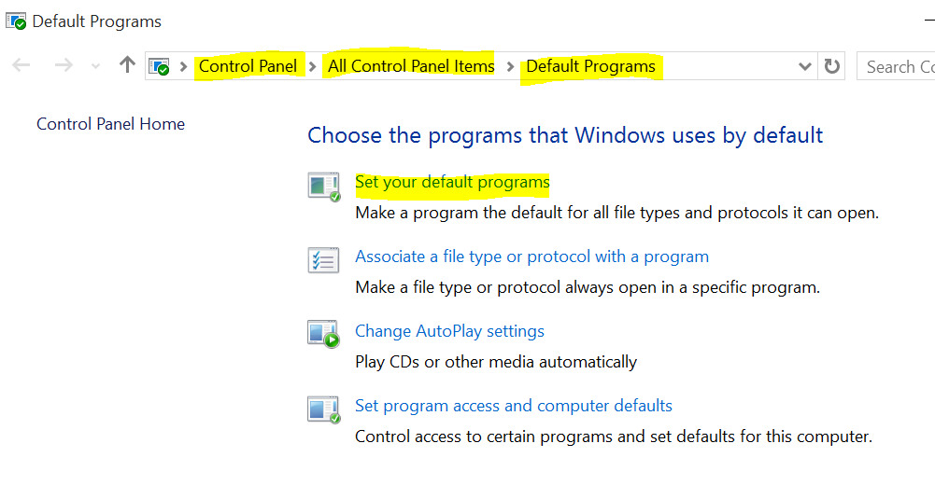
Default Programs
Set your Default Programs interface enables you to specify the types of files and associated application
A user simply double clicks a file and the application will launch itself by associating the type of file with an appropriate application as defined

Slide 4
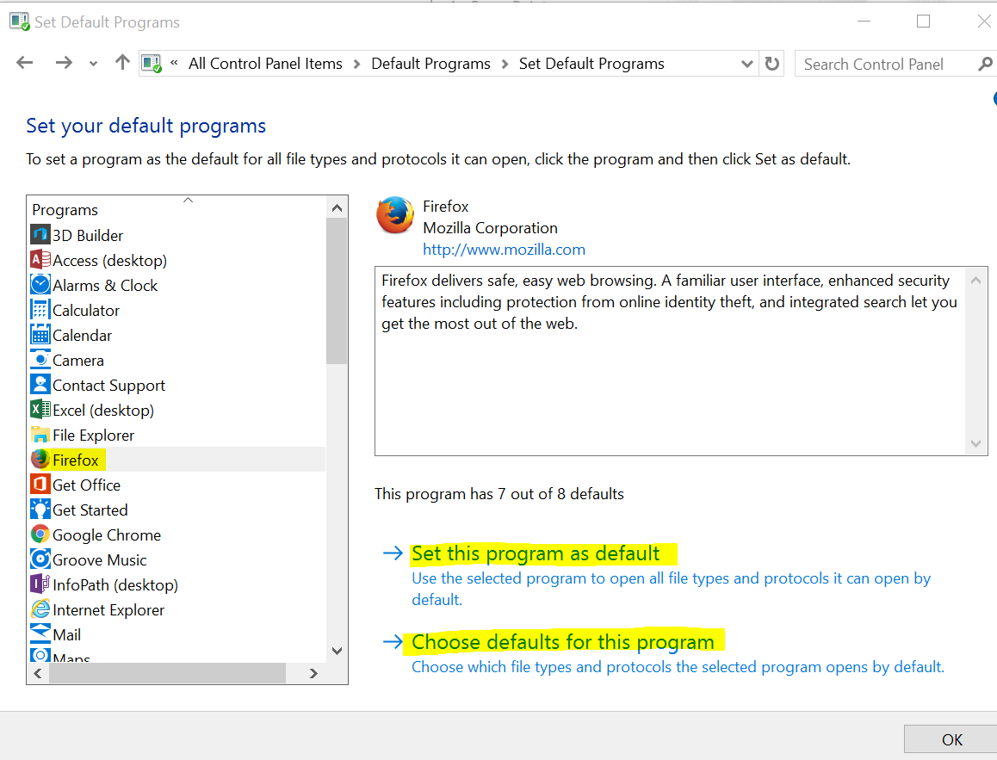
Default Programs

Slide 5
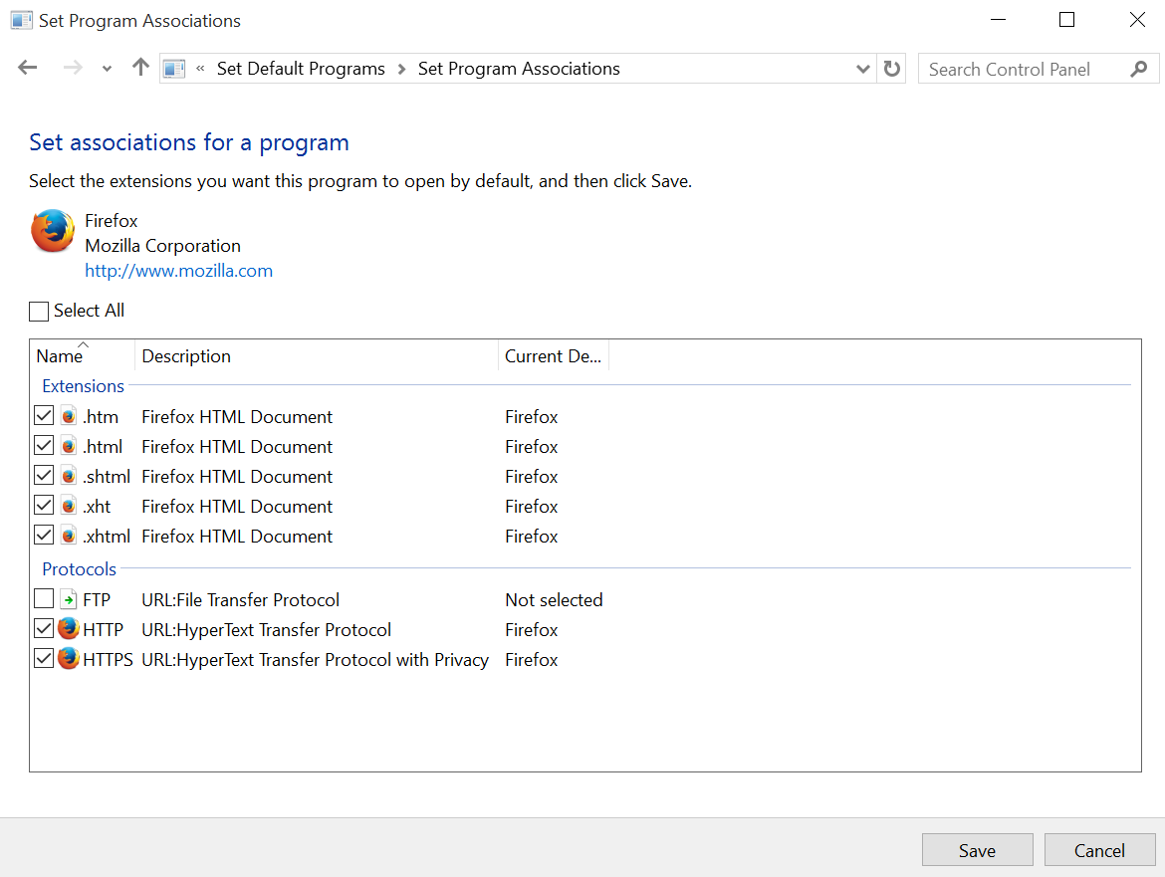
Choosing default for the program

Slide 6
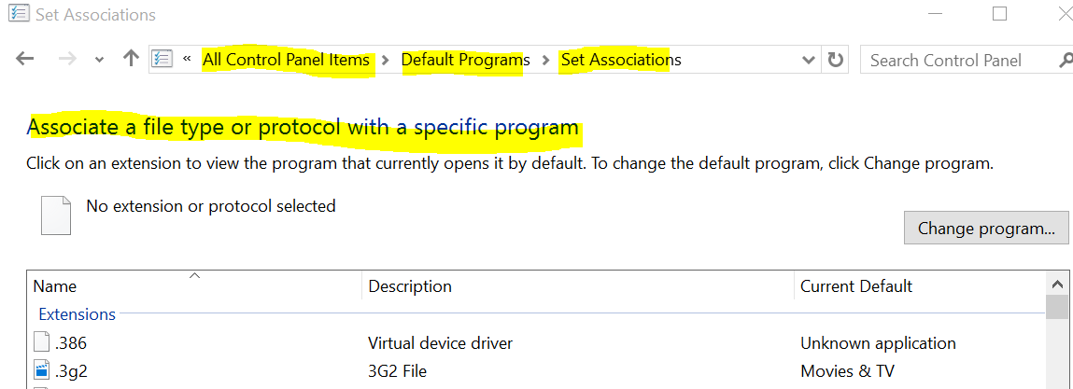
Modifying File Associations : Default Programs > Set Associations
The Default Programs control panel enables you to select a program and choose the file types that are associated with it.
You can also approach the problem from the other direction, by selecting a file type and then choosing the program to be associated with it.

Slide 7
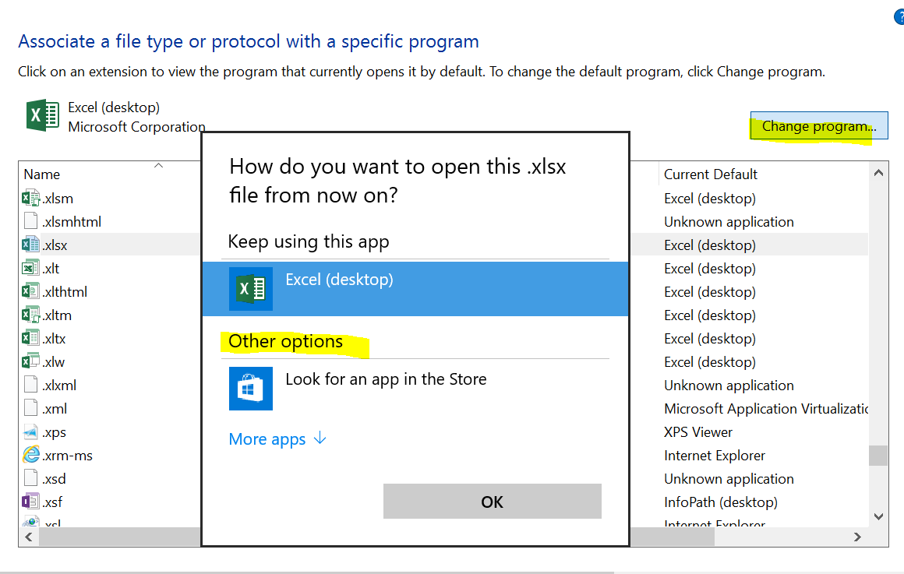
To change : Select the file type and click Change Program

Slide 8
Autoplay Settings
Autoplay defines the actions that Windows takes when you insert a new removable medium, such as a CD, DVD, or USB flash drive, in to the computer.
When you click Change Autoplay settings in the Default Programs control panel, the Autoplay dialog box appears. This dialog box enables you to select from a variety of actions for different media types and different types of content.

Slide 9
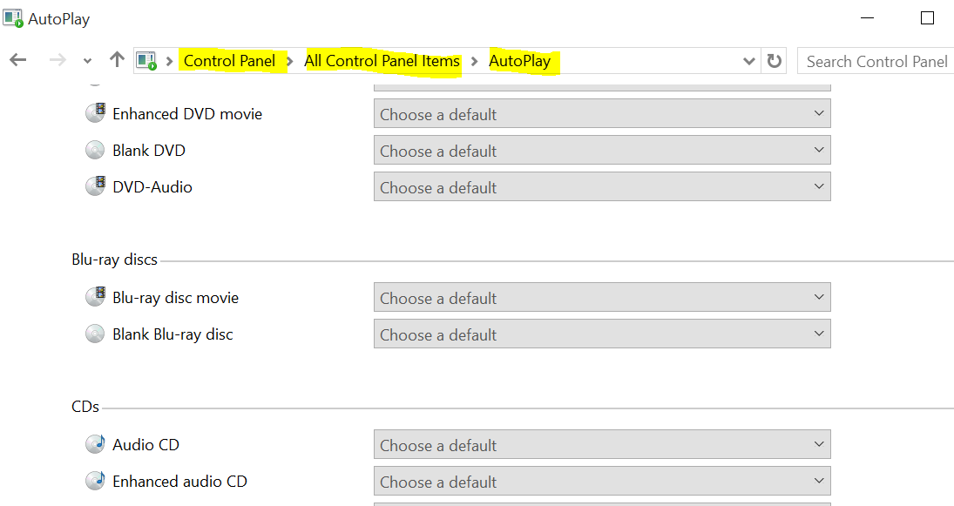
Modifying Autoplay Settings

Slide 10
Setting Program Access & Computer Defaults
Control access to certain programs and set defaults for your computer
The Default Programs control panel enables you to create a program configuration that specifies which applications Windows 10 should use to perform specific tasks, such as browse the Web, send email, and play media files.
Set Program Access and Computer Defaults dialog box options:
Select an all-Microsoft solution
Stick with the applications your system is currently using
Select a combination of the two

Slide 11
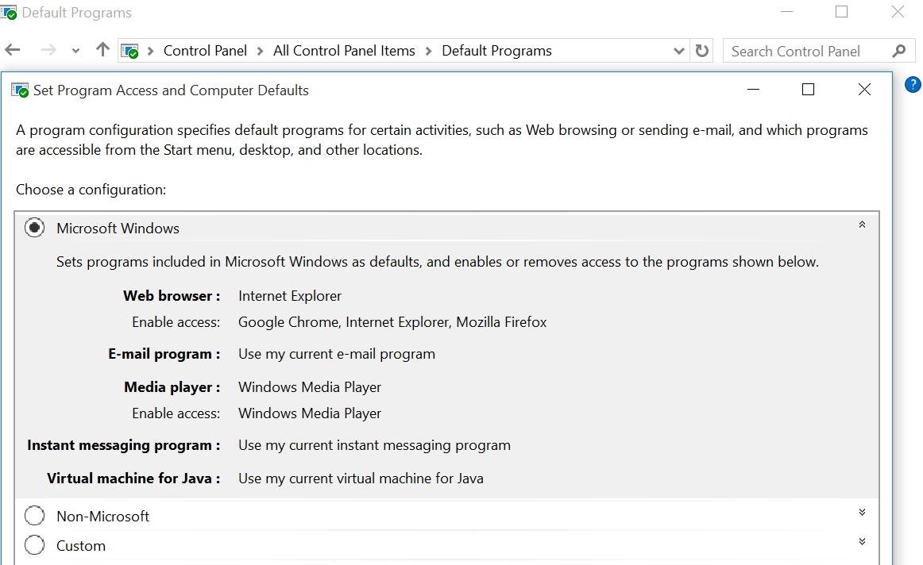
Select Custom to customize

Slide 12
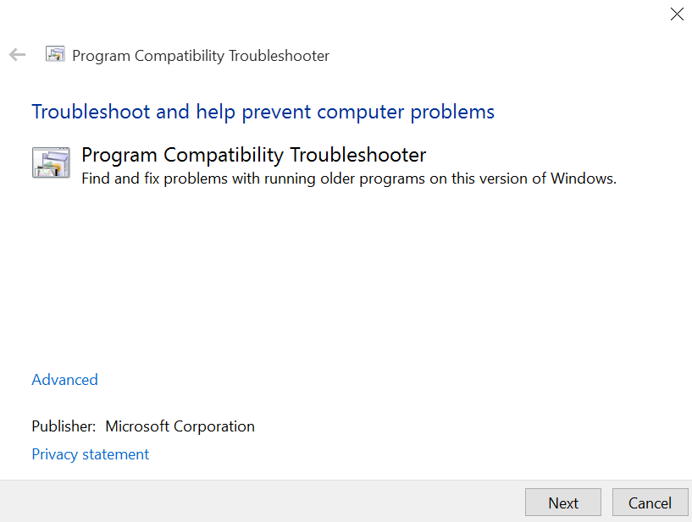
Application Compatibility
Troubleshooter is a wizard-based solution that users or administrators can use to automatically configure an executable file to use an appropriate Windows 10 compatibility mechanism.

Slide 13
Setting Compatibility Modes
The Program Compatibility Troubleshooter is a wizard that simplifies the process of selecting compatibility mode settings for an executable.
You can also configure compatibility mode settings manually.
To configure the compatibility mode settings for an application:
Right click the executable file and click Properties > Select the Compatibility tab > Compatibility Mode >> Check Run this program in compatibility mode for´>> Select a previous version of Windows from the drop down list

Slide 14
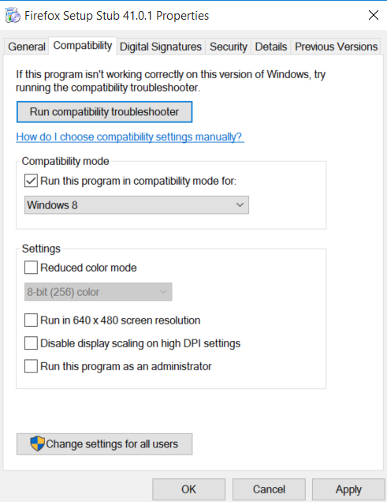
Settings : Compatibility Mode

Slide 15
Installing & Configuring Windows Store Apps
The Windows Store is a central location for purchasing and downloading thousands of new apps for Windows 10 devices
The Windows Store provides access to both traditional apps as well as Windows apps (for example, packaged apps).
Windows apps use the new Windows user interface (UI) designed to display and work across Windows 10 devices with different form factors and display sizes.
There are currently thousands of Windows 10 apps available within the store, and the number is continuing to grow on a daily basis.
Each of these apps must meet a certain benchmark for quality and functionality to be placed in the store.

Slide 16
Installing, Reinstalling, and Updating Windows Store Apps
To install, reinstall, and update Windows Store apps, you need a Microsoft account and an Internet connection.
Using a Microsoft account enables you to not only access Windows Store apps but synchronize key files and settings in the cloud and across multiple Windows 8.1 devices, providing a consistent interface and access to the same content on all your devices.
A Microsoft account (formerly called Windows Live ID) includes an email address and a password that enables you to sign in to all Microsoft sites and services.

Slide 17
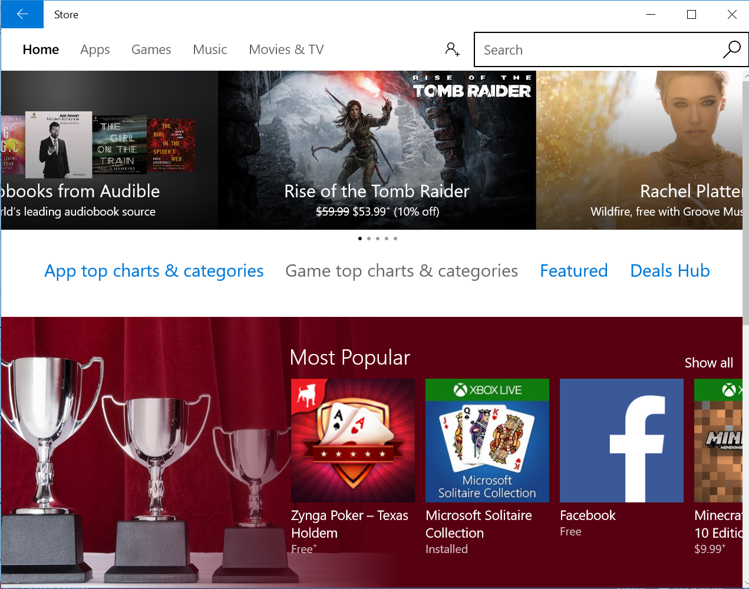
Windows Store

Slide 18
Reinstalling Windows Store Apps
Each time you install a Windows app on a device, it’s saved to your Microsoft account and the device is added to the list of devices allowed to run it.
First, you can install the app on up to five Windows 10 devices using the same account.
If you uninstall a Windows App, you can reinstall it quickly.

Slide 19
Updating Windows Store Apps
On a daily basis, Microsoft checks to see whether there are any updates for the apps you’ve previously downloaded from the Windows Store.
If any are found, a number indicator appears on the Store tile.
To see the actual apps requiring updates, click the Store tile and select the Updates link.
By default, all updates are selected automatically and clicking Install starts the update process.

Slide 20
References
Microsoft - MOAC 70-687: Configuring Windows 8.1

