Slide 1
Network Security in Windows 10 – Chapter 7
Deepak KC

Slide 2
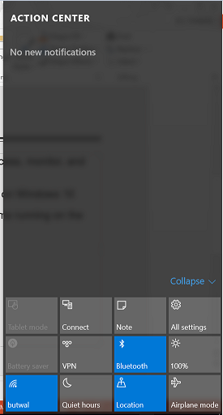
Windows 10 – Action Center
A centralized console that enables users and administrators to access, monitor, and configure the various Windows 10 security mechanisms
By default, Action Center starts automatically & runs continuously on Windows 10
Action Center constantly monitors the different security mechanisms running on the computer

Slide 3
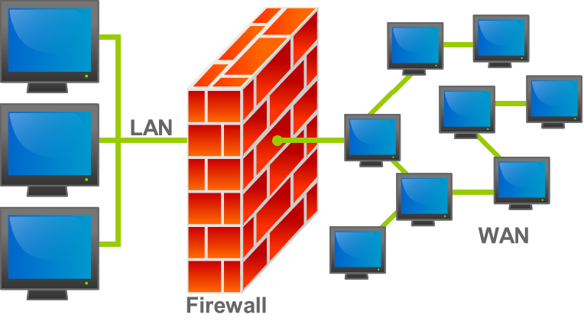
Firewall
A firewall is hardware, software, or a combination of both that is used to prevent unauthorized programs or Internet users from accessing a private network and/or a single computer
Firewall use rules to filter traffic which specify
which packets are allowed to pass
and which are blocked

Slide 4
Firewall
The filtering is based on the TCP/IP (Network, Transport & Application layers of the OSI Model)
IP addresses - Represent specific computers on the network
Protocol numbers – Identify the transport layer protocol being used by the packets.
Port numbers – Identify specific applications running on the computer.
Notes:
Open Systems Interconnection (OSI)

Slide 5
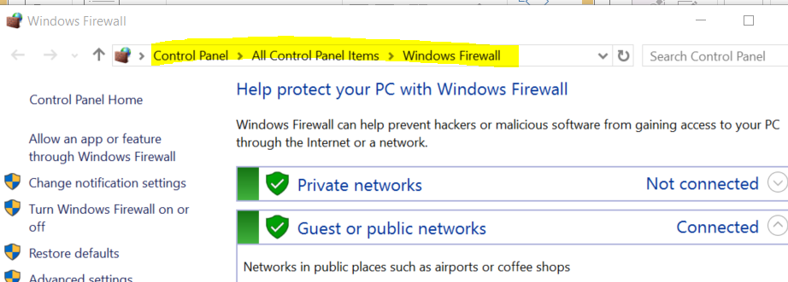
Windows Firewall
Notes:
Each of the headings contains the following information:
Whether the computer is connected to a domain, private, or public network
Whether the Windows Firewall service is currently turned on or off
Whether inbound and outbound connections are blocked
Whether users are notified when a program is blocked

Slide 6
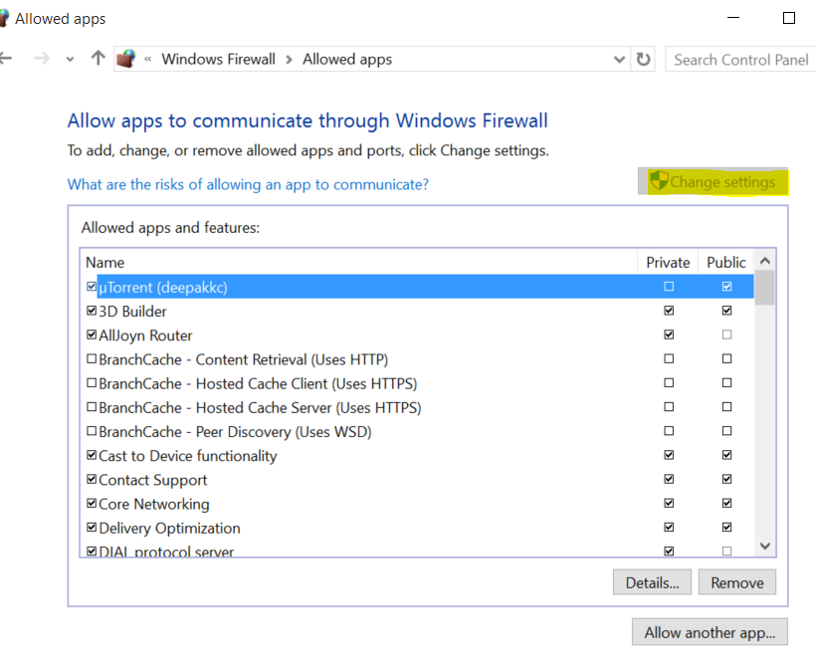
Allow apps to communicate through Windows Firewall

Slide 7
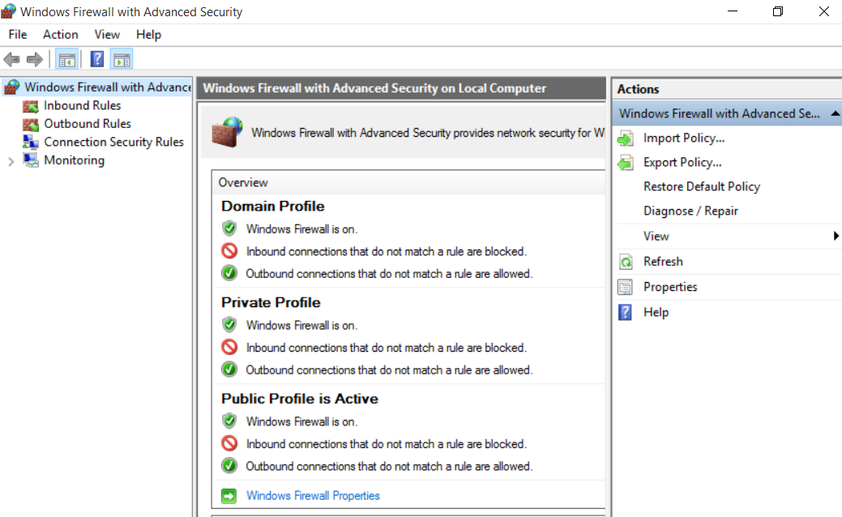
Windows Firewall with Advanced Security Console

Slide 8
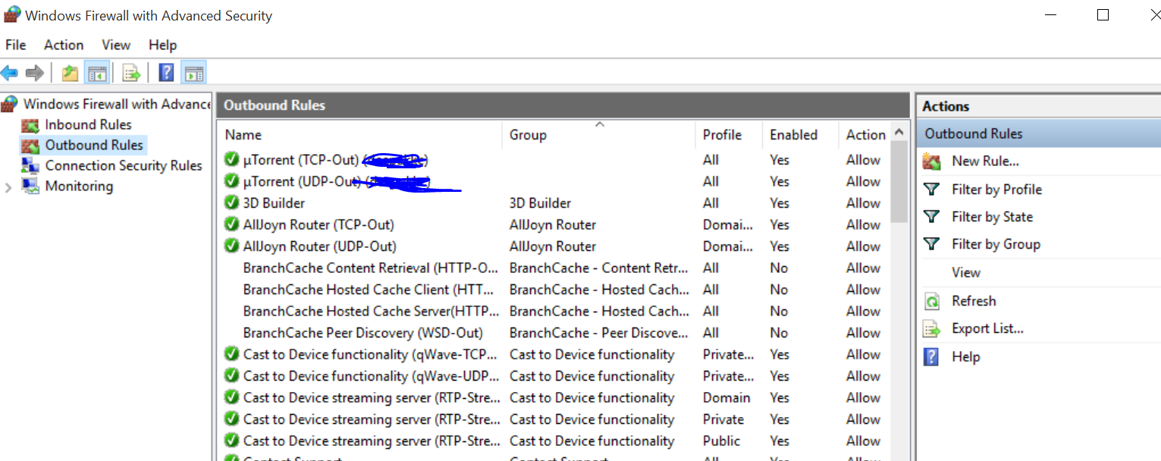
Creating Rules
Windows Firewall with Advanced Security console
Inbound Rules
Outbound Rules
Currently operational rules have a checkmark in green circle
Rules not in force are grayed out

Slide 9
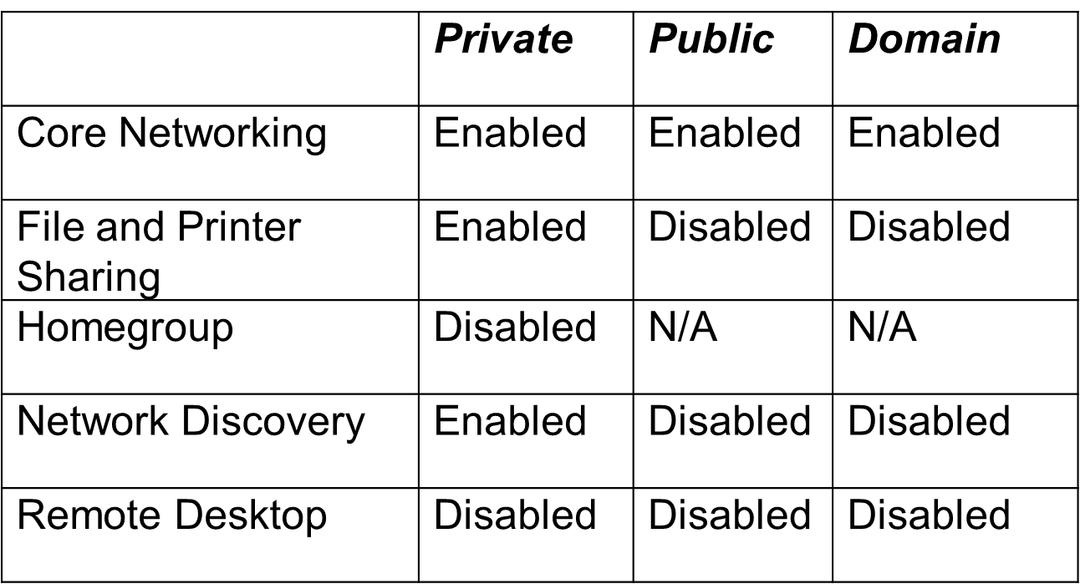
Default Windows Firewall Rules Settings

Slide 10
New Rule Wizard
Rule Type
Program
Protocol and Ports
Scope
Action
Profile
Name
Notes:
The New Rule Wizard takes you through the process of configuring the following sets of parameters:

Slide 11
References
Microsoft - MOAC 70-687: Configuring Windows 8.1

