Slide 1
Application Strategy for Cloud Applications
Deepak KC

Slide 2
Objectives
Windows Store Applications
Restricting Windows Store Content
Applocker

Slide 3
Windows Store Applications
Windows Apps, also called packaged apps are available from the Windows Store
They are different from traditional applications as they are designed to run in a single, full windows across multiple devices (desktops, tablets & laptops)
Windows Store : A central location for purchasing and downloading apps
Notes:
Windows 8 and later operating systems. The applications made available through the store must be certified for compatibility and content by Microsoft.

Slide 4
Sideloading Wndows Apps
To provide in-house app across your organization without making it available in Windows Store
To leverage in-house Windows App, you have two options
Through Windows Store by adhering to certification policies and the processes used by all Apps in the Store
Through a process called Sideloading so that your App is not available to public but you can still take advantage of the portability and design of Windows Apps
If you have access to the app installation files, you can sideload with Windows Intune
However, the application can only be deployed after the operating system is deployed. When you sideload an application, you can deploy an app to all Windows accounts on a device, or to a specific Windows account on a device.
Notes:
In house app: a windows app created in your organization

Slide 5
Requirements for Sideloading
A windows 10 Enterprise/Professional computer joined to an Active Directory Domain
Group Policy must be set to Allow al trusted apps to install
The App must be signed by a Certificate Authority (CA) that is trusted by the targeted PCs on the network. A CA issues digital certificates that certify a person, organization, server or computer is who it claims to be.
A sideloading product activation key if the Windows 10 Enterprise/Windows 10.1 Professional computer is not joined to a domain

Slide 6
Restricting Access to the Windows Store Using Group Policy
Policy for a user
Run >> Gpedit.msc >> User Configuration >> Administrative Templates >> Windows Components >> Store >> Turn Off the Store Application

Slide 7
Applocker
AppLocker, also known as application control policies, is essentially an updated version of the concept implemented in software restriction policies.
AppLocker uses rules, which administrators must manage.
Process of creating the rules is much easier because of a wizard-based interface.

Slide 8
Applocker
Local Group Policy Editor >> Computer Configuration >> Windows Settings >> Security Settings>>Application Control Policies>>AppLocker
In the AppLocker container, there are four nodes that contain the basic rule types, as follows:
Executable Rules
Windows Installer Rules
Script Rules
Packaged app Rules
Right Click Executable Rules >> Create New Rule
Notes:
Gpedit.msc
Executable Rules – Contains rules that apply to files with .exe and .com extensions
Windows Installer Rules – Contains rules that apply to Windows Installer packages with .msi and .msp extensions
Script Rules – Contains rules that apply to script files with .ps1, .bat, .cmd, .vbs, and .js extensions
Packaged app Rules – Contains rules that apply to applications purchased through the Windows Store.

Slide 9
Creating Rules Automatically
When you right-click one of the three rules containers and select Create Rules Automatically from the context menu, an Automatically Generate Rules Wizard appears.
After specifying the folder to be analyzed and the users or groups to which the rules should apply, a Rule Preferences page appears.
The wizard then displays a summary of its results in the Review Rules page and adds the rules to the container.

Slide 10
Create & Test an applocker rule
Windows logo key +r >> services.msc >> Right click the Application Identity & the choose Start > Close the Service Console after confirming the service is running
Windows logo key +r >> gpedit.msc >> Computer Configuration >> Windows Settings >> Security Settings >> Application Control Policies >> Applocker >> Expand it >> Right click Executable Rules >> Create New Rule >> Read the Before you Begin Screen >> Click Next >> Select Deny >> Click Next >>
To Select User/ Groups , click Select & type Users
Click Next >> Select Publisher >> Next >> Click Browse & Navigate to the file C:\Windows\System32directory>> Select the mstc.exe and then click Open.
Drag the slider to File Name >> Click Next (This setting will ensure that this rule will block all instances of the Remote Desktop Connection client)

Slide 11
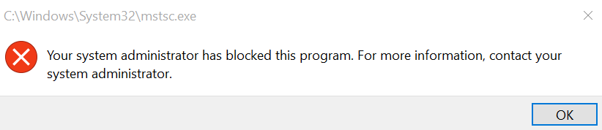
Create & Test an applocker rule
Click Next. You do not set an exception to this rule.
Type a name for the rule and a description (optional)
Click Create
When prompted to create the default rules, clik Yes. This ensures that important rules are allowed to run
Close the Local Group Policy Editor
Update the policy, type Gpudate in the run box
Try to open the application (mstc.exe)

Slide 12
Software Restriction Policies
Software restriction policies are Group Policy settings that enable administrators to specify the programs that are allowed to run on workstations by creating rules of various types.
Rules
Certificate rules
Hash rules
Network zone rules
Path rules
Notes:
Certificate rules – Identify applications based on the inclusion of a certificate signed by the software publisher. An application can continue to match this type of rule, even if the executable file is updated, as long as the certificate remains valid.
Hash rules – Identify applications based on a digital fingerprint that remains valid even when the name or location of the executable file changes
Network zone rules – Identify Windows Installer (.msi) packages downloaded with Internet Explorer based on the security zone of the site from which they are downloaded
Path rules – Identify applications by specifying a file or folder name or a registry key. The potential vulnerability of this type of rule is that any file can match the rule, as long as it is the correct name or location.

Slide 13
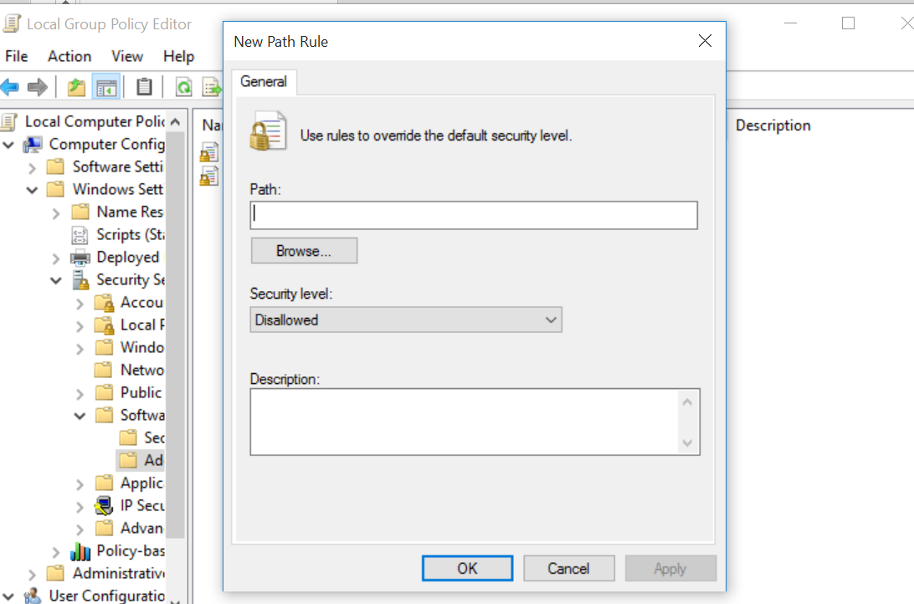
Creating Rules
Run > gpedit.msc >> Computer Configuraion >> Windows Settings >> Security Settings >> Software Restriction Policies >>
To create your own rule, click Additional Rules folder , Right Click & Select New … Rule

Slide 14
Rule Settings
Disallowed – Prevents an application matching a rule from running.
Basic user – Allows all applications not requiring administrative privileges to run. Allows applications that do require administrative privileges to run only if they match a rule.
Unrestricted – Allows an application matching a rule to run.

Slide 15
Controlling Device Installation
The Device Installation Restrictions folder in a GPO contains policy settings that enable you to prevent Windows computers from installing and updating device drivers under specific conditions.
To open Local Group Policy Editor
Run > gpedit.msc
Local Group Policy Editor >> Computer Configuration >> Administrative Templates >> System >>Device Installation >> Device Installation Restrictions folder enable you to specify if or when the computers on your network can install drivers for hardware devices

Slide 16
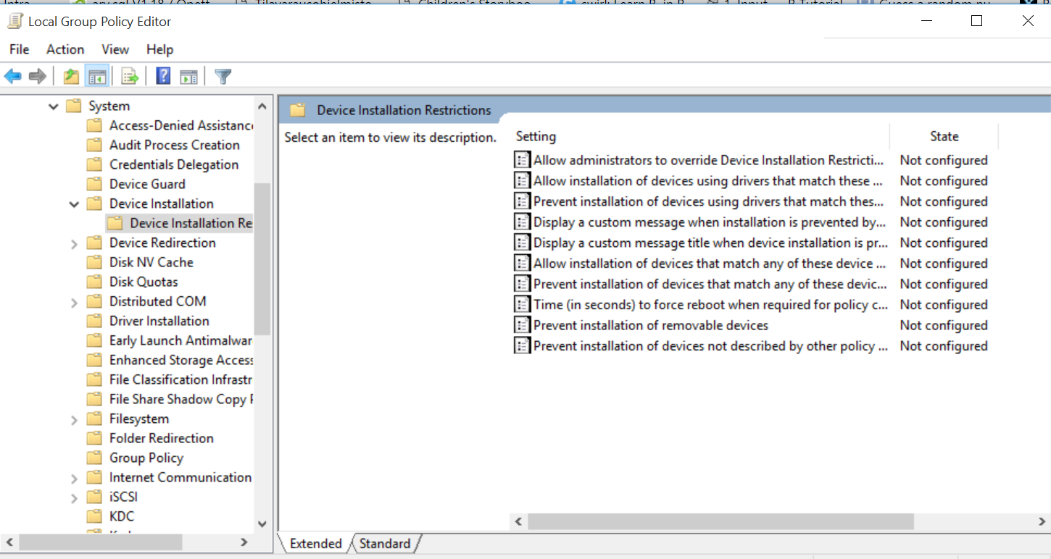
Controlling Device Installation

Slide 17
Controlling Removable Storage Access
For control over access to specific types of removable storage at the computer level, you can use the policy settings
Local Group Policy Editor >> Computer Configuration >> Administrative Templates >> System >> Removable Storage Access folder

Slide 18
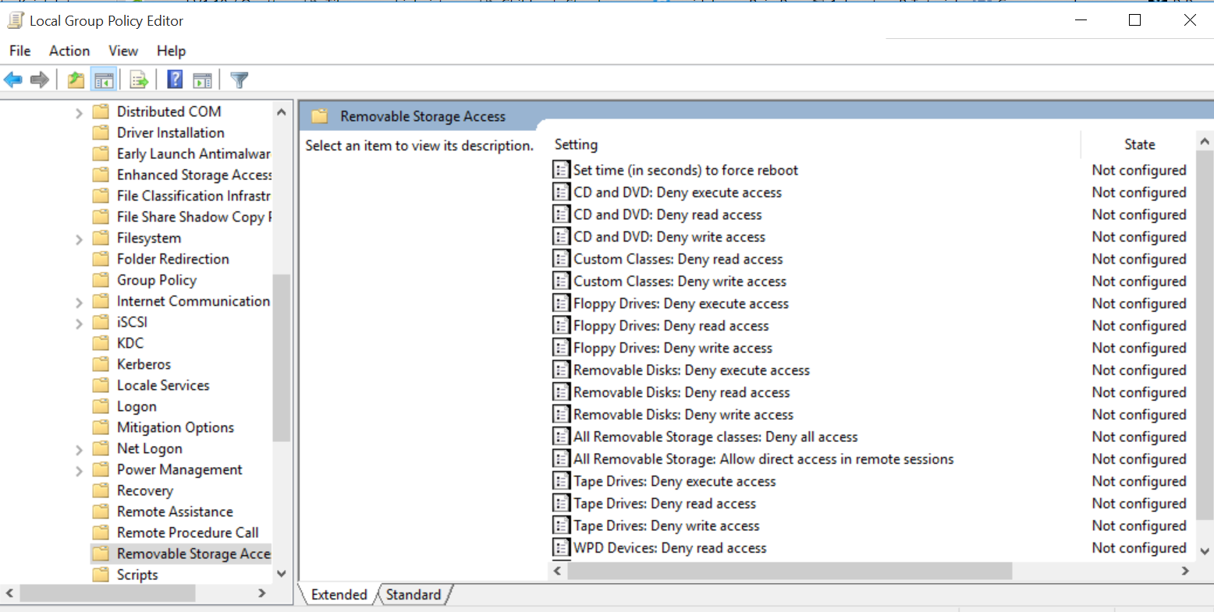
Controlling Removable Storage Access

Slide 19
References
Microsoft - MOAC 70-687: Configuring Windows 8.1

