Slide 1
Remote Management tools & settings – Chapter 8 Windows 10
Deepak KC

Slide 2
Key Terms
Microsoft Management Console (MMC)
A shell application that loads a variety of Windows management tools called snap-ins
Remote Assistance
A Windows feature that enables an administrator, trainer, or technical specialist at one location to connect to a distant user’s computer, chat with the user, and either view all the user’s activities or take complete control of the system.

Slide 3
Remote Desktop
Remote Desktop
A Windows feature that enables an administrator to connect to a computer and operate it from a remote location
Remote Desktop Protocol (RDP)
A specialized communications protocol that transmits screen information, keystrokes, and mouse movements between the two computers.

Slide 4
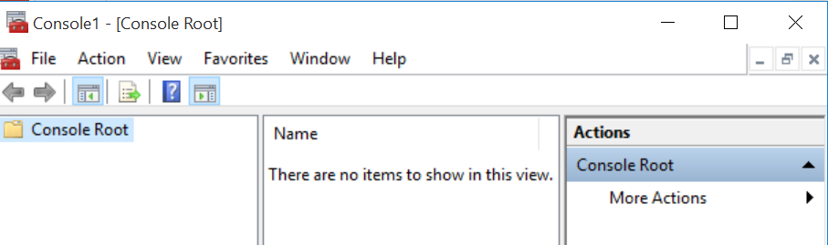
Using Microsoft Management Console to connect to a remote computer
Run MMC command

Slide 5
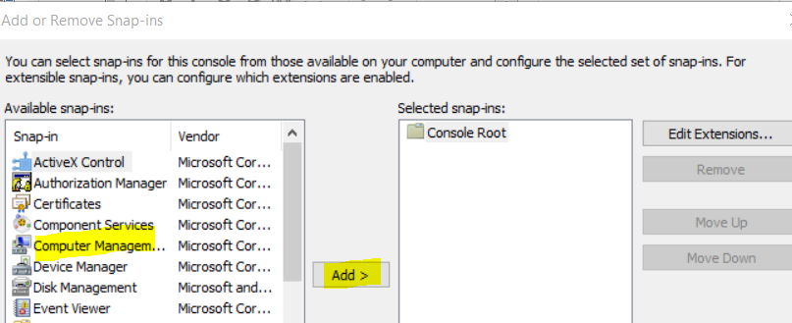
Using Microsoft Management Console to connect to a remote computer
Click File >> Add/Remove Snap in >> Select Computer Management >> Click Add

Slide 6
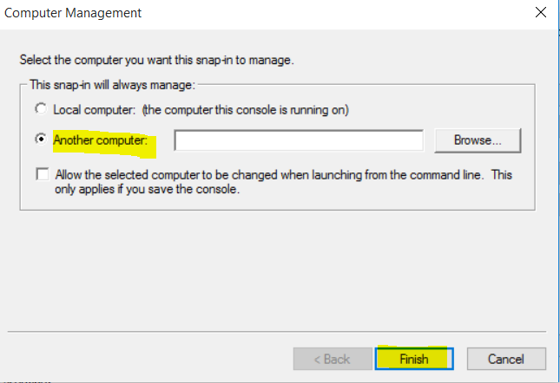
Using Microsoft Management Console to connect to a remote computer
Select Another Computer to manage & Click Finish

Slide 7
Creating a custom MMC console
Run > Type mmc >>Click Add/Remove Snap-in on the File menu >> Click Add >> Double-click the snap-in that you want to add then follow the instructions in the wizard
To save the console
After a custom console is created, click Save on File menu, type a name for the file .

Slide 8
Remote Assistance
Remote assistance allows the possibilities for remote
Training
Troubleshooting
Technical support
To enable remote assistance, the computer must be configured to use the remote assistance feature by using :
Control Panel or
Group Policy

Slide 9
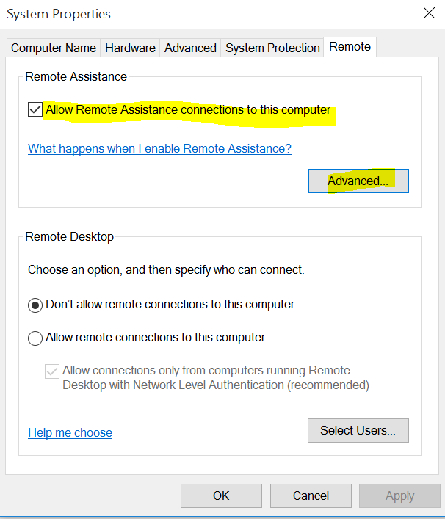
Remote Assistance
Notes:
Search remote access & check

Slide 10
Creating an Invitation
To request a Remote Assistance session, a client must issue an invitation and send it to a particular expert
Request can be sent via an email or save it as a file to be sent in some other ways

Slide 11
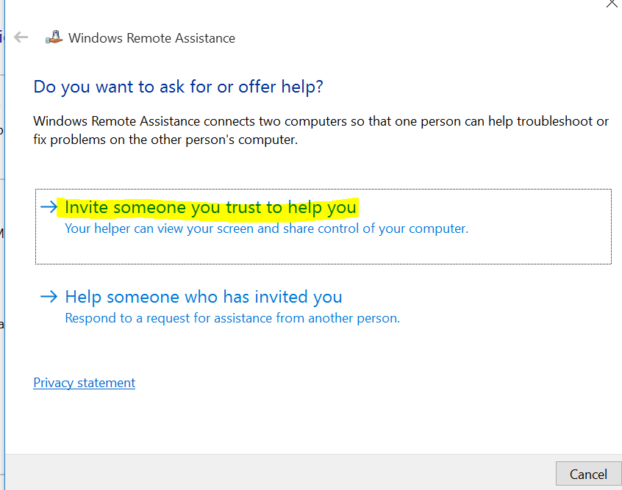
Sending invitation to Control Computer
Initiate Run Box (Windows Key + R)
Type “msra” & press “Enter”
Select “Invite someone you trust to help you”

Slide 12
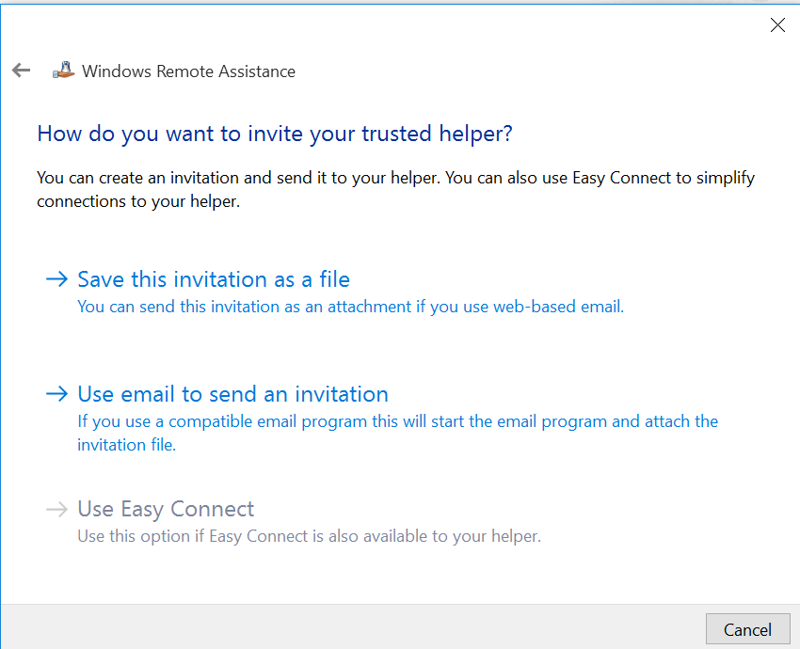
Sending invitation to Control Computer
Select appropriate option: “How do you want to invite your trusted helper”?
Invitation as a file
Email
Easy Connect

Slide 13
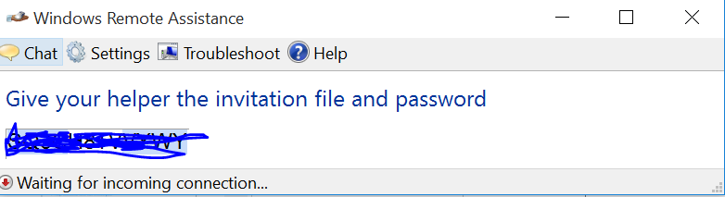
Sending invitation to Control Computer
Select the location to save the file, then select Save.
A window opens with a password. Keep this window open otherwise the session will end.
Send the invitation file and password to the person you want to connect to your computer

Slide 14
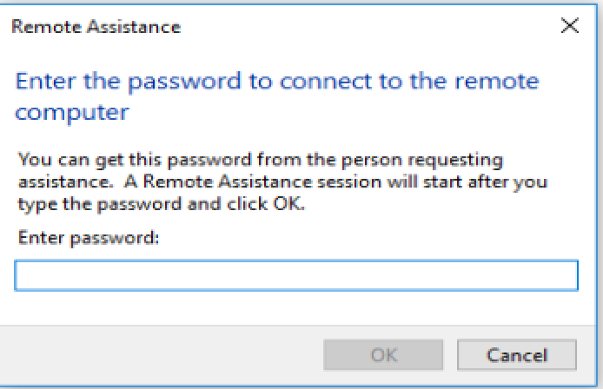
Connecting after receiving invitation
Initiate Run Box (Windows Key + R)
Type “msra“, then press “Enter“.
Select “Help someone who has invited you“.
Select “Use an invitation file“.
Select the invitation file.
Type the password provided in the email.
Select “OK” and you are connected for remote assistance
Or simply click on the invitation file that you have received and provide the password

Slide 15
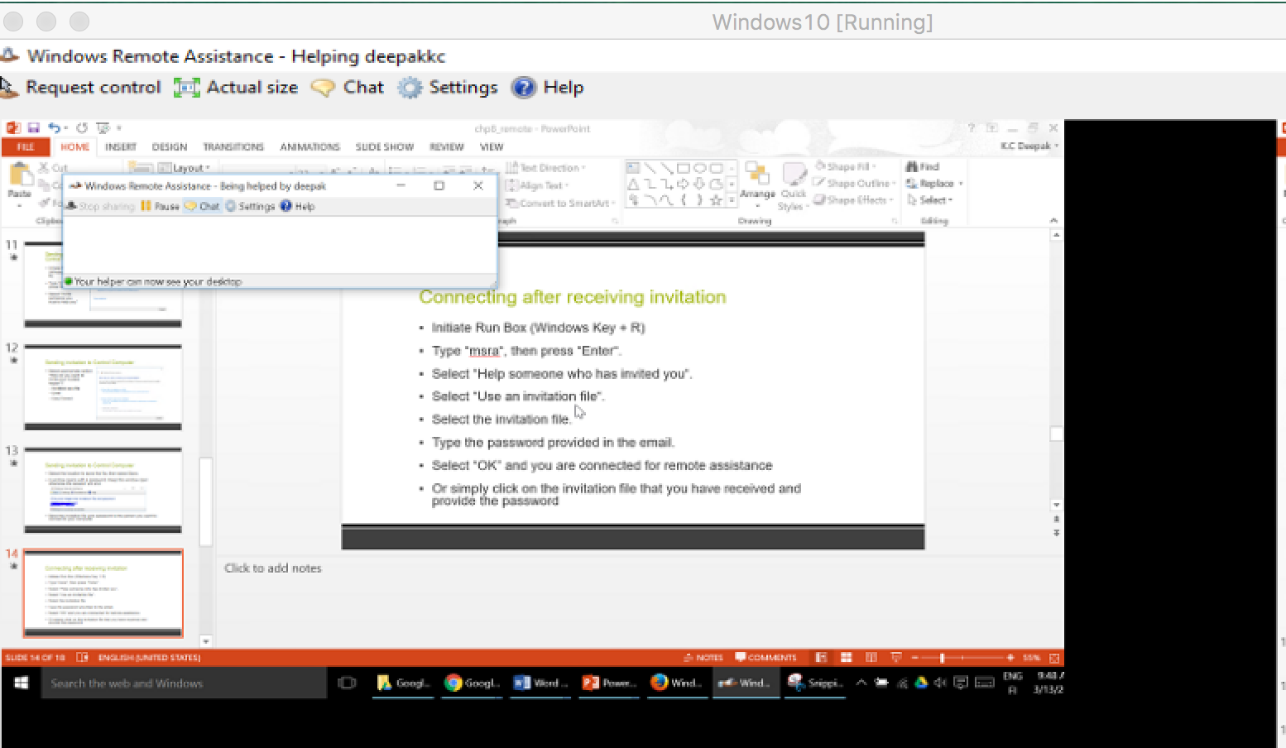

Slide 16
Securing Remote Assistance
An unauthorized user who takes control of a computer using Remote Assistance can cause almost unlimited damage.
Remote Assistance is designed to minimize the dangers. Some of the protective features of Remote Assistance are:
Invitations
Interactive connectivity
Client-side control
Remote control configuration
Firewalls
Notes:
Invitations – No person can connect to another computer using Remote Assistance unless that person has received an invitation from the client. Clients can configure the effective lifespan of their invitations in minutes, hours, or days to prevent experts from attempting to connect to the computer later.
• Interactive connectivity – When an expert accepts an invitation from a client and attempts to connect to the computer, a user must be present at the client console to grant the expert access. You cannot use Remote Assistance to connect to an unattended computer.
• Client-side control – The client always has ultimate control over a Remote Assistance connection. The client can terminate the connection at any time, by pressing the ESC key or clicking Stop Control (ESC) in the client-side Remote Assistance page.
• Remote control configuration – Using the System Properties sheet or the Remote Assistance Group Policy settings, users and administrators can specify whether experts are permitted to take control of client computers. An expert who has read-only access cannot modify the computer’s configuration in any way using Remote Assistance. The group policies also enable administrators to grant specific users expert status, so that no one else can use Remote Assistance to connect to a client computer, even with the client’s permission.
• Firewalls – Remote Assistance uses Transmission Control Protocol (TCP) port number 3389 for all its network communications. For networks that use Remote Assistance internally and are also connected to the Internet, it is recommended that network administrators block this port in their firewalls to prevent users outside the network from taking control of computers that request remote assistance. However, it is also possible to provide remote assistance to clients over the Internet, which would require leaving port 3389 open.

Slide 17
Remote Desktop
A remote control program with no invitations and no read only capabilities
Remote Desktop Protocol (RDP) is used for connection
When connecting with Remote Desktop, you must log on as if you would do when sitting at the console

Slide 18
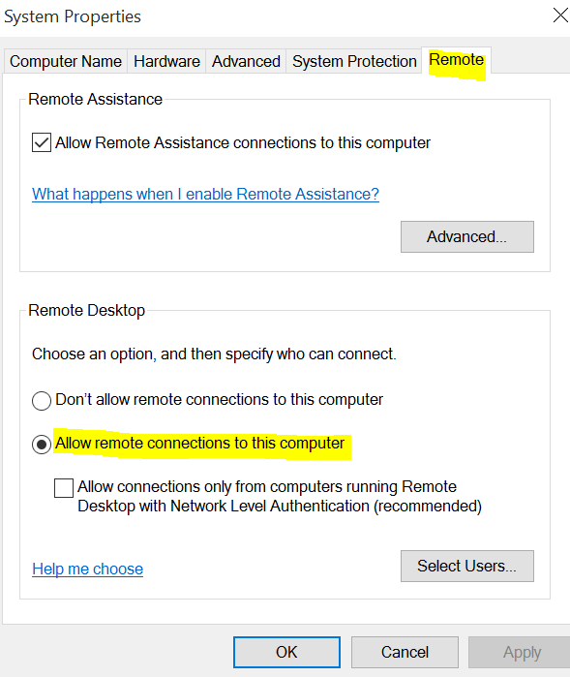
Activating Remote Desktop
Remote desktop must be enabled before using a remote computer to connect

Slide 19
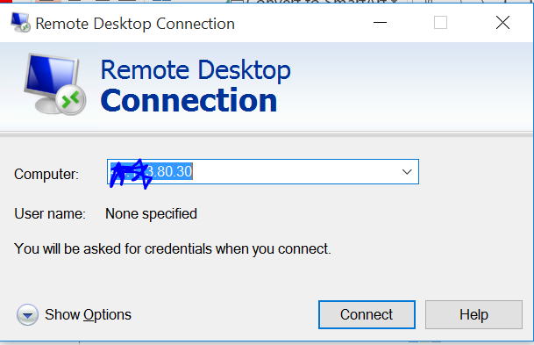
Remote Desktop Connection
Type the IP address of the computer you want to connect to
Notes:
In the Search box type remote desktop connection

Slide 20
References
Microsoft - MOAC 70-687: Configuring Windows 8.1

