Slide 1
Network Settings in Windows 10 – Chapter 6
Deepak KC

Slide 2
Objective
Installing Network Support
Connecting to a Network
Configuring Network Locations

Slide 3
Installing Network Support
Windows 10 detects a network interface adapter in the computer
either during the operating system installation or afterwards,
it installs a device driver for the adapter, as well as the components of the default networking stack as follows
Client for Microsoft Networks
File and Printer Sharing for Microsoft Networks
QoS Packet Scheduler
Microsoft Network Adapter Multiplexor Protocol
Microsoft LLDP Protocol Driver
Link Layer Topology Discovery Mapper I/O Driver and Link Layer Topology Discovery Responder
Internet Protocol Version 6 (TCP/IPv6)
Internet Protocol Version 4 (TCP/IPv4)

Slide 4
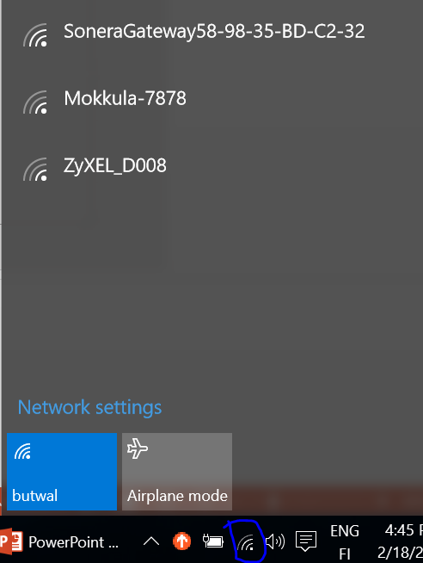
Connecting to Wireless Networks broadcasting its SSID
Any wireless network that broadcasts its (SSID) name appears in the list of available networks in Windows 10
SSID: service set identifier

Slide 5
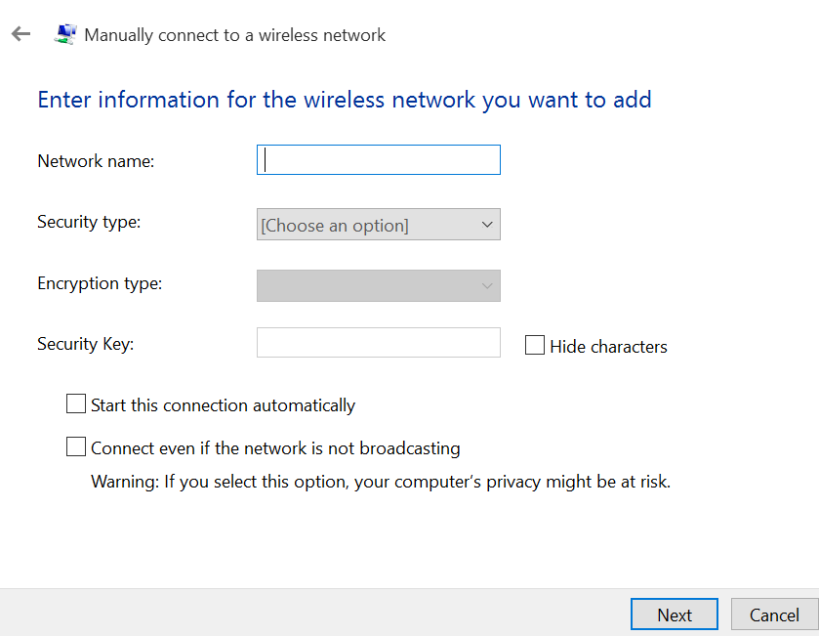
Connecting to Wireless Network that is not broadcasting its SSID
As SSID is not broadcasted, the network does not appear in the list of available networks
You need to provide information such as
Network’s SSID Security Type
Encryption Type
Security Key
Network & Sharing Center >> Set Up a New Connection or Network >> Manually Connect to Wireless Networks & Enter Information for the Wireless Network You want to Add >> Click Next >>

Slide 6
Wireless Security
Wireless networks are subjected to several security threats and it is easier for attackers to penetrate them
Some common attacks for unsecured wireless networks are
Eavesdropping
Masquerading
Attacks against wireless clients
Denial of service
Data tampering
Two main security protocols used in Wireless LAN devices
Wired Equivalent Privacy (WEP)
WiFi Protected Access (WPA and WPA2)
Notes:
Eavesdropping is secretly listening to the private conversation of others without their consent
Masquerading: pretending to be someone one is not

Slide 7
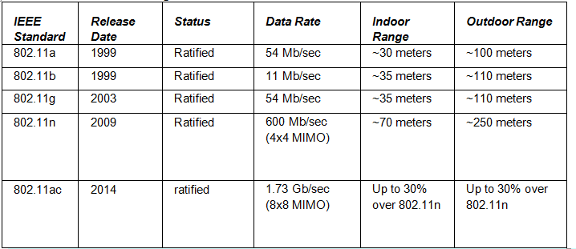
IEEE Wireless Networking Standards

Slide 8
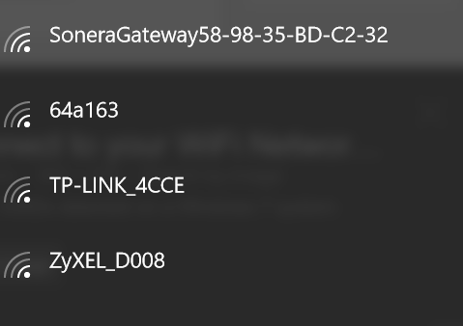
SSID - Service Set Identifier
It is the name for the wireless network

Slide 9
Preferred Wireless Networks
The priority for the wireless connection is automatically set based on the type of network you are connected to
Highest Priority is Ethernet (wired) connection, wifi and then mobile broadband networks

Slide 10
Removing Wireless Profiles
To delete a wireless profile
Netsh wlan delete profile name=“<profile name>”

Slide 11
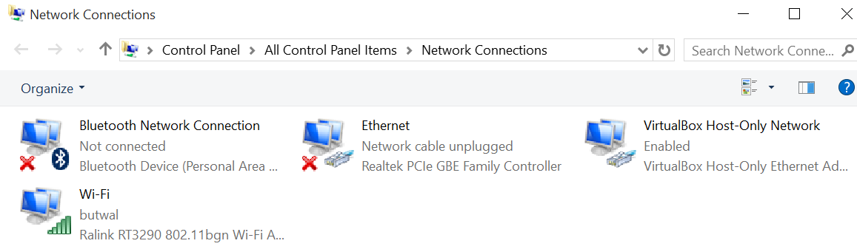
Network Adapters
A network adapter (network interface card - NIC) is the hardware component that is used to connect your computer to a wired or wireless network
Ethernet adapter
Wireless adapter
To configure network adapter
Network Settings >> Change Adapter Options >> Select the adapter to change >> Right click the adapter and select Properties

Slide 12
Network Adapter Modes
Adhoc mode
Configuring the wireless network adapter to connect to other computers using wireless network adapters
Infrastructure mode
The wireless network adapter is configured to connect to other computers through a wireless access point

Slide 13
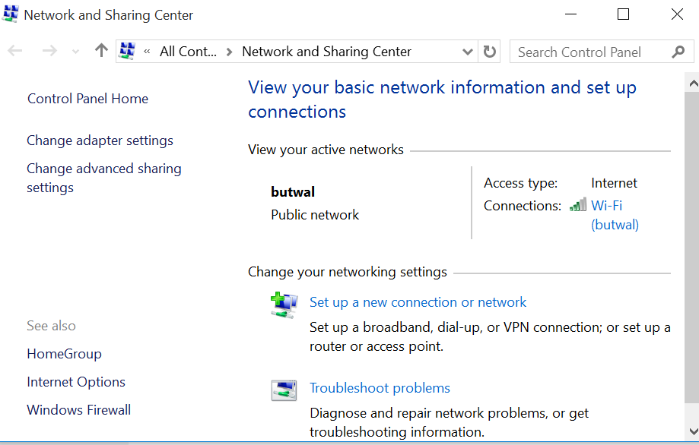
Network and Sharing Center
A centralized console that provides technical specialists and system administrators with access to most of the major networking tools included with Windows

Slide 14
Network location
Private
Guest or Public

Slide 15
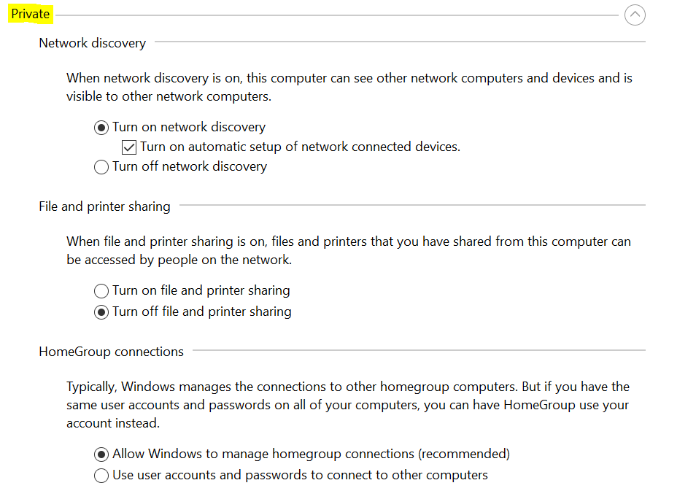

Slide 16
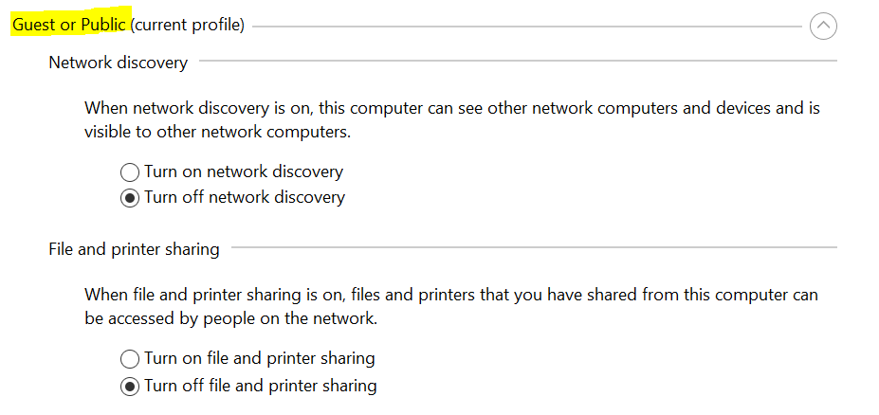

Slide 17
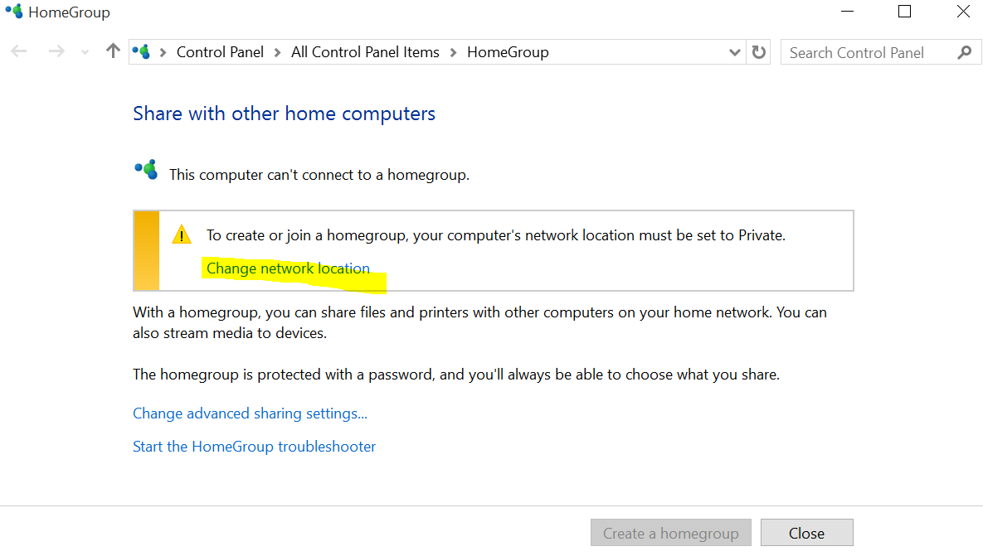
To change the network location from public to private

Slide 18
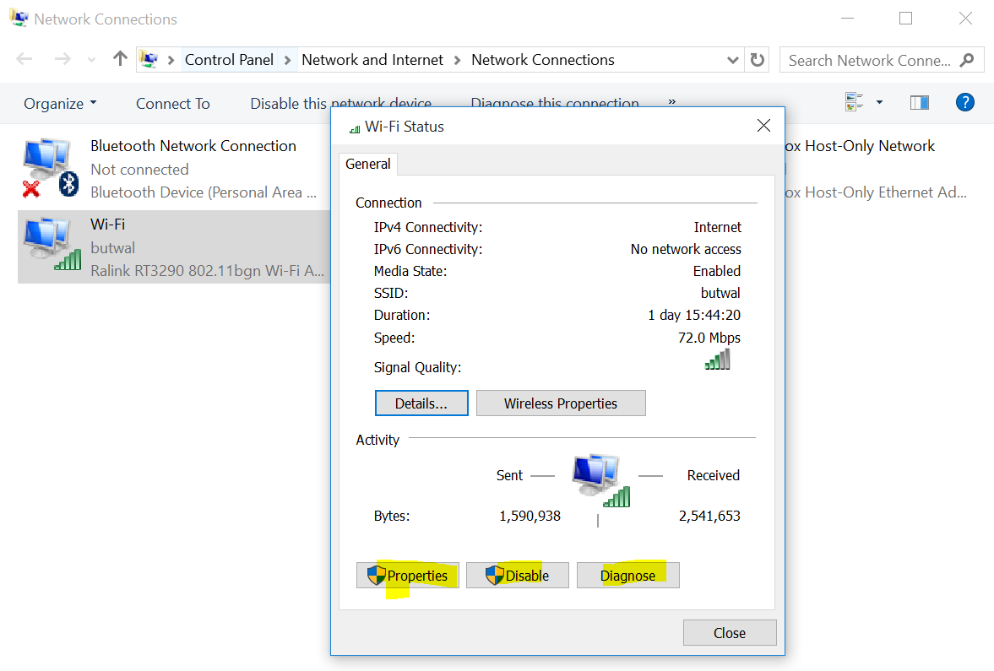
Managing network connections
Each local area connection on a
Windows 10 system has a status dialog box
that displays real time information about the connection
Right click the connection & select Status

Slide 19
Configuring IPv4 Settings
Most networks today use DHCP to configure the TCP/IP configuration settings of their workstations.
DHCP automates the configuration process and prevents the duplication of IP addresses.
However, there are still some situations in which it is desirable or necessary to configure the Windows 10 TCP/IP client manually.

Slide 20
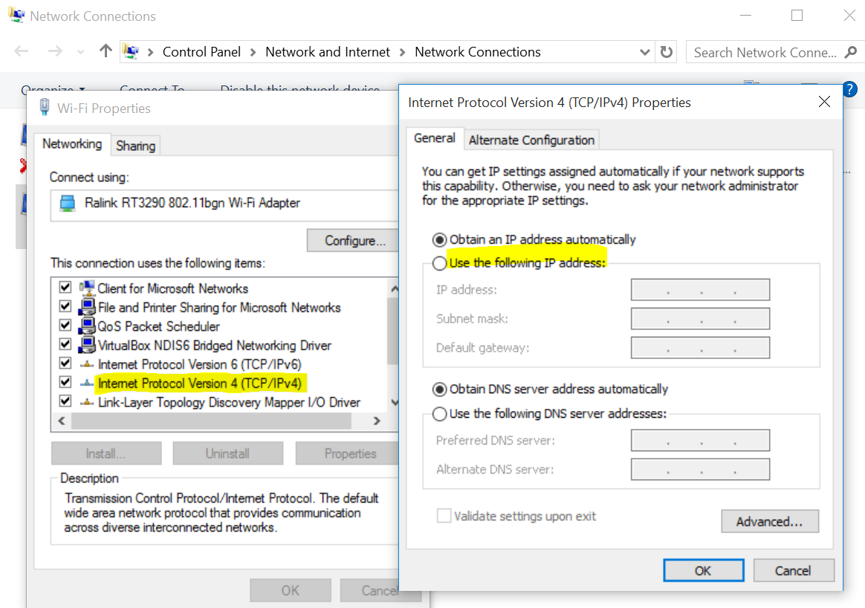
Configuring IPv4 Settings

Slide 21
TCP/IP Tools
Ipconfig
ipconfig
Displays your current TCP/IP settings
ipconfig /all
Displays your IP information for all adapters
ipconfig /release
Releases your current IP information and obtains a new IP Address from the DHCP server
ipconfig /renew
Renews your IP Address
ipconfig /displaydns
Displays your current DNS Resolver Cache Logs
ipconfig /flushdns
Clears your current DNS Resolver Cache Logs
ipconfig /registerdns
Updates the DNS settings on the Windows computer.

Slide 22
Ping
To know if the TCP/IP stack of another system on the network is functioning normally
Ping
Generates a series of Echo Request messages (using the Internet Control Message Protocol (ICMP) )
Transmits them to the computer whose name or IP address you specify on the command line
Ping command
ping xxx.xxx.xxx.xxx
ping website.com
ping xxx.xxx.xx.xx –t (continuous ping until you press ctrl+c to stop)
ping xxx.xxx.xx.xx -n 10 (N Switch is for setting the number of pings, by default ping sends 4 packets at 32 bytes each
ping xxx.xxx.xx.xx -l 1500 (l sets the size of the packet sents, by default it is 32 bytes, maximum: 65500 bytes
ping xxx.xxx.xx.xx -w 5000 (w sets the time out in milliseconds, default timeout: 4000, max timeout: 4 mins

Slide 23
Tracert
Trace route traces the path your packets take across the internet from you to the destination
tracert site.com

Slide 24
nslookup
To get the IP address for a domain name
nslookup website.com
nslookup xxx.xxx.xxx.xxx

Slide 25
netstat
To view your active network connections and TCP/IP connections
To know open/close ports and what programs are using your ports
Netsat –a
Displays all active TCP connections (TCP & UPD ports)
Netstat –b
Displays all active programs that are listening.
Netstat – e
Displays Ethernet statistics

Slide 26
References
Microsoft - MOAC 70-687: Configuring Windows 8.1

