Slide 1
Managing Updates– Chapter 9 Windows 10
Deepak KC

Slide 2
Update Settings
Control Panel can be used to download and install the latest updates from the Microsoft
Categories of updates provided by Microsoft. Each category prioritizes the updates based on importance and recommended use by the end user.
Important updates
Recommended updates
Optional updates
Security updates
Service Packs
Critical updates

Slide 3
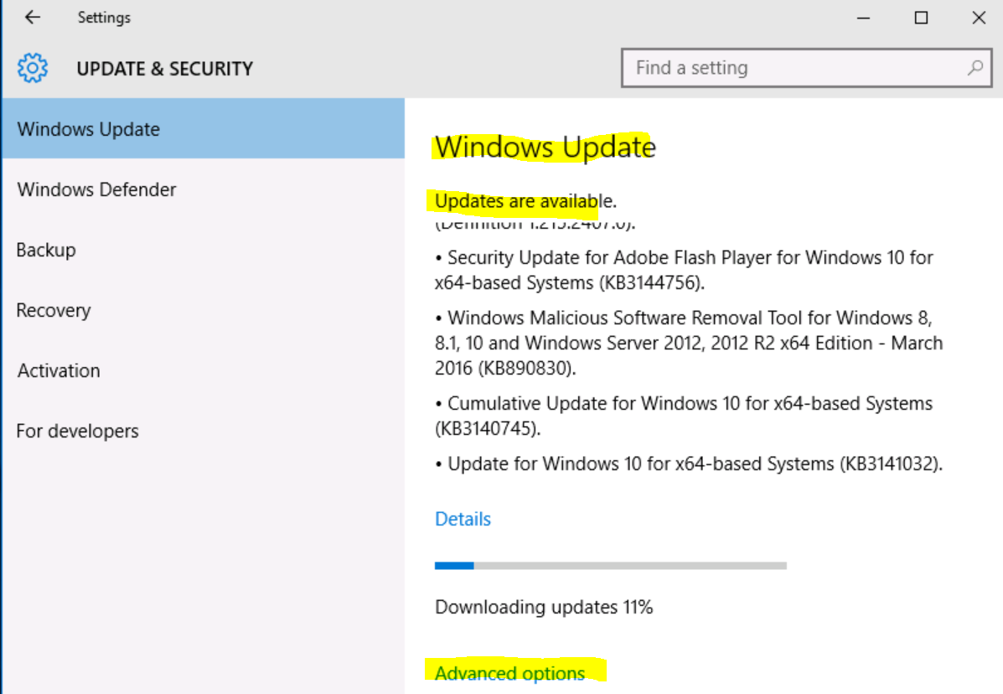
Notes:
Windows 10 and Enterprise Mobility Lab

Slide 4
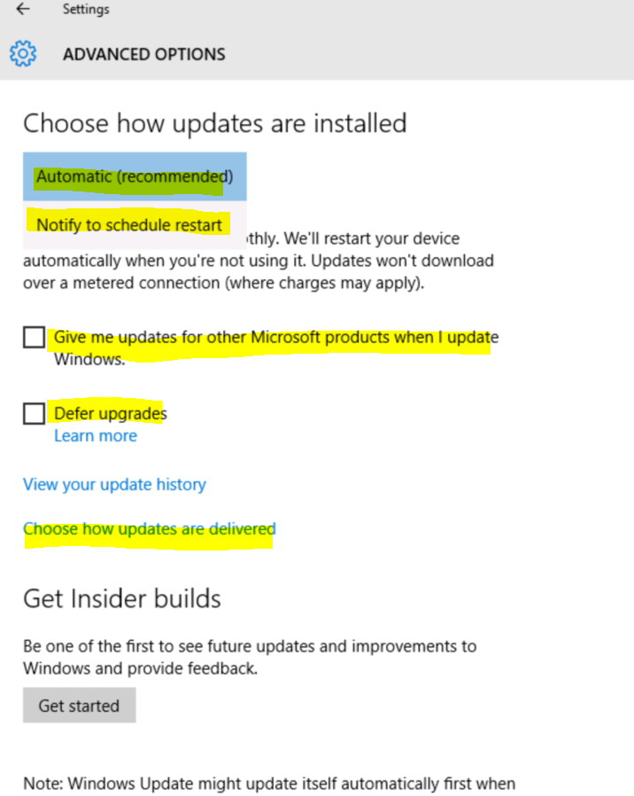
Updates in Windows 10
Forced Updates: Download & Install Automatically
On clicking Advanced Options in the Update & Security Wizard, Choose how updates are installed:
Automatic (recommended)
Notify to schedule restart

Slide 5
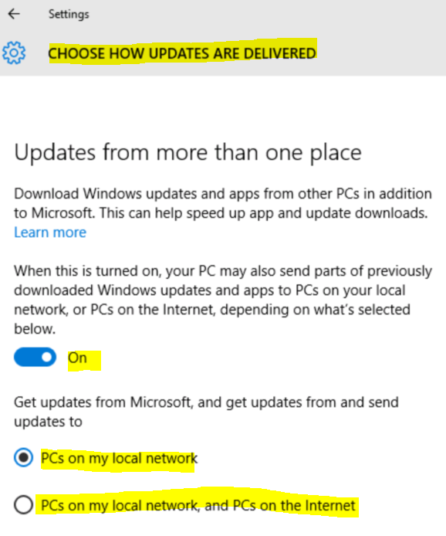
Choose how updates are delivered

Slide 6
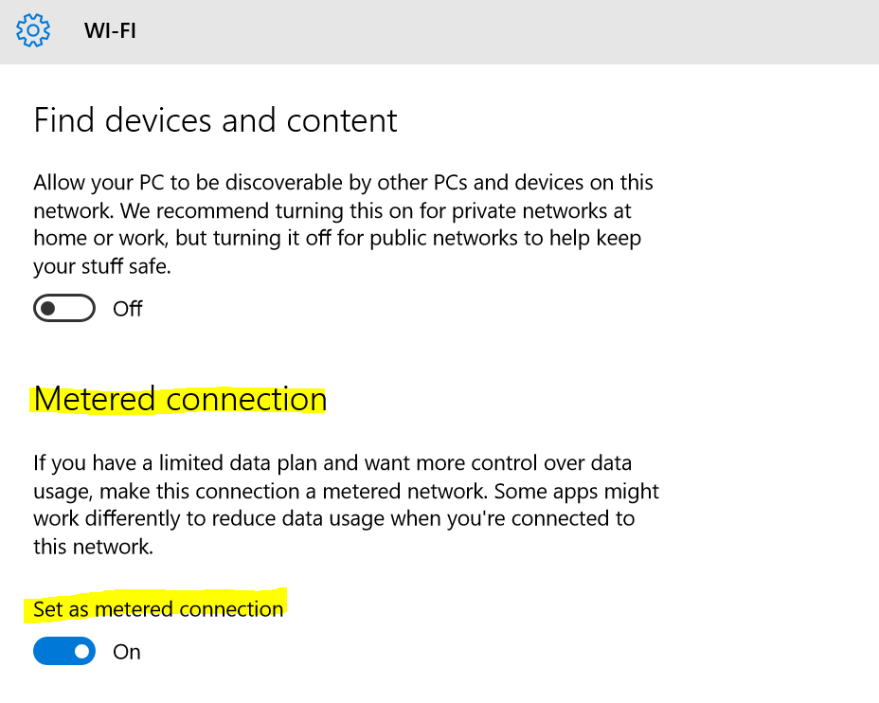
To prevent automatic downloading of updates on particular connection
Set connection as metered to prevent Windows 10 from downloading updates automatically.
Network & Internet >> Advanced Options >>

Slide 7
Prevent Windows from installing specific drivers and updates
Sometimes a specific update might cause a problem, it is possible to prevent Windows update from installing that update
No built in way to block Microsoft Update and drivers from being automatically downloaded but offers a downloadable tools that blocks specific updates and drivers
Update & Security >> Advanced Options >> View Your Update History >> Uninstall Updates >> Select the update, you want to Uninstall or Change

Slide 8
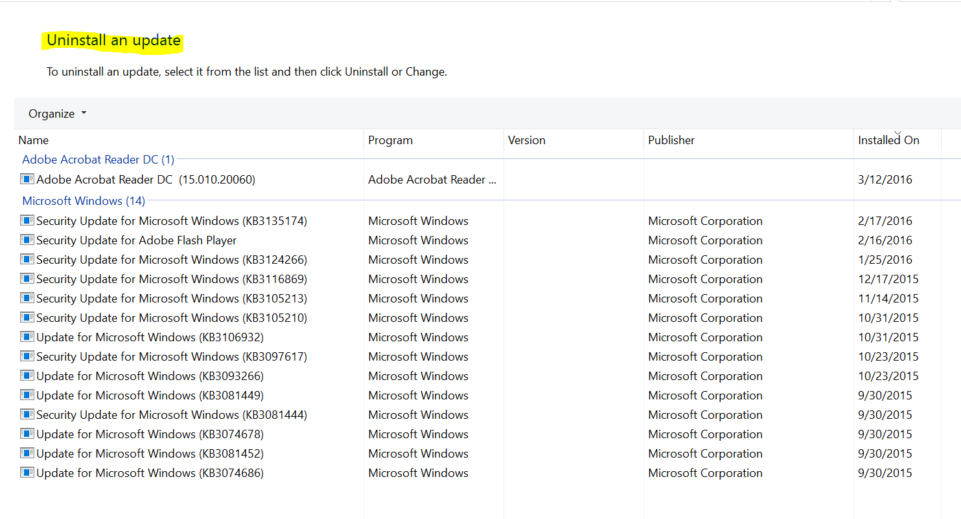

Slide 9
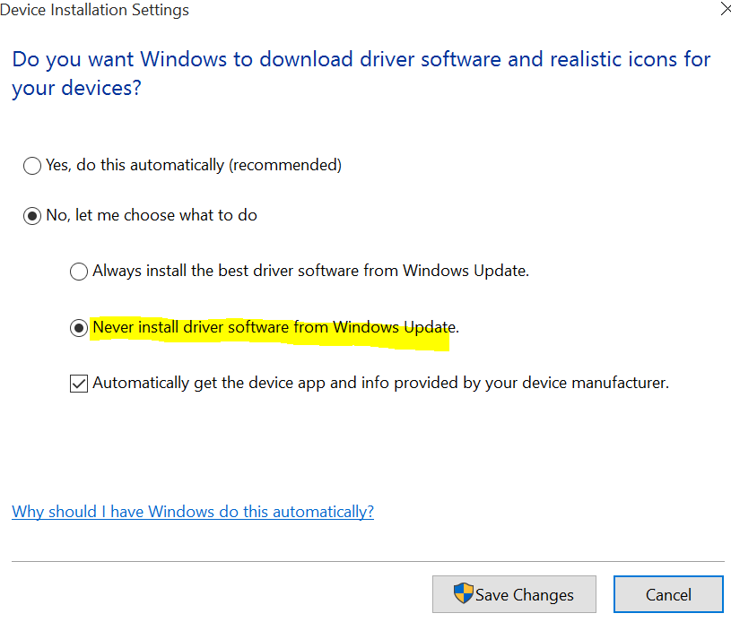
Disabling automatic download of Drivers from Windows Update
Control Panel >> System & Security >> System >> Advanced System Settings >> Hardware Tab >> Device Installation Settings >> Select the “No, let me choose what to do option” >> Select “Never install driver software from Windows Update”
Notes:
Or type advance system setting in the search box

Slide 10
Group Policy Editor: to notify new updates without automatically installing them like in previous version of Windows
Start the Local Group Policy Editor Wizard (Run Command >> gpedit.msc)
Computer Configuration >> Administrative Templates >> Windows Components >> Windows Update
Configure Automatic Updates >> Enabled >> Configure Automatic Updating setting to ‘2 – Notify for download and notify for install’ >> Click Apply >> OK
Go to Update & Security Wizard >> Click Check for Updates which applies the new configuration setting >> Restart the Computer
Notes:
Open the Run command (Win + R), in it type: gpedit.msc and press enter

Slide 11
References
Microsoft - MOAC 70-687: Configuring Windows 8.1

