Slide 1
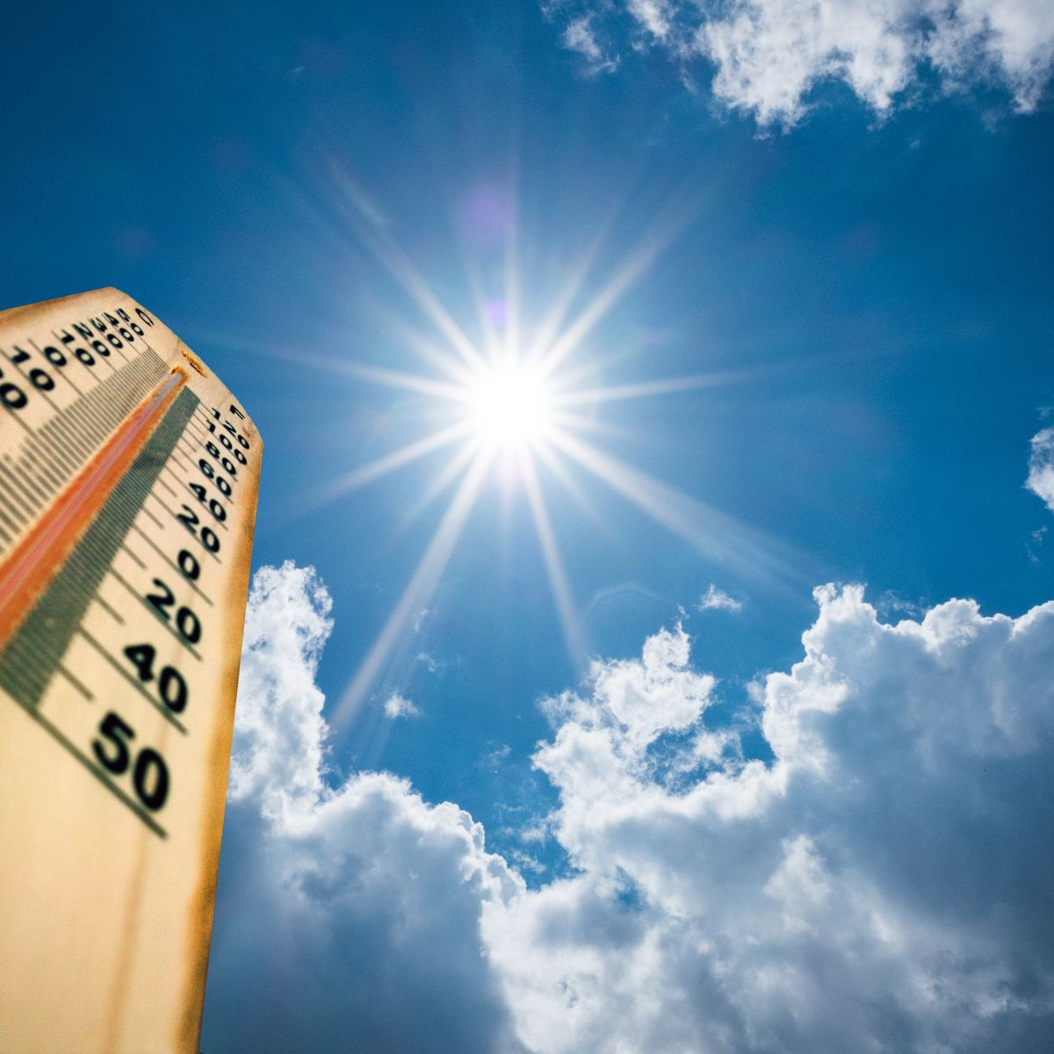
IOT BASED WEATHER REPORTING SYSTEM USING RASPBERRY PI/ESP8266

Slide 2
IOT BASED WEATHER REPORTING SYSTEM USING RASPBERRY PI/ESP8266
Project Member Roll no.
Akshay Prakash Chavan 707
Radhika Yuvraj Kamble 715
Tanvi Satish Nanekar 729
Anjali Narayan Rane 732
Project Guide Project Co- Ordinator
Prof. Dipali Joshi-Jain Prof. N.S. Chame
Prof. Vidya Kamankar

Slide 3
PROBLEM STATEMENT
The Problem found in most weather Stations recently all the weather Stations Consists of their Own Data Centre to Access and send the information to Display devices.
Each and every data centre needs Crores to build their own data centre in the particular place.
IoT Based Weather System acts as Weather Station and it update the Data Centre in Cloud.
So, by using IoT Based Weather monitoring System we can solve the cost of equipment problem and also, we can also access the information remotely through internet Devices and Websites.

Slide 4
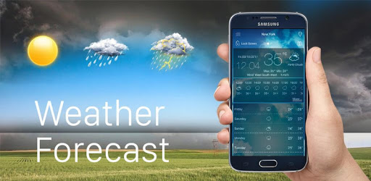

Objective
The objective of this project is to create an online weather system which enables the user to check real-time weather parameters of a place anytime and anywhere with just a few buttons click.
On top of that, people will receive real-time notification or reminder to get themselves prepared for their plans in the current weather.

Slide 5
VALUE ADDITION
In our project we can monitor the Weather parameters like temperature , pressure, humidity & rain prediction.
In addition , we can also try to monitor the Air quality index ,PM 2.5 & PM 10 pollution parameters.
In our project we can use Raspberry pi board/ ESP8266- 12 E board instead of Arduino board.
Therefore the size of the weather reporting project can be made more compact by using the Raspberry Pi board / ESP8266 12 E board.

Slide 6
BLOCK DIAGRAM OF THE SYSTEM
R
A
S
P
B
E
R
R
Y
PI
TEMPERATURE SENSOR
LCD DISPLAY
HUMIDITY SENSOR
BUZZER
PRESSURE SENSOR
WI-FI
RAIN SENSOR
IOT WEBSITE

Slide 7
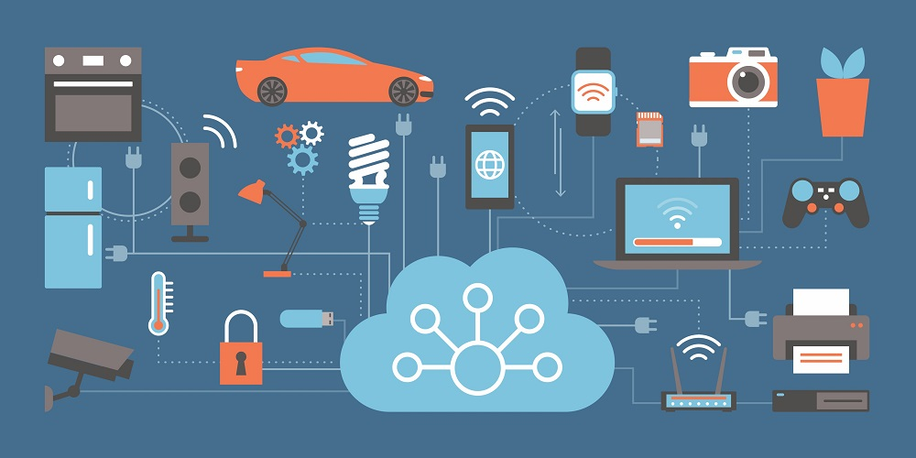

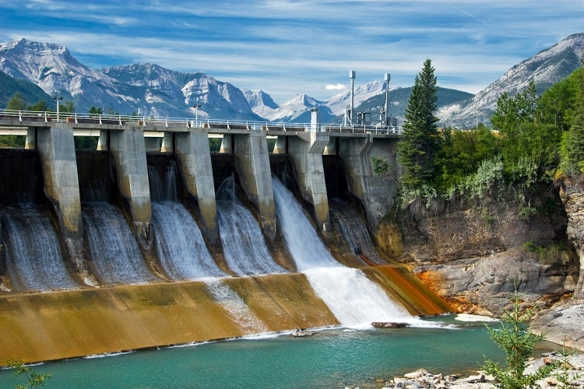

Introduction
Weather forecasts are not only important for the functioning of our day to day lives but they also play a crucial role in agriculture, cattle farming, forestry, hydroelectric dams, wild-fire monitoring, disaster management, and numerous other sectors.

Slide 8
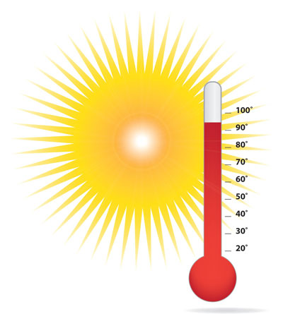

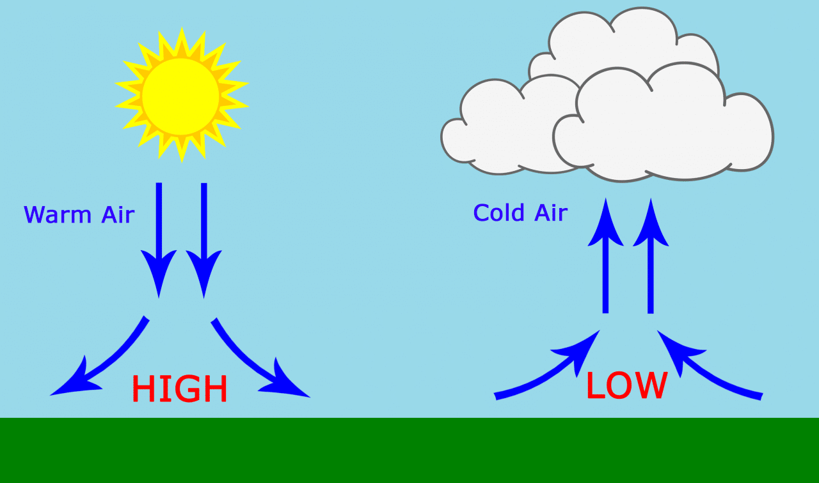
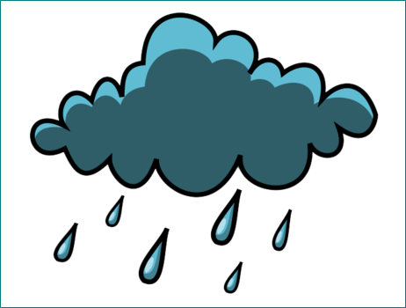
This local weather monitoring project employs four different sensors for the monitoring of temperature, humidity, Pressure and rain parameters.
Based on the information provided by this weather station project, heavy rains, excessive temperatures can be early forecasted and therefore measures can be taken to avoid natural disasters and catastrophes.

Slide 9
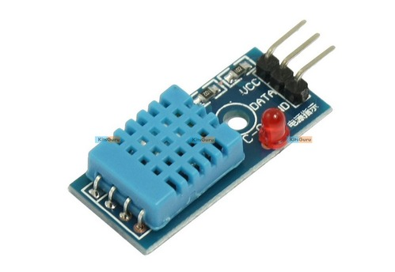
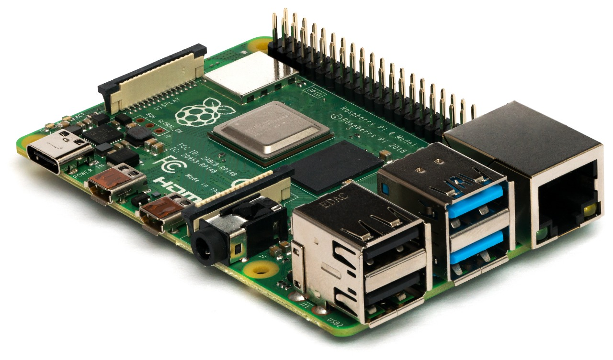
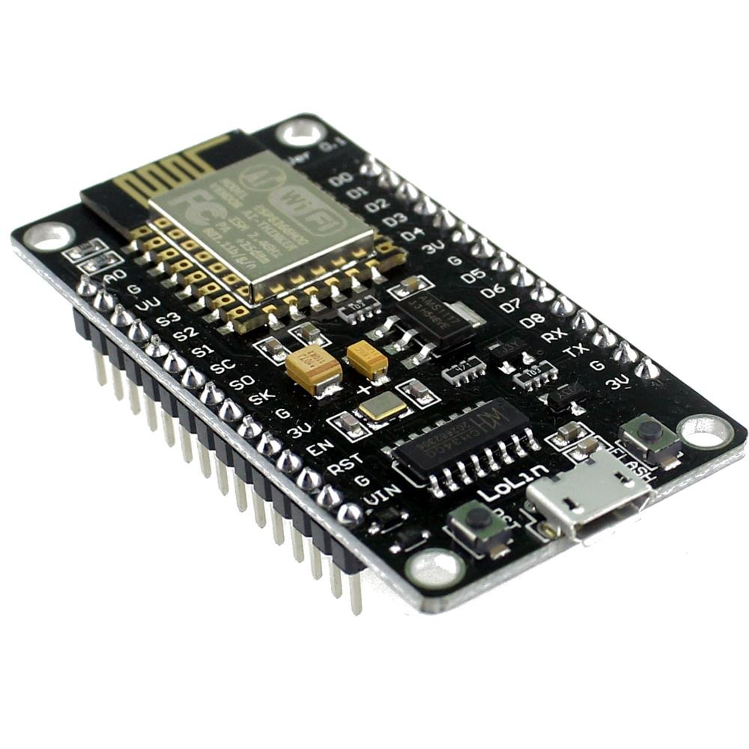
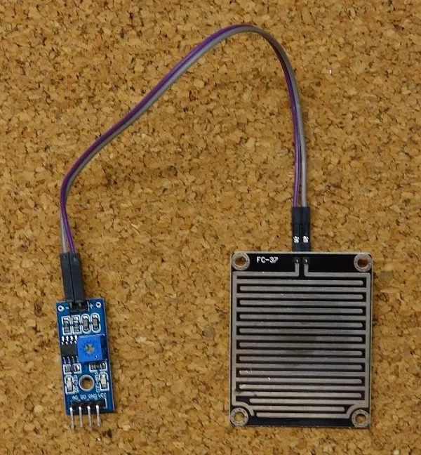
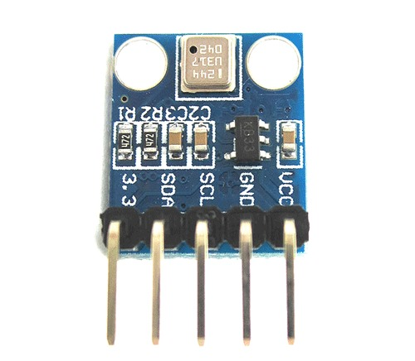
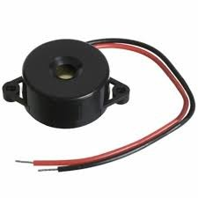
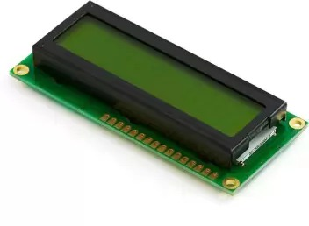
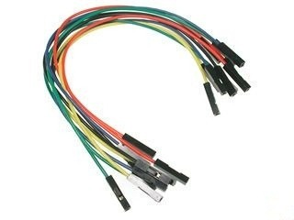
HARDWARE REQUIREMENTS
Raspberry Pi Module ESP8266 FC-37 Rain Level Sensor
DHT11 Humidity Sensor
& Temperature Sensor
BME 185 Pressure sensor Buzzer LCD Display Connecting Wire

Slide 10
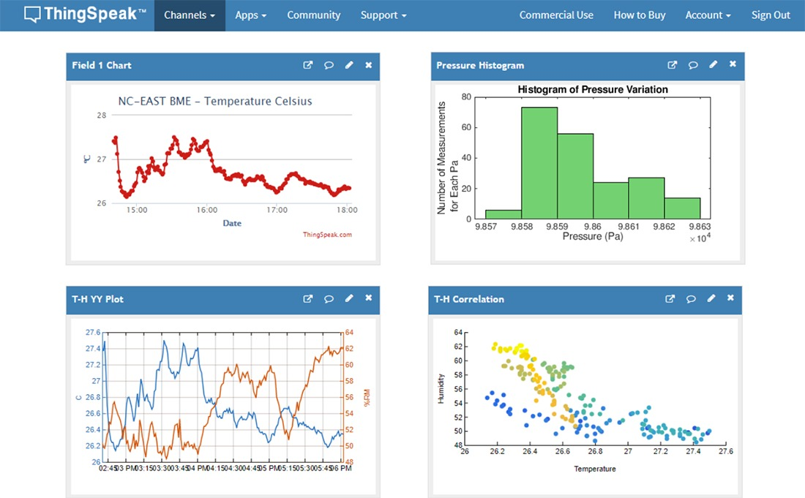

SOFTWARE REQUIREMENTS
X
Thinkspeak
Python

Slide 11
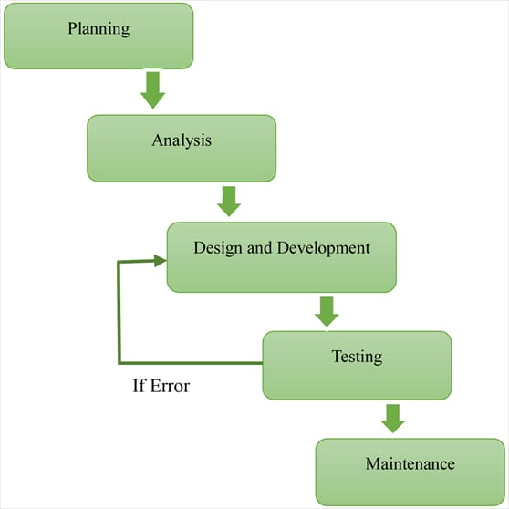
METHODOLOGY
The above fig show diagrammatic representation of different phases of proposed methodology

Slide 12
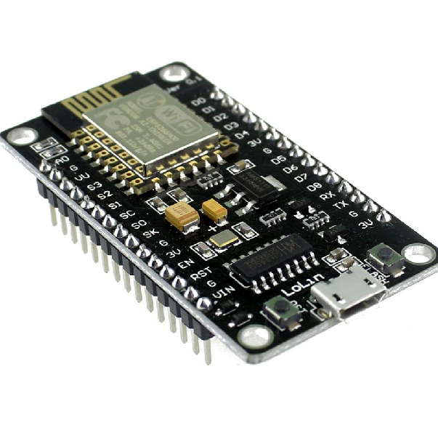
Implementation phases
There are three phases to achieve the stated objectives above:
Weather station design and prototype development
These weather parameters are measured using various sensors like DHT humidity & temperature sensor , BME 180 pressure sensor & rain sensor and the Raspberry Pi / ESP8266 with built-in Wi-Fi is used to capture all the data from the weather sensor. The measurements taken include temperature, humidity, atmospheric pressure, and rain precipitation.

Slide 13
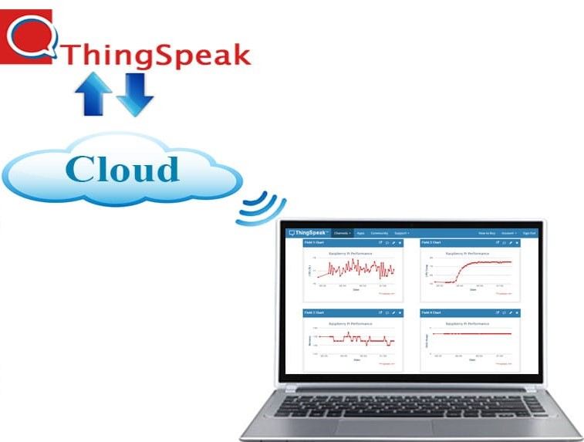
Transferring data to initial state cloud platform
Raspberry Pi/ESP8266 will stream the data directly to the cloud. Cloud platform that are suggested to be used in this project are Thinkspeak because ThingSpeak enables the creation of sensor logging applications, location tracking applications, and a social network of things with status updates .

Slide 14
Application of Internet of Things (IoT)
A stream of weather parameters/information can be displayed in a professional graphical fashion which can be accessed from mobile phone or web. One such IoT application platform that offers a wide variety of analysis, monitoring and counter action capabilities is ‘thingSpeak.
Thinkspeak also allows the development of next generation of applications of the web that is reliable, fast and engaging. Real-time notification will then be sent to the user as a reminder.

Slide 15
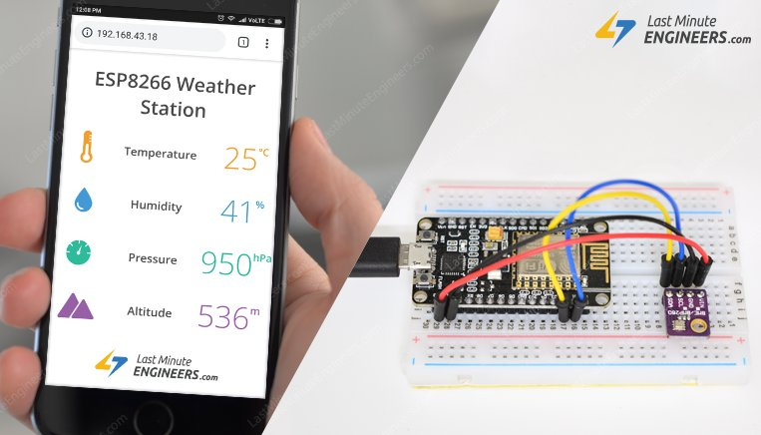
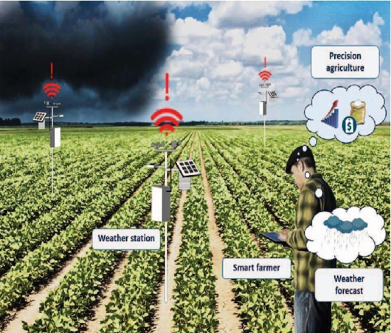
APPLICATION
1.People can access the weather related information via mobile phone or web easily.
2.Agriculture

Slide 16
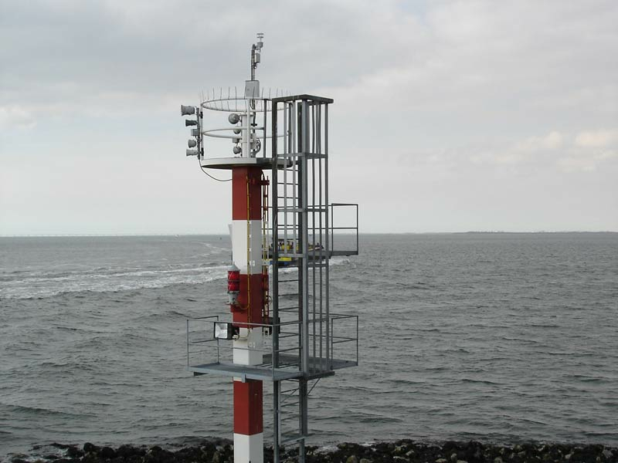
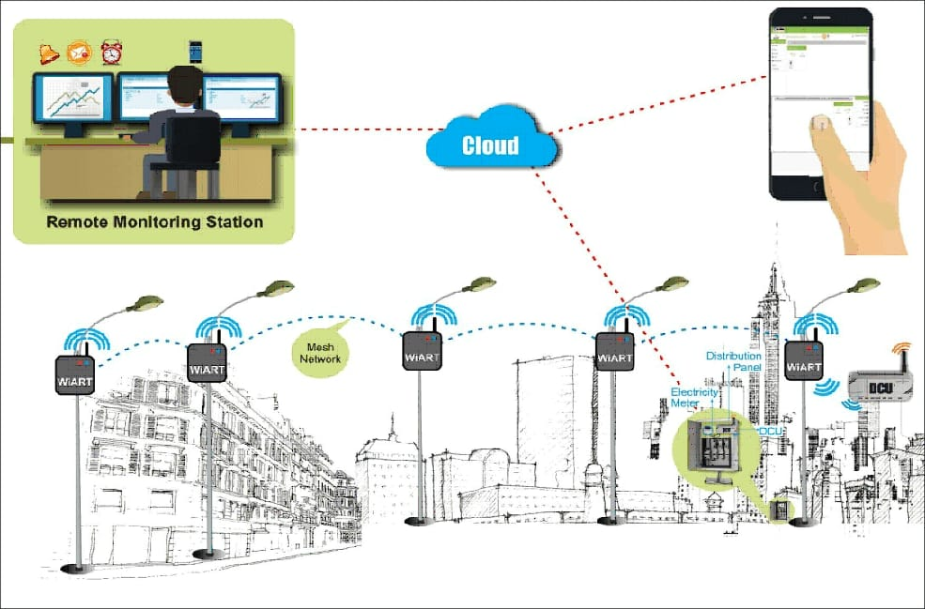
4.Industry Monitoring
3.It also help in the water level management at hydroelectric dams

Slide 17
REFERENCES
https://circuitdigest.com/microcontroller-projects/raspberry-pi-iot-weather-station-to-monitor-temperature-humidity-pressure
https://iotworld.co/2018/01/iot-based-weather-station-by-using-raspberry-pi-3/
https://iotdesignpro.com/projects/iot-based-raspberry-pi-weather-station-using-dht11-and-bmp180-sensor
https://youtu.be/K-QmBoERMcg
https://www.pantechsolutions.net/iot-weather-reporting-system-using-raspberry-pi
https://www.pantechsolutions.net/iot-weather-reporting-system-using-raspberry-pi

