Slide 1
Histogram of Oriented Gradients (HOG)
Dr. Partha Pratim Das
Department of Computer Science and Engineering of
Indian Institute of Technology, Kharagpur
CSED441:Introduction to Computer Vision (2015S), POSTECH, South Korea
Notes:
Source: Image Compression (Chapter 8) H.R. Pourreza

Slide 2


HOG
Histograms of Oriented Gradients for Human Detection by Navneet Dalal and Bill Triggs, CVPR 2005
Inspired by SIFT
Robust detector of humans in natural environments

Slide 3
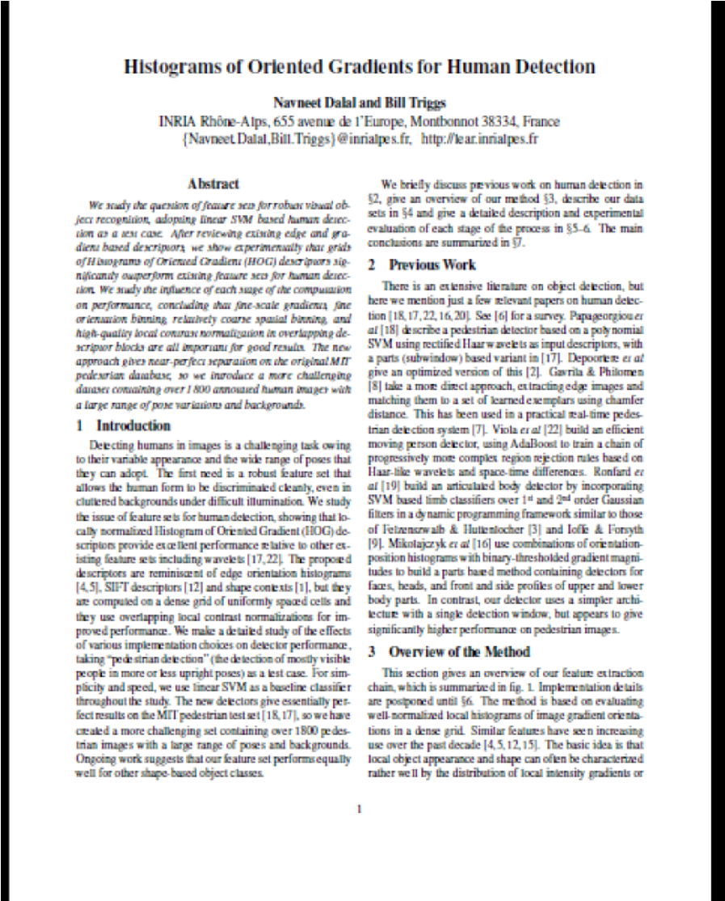
Citations: 24,301 as on 28-Oct-2018
Computer Vision and Pattern Recognition, 2005. CVPR 2005

Slide 4
HOG
SIFT is a local image descriptor, while HOG a regional image descriptor
HOG descriptor is not normalized with respect to orientation. Therefore, the HOG descriptor is not rotationally invariant
HOG histograms are normalized with respect to image contrast

Slide 5
HOG Feature Extraction
Compute centered horizontal and vertical gradients with no smoothing
Compute gradient orientation and magnitudes
For color image, pick the color channel with the highest gradient magnitude for each pixel.
For a 64x128 image, divide the image into 16x16 blocks of 50% overlap.
7x15=105 blocks in total
Each block should consist of 2x2 cells with size 8x8.
Quantize the gradient orientation into 9 bins
The vote is the gradient magnitude
Interpolate votes between neighboring bin center.
The vote can also be weighted with Gaussian to down-weight the pixels near the edges of the block.
Concatenate histograms (Feature dimension: 105x4x9 = 3,780)

Slide 6
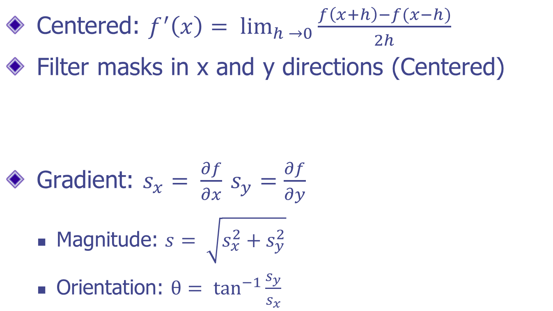

Computing Gradient

Slide 7
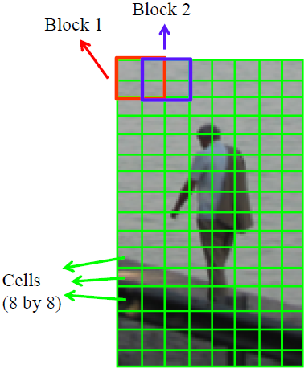
Blocks, Cells
16x16 blocks of 50% overlap
7x15=105 blocks in total
Each block should consist of 2x2 cells with size 8x8

Slide 8
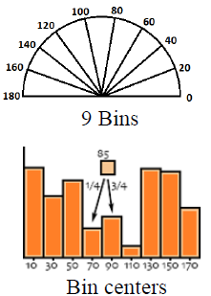
Votes
Each block consists of 2x2 cells with size 8x8
Quantize the gradient orientation into 9 bins (0-180)
The vote is the gradient magnitude
Interpolate votes linearly between neighboring bin centers.
Example: if θ=85 degrees.
Distance to the bin center Bin 70 and Bin 90 are 15 and 5 degrees, respectively.
Hence, ratios are 5/20=1/4, 15/20=3/4.
The vote can also be weighted with Gaussian to down weight the pixels near the edges of the block.

Slide 9
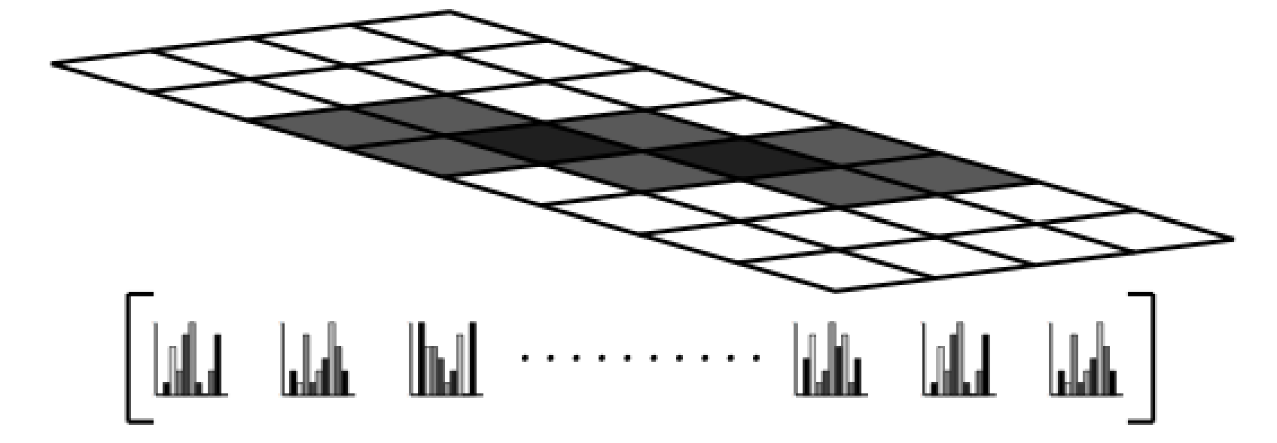
Final Feature Vector
Concatenate histograms
Make it a 1D vector of length 105 * 4 * 9 = 3780

Slide 10
HOG – Outline of Steps
Normalize gamma and color
Compute gradients in the region to be described
Divide the region into cells
Construct histogram of gradient orientations for each cell
Group the cells into large blocks
Normalize each block

Slide 11
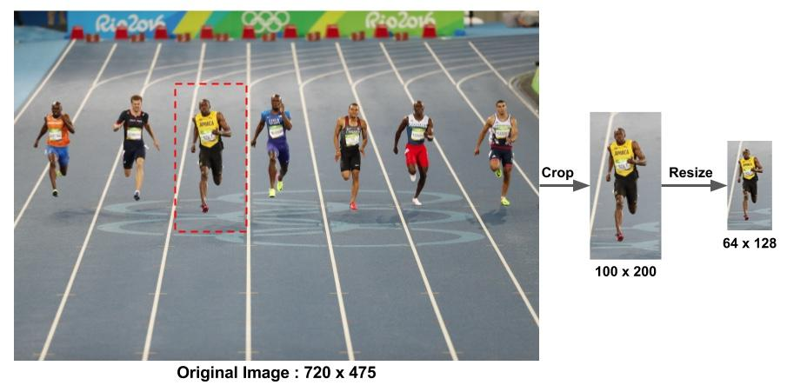
Step 1: Pre-processing
Get 64X128 patch

Slide 12
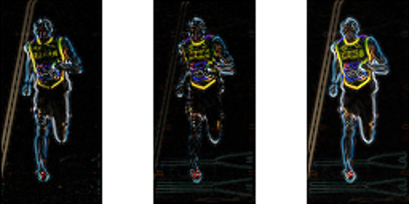
Step 2: Compute Gradient Image
Magnitude
Orientation

Slide 13
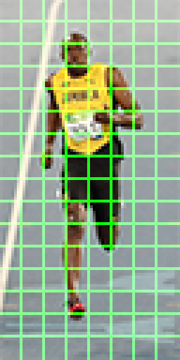
Step 3: Calculate Histogram of Gradients in 8×8 cells
8*8*3 = 192 pel values
8*8*2 = 128 grad values
Use 9 bins: 0-20, 20-30, … for histogram

Slide 14
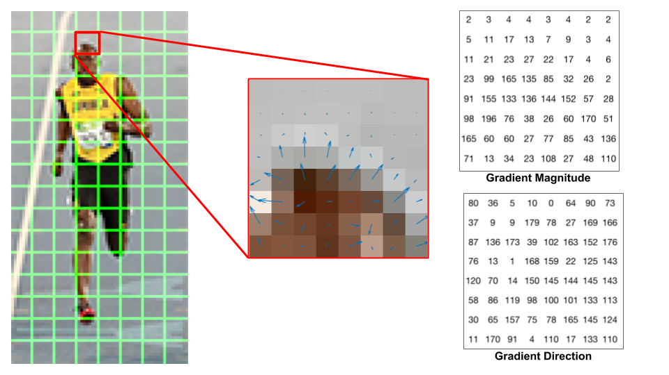
Step 3: Calculate Histogram of Gradients in 8×8 cells

Slide 15
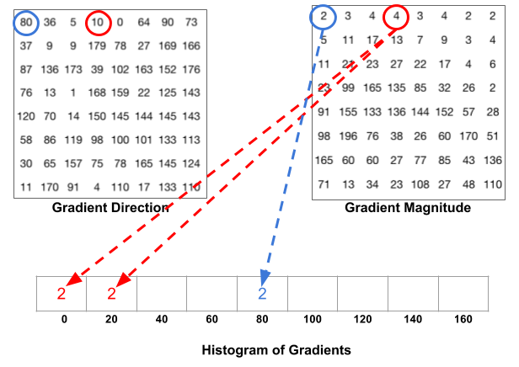
Step 3: Calculate Histogram of Gradients in 8×8 cells

Slide 16
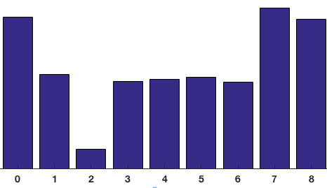
Step 3: Calculate Histogram of Gradients in 8×8 cells

Slide 17
Step 4: 16X16 Block Normalization
Normalize over a block of 16×16
A 16×16 block has 4 histograms which are concatenated to form a 36 x 1 element vector and normalized
The window is then moved by 8 pixels and a normalized 36×1 vector is calculated over this window and the process is repeated

Slide 18
Step 5: Calculate the HOG feature vector
For final feature vector for the entire image patch, the 36×1 vectors are concatenated into one giant vector
How many positions of the 16×16 blocks do we have? (Patch is 64X128 = 8X16 cells)
There are 7 horizontal and 15 vertical positions making a total of 7 x 15 = 105 positions

Slide 19
Step 5: Calculate the HOG feature vector
Each 16×16 block is represented by a 36×1 vector. So when we concatenate them all into one giant vector we obtain a 36×105 = 3780 dimensional vector.

Slide 20
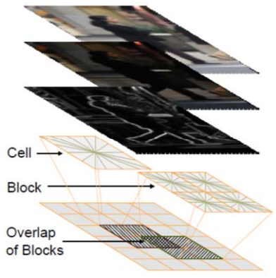
HOG

Slide 21
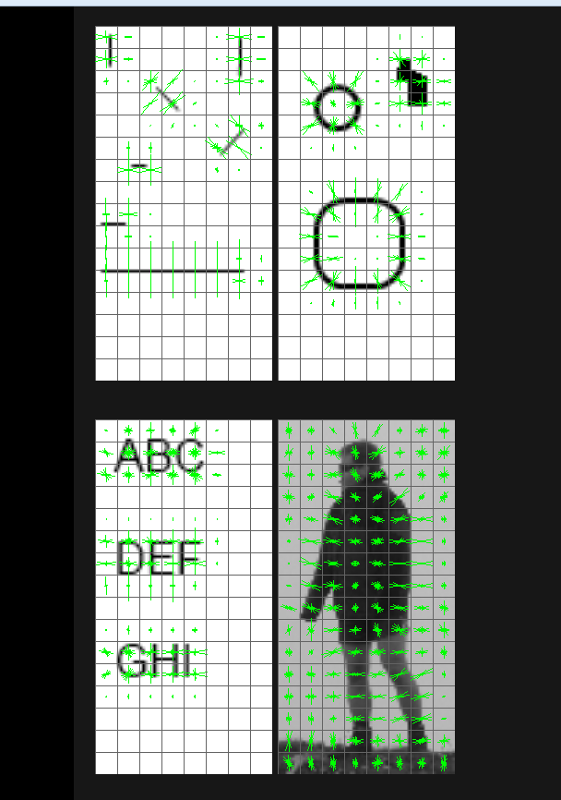
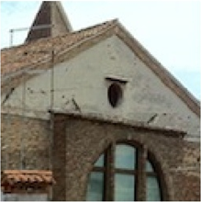
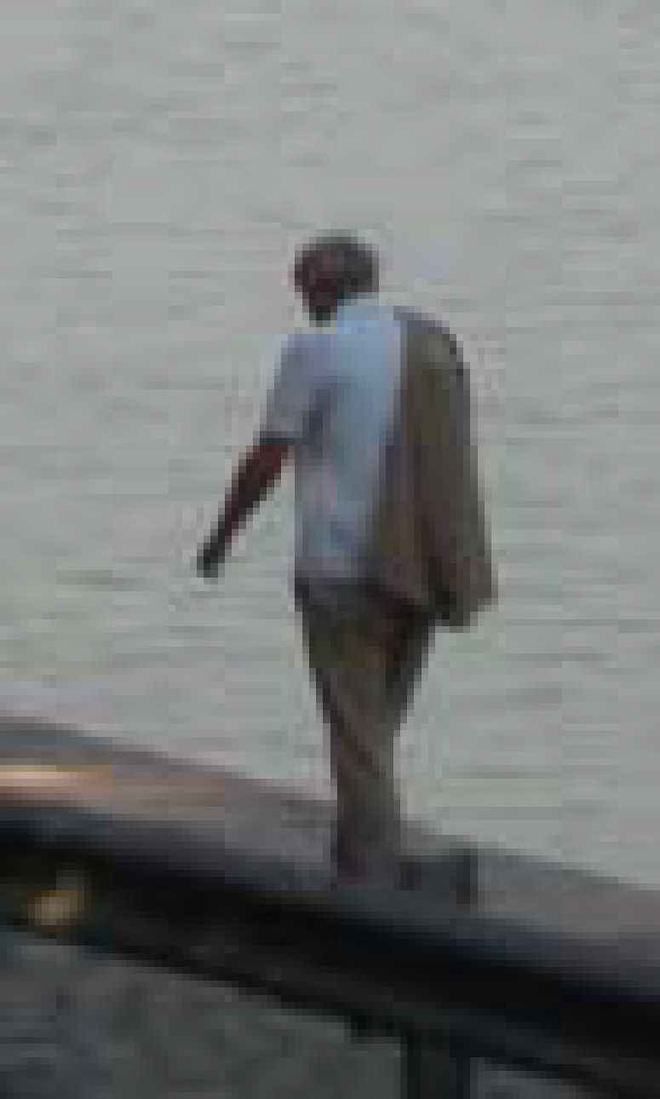
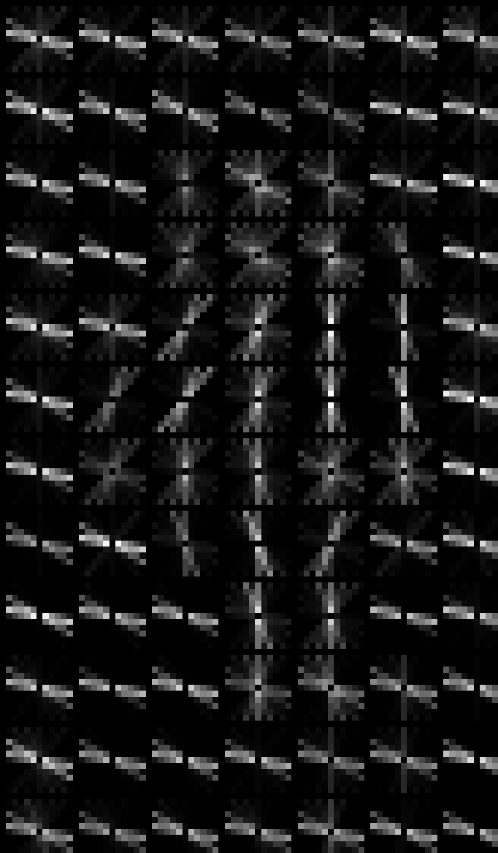
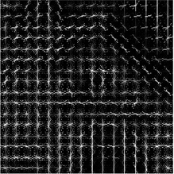
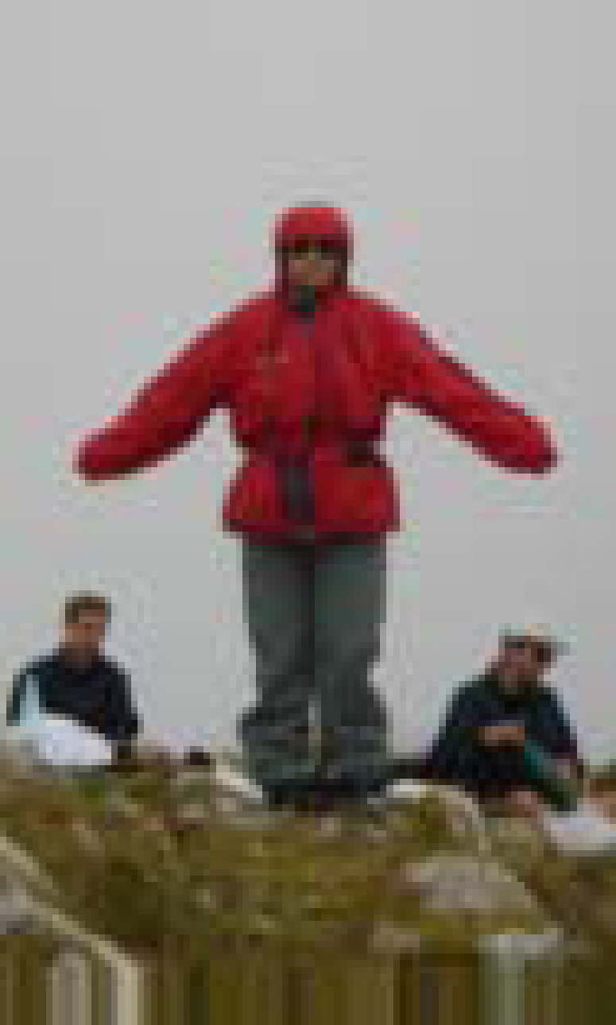
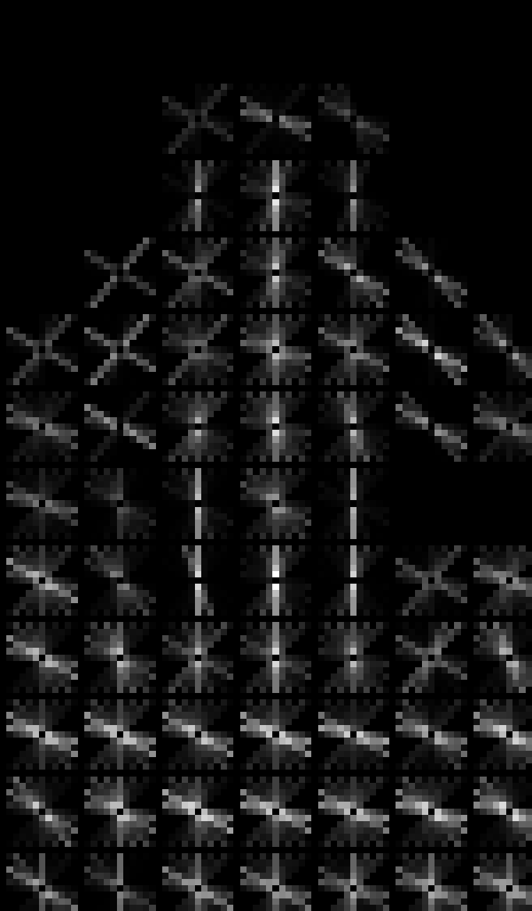
Visualization

Slide 22
Comparison: SIFT vs. HOG
SIFT
HOG
Generic Detector
Patented by UBC
Local Descriptor (Key Points)
Scale and Rotation Invariant
SIFT is analogously sparse HOG
128 dimensional vector
16x16 window
4x4 sub-window (16 total)
8 bin histogram
Human Detector
Open and Free
Regional Descriptor
Not Scale and Rotation Invariant
HOG is analogously dense SIFT
3,780 dimensional vector
64x128 window
16x16 blocks with overlap
Each block consists of 2x2 cells each of 8x8
Overlapping
9 bin histogram

Slide 23
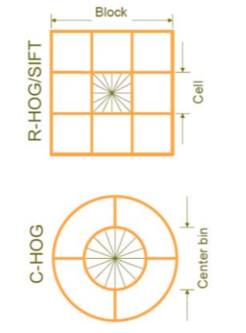
Variations of HOG
Parameters
Gradient scale
Size of blocks and cells
Orientation bins
Percentage of block overlap
Schemes
RGB or Lab, color / gray‐space
Block normalization
Block shapes: R‐HOG, C‐HOG, S-HOG
Notes:
S-HOG: Segmented HOG

