Slide 1
EDV
EDUVISION DV
Higher Education Performance Dashboard
A unified analytics suite for university rankings, research output, student diversity, and global education trends
4
8
8
1
Dashboards
Modules
Weeks
Tableau Workbook

Slide 2
PROJECT STATEMENT
What We're Building
This project develops a comprehensive higher education analytics dashboard suite covering university rankings, research performance, student diversity, academic excellence, and global education trends.
Using publicly available datasets — QS World University Rankings and Times Higher Education World University Rankings — raw educational data is transformed into actionable insights through interactive Tableau dashboards.
Built for students, researchers, university administrators, policymakers, and education consultants to evaluate institutional performance and benchmark globally.
FINAL DELIVERABLE
One Unified Tableau Workbook,
Four Linked Dashboards
1
University Overview
2
Research Analytics
3
Student Analytics
4
Country Comparison
EduVision DV — Higher Education Performance Dashboard
2

Slide 3
OUTCOMES
What This Project Delivers
1
Integrated Datasets
2
Clean, Ready Data
3
Education KPIs
Collection and integration of global university datasets from multiple ranking sources.
Data cleaning and transformation pipeline built for educational analytics.
A full set of higher-education KPIs engineered for cross-institution comparison.
4
4 Interactive Dashboards
5
Ranking & Performance Analysis
6
Country Benchmarking
Creation of four interconnected, interactive Tableau dashboards.
University ranking and institutional performance analysis at scale.
Country-level education benchmarking with drill-down and filters.
EduVision DV — Higher Education Performance Dashboard
3

Slide 4
PROCESS
Workflow Diagram
1
2
3
4
5
6
7
Collect University
Datasets
Data Cleaning &
Transformation
Education KPI
Engineering
Dashboard
Development
Dashboard
Integration
Testing &
Validation
Documentation
& Delivery
→
→
→
→
→
→
Eight sequential modules, executed across four two-week milestones.
EduVision DV — Higher Education Performance Dashboard
4

Slide 5
MILESTONE 1 · WEEKS 1–2
Data Collection and Preparation
Module 1: University Data Collection
Module 2: Data Cleaning & Transformation
TASKS
TASKS
Download QS Ranking datasets
Download World University Ranking datasets
Collect university performance indicators
Merge ranking datasets into a common structure
Remove duplicates
Standardize university names
Standardize country names
Normalize ranking metrics
Create Tableau-ready datasets
DELIVERABLES
university_raw_data.csv
data_collection.py
DELIVERABLES
university_cleaned.csv
education_cleaning.ipynb
EduVision DV — Higher Education Performance Dashboard
5

Slide 6
MILESTONE 2 · WEEKS 3–4
KPI Engineering and Dashboard Planning
Module 3: Education KPI Engineering
Module 4: Dashboard Planning & Prototyping
TASKS
TASKS
Global Ranking Score
Research Impact Score
Faculty-to-Student Ratio
International Student Percentage
Academic Reputation Score
Research Productivity Index
Design layouts: all 4 dashboards
Define filters & navigation
Define dashboard actions
Plan interactive comparisons
DELIVERABLES
dashboard_storyboard.pdf
eduvision_prototype.twbx
DELIVERABLES
university_final_dataset.xlsx
generate_education_kpis.py
EduVision DV — Higher Education Performance Dashboard
6

Slide 7
MILESTONE 3 · WEEKS 5–6
Dashboard Development
Module 5: Overview + Research Dashboards
Module 6: Student + Country Dashboards
TASKS
TASKS
Top university rankings
Global university distribution
Academic reputation analysis
Publications & citation performance
Top research institutions
International student analysis
Faculty-to-student ratio analysis
Student diversity & enrollment trends
Country ranking comparison
DELIVERABLES
DELIVERABLES
Dashboard Integration:
Global filters, navigation,
parameter actions, linking
eduvision_dashboard_v1.twbx
EduVision DV — Higher Education Performance Dashboard
7

Slide 8
MILESTONE 4 · WEEKS 7–8
Testing and Delivery
Module 7: Testing and Validation
Module 8: Documentation & Delivery
TASKS
TASKS
Validate KPI calculations
Verify ranking calculations
Test dashboard interactions
Validate educational metrics
Document dataset sources & KPI definitions
Write dashboard guide & methodology
Organize project structure (/scripts /data /dashboard /docs)
Deploy to GitHub + Tableau Public
DELIVERABLES
QA Checklist
Dashboard Testing Report
DELIVERABLES
GitHub Repository
Final Documentation
Tableau Workbook
EduVision DV — Higher Education Performance Dashboard
8

Slide 9
QUALITY BAR
Evaluation Criteria
Milestone | Focus Area | Metric | Target
1 | Data Collection & Cleaning | Dataset Completeness | > 95% Complete
2 | KPI Engineering | KPI Accuracy | 6+ KPIs Generated
3 | Dashboard Development | Dashboard Functionality | 4 Dashboards Integrated
4 | Documentation & Delivery | Project Quality | Portfolio Ready
EduVision DV — Higher Education Performance Dashboard
9

Slide 10
UNDER THE HOOD
Tech Stack
Area | Tools / Libraries
Data Collection | Python · QS Rankings · World University Rankings
Data Processing | Pandas · NumPy
Data Cleaning | Python
Visualization | Tableau Desktop / Tableau Public
Dashboard Integration | Tableau Filters · Parameters · Actions
Documentation | Markdown · GitHub
EduVision DV — Higher Education Performance Dashboard
10

Slide 11
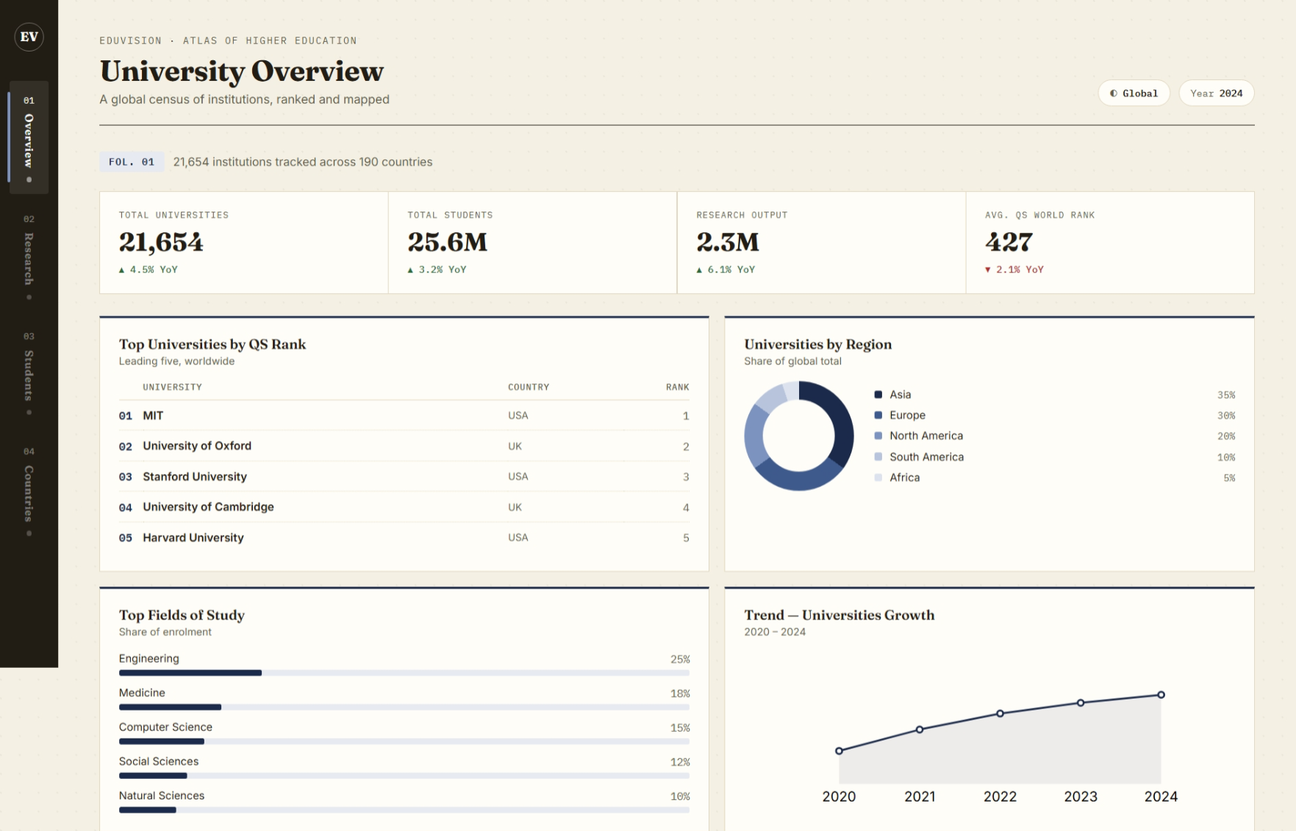

Slide 12
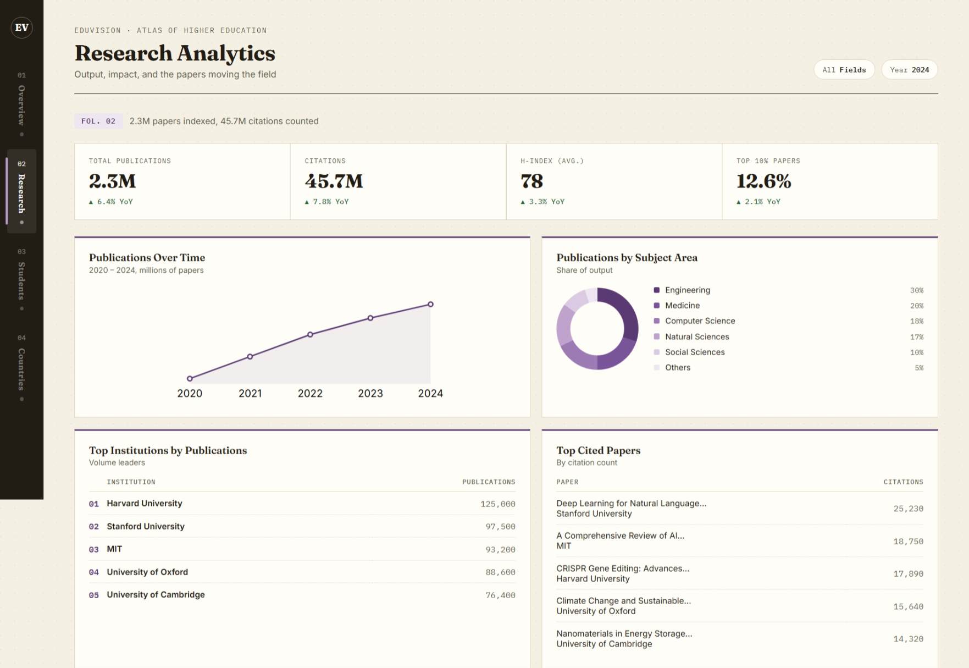

Slide 14
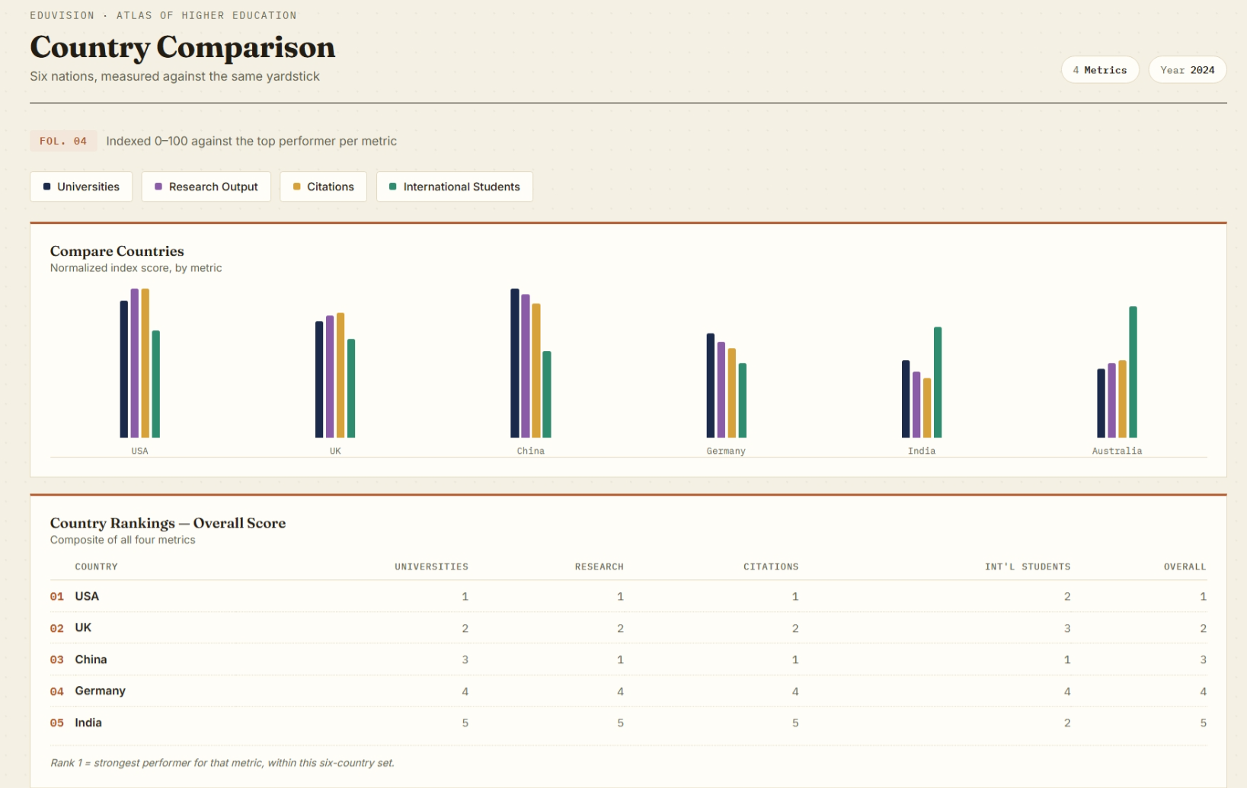

Slide 15
PORTFOLIO-READY DELIVERY
Ready for GitHub, Portfolio,
and Tableau Public
1
GitHub Repository
Full source: /scripts, /data, /dashboard, /docs
2
Final Documentation
Dataset sources, KPI definitions, dashboard guide, methodology
3
Tableau Workbook (.twbx)
EduVision_DV.twbx — 4 linked, interactive dashboards
EduVision DV — Higher Education Performance Dashboard
12

