Slide 1
Project Name: CastleArt
Project Members:
Dipak Kalekar. (210943120037)
Ruturaj Vitekar. (210943120083)
Prasad Pisal (210943120072)
Shubham Dighe (210943120099)

Slide 2
Objective of Project:
CastleArt will help to improve the overall productivity of arts businesses and helps to customers to enjoy their favorite paintings right at their home with just a click.
Easy paintings and handcrafts ordering.
Improves painting businesses.
This system help artist to show their artistic skill.
Easy to book artist at customer place.
System provide income source for small artist.

Slide 3
Introduction:
A CastleArt is not just a website that features images of artists' creative work but also provides platform to keep record of artists and their paintings, Artist details, Handicraft Items, and showcases pictures of paintings to the customers so that customers can buy these products online by paying the amount online also provide service to book artist at Customer place.
Nowadays everything happens via a digital platform, the concept of a CastleArt is created. The "CastleArt" has been developed to override the problems prevailing in the practicing manual system. This software is supported to eliminate and in some cases reduce the hardships faced by this existing system. Moreover this system is designed for the particular need of the company to carry out operations in a smooth and effective manner.

Slide 4
Modules:
User Module: Used for managing the users of system.
Artist Module: Used for managing artist details.
Admin Module: Used for managing customers, artists, orders, stocks.
Login Module: Used for managing login details.
Order Module: Used for managing order details.
Billing: Use for managing the bill information.

Slide 5
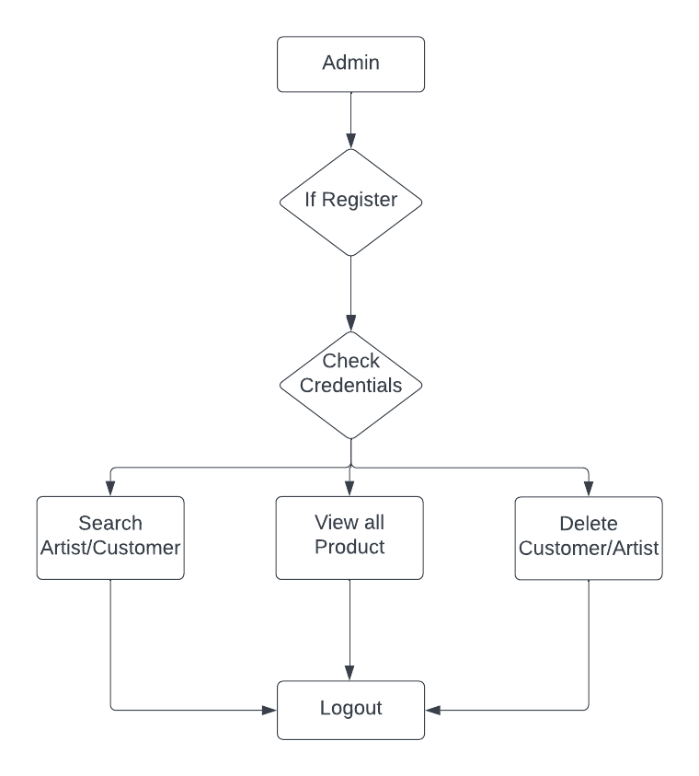
Activity Diagram of Admin:

Slide 6
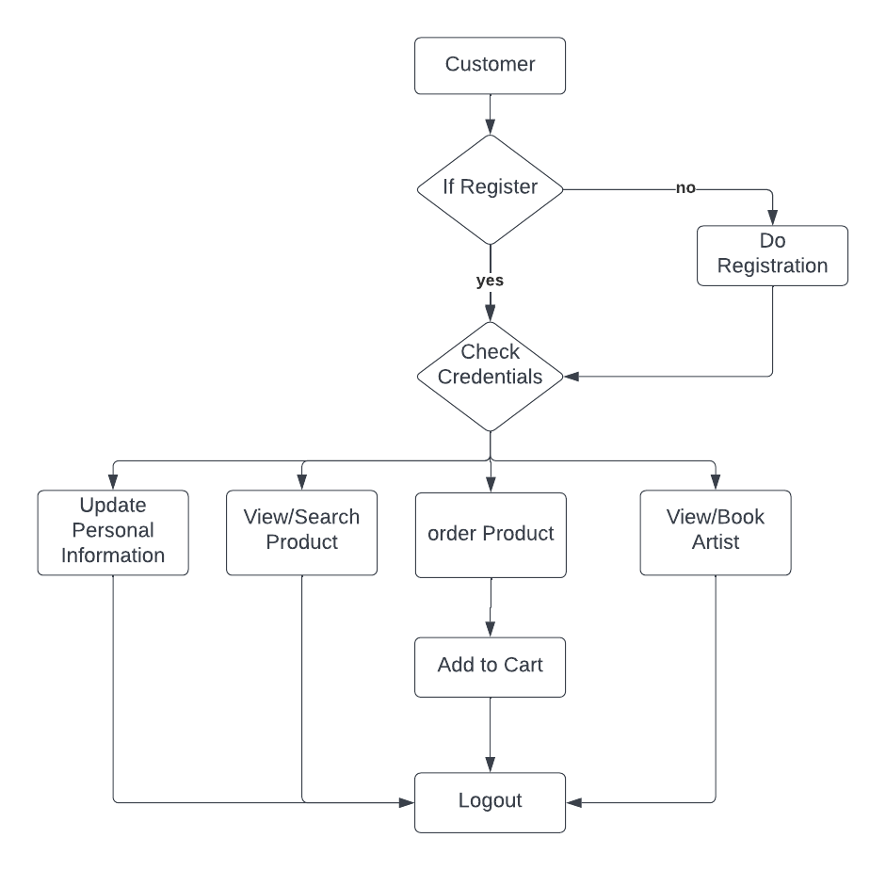
Activity Diagram of Customer:

Slide 7
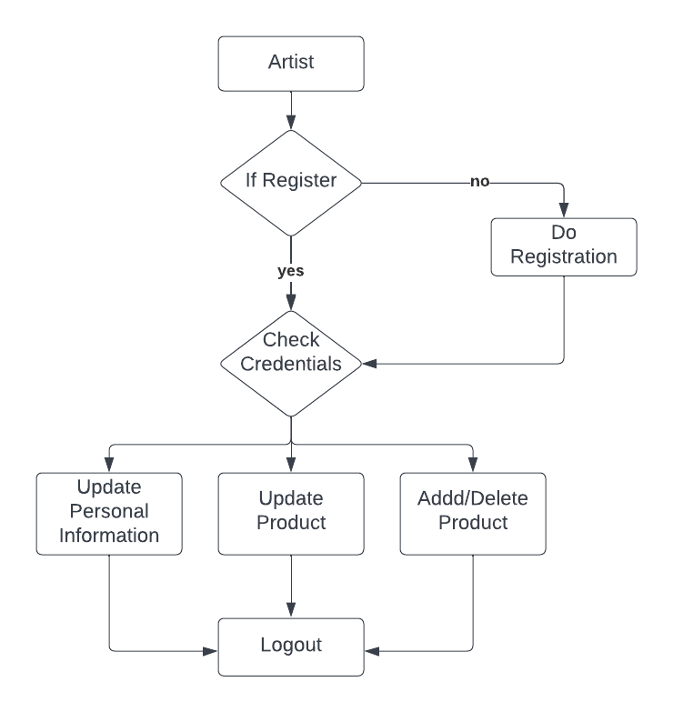
Activity Diagram of Artist:

Slide 8
Future Scope:
CastleArt provides a verified platform for online shopping and booking of Artist. A single platform to sell products by artist and to buy by customers
We can add Exhibition service in existing project.
We can arrange live tutorials, exhibitions for artist and customer respectively.
We can add different artists like Dancers, magicians, singer, etc for book at your place service.

