Slide 1

TO STUDY SOCIO - ECONOMIC STATUS AND IMPACT OF DRUDGERY ON PHYSICAL HEALTH OF FARMING WOMEN
Guided by:
Dr. Manisha Pandya
Mr. Shrey Pandya
Presented by:
Darpan Padaria
Vishal Harijan
Rajdeep Chhasatiya
Dipak Bariya
Notes:
1

Slide 2
OUTLINE
1] INTRODUCTION
2] NEED FOR STUDY
3] OBJECTIVES
4] METHODOLGY
5] GRAPHICAL VISUALIZATION
6] ANALYSIS
Equality of variance
Equality of Mean
Chi–square test
Correspondence Analysis
K modes clustering
7] SUMMARY
8] REFERENCES
Notes:
2
2

Slide 3
INTRODUCTION
The rural women play a significant role in agriculture and other agri based activities. Also in agriculture, women are the major workers assigned the heavy drudgery work, such as weeding, harvesting, carrying head loads, etc.
Such work is often called “drudgery work”, which means dull and boring work, but it is also heavy work, back-breaking work, often dangerous work.
If appropriate drudgery reduction technologies are made available to the farmwomen at home and farm, it would definitely contribute in reducing their drudgery, increasing their working capability, increasing farm production resulting in improved quality of life.
Notes:
3
3

Slide 4
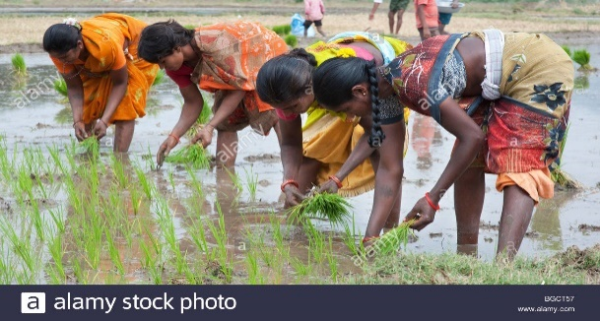
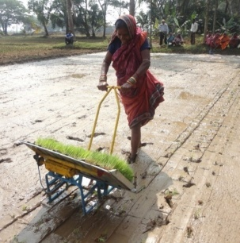
NEED FOR STUDY
Activities like sowing, weeding, irrigation, harvesting, winnowing, etc. are mostly done by manually or by traditional tool.
All these factors results in physical and mental fatigue, monetary hardship, exploitation, pain etc. Various activities done by traditional methods takes long time to complete and this may results in mental tiredness .
By providing drudgery reduction tools these all problems can be solved or minimize the risk of women’s health.
So it is very necessary to first study the impact of different drudgery activities on women’s health.
And also this will improve rural women’s economic condition in long run.

Slide 5
OBJECTIVES
❑ To study the relationship between different drudgery activity and their impact on physical injuries / problems.
❑ To study the socio-economic status of farming and non- farming women.
Notes:
5
5

Slide 6
METHODOLOGY
Source of data:
Study is based on primary data.
Target Population:
All women (farming and non farming) of Kareli and Samoj village of Jambusar taluka in Bharuch district.
Survey Design
- Primary data have collected by questionnaires.
Notes:
6
6

Slide 7

SAMPLING METHOD
Multi stage sample
Stage 1 : Simple Random Sampling
Stage 2 : Stratified Sampling
Stage 3 : Equal Proportion Allocation
STAGE 1 :
N = Total Population Size = N1 + N2 = 3429
α= 0.05
Z score = 1.96
Ɛ= Margin of error = 0.05
p = 0.83 = proportion of those people on which drudgery impact’s their health status
n = Total Sample size = 288
- Simple Random Sampling
$$n=\frac{NZ_{α/2}^{2}pq}{\left(N−1\right)Ɛ^{2}p^{2}+Z_{α/2}^{2}pq}$$

Slide 8
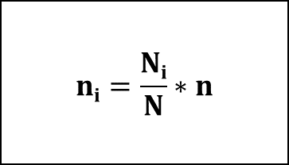
STAGE 2:
- By Stratified Proportional allocation
Population Size
Kareli (2712)
Samoj (717)
$$ni=\frac{Ni}{N}∗n$$
Total Sample size (288)
Kareli (228)
Samoj (60)
STAGE 3:
- By Equal Proportion allocation.
Farming (114)
Non-farming (114)
Farming (30)
Non-farming(30)

Slide 9
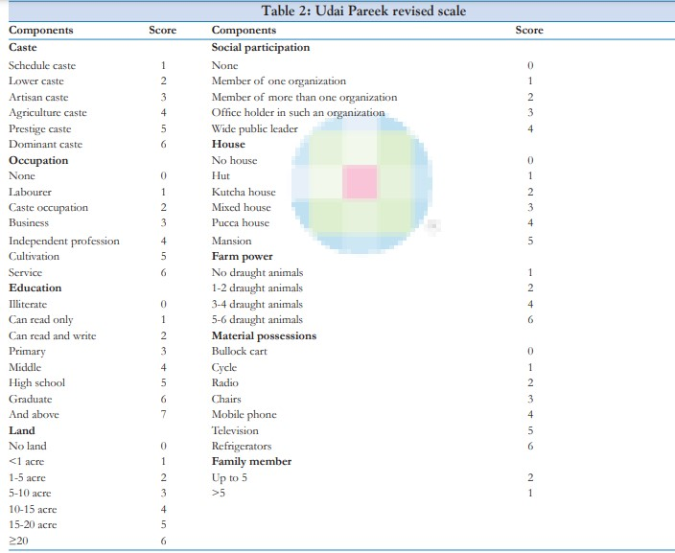
UDAI-PAREEKH SCALE
CLASSIFICATION
Category Scale
Upper Class >43
Upper Middle Class 33-42
Middle Class 24-32
Lower Middle Class 13-23
Lower Class <13

Slide 10
DRUDGERY INDEX
To decide drudgery load for various farming activities
Drudgery Index = [ (X+Y+Z)/3 ] *100
Where,
X = Co-efficient of frequency of performance
Y = Co-efficient of difficulty felt
Z = Co-efficient of time spent in particular farm activity
Y = Difficulty score X = Performance score Z = Time score
- Very hard -5 More then 10 days - 6
Hard – 4 8 – 10 days - 5 No of hour * no of days per crop
Neutral – 3 6 – 8 days - 4
Easy – 2 4 – 6 days - 3
Very easy – 1 2 – 4 days - 2
0 – 2 days - 1

Slide 11
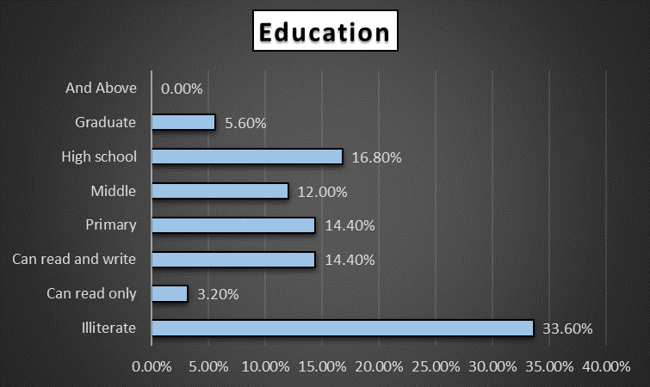
GRAPHICAL VISUALIZATION
INTERPRETATION: 69.60% of women belongs to Middle class family, 25.60% women belongs to Lower middle class family. And 4.80% comes from upper middle class family.
INTERPRETATION: Percentage of illiterate women are bigger than any other category. After that most women completes their primary, middle and high school education.

Slide 12
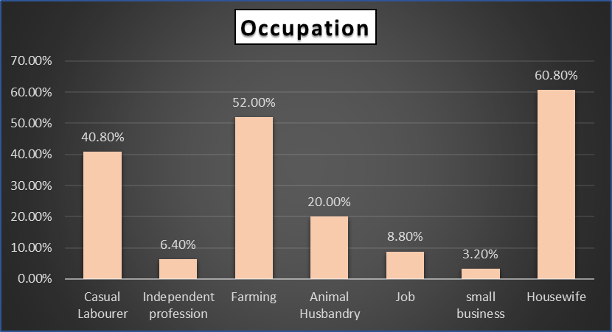
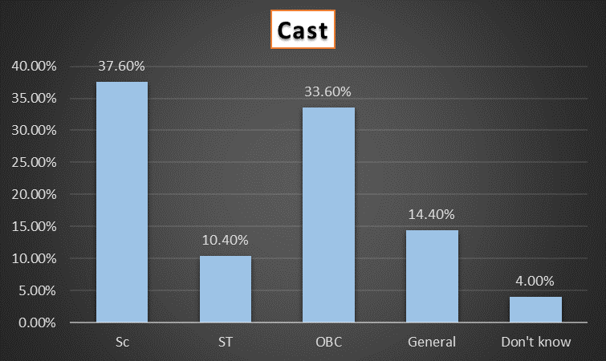
INTERPRETATION: Most women generally prefers either to do housework or to work in farm or both.
INTERPRETATION: We, can see that, in village there are more population comes from SC and OBC cast.

Slide 13
INTERPRETATION: Weeding, Farm Cleaning, Sowing, and Fodder cutting are the most drudgery prone farm activities.

Slide 14
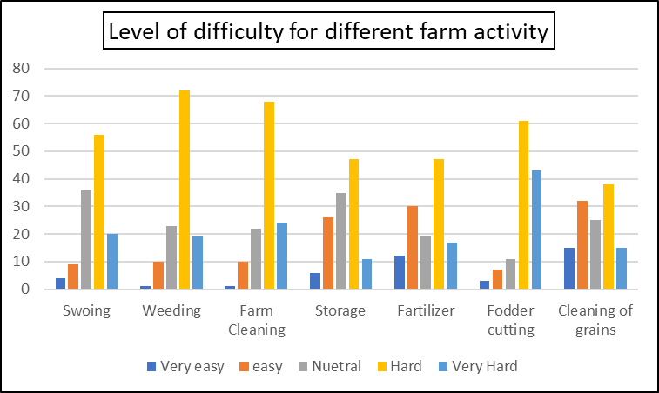
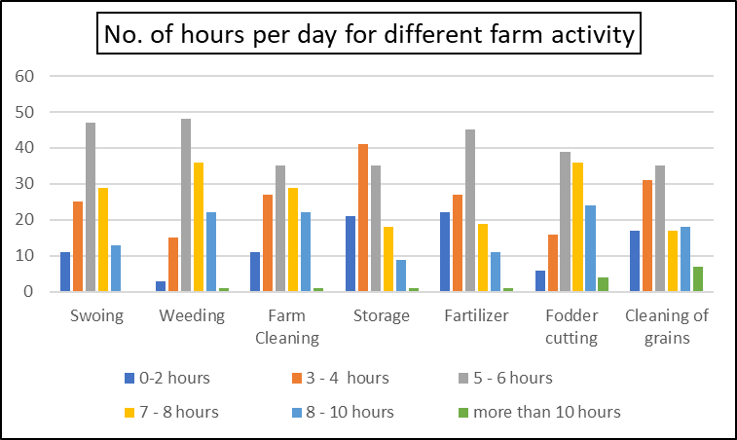
INTERPRETATION: From the above graph, most people feels that all activities are hard for them. According to women Weeding, Farm cleaning and Fodder cutting activities are the most challenging activity for them.
INTERPRETATION: We can observe that majority of women are spending almost 5-8 hours per day for various farm activities.

Slide 15
INTERPRETATION: More than 50% of women having joint pain/injuries during farming activity.

Slide 16
STATISTICAL ANALYSIS
NORMALITY TEST
-By shapiro wilk test
Objective: To check whether SES follows Normally distribution or not.
Hypothesis:
Ho : SES is normally distributed.
H1 : SES is non-normally distributed.
Output:
test statistic = 0.981
p value = 0.079
Conclusion:
p value > alpha, so test not significant, and we do not reject Ho, and conclude that SES is normally distributed.

Slide 17
NORMALITY TEST
Objective: To check whether Drudgery score follows Normally distribution or not.
Hypothesis:
Ho : Drudgery Score is normally distributed.
H1 : Drudgery Score is non-normally distributed.
Output:
test statistic = 0.981
p value = 0.081
Conclusion:
p value > alpha, so test not significant, and we do not reject Ho, and conclude that Drudgery score is normally distributed.

Slide 18
Normality test:
variable | Null Hypothesis | Statistic value | P-value | Conclusion
SES | Sample follows Normal distribution. | 0.981 | 0.079 | Do not reject H0.
Drudgery Score | Sample follows normal distribution. | 0.981 | 0.081 | Do not reject H0.

Slide 19
PROPORTION TEST
Objective: To check whether the population of two groups have same proportion.
Hypothesis:
Ho : Proportion of farming and non farming group are same
H1 : Proportion of farming and non farming group are not same
Output:
test statistic = 5.6920
p value = 0.000
Conclusion:
p value < alpha, so test is significant, and we reject Ho, and conclude that proportion of farming and non farming are not same.

Slide 20
Proportion test:
Variable | Null Hypothesis | Statistic value | P-value | Conclusion
Farming & non-Farming | Both groups have same Proportion. | 5.6920 | 0.000 | Reject H0.
SHG & non-SHG | Both groups have same Proportion. | 4.6801 | 0.000 | Reject H0.

Slide 21
F test for Equality of Variance
Hypothesis:
H₀: 𝝈₁² = 𝝈₂²
H₁: 𝝈₁² ≠ 𝝈₂²
H₀: Variance of SES for farming and non-farming women are equal
H₁: Variance of SES for farming and non-farming women are not equal
Test Statistic:
F = S₁² / S₂²
Where S₁² and S₂² are the sample variances.

Slide 22
Equality of Variance:
variable | Null Hypothesis | Statistic value | P-value | Conclusion
SES of Farming & non-Farming | Both group have same variance. | 3.6791 | 0.0607 | Do not reject H0.
SES of SHG & non-SHG | Both groups have same variance. | 0.7487 | 0.3885 | Do not reject H0.
DS of Socio-Economic categories | Variance of DS for all SES category are same. | 4.7872 | 0.0099 | Reject Ho.
DS of Farming Activities | Variance of DS for all farming activities are same. | 2.31172 | 0.0320 | Reject Ho.

Slide 23
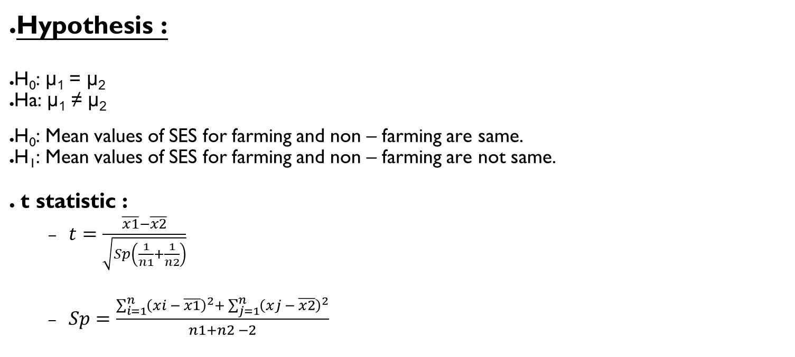
Equality of Mean
Hypothesis :
H₀: μ₁ = μ₂
Ha: μ₁ ≠ μ₂
H₀: Mean values of SES for farming and non – farming are same.
H₁: Mean values of SES for farming and non – farming are not same.
t statistic :
$t=\frac{\overline{x1}−\overline{x2}}{\sqrt{Sp\left(\frac{1}{n1}+\frac{1}{n2}\right)}}$
$Sp=\frac{\sum_{i=1}^{n}{{\left(xi − \overline{x1}\right)}^{2}}+ \sum_{j=1}^{n}{{\left(xj − \overline{x2}\right)}^{2}}}{n1+n2 −2}$

Slide 24
Equality of Mean:
Variable | Hypothesis | Statistic value | P-value | Conclusion
Farming & non-Farming | Both group have same mean. | -1.9817 | 0.0497 | Reject H0.
SHG & non-SHG | Both groups have same mean. | 0.2031 | 0.8393 | Do not reject H0.

Slide 25
Objective : To check whether all activities has same drudgery score.
Using post hoc test
Hypothesis:
H₀: μ1 = μ2 = μ3 = μ4 = μ5 = μ6 = μ7
H₁: Inequality at one place.
Output:
test statistic = 30.7074
p value = 0.00000
Conclusion :
Here P-value < alpha so we have enough evidence to reject null hypothesis and conclude that mean drudgery score for all activities are not same

Slide 26
Objective: To check whether mean drudgery score is same two activities.
Hypothesis: H0: μ1 = μ2 Ag. H1: μ1 ≠ μ2
Activity1 | Activity2 | T test | P value | Result
Sowing | Weeding | -3.0212 | 0.0027 | Reject Ho
 | Farm cleaning | -2.1941 | 0.0291 | Reject Ho
 | Storage | 5.7668 | 0.0000 | Reject Ho
 | Fertilizer application | 4.2380 | 0.0000 | Reject Ho
 | Fodder cutting | -4.8378 | 0.0000 | Reject Ho
 | Cleaning of grains | 2.2792 | 0.0235 | Reject Ho
Weeding | Farm cleaning | 0.8056 | 0.4212 | Do not reject Ho
 | Storage | 9.3558 | 0.0000 | Reject Ho
 | Fertilizer application | 7.4461 | 0.0000 | Reject Ho
 | Fodder cutting | -2.1546 | 0.0321 | Reject Ho
 | Cleaning of grains | 5.1862 | 0.0000 | Reject Ho
Farm cleaning | Storage | 8.3124 | 0.0000 | Reject Ho
 | Fertilizer application | 6.5364 | 0.0000 | Reject Ho
 | Fodder cutting | -2.8478 | 0.0047 | Reject Ho
 | Cleaning of grains | 4.3819 | 0.0000 | Reject Ho
Storage | Fertilizer application | -1.2094 | 0.2276 | Reject Ho
 | Fodder cutting | -10.7643 | 0.0000 | Reject Ho
 | Cleaning of grains | -2.9572 | 0.0034 | Reject Ho
Fertilizer Application | Fodder cutting | -8.9364 | 0.0000 | Reject Ho
 | Cleaning of grains | -1.7130 | 0.0879 | Do not reject Ho
Fodder cutting | Cleaning of grains | 6.7615 | 0.0000 | Reject Ho

Slide 27
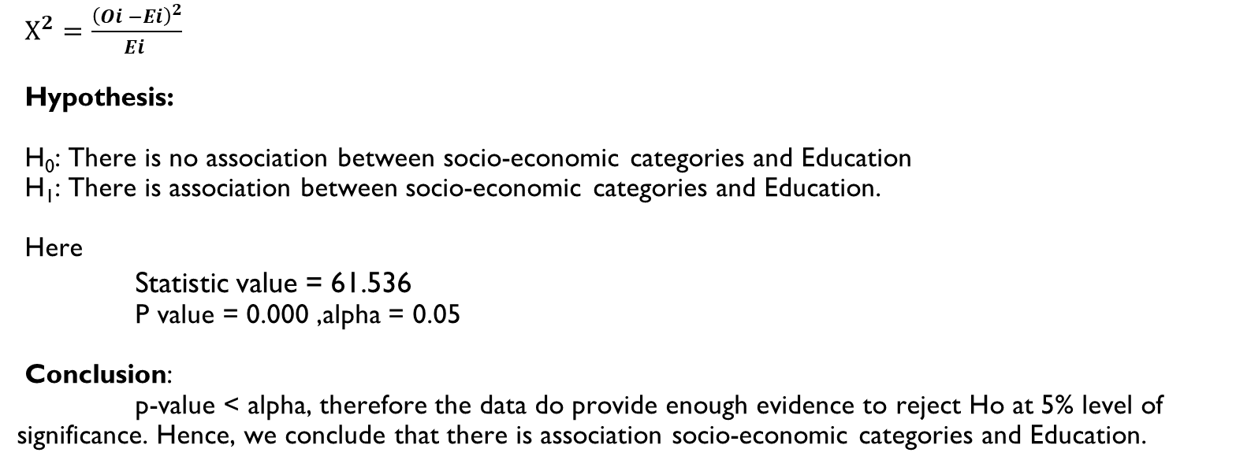
CHI-SQUARE TEST
$Χ^{2}=\frac{{\left(Oi −Ei\right)}^{2}}{Ei }$
Hypothesis:
H₀: There is no association between socio-economic categories and Education
H₁: There is association between socio-economic categories and Education.
Here
Statistic value = 61.536
P value = 0.000 ,alpha = 0.05
Conclusion:
p-value < alpha, therefore the data do provide enough evidence to reject Ho at 5% level of significance. Hence, we conclude that there is association socio-economic categories and Education.

Slide 28
Chi-square test
variable | Null Hypothesis | Statistic value | P-value | Conclusion | Association
Age & SES | There is no association between variables. | 73.789 | 0.239 | Do not reject H0.
Education & SES | There is no association between variables. | 61.536 | 0.0000 | Reject H0. | Positively 85%
Cast and SES | There is no association between variables. | 36.521 | 0.000 | Reject Ho | Negatively 40%
Family type and SES | There is no association between variables. | 10.231 | 0.037 | Reject Ho | Negatively 13%
Ration Card and SES | There is no association between variables. | 30.225 | 0.000 | Reject Ho | Negatively 18%
House type and SES | There is no association between variables. | 42.087 | 0.000 | Reject Ho | Positively 82%
Cultivable land and SES | There is no association between variables. | 4.036 | 0.133 | Do not reject Ho

Slide 29
K MODES CLUSTERING
Step 1: Randomly select K initial center points.
Step 2 : For each data point, calculate the distance between the sample point and k center points, divide the category corresponding to the center point closest to it.
Step 3 : After the clasification, redetermine the center point, and use mode of all feature.
Step 4: Repeat step 2 – 3 until the total distance no longer decreases.

Slide 30
Feature Selection Using forward selection approach
Clustering Variables | K=2 | K=3 | K = 4 | K = 5 | K = 6
Education | 50 | 30 | 20 | 15 | 0
Occupation | 60 | 38 | 22 | 11 | 4
No of people in family | 10 | 1 | 0 | 0 | 0
Religion | 10 | 1 | 0 | 0 | 0
Cast | 78 | 36 | 18 | 5 | 0
Family type | 50 | 17 | 0 | 0 | 0
Ration card | 43 | 10 | 0 | 0 | 0
Type of house | 0 | 74 | 31 | 0 | 0
Material possession | 0 | 53 | 41 | 29 | 19
Land | 0 | 51 | 9 | 4 | 0
Education, Occupation, Family size, Cast, Ration_card, Housetype, Material_possession | 531 | 488 | 480 | 467 | 448

Slide 31
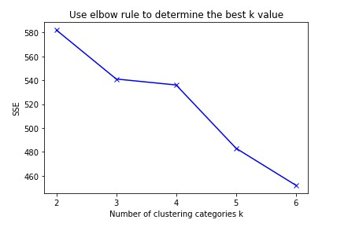
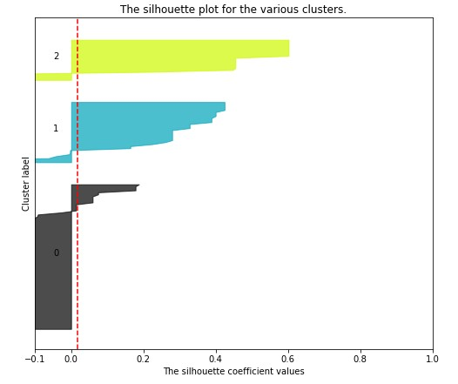
Here, graph indicates that cost (SSE) is minimizing at K = 3.
So, No of cluster = 3
In Silhouette plot, silhouette coefficient has range -1 to +1.
where, -1 = assignment are wrong
0 = distance between cluster is insignificant
+1 = true assignment, clearly distinguish clusters

Slide 32
CORRESPONDENCE ANALYSIS
Test of Independence
OBJECTIVE: To check whether the there is association between (no. of days and no. of farm activities) the two variable.
HYPOTHESIS:
Ho : Assumes that there is no association between the two variable.
H1 : Assumes that there is association between the two variable.
OUTPUT:
Chi-square calculated = 132.97
Chi-square tabulated (or critical) =18.439
CONCLUSION:
Chi-square tabulated (or critical) < Chi-square calculated , so test is significant, and we reject Ho, and conclude that there is association between there is association between No. of days and No. of farm activities.

Slide 33


Now we look into CA step by step:-
Step - 1 : Develop correspondence matrix :-
Step - 2 : Find Row profile
Step - 3 : Find column profile
Step - 4 : Now we find Weighted Chi-square distance Z:-
Z is distance matrix, D(r) and D(c) are diagonal matrices,
P is correspondence matrix, r and c are row and column messes respectively.
Step -5 : Find singular value decomposition:- Z = UdV’
Where,
matrix U are eigenvector of ZZ’ matrix V are eigenvector of Z’Z.
d is called singular values of Z. singular values = (eigenvalues)^(1/2)
Row coordinates (X) :- Column coordinates (Y) :-
$$X={\left( \text{D}\text{( }\text{r}\text{ ) } \right)}^{−\frac{1}{2}} UZ$$
$$Y={\left( \text{D}\text{( }\text{c}\text{ ) } \right)}^{−\frac{1}{2}} V^{′}Z$$

Slide 34
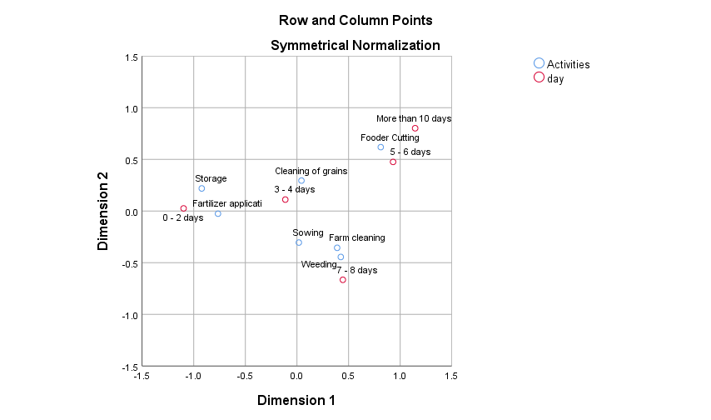
INTERPRETATION :-
Storage and Fertilizer application are mostly done by 0 - 2 days.
Weeding, sowing and farm cleaning are mostly done by 7 - 8 days.
Cleaning of grains is mostly done by 3 - 4 days.
Fodder cutting is mostly done by 5 - 6 days or some time its take more than 10 days.

Slide 35
SUMMARY
Mean Socio-Economic score for farming and non-farming women are not same.
For SHG and Non-SHG groups mean socio-economic score are same.
SES and age are not dependent whereas SES with education of women and house type are positively dependent & SES with cast, family type and ration card are negatively dependent.
Mean drudgery score for Weeding and Farm cleaning activity are same , also it is same for Fertilizer application and cleaning of grains. Except this, for all other combination of activities the drudgery score is different.
Weeding, Farm Cleaning, Sowing, and Fodder cutting are the most drudgery prone farm activities for farming women.

Slide 36
REFERENCES
https://www.researchgate.net/publication/323147882_Impact_of_Drudgery_Reducing_Technologies_among_Farmwomen_of_Gorakhpur_and_Deoria_districts_of_U_P
https://www.researchgate.net/publication/337903792_Drudgery_reduction_for_women_in_agriculture_sector_in_Nepal_An_analytical_study
Research Article AWARENESS AND ADOPTION OF DRUDGERY REDUCING TECHNOLOGIES AMONG FARM WOMEN OF DANTIWADA TALUKA (SUMITRA SUNDHESHA, AHLAWAT SANTOSH AND SINGH SURABHI)
A case study on women reducing drudgery through empowerment in agriculture in Dangs of Gujarat (G.J. BHIMANI AND C.S. DESAI)

Slide 37
THANK-YOU!
Notes:
37
37

