Slide 1

UE18CS202: DATA STRUCTURES
Department of Computer Science and Engineering PES UNIVERSITY

Slide 2
TEXTBOOK
“Data Structures and Program Design in C”,
Robert Kruse, C.L.Tondo, Bruce Leung and Shashi Mogalla,
Second Edition, /PHI, 2015
“Data Structures Using C and C++”, Tanenbaum, Langsam, Augenstein Pearson/Prentice Hall , 2nd Edition, 2015

Slide 3
LECTURE1
Overview of the course
Programming Practices
Naming conventions
Definition of Data Structures
Classification of Data Structures

Slide 4
Course Objective
Enable the learner with the concepts of recursion and linear data structures viz., Linked Lists, Stacks and Queues.
Enable the learner with the concepts of non-linear data structures viz., Graphs, Trees, Heaps, Trie and Hashing.
Hone the learner such that they obtain the ability to compare different implementations of data structures and recognize the advantages and disadvantages of different implementations.
Inculcate in the learner, the aspects of choosing the appropriate data structure and algorithm design method for a specified application and with the usage of standard libraries.

Slide 5
Course Outcome
At the end of the course, the student will be able to:
Implement fundamental data structures viz., Lists, Stacks, Queues, Linked Lists, Binary Trees from first principles
Demonstrate the use of appropriate data structures for a given problem.
Design and implement solutions to basic practical problems using customized data structures.
Develop quick solutions to practical problems using abstract data types.

Slide 6
Course Contents
1. Data Structures Overview: Recursion, Pointers, Programming Practices. Lists: Definition, Create, Insert, Delete, Update, Traverse and Position-based Operations, Linked List and Array Implementations, Concatenate, Merge, and Reverse Lists, Doubly-Linked List Implementation and Operations, Circular Lists and Multi-List, Applications of Lists.
2. Stacks: Definition, Operations, Implementation using Linked-List and Arrays, Applications of Stacks – Postfix Conversion and Expression Evaluation, Parentheses Balancing. Queues: Definition, Operations, Implementation, Applications, Circular Queue, Dequeue.

Slide 7
Course Contents
3. Graphs: Representation of Graphs - Adjacency/ Cost Matrix, Adjacency Lists, and Traversal of Graphs. Trees: General Tree Representation, Traversals, Applications. Binary Trees: Definition, Properties, Implementation, Traversals, Applications.
4. Binary Search Tree: Definition, Implementation, Search, Insert, Delete operations. Building and Evaluating Binary Expression Tree, AVL Tree, Threaded BST. Heap Tree: Implementation, Insert, Delete, FindMin operations. Priority Queue using Arrays and Heap.
5. Tries: Definition, Implementation, Applications. Hashing: Hash Table, Hash Functions, Collision Handling by Open Addressing, Chaining.

Slide 8
Data Structures
“Clever” ways to organize information in order to enable efficient computation
What do we mean by clever?
What do we mean by efficient?
Data Structure is a way of collecting and organizing data in such a way that we can perform operations on these data in an effective way

Slide 9
Why Data Structures?
Data Structure is most fundamental & building block concept in CS
Good knowledge of DS is required to build and develop a good S/W
Efficient organization of data improves time complexity of the algorithms
Example: Dictionary , City Map

Slide 10
Data Structures
Data structure is a class of data that can be characterized by its organization and the operations that are defined on it. Hence
DS = Organized Data + Allowed operations

Slide 11
Data Structure Operations
Traversing: Accessing each record exactly once so that certain terms in the record may be proceeded.
Searching: Finding the location of the record with a given key value.
Inserting: Adding a new record to the structure.
Deleting: Removing a record from the structure.
Sorting: Arranging the records either in ascending or descending order according to some key.
Merging: Combining the records in two different sorted files into a single sorted file.
Copying: Records in one file are copied to another file.

Slide 12
Classification of Data Structures
Simple Data Structure
Compound Data Structure
Linear Data Structure
Non linear Data Structure

Slide 13
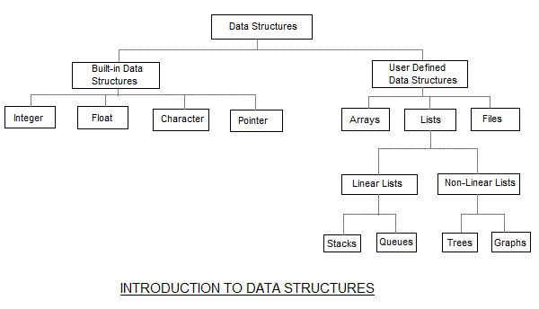
Classification of Data Structures

Slide 14
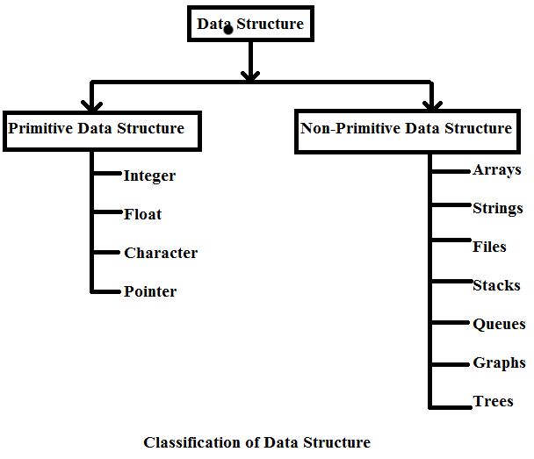
Classification of Data Structures

Slide 15
Classification of Data Structures
Simple Data Structure can be constructed with the help of Primitive Data Structure.
A primitive data structure used to represent the standard data types of any one of the computer languages.
Variables, arrays, pointers, structures, unions, etc. are examples of simple data structures.

Slide 16
Classification of Data Structures
Compound Data Structure
Compound data structure can be constructed with the help of any one of the primitive data structure and it is having a specific functionality. It can be designed by user. It can be classified as
1) Linear Data Structure
2) Non-linear Data Structure

Slide 17
Linear Data Structures
In a linear Data structure elements are accessed in a sequence
Operations applied on linear data structure :
Add an element
Delete an element
Traverse
Sort the list of elements
Search for a data element
Example: Stack, Queue, Tables, List, and Linked Lists.

Slide 18
Non-linear Data Structure
Non-linear data structure can be constructed as a collection of randomly distributed set of data item . In non-linear Data structure the relationship of adjacency is not maintained between the Data items.
Operations applied on non-linear data structures :
1. Add elements
2. Delete elements
3. Display the elements
4. Sort the list of elements
5. Search for a data element
Example: Tree, Decision tree, Graph and Forest

Slide 19
Applications of Data Structures
Array
To represent/implement other data structures in memory
To store files in memory
Linked Lists
To represent/implement other data structures in memory
To manipulate large numbers
To dynamically allocate space in the main memory
To allocate blocks in hard disk

Slide 20
Applications of Data Structures
Stacks
To use recursion
To help you call multiple functions in a program. The called sequence is stored in a stack.
To convert the arithmetic expressions that you write in a program to computer understandable form (Infix
to postfix conversion)
To evaluate a postfix expression
Rearranging railroad cars
To perform undo and redo in a word processor

Slide 21
Applications of Data Structures
Queues
In operating systems, to schedule processes waiting for the CPU
To process objects in a manufacturing line
Handling key presses and mouse events in a keyboard and mouse respectively
A call center takes calls from customers, queues it and distributes calls to agents
Jukeboxes help users to select a song. The songs selected form a queue
Handling of interrupts by the operating system
To store the browsing history

Slide 22
Applications of Data Structures
Trees
Auto complete features (Trie)
For easier substring matching
For metadata indexing in file systems (B+ tree)
To maintain table indices in relational database systems (B+ tree)
Store dictionary in a mobile (Trie)
To check spellings (Trie)

Slide 23
Applications of Data Structures
To construct associative array (Red black trees)
To ensure direct access of data blocks in file systems (B tree)
Used by compilers to check the syntax of a statement in a program (Parse Trees)
Used by operating systems to maintain the structure of a file system

Slide 24
Applications of Data Structures
Heaps
To implement priority queues
To sort numbers using heap sort
Graphs
To fill a MSPaint object with some colour
To find the shortest route from your workplace to home

Slide 25
Applications of Data Structures
Graphs
To decide the amount of cable while setting a computer lab
Connections and relations in social networking sites
Spread of viruses
Electrical power grids
Citation of journals

