Slide 1

UE18CS202: data structures Department of Computer Science and Engineering PES UNIVERSITY

Slide 2
Recursion
The function definition involving a call to the same function
Solving a problem using recursion depends on solving smaller (simpler) occurrences of the same problem until the problem is simple enough that you can solve it directly
Key question: "How is this problem self-similar?“
what are the smaller subproblems that make up the bigger problem?
Occurs in many places in code and in real world:
– Looking up a word in dictionary may involve looking up other words
– Nested structures (trees, file folders, collections) can be self-similar.
– Patterns can contain smaller versions of the same pattern (fractals)

Slide 3
Recursive Programming
Writing functions that call themselves to solve problems that are recursive in nature.
– An equally powerful substitute for iteration (loops)
– Particularly well-suited to solving certain types of problems
– Leads to elegant, simplistic, short code (when used well)

Slide 4
Every recursive algorithm involves at least 2 cases:
– base case: A simple occurrence that can be answered
– recursive case: A more complex occurrence of the problem that
cannot be directly answered, but can instead be described in terms of
smaller occurrences of the same problem

Slide 5
Three Rules of Recursion
Every (valid) input must have a case (either recursive or base)
• There must be a base case that makes no recursive calls
(i.e. on some input(s), the code should not make any
recursive calls)
The recursive case must make the problem simpler and make forward progress to the base case

Slide 6
Recursive Program Structure
recursiveFunc() {
if (test for simple case) { // base case
Compute the solution without recursion
} else { // recursive case
Break the problem into subproblems of the same form
Call recursiveFunc() on each self-similar subproblem
Reassamble the results of the subproblems
}
}

Slide 7
Examples
// Returns n!, or 1 * 2 * 3 * 4 * ... * n.
// Assumes n >= 1.
int factorial(int n) {
int total = 1;
for (int i = 1; i <= n; i++) {
total *= i;
}
return total;
}
Important observations:
0! = 1! = 1
4! = 4 * 3 * 2 * 1
5! = 5 * 4 * 3 * 2 * 1
= 5 * 4!

Slide 8
Recursive Solution
// Returns n!, or 1 * 2 * 3 * 4 * ... * n.
// Assumes n >= 0.
int factorial(int n) {
if (n <= 1) { // base case
return 1;
} else {
return n * factorial(n - 1); // recursive case
}
}

Slide 9
Recursive stack Trace

Slide 10
Multiple calls tracing
int mystery(int n) {
if (n < 10) {
return (10 * n) + n;
} else {
int a = mystery(n / 10);
int b = mystery(n % 10);
return (100 * a) + b;
}
}

Slide 12
Direct and Indirect Recursion
What is the difference between direct and indirect recursion? A function fun is called direct recursive if it calls the same function fun. A function fun is called indirect recursive if it calls another function say fun_new and fun_new calls fun directly or indirectly
// An example of direct recursion
void directRecFun()
{
// Some code....
directRecFun();
// Some code...
}

Slide 13
Indirect Recursion
// An example of indirect recursion
void indirectRecFun1()
{ // Some code...
indirectRecFun2();
// Some code...
}
void indirectRecFun2()
{ // Some code...
indirectRecFun1();
// Some code...
}

Slide 14
Tailed and Non Tailed Recursion
What is difference between tailed and non-tailed recursion? A recursive function is tail recursive when recursive call is the last thing executed by the function.
How memory is allocated to different function calls in recursion? When any function is called from main(), the memory is allocated to it on the stack. A recursive function calls itself, the memory for a called function is allocated on top of memory allocated to calling function and different copy of local variables is created for each function call. When the base case is reached, the function returns its value to the function by whom it is called and memory is de-allocated and the process continues.

Slide 15
Tailed Recursion
// An example of tail recursive function
void print(int n)
{
if (n < 0) return;
cout << " " << n;
// The last executed statement is recursive call
print(n-1);
}

Slide 16
Why Stack Overflow error occurs in recursion?
If the base case is not reached or not defined, then the stack overflow problem may arise. Let us take an example to understand this.
int fact(int n)
{ // wrong base case (it may cause
// stack overflow).
if (n == 100)
return 1;
else
return n*fact(n-1);
}

Slide 17
Stack Frame
The stack frame generally includes the following components:
The return address
Argument variables passed on the stack
Local variables (in HLLs)
Saved copies of any registers modified by the subprogram that need to be restored

Slide 18
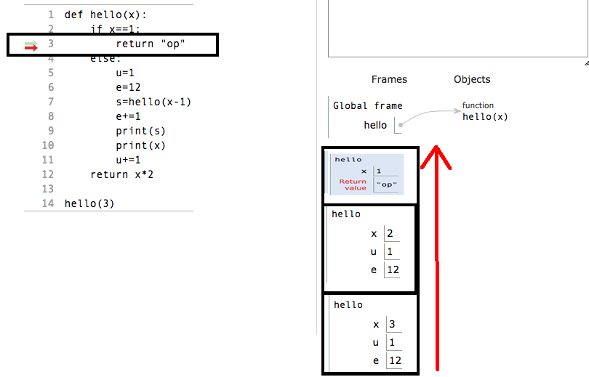
Recursion and stack frame(Allocation)

Slide 19
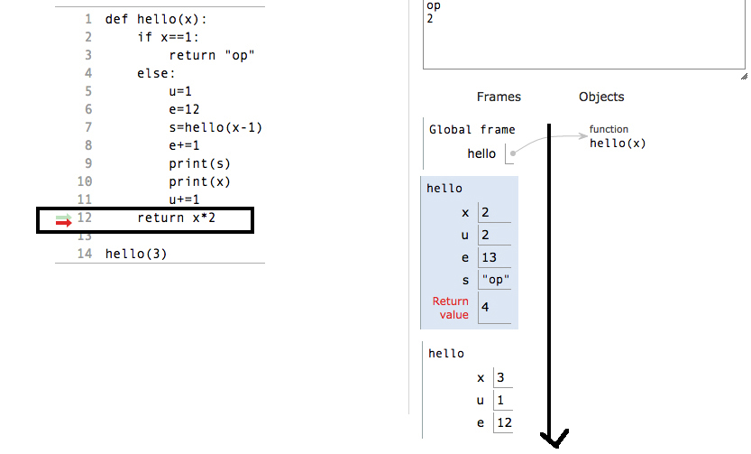
Recursion and stack frame(Deallocation)

