Slide 1

SpaceX Falcon 9 First Stage Landing Prediction
Forecasting rocket landings for reusable
spaceflight
Notes:
AI-generated content may be incorrect. ---

Slide 2
Executive Summary
Notes:
Project Highlights

Slide 3

Project Highlights
Landing Prediction Purpose
The project predicts Falcon 9 first stage landing success to optimize costs and improve aerospace planning.
Machine Learning Model
Logistic Regression model achieved a high R² score of 0.94 after tuning for accurate landing forecasts.
Deployment and Accessibility
The solution was deployed as an interactive web app on Streamlit Cloud for easy user access.
Strategic Impact
Predictive insights help competitors estimate launch costs and plan missions more effectively.
Notes:
The SpaceX Falcon 9 First Stage Landing Prediction project aims to forecast whether the first stage of the Falcon 9 rocket will successfully land, which is critical for cost optimization and strategic planning in the aerospace industry. The project leverages machine learning models to predict landing success based on mission parameters. Logistic Regression emerged as the best-performing model, achieving an R² score of 0.94 after hyperparameter tuning. The solution was deployed as an interactive web application using Streamlit, hosted on Streamlit Cloud for accessibility. This predictive capability provides actionable insights for competitors like SpaceY, enabling them to estimate launch costs and plan missions effectively. The executive summary encapsulates the project's objectives, methodology, and deployment strategy, emphasizing its role in reducing costs and enhancing decision-making in space missions.

Slide 4
Project Overview
Notes:
Cost Advantage and Strategic Importance

Slide 5

Cost Advantage and Strategic Importance
Launch Cost Reduction
Reusable rocket stages reduce launch costs dramatically, making space missions more affordable and viable.
Economic Impact of Reusability
Recovering and reusing rocket parts accounts for 50-60% cost savings in total rocket expenses.
Predictive Analytics Role
Predicting landing success is crucial for cost estimation and strategic decision-making in aerospace missions.
Competitive Strategy
Accurate predictions enable companies to benchmark, optimize planning, and allocate resources effectively.
Notes:
SpaceX has revolutionized the space industry by significantly reducing launch costs. A Falcon 9 launch costs approximately $62 million, compared to competitors charging upwards of $165 million. This cost advantage is primarily due to the reusability of the first stage, which accounts for 50–60% of the total rocket cost. By successfully landing and reusing the first stage, SpaceX achieves substantial savings, making space missions more economically viable. The project focuses on predicting the success of these landings, which is essential for cost estimation and competitive strategy. Accurate predictions allow companies like SpaceY to benchmark against SpaceX, optimize mission planning, and allocate resources efficiently. This overview highlights the economic impact of reusability and the strategic importance of predictive analytics in the aerospace sector.

Slide 6
Business Problem & Objective
Notes:
Challenges and Goals

Slide 7
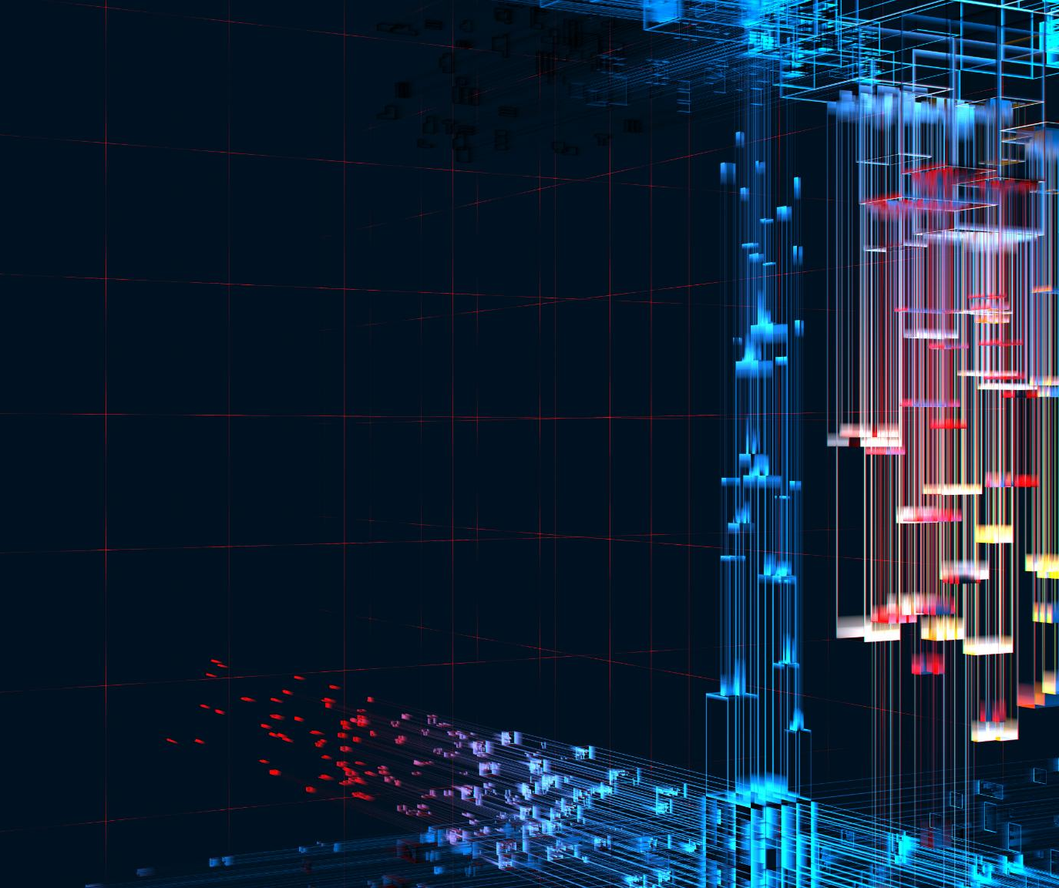
Challenges and Goals
Rocket Reusability Impact
Reusing the first rocket stage reduces costs and increases mission frequency in the space industry.
Complexity of Prediction
Landing success prediction depends on parameters like orbit type, payload mass, and launch conditions.
Business Problem and Objective
Accurate predictions optimize launch costs and mission planning to reduce financial risks.
Strategic Benefits
Predictive modeling supports informed decisions and enhances operational efficiency in space missions.
Notes:
The ability to reuse the first stage of a rocket is a game-changer in the space industry, drastically reducing costs and increasing mission frequency. However, predicting whether the first stage will successfully land is complex, involving multiple mission parameters such as orbit type, payload mass, and launch conditions. The business problem centers on the need for accurate predictions to estimate launch costs and optimize mission planning. The primary objective of this project is to build a predictive model that determines landing success based on these parameters. By achieving this goal, stakeholders can make informed decisions, minimize financial risks, and enhance operational efficiency. This section underscores the critical role of predictive modeling in addressing industry challenges and supporting strategic objectives.

Slide 8
Methodology
Notes:
Data Collection and Modeling Approach

Slide 9

Data Collection and Modeling Approach
Data Collection and Storage
Data was gathered from APIs and web scraping, then stored efficiently in a structured SQLite database.
Data Wrangling and Feature Engineering
Data cleaning fixed types, removed irrelevant info, and created a target 'Class' column for success classification.
Exploratory Data Analysis (EDA)
Visualization of trends and launch locations was performed using Seaborn, Matplotlib, and Folium tools.
Model Development and Deployment
Multiple algorithms were tested; Logistic Regression tuned with GridSearchCV was deployed via a Streamlit web app.
Notes:
The methodology adopted for this project involves several key steps. Data was sourced from the SpaceX API and Wikipedia launch records, scraped using BeautifulSoup, and stored in an SQLite database for efficient querying. Data wrangling included removing irrelevant columns, correcting data types, and handling missing values. Feature engineering introduced a 'Class' column to represent landing success (1) or failure (0). Exploratory Data Analysis (EDA) was conducted using Seaborn, Matplotlib, and Folium to visualize trends and geographic launch patterns. Model development tested multiple algorithms, including Logistic Regression, SVC, Decision Tree, and KNN. Logistic Regression was selected as the best model after hyperparameter tuning with GridSearchCV, achieving an R² score of 0.94. The final model was deployed using Streamlit, enabling real-time predictions through an interactive web application hosted on Streamlit Cloud.

Slide 10
EDA Insights
Notes:
Key Observations from Data Analysis

Slide 11
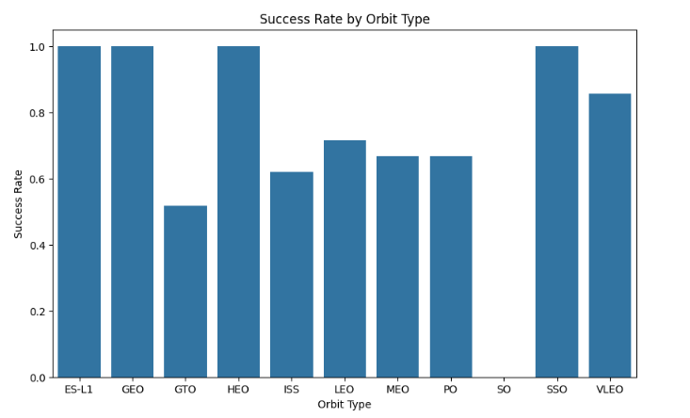
Key Observations from Data Analysis
Orbit | Success Rate (%)
ES-L1 | 100
GEO | 100
HEO | 100
SSO | 100
Notes:
Exploratory Data Analysis revealed several critical insights into factors influencing landing success. Orbits such as ES-L1, GEO, HEO, and SSO exhibited the highest success rates, indicating that orbit type plays a significant role in landing outcomes. The maximum payload carried by Falcon 9 was recorded at 3726 kg, suggesting that payload mass is another influential factor. Additionally, NASA emerged as a major client, accounting for 32 launches, highlighting the importance of institutional partnerships in mission planning. Visualizations created using Seaborn and Matplotlib illustrated these trends, while Folium maps provided a geographic perspective on launch sites and landing results, with green markers representing successful landings and red markers indicating failures. These insights informed feature selection and model development, ensuring that the predictive model captures the most relevant variables.

Slide 12
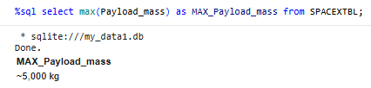
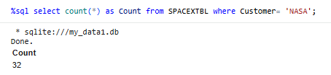
Key Observations from DataAnalysis
Maximum payload carried by Falcon 9: 5000 kg
NASA is a major client with 32 launches

Slide 13
Model Development
Notes:
Algorithm Selection and Performance

Slide 14

Algorithm Selection and Performance
Algorithm Testing
Several algorithms including Logistic Regression, SVC, DecisionTreeClassifier AND KNeighborsClassifier were evaluated for model development and classification performance.
Logistic Regression Selection
Logistic Regression was selected for its high accuracy, interpretability, and strong predictive capability.
Hyperparameter Tuning
GridSearchCV optimized parameters such as C, penalty, and solver to improve model performance.
Model Validation and Deployment
The tuned model achieved an R² score of 0.94 through cross-validation, ideal for real-time applications.
Notes:
Model development involved testing multiple classification algorithms, including Logistic Regression, Support Vector Classifier (SVC), Decision Tree, and K-Nearest Neighbors (KNN). After rigorous evaluation, Logistic Regression was chosen as the best-performing model due to its high accuracy and interpretability. Hyperparameter tuning was conducted using GridSearchCV, optimizing parameters such as C = 0.01, penalty = 'l2', and solver = 'lbfgs'. The tuned model achieved an impressive R² score of 0.94, validated through 5-fold cross-validation. This performance indicates strong predictive capability and robustness, making Logistic Regression ideal for deployment. The model's simplicity and efficiency further enhance its suitability for real-time applications, ensuring reliable predictions for mission planning and cost estimation.

Slide 15
Model Comparison
Notes:
Evaluation of Tested Models

Slide 16
Evaluation of Tested Models
Model | Accuracy
Logistic Regression | 94%
SVC | 88%
Decision Tree | 88%
KNN | 93%
Notes:
Several models were evaluated to identify the most effective approach for predicting landing success. Logistic Regression outperformed SVC, Decision Tree, and KNN in terms of accuracy and consistency. While SVC and Decision Tree provided moderate performance, they lacked the interpretability and efficiency offered by Logistic Regression. KNN showed lower accuracy, making it unsuitable for this application. Evaluation metrics included accuracy scores, confusion matrices, and cross-validation results. The comparison underscores the importance of selecting a model that balances predictive power with operational simplicity, ensuring reliable and actionable insights for stakeholders.

Slide 17
Deployment
Notes:
Interactive Application and Hosting

Slide 18

Interactive Application and Hosting
Interactive Web Application
Streamlit was used to build an interactive app offering real-time mission prediction based on input parameters.
Model Serialization and Storage
The predictive model was serialized with joblib into a .pkl file for efficient loading and use within the app.
Code Management and Collaboration
Application code was managed in GitHub to ensure version control and facilitate team collaboration.
Cloud Hosting Deployment
Streamlit Cloud hosted the app, providing easy access for stakeholders and seamless deployment.
Notes:
The final model was deployed as an interactive web application using Streamlit, providing users with real-time predictions based on mission parameters. The model was serialized using joblib and stored as a .pkl file for efficient loading. The application code was maintained in a GitHub repository, ensuring version control and collaboration. Hosting was implemented on Streamlit Cloud, enabling easy access for stakeholders and decision-makers. This deployment strategy ensures that predictive insights are readily available, supporting mission planning and cost estimation in a user-friendly format.

Slide 19
Key Findings
Notes:
Insights Driving Strategic Decisions

Slide 20

Insights Driving Strategic Decisions
Key Factors for Landing Success
Orbit type and payload mass are critical factors influencing successful spacecraft landings.
Predictive Model Performance
Logistic Regression shows strong predictive accuracy, suitable for operational use in mission planning.
Institutional Partnerships
NASA’s role as a primary client highlights strategic partnerships that support frequent launches and revenue.
Optimizing Mission Planning
Insights guide stakeholders to reduce costs and boost competitiveness in the evolving space industry.
Notes:
The analysis yielded several key findings that inform strategic decision-making. Orbit type and payload mass emerged as the most significant factors influencing landing success, guiding mission design and resource allocation. Logistic Regression demonstrated exceptional predictive performance, validating its suitability for operational deployment. Additionally, NASA's dominance as a client underscores the importance of institutional partnerships in sustaining launch frequency and revenue streams. These insights enable stakeholders to optimize mission planning, reduce costs, and enhance competitiveness in the rapidly evolving space industry.

Slide 21
Conclusion & Future Scope
Notes:
Summary and Next Steps

Slide 22

Summary and Next Steps
Project Achievement
Developed a predictive model with 0.94 R² score using Logistic Regression for Falcon 9 landing success.
Strategic Impact
Model insights aid cost estimation and mission planning, enhancing the advantage of reusability in space missions.
Future Enhancements
Plans include adding weather features, advanced algorithms, and real-time data for improved predictions.
Notes:
The project successfully developed and deployed a predictive model for Falcon 9 first stage landing success, achieving an R² score of 0.94 with Logistic Regression. This capability provides valuable insights for cost estimation and mission planning, reinforcing the strategic advantage of reusability in space missions. Future enhancements include incorporating additional features such as weather data, exploring advanced algorithms like XGBoost and neural networks, and integrating real-time mission data for dynamic predictions. These improvements will further refine predictive accuracy and operational utility, ensuring continued innovation and competitiveness in the aerospace sector.

Slide 23
Appendix
Notes:
Technical Details and Tools

Slide 24

Technical Details and Tools
Tech Stack Overview
The project used Python and key libraries like Pandas, NumPy, and BeautifulSoup for data processing and modeling.
Application Development
Streamlit facilitated app creation with hosting on Streamlit Cloud for user accessibility.
Collaboration Tools
Google Colab and GitHub enabled collaborative coding, version control, and project deployment.
Model Evaluation Metrics
Metrics like R² score, accuracy, confusion matrix, and cross-validation ensured thorough model assessment.
Notes:
The project utilized a comprehensive tech stack to ensure robust data processing and model development. Languages and libraries included Python, Pandas, NumPy, BeautifulSoup, Matplotlib, Seaborn, Folium, and Scikit-learn. Streamlit was employed for application development, with hosting on Streamlit Cloud for accessibility. Tools such as Google Colab and GitHub facilitated coding, collaboration, and deployment. Evaluation metrics comprised R² score, accuracy, confusion matrix, and cross-validation, ensuring rigorous model assessment. This appendix provides a detailed overview of the technical components underpinning the project's success.

