Slide 1
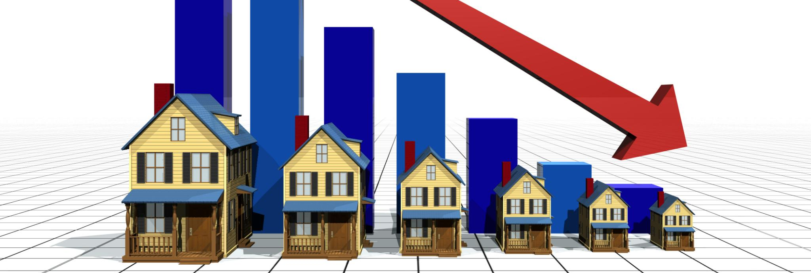
USA House Price Prediction Project
Forecasting trends in American real estate market
Notes:
AI-generated content may be incorrect. ---

Slide 2
Executive Summary
Notes:
Project Overview and Performance

Slide 3

Project Overview and Performance
Project Objective
Predict house prices in the USA using machine learning to aid Real Estate Investment Trust decisions.
Model Development
RandomForestRegressor was chosen after testing multiple regression models for best predictive accuracy.
Hyperparameter Tuning
GridSearchCV optimized model parameters to max_depth 30 and n_estimators 300 for improved performance.
Deployment
Model deployed as interactive web app using Streamlit for real-time house price predictions.
Notes:
This project aims to predict house prices in the USA using machine learning techniques to support investment decisions by a Real Estate Investment Trust. The dataset spans from May 2014 to May 2015 and includes various features of residential properties. The approach involved data wrangling, exploratory data analysis (EDA), model development, and deployment. Multiple regression models were tested, and RandomForestRegressor was selected as the best-performing model. Hyperparameter tuning using GridSearchCV identified optimal parameters: max_depth = 30 and n_estimators = 300. The final model achieved an R² score of 0.78, indicating strong predictive performance. The model was deployed as an interactive web application using Streamlit, allowing users to input house features and receive price predictions.

Slide 4
Introduction
Notes:
Business Problem and Project Goal

Slide 5

Business Problem and Project Goal
Business Problem Overview
The project addresses the need for precise house price predictions to aid real estate investment decisions.
Project Goal
Aim to determine market house prices based on features to improve financial planning and investment.
Methodology
Utilize historical sales data and machine learning models to identify key factors influencing house prices.
Notes:
The business problem addressed in this project is the need for accurate house price predictions to guide investment decisions for a Real Estate Investment Trust focusing on residential properties. The goal is to determine the market price of a house based on its features, enabling better financial planning and strategic investments. By analyzing historical house sales data and applying machine learning models, the project seeks to uncover key factors influencing house prices and provide a reliable prediction tool.

Slide 6
Methodology
Notes:
Data Processing and Modeling Approach

Slide 7
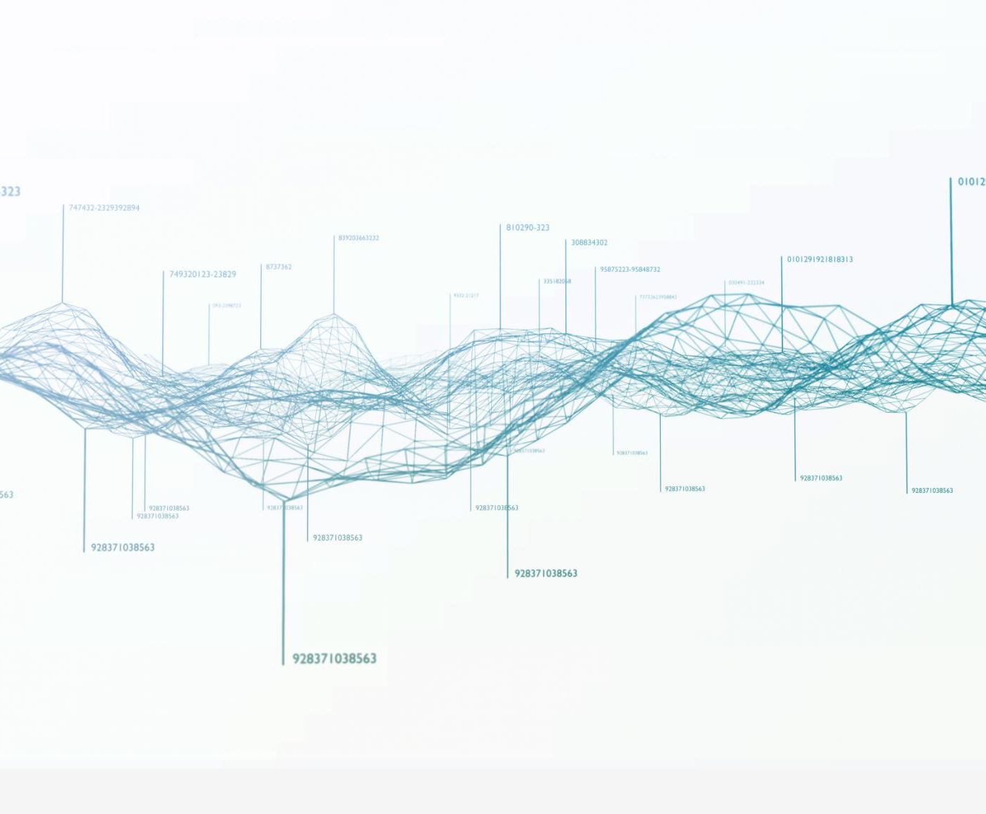
Data Processing and Modeling Approach
Data Cleaning and Wrangling
Irrelevant columns were dropped, missing values replaced with column means, and data types corrected for accuracy.
Exploratory Data Analysis
EDA was performed using Pandas, Seaborn, and Matplotlib to visualize feature distributions and correlations.
Regression Model Development
Multiple regression models including Linear, Ridge, Lasso, Decision Tree, Random Forest, and XGBoost were developed.
Model Optimization and Selection
GridSearchCV was used for hyperparameter tuning, and RandomForestRegressor was selected for its robustness and high R² score.
Notes:
The methodology involved several key steps. First, data wrangling was performed by dropping irrelevant columns such as 'Unnamed: 0' and 'id', handling missing values by replacing them with column means, and correcting data types. Exploratory Data Analysis (EDA) was conducted using Pandas and visualization libraries like Seaborn and Matplotlib to understand feature distributions and correlations. Multiple regression models were developed using Scikit-learn, including Linear Regression, Ridge, Lasso, Decision Tree, Random Forest, and XGBoost. Hyperparameter tuning was performed using GridSearchCV to optimize model performance. The RandomForestRegressor model was selected based on its superior R² score and robustness.

Slide 8
EDA Insights
Notes:
Key Features Influencing House Prices

Slide 9

Key Features Influencing House Prices
Influential Features
Square footage and overall grade are the most influential factors affecting house prices.
Waterfront Premium
Homes with waterfront views are significantly more expensive than others without such views.
Condition Impact
Condition of the house has less impact on price than initially expected.
Additional Square Footage
Extra square footage excluding basement positively correlates with higher house prices.
Notes:
Exploratory Data Analysis revealed several important insights. The square footage of the home and the overall grade assigned to the housing unit were found to be the most influential features affecting house prices. Homes with a view of a waterfront were significantly more expensive than others. Interestingly, the condition of the house did not impact the price as much as expected. Additional square footage, excluding the basement, also positively correlated with higher prices. These findings were supported by correlation analysis and visualizations such as heatmaps and bar plots.

Slide 10
Model Development
Notes:
Selected Model and Hyperparameter Tuning

Slide 11
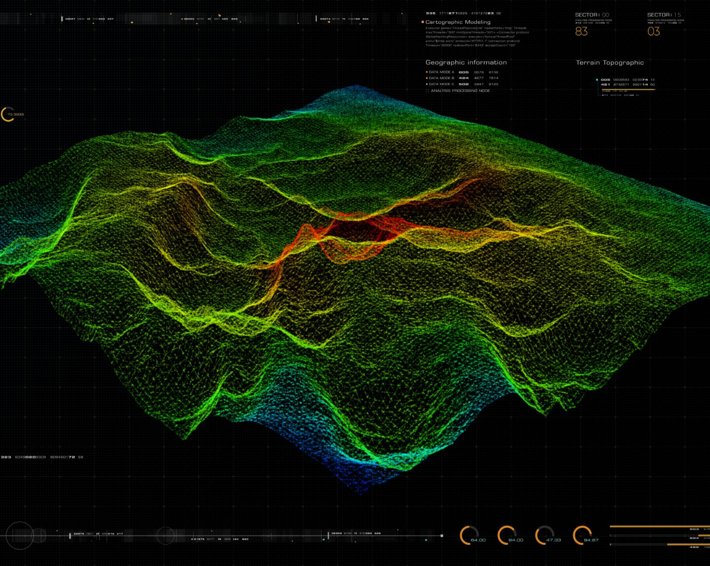
Selected Model and Hyperparameter Tuning
Model Selection
RandomForestRegressor was chosen due to its superior performance on the regression task.
Hyperparameter Tuning
GridSearchCV identified optimal parameters: max_depth 30 and n_estimators 300 for best accuracy.
Model Performance
Tuned model achieved R² score of 0.78, demonstrating improved prediction accuracy and robustness.
Training and Testing Split
Model trained on 80% of data and tested on 20%, ensuring reliable evaluation of predictions.
Notes:
After evaluating multiple regression models, RandomForestRegressor was selected for its superior performance. Hyperparameter tuning was conducted using GridSearchCV, which identified the best parameters as max_depth = 30 and n_estimators = 300. These settings significantly improved the model's accuracy, resulting in an R² score of 0.78. The model was trained using 80% of the data and tested on the remaining 20%, with performance metrics calculated using mean_squared_error and r2_score. The model's robustness and ability to handle non-linear relationships made it the ideal choice for this prediction task.

Slide 12
Model Comparison
Notes:
Performance of Regression Models

Slide 13
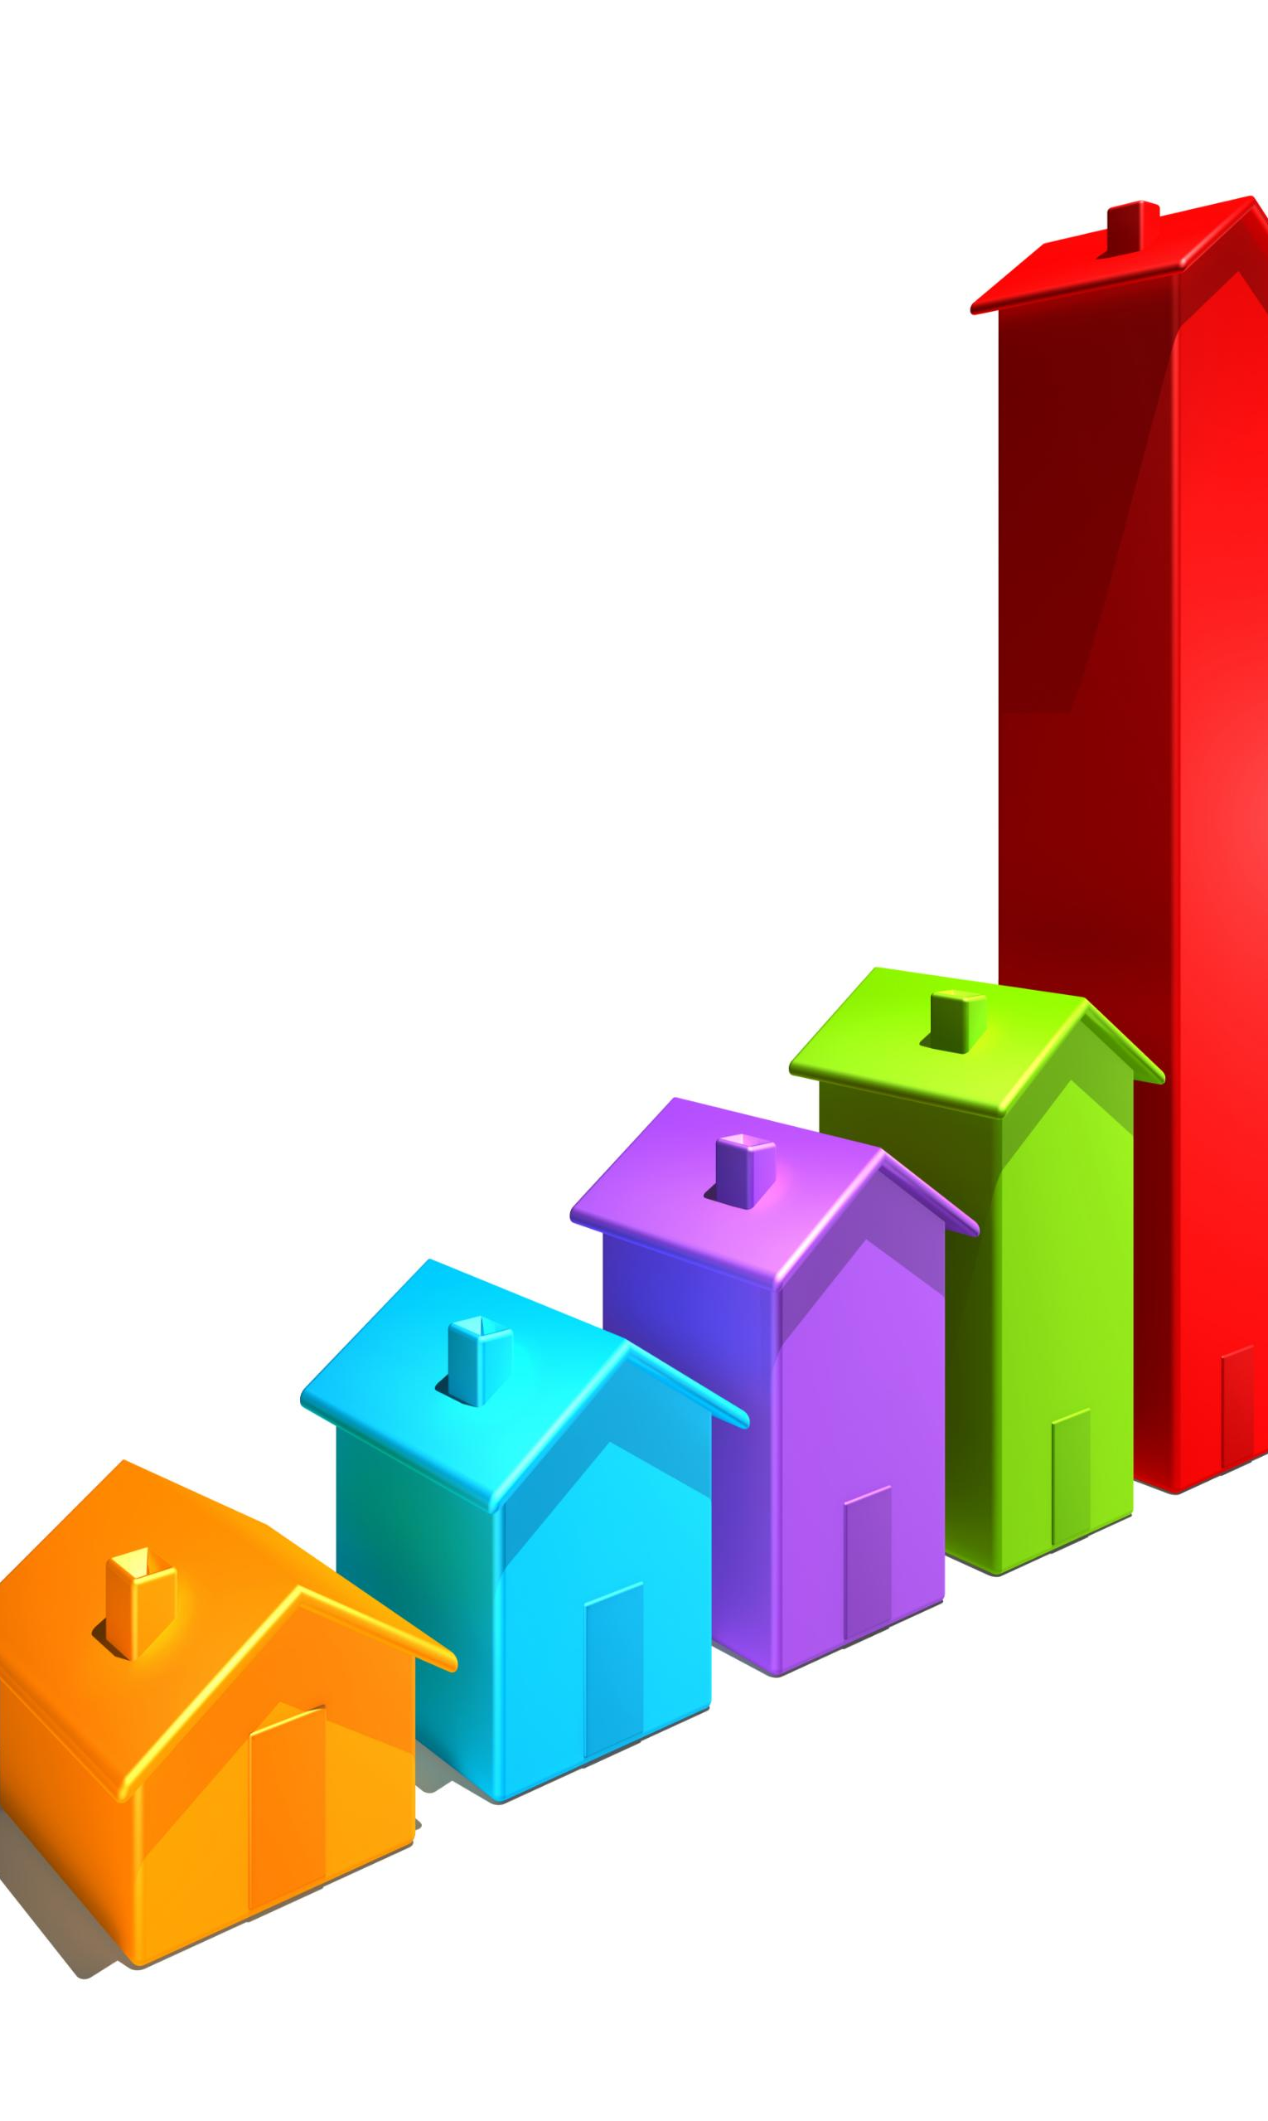
Performance of Regression Models
Baseline Regression Models
Linear, Ridge, and Lasso regression models provided baseline predictive performance for house prices.
Improved Model Performance
Decision Tree and XGBoost models showed moderate improvements over baseline regression models.
Top Performing Model
Random Forest achieved the highest R² score of 0.78, outperforming all other tested models.
Model Selection Importance
Selecting and tuning the right model is crucial for accurate house price prediction.
Notes:
Several regression models were tested to identify the best approach for predicting house prices. Linear Regression, Ridge, Lasso, Decision Tree, Random Forest, and XGBoost were evaluated using R² scores. While Linear, Ridge, and Lasso provided baseline performance, Decision Tree and XGBoost showed moderate improvements. RandomForestRegressor outperformed all others with an R² score of 0.78. This comparison highlights the importance of model selection and tuning in achieving accurate predictions. A summary table of model performance was created to visualize the differences and support the final model choice.

Slide 14
Deployment
Notes:
Web Application and Hosting

Slide 15

Web Application and Hosting
Interactive Web Application
The model was deployed as a Streamlit web app allowing users to input data and get real-time predictions.
Model Storage and Access
The machine learning model is stored on Google Drive and accessed using Python libraries like requests and joblib.
Code Management and Hosting
Application code is maintained in GitHub and hosted publicly on Streamlit Cloud for accessibility and collaboration.
Stakeholder Accessibility
Hosting ensures stakeholders can easily access the app to make informed investment decisions using model outputs.
Notes:
The final model was deployed as an interactive web application using Streamlit. The app allows users to input house features and receive real-time price predictions. The model was stored in Google Drive and accessed using Python libraries such as requests and joblib. The application code was maintained in a GitHub repository, and the app was hosted on Streamlit Cloud for public access. This deployment ensures accessibility and usability for stakeholders, enabling them to make informed investment decisions based on model predictions.

Slide 16
Key Findings
Notes:
Insights for Real Estate Investment

Slide 17

Insights for Real Estate Investment
Key Price Predictors
Square footage and housing grade are the strongest factors influencing property prices for investors.
Impact of Waterfront Views
Properties with waterfront views command higher values, significantly boosting investment potential.
Minimal Effect of House Condition
Surprisingly, the house's condition has little impact on price according to the investment model.
Model for Investment Decisions
The analytical model aids investors in estimating prices and identifying valuable real estate opportunities.
Notes:
The analysis provided several key findings that can guide real estate investment decisions. Square footage and housing grade are the most significant predictors of price. Waterfront views add substantial value to properties. The condition of the house, contrary to expectations, has minimal impact on price. These insights help investors focus on the most valuable features when evaluating properties. The deployed model serves as a practical tool for estimating house prices and identifying high-value investments.

Slide 18
Conclusion
Notes:
Project Summary and Future Scope

Slide 19

Project Summary and Future Scope
Model Development and Performance
A RandomForestRegressor model was developed with an R² score of 0.78, offering reliable house price predictions.
Insights for Investment
Exploratory data analysis and model evaluation provided insights to support strategic investment decisions in housing market.
Future Enhancements
Future scope includes adding features, exploring advanced models like deep learning, and integrating real-time dynamic data.
Notes:
The project successfully developed and deployed a RandomForestRegressor model to predict house prices in the USA. With an R² score of 0.78, the model provides reliable predictions based on key house features. The insights gained from EDA and model evaluation support strategic investment decisions. Future improvements could include incorporating additional features, testing advanced models like deep learning, and integrating real-time data for dynamic predictions. The project demonstrates the power of data science in solving real-world business problems.

Slide 20
Appendix
Notes:
Technical Details and Tools Used

Slide 21
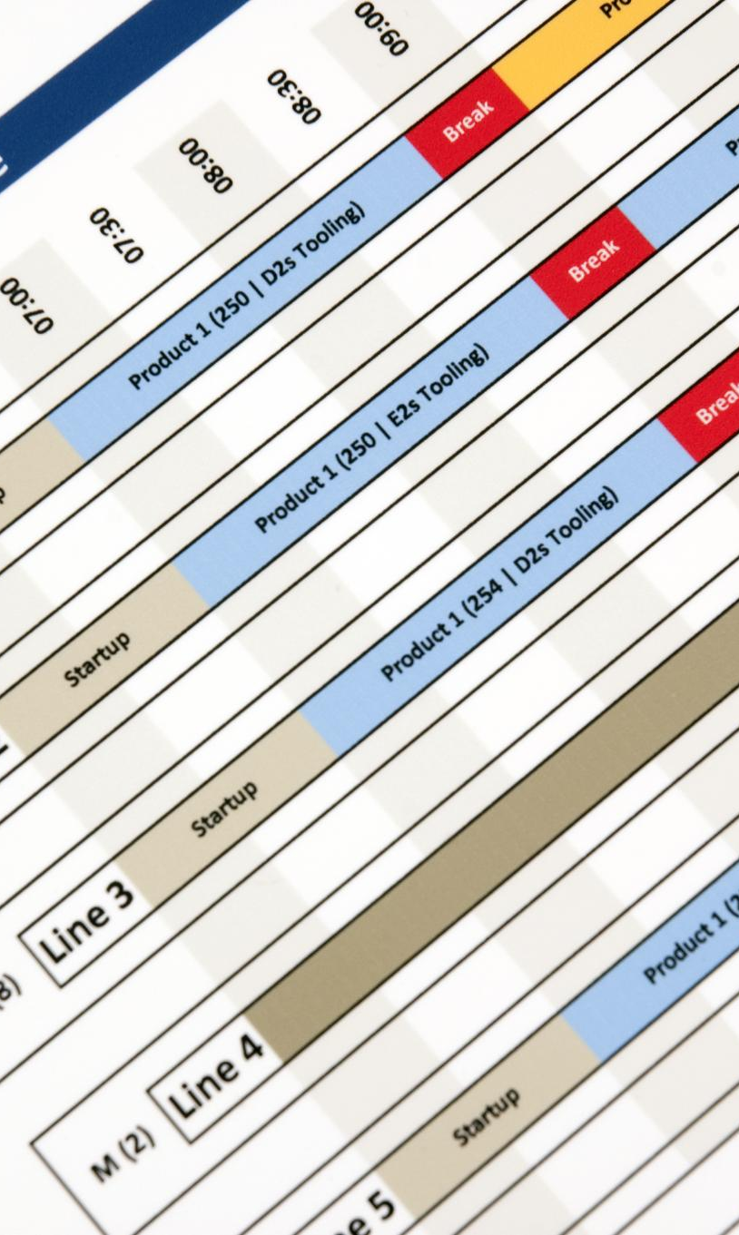
Technical Details and Tools Used
Dataset Overview
House sales data from USA between May 2014 and May 2015 includes features like square footage and waterfront view.
Data Preprocessing Steps
Data preprocessing involved managing missing values, encoding categories, and normalizing numerical features.
Machine Learning Models
Applied models include Linear Regression, Ridge, Lasso, Decision Tree, Random Forest, and XGBoost for prediction.
Tools and Evaluation Metrics
Used Python libraries, visualization tools, and evaluation metrics such as R² score and mean squared error.
Notes:
The dataset used in this project covers house sales in the USA from May 2014 to May 2015. Key features include square footage, grade, condition, and waterfront view. Data preprocessing involved handling missing values, encoding categorical variables, and normalizing numerical data. Models applied include Linear Regression, Ridge, Lasso, Decision Tree, Random Forest, and XGBoost. Evaluation metrics used were R² score and mean squared error. Tools and libraries used include Python, Pandas, NumPy, Scikit-learn, Seaborn, Matplotlib, Streamlit, Google Drive, and GitHub. The project highlights the importance of thorough analysis and model tuning in achieving accurate predictions.

