Slide 1

TOUR PACKAGE PREDICTION

Slide 2
PROBLEM STATEMENT:
Tourism is one of the most rapidly growing global industries and tourism forecasting is becoming an increasingly important activity in planning and managing the industry.
Because of high fluctuations of tourism demand, accurate predictions of purchase of travel packages are of high importance for tourism organizations.
The goal is to predict whether the customer will purchase the travel or not.
Approach:
The classical machine learning tasks like Data Exploration, Data Cleaning,
Feature Engineering, Model Building and Model Testing. Try out different machine learning algorithms that’s best fit for the above case.
We need to analyze the customers' data and information to provide recommendations to the Policy Maker and Marketing Team and also build a model to predict the potential customer who is going to purchase the travel package.

Slide 3
ARCHITECTURE
Data collection and Insertion
Understanding Of Data
Data pre-processing
Data Visualization
Performance Tabulation
Model Building
Outlier Treatment
Outlier Detection
Handling of imbalanced data
Standardizing of Data
Rebuilding of Model
Performance Tabulation
Model Saving
Selecting Best Model
Performance Tabulation
Tuning of model
Cloud deployment
Data insertion for prediction
Prediction

Slide 4
DATA COLLECTION AND INSERTION
Data collection and insertion in machine learning (ML) are critical steps in building and training machine learning models. These steps involve gathering, preparing, and integrating data for use in ML applications.
Data collected from
https://www.kaggle.com/datasets/sanamps/tourpackageprediction
Data read from .csv file
"C:\Users\Akash\OneDrive\Desktop\ML-Proj\travel\travel\Travel-Package-Purchase-Project-using-CICD-Pipeline-main\data\tour_package.csv"

Slide 5
CustomerID: Unique customer ID
ProdTaken: Whether the customer has purchased a package or not (0: No, 1: Yes)
Age: Age of customer
TypeofContact: How customer was contacted (Company Invited or Self Inquiry)
CityTier: City tier depends on the development of a city, population, facilities, and living standards. The categories are ordered i.e. Tier 1 > Tier 2 > Tier 3
Occupation: Occupation of customer
Gender: Gender of customer
NumberOfPersonVisiting: Total number of persons planning to take the trip with the customer
PreferredPropertyStar: Preferred hotel property rating by customer
MaritalStatus: Marital status of customer
NumberOfTrips: Average number of trips in a year by customer
Passport: The customer has a passport or not (0: No, 1: Yes)
OwnCar: Whether the customers own a car or not (0: No, 1: Yes)
NumberOfChildrenVisiting: Total number of children with age less than 5 planning to take the trip with the customer
Designation: Designation of the customer in the current organization
MonthlyIncome: Gross monthly income of the customer
Customer interaction data:
PitchSatisfactionScore: Sales pitch satisfaction score
ProductPitched: Product pitched by the salesperson
NumberOfFollowups: Total number of follow-ups has been done by the salesperson after the sales pitch
DurationOfPitch: Duration of the pitch by a salesperson to the customer

Slide 6
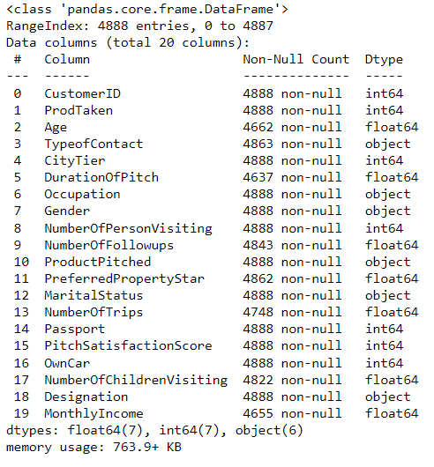
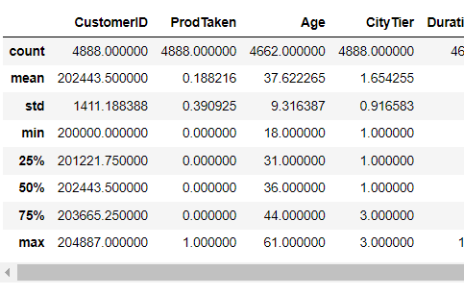
UNDERSTANDING OF DATA
Checking for size of data
Checking for statistical description of data
Checking for data types of columns
Value counts for categorical columns

Slide 7
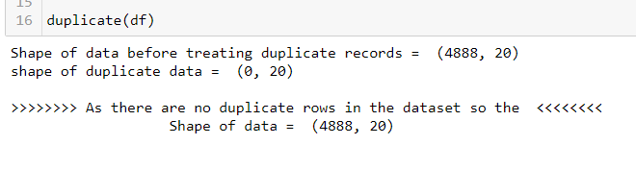
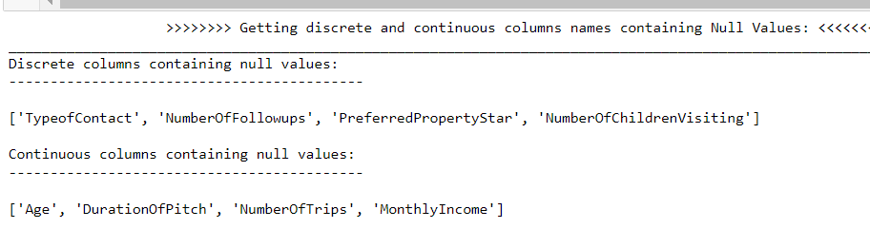
DATA - PREPROCESSING
Data preprocessing in machine learning is the process of cleaning, transforming, and organizing raw data to make it suitable for model training, improving data quality, and model performance.
Steps in data pre-processing
Handling of duplicate records and columns
Handling of Null Values
Handling of Categorical Data
Handling of Numerical Data
Handling of Outliers
Data Transformation

Slide 8

DATA VISUALIZATION
Data visualization is the graphical representation of data using charts, graphs, and other visual elements to convey insights and patterns within the data.
Visualizations of each categorical features
Visualizations of each categorical features with Target variable
Visualizations of each numerical continuous features
Visualizations of each numerical discrete features

Slide 9
OUTLIER DETECTION AND TREATMENT
Outlier detection is the process of identifying data points that deviate significantly from the majority of the dataset.
Outlier treatment involves deciding whether to remove, transform, or handle these outliers to improve the quality and robustness of data analysis and modeling.
Methods To Detect Outliers
Z-Score :
Identifies data points that are significantly different from the mean.
IQR (Interquartile Range):
Detects outliers based on the range between the first and third quartiles.
Visual Inspection:
Using box plots, scatter plots, or histograms to visually identify unusual data points.
Methods To Remove Outliers
Removal:
Delete or exclude outlier data points from the dataset.
Transformation:
Apply mathematical transformations (e.g., log, square root) to mitigate the impact of outliers.
Click here
Click here

Slide 10
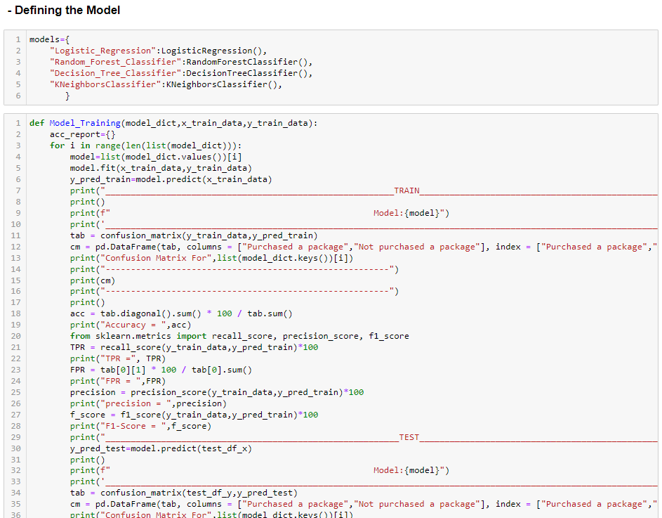
MODEL BUILDING AND PERFORMANCE TABULATION
Here we have build model on 4 different Algorithms
Logistic Regression Algorithm
Decision Tree Algorithm
Random Forest Algorithm
K-Nearest Neighbors Algorithm
Models
Performance Metrics

Slide 11
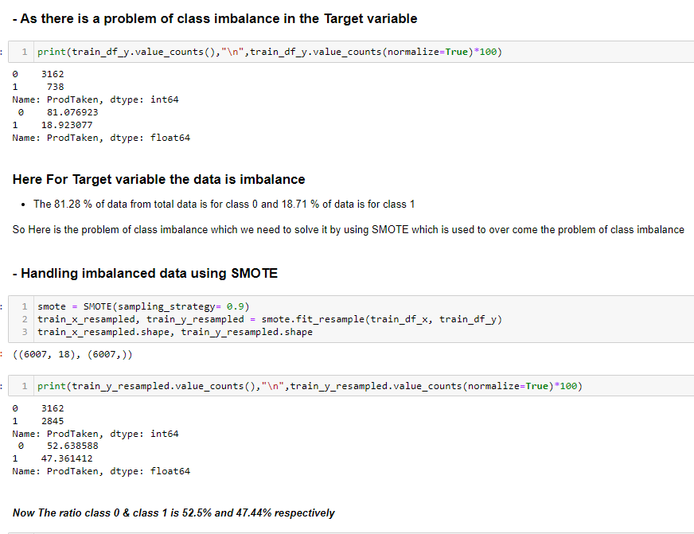
HANDLING OF IMBALANCED DATA & STANDARDIZATION OF DATA

Slide 12
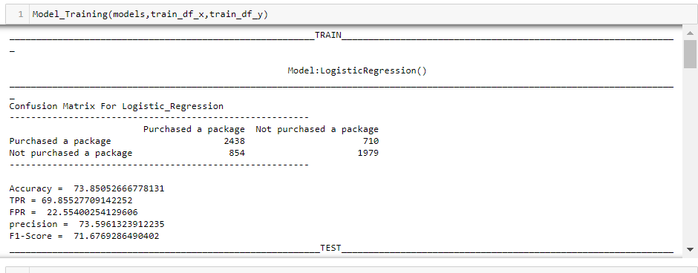
REBUILDING OF MODEL & PERFORMANCE TABULATION
After handling of imbalanced data and after transforming the data we again rebuild the model and check for its performance but there is not that much difference in the performance of models
Models
Performance Metrics

Slide 13
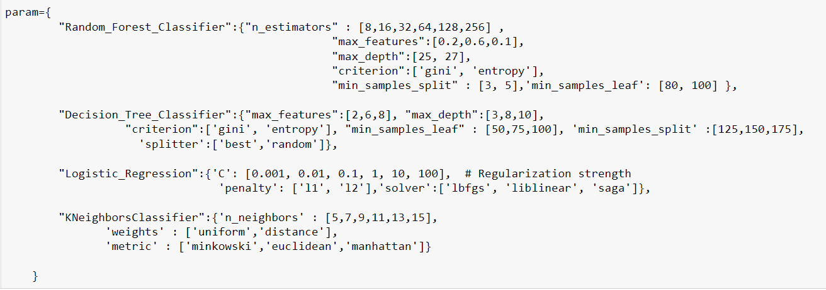
TUNING OF MODEL & PERFORMANCE TABULATION
As there is no effect of handling the imbalance data and the data transformation in order to get better performance here we try to tuned the model by hyper parameter tuning.
Models
Performance Metrics

Slide 14
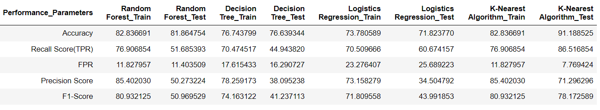
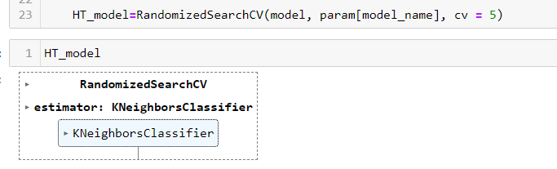
SELECTING BEST MODEL & MODEL SAVING
In terms of accuracy and precision the K-Nearest Neighbor model works better and gives good training and testing accuracy .
So we selected the best model as a K-Nearest Neighbor and we also checked for the RandomizedsearchCV which automatically selects the best model it also select the best model as KNN

Slide 15
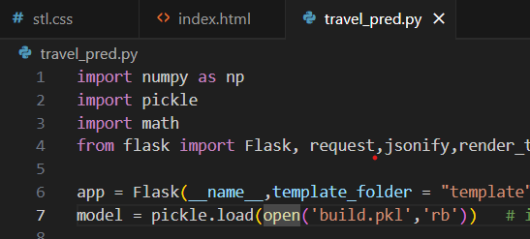
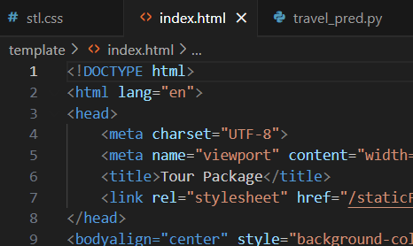
CLOUD DEPLOYMENT
Cloud deployment in machine learning projects involves hosting and running machine learning models and applications on cloud-based infrastructure, making them accessible over the internet for scalability and accessibility.

Slide 16
DATA INSERTION FOR PREDICTION
Observation Trend for most of the customers who purchased package:
Age Group: 42 - 56
Contacted by: Self
Gender: Female
City Tier: 1
Occupation: Small Business
Number of Persons Visiting: 2 - 3
Marital Status: Single
Designation: VP
Monthly Income Mean: ~35K

Slide 17
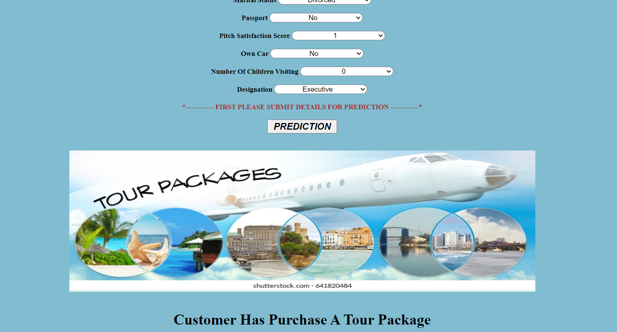
PREDICTION

Slide 18
CONCLUSION
Designation, Passport, City Tier , Martial status, Occupation are most important features. Income and Age can also be looked into, some of the models have given higher importance to these.
Gender, number of children visiting, owning a car appears to be insignificant.
Customers with Designation as Manager & Executive should be the target customers for the company.
Customers who have passport and are from tier 3 city and are single or unmarried, have large business, have higher chances of taking new package.
Customers monthly income in range of 15000- 25000, and age range 18-30, prefer 5 star properties also have higher chances of taking new package based on EDA.

