Slide 1

Kickstarter crowdfunding project
PRESENTED BY GROUP 3
PARTICIPANTS:
REVATI PATIL SOUNDARYA GOPI
DIPALI BOTE
GOWTHAM P.
K. S. SREHITHA
S. NIKHITHA
SUHAS HALWAI

Slide 2
Project: Kickstarter Crowdfunding Project Analysis
Contents:
KPI 1 – Total Projects by Outcome (Chart & Observation)
KPI 2 – Total Projects by Location (Chart & Observation)
KPI 3 – Total Projects by Category (Chart & Observation)
KPI 4 – Total Projects by Time (Year, Quarter, Month) (Chart & Observation)
KPI 5 – Successful Projects Analysis (Amount Raised, Backers, Duration)
Excel Dashboard Overview (Screenshot)
Power BI Dashboard Overview (Screenshot)
Tableau Dashboard Overview (Screenshot)
MySQL Queries (Screenshot)
Challenges Faced and Solutions
Conclusion and Business Recommendations

Slide 3
KPI 1 – Total Number of Projects by Outcome
Key Findings
Failed projects represent the largest share of total campaigns
Successful projects account for approximately 38% of total projects
Canceled projects represent a smaller portion compared to failed and successful
Very few projects fall under suspended or purged status
Observations
Majority of campaigns do not achieve funding goals
Success rate indicates crowdfunding is highly competitive
Project planning, goal setting, and promotion influence outcomes
Improving campaign strategy can increase success probability

Slide 4
KPI 2 – Total Number of Projects by Location
Key Findings
United States has the highest number of projects
Other countries contribute significantly fewer campaigns
Crowdfunding activity is concentrated in a few regions.
Observations
Kickstarter adoption is strongest in the US market
International participation is comparatively limited
Indicates potential growth opportunities in global markets
Regional awareness and accessibility impact campaign volume

Slide 5
KPI 3 – Total Number of Projects by Category
Key Findings
Certain categories have significantly higher project counts
Creative categories such as Games, Design, and Film show strong presence
Some categories have relatively low participation
Observations
Popular categories attract more creators and backers
Category demand influences campaign creation volume
Competitive categories may have lower success probability due to saturation
Category selection plays an important role in campaign performance

Slide 6
KPI 4 – Total Number of Projects by Year, Quarter, and Month
Key Findings
Project creation varies across different years and time periods
Some years show higher campaign activity than others
Seasonal trends observed across months and quarters
Observations
Crowdfunding activity shows growth trends over time
Certain periods may be more favorable for launching campaigns
External factors such as market trends and awareness influence campaign creation
Timing plays an important role in campaign visibility and engagement

Slide 7
KPI 5 – Successful Projects Analysis (Amount Raised, Backers, Duration)
Key Findings
Total Amount Raised by Successful Projects: $3.48 Billion
Total Number of Backers: 40 Million
Average Project Duration: 80 Days
Successful projects attracted strong financial and community support
Observations
Higher funding amounts indicate strong investor confidence in successful projects
Large number of backers shows high user engagement and platform trust
Successful projects require sufficient time to gain visibility and funding momentum
Projects with better reach and engagement tend to achieve higher success

Slide 8
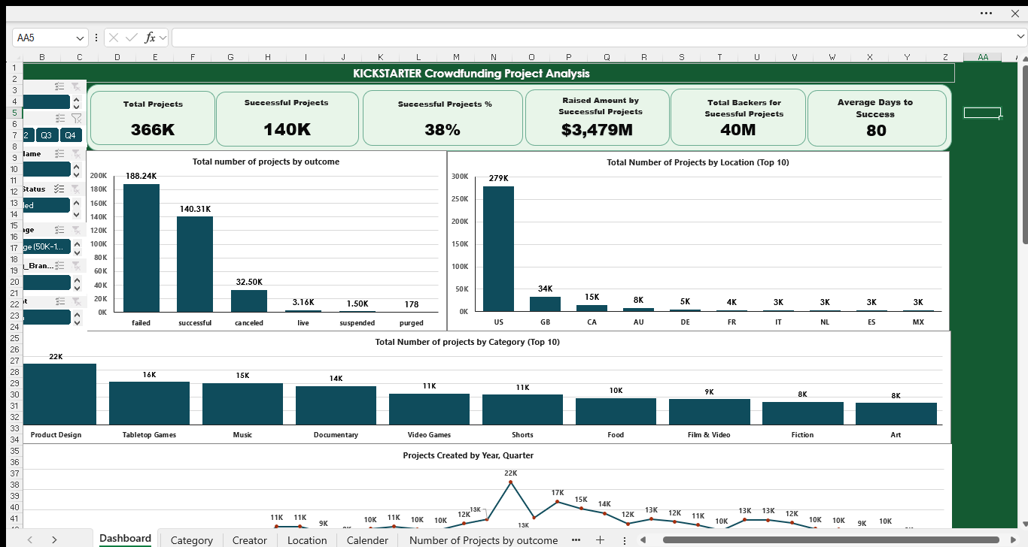
EXCEL DASHBOARD

Slide 9
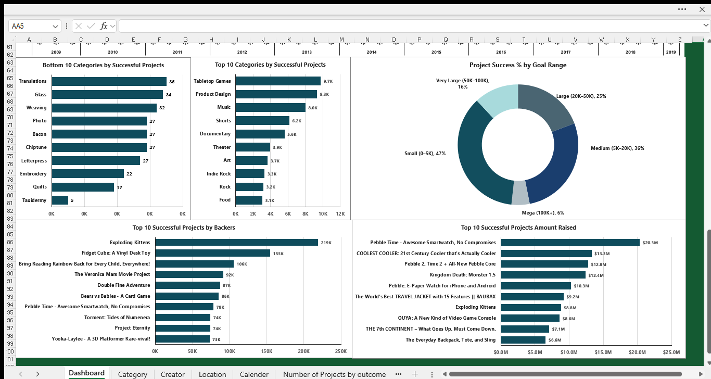
EXCEL DASHBOARD

Slide 10
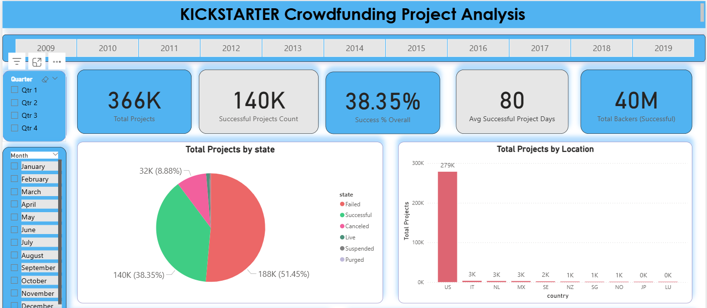
Power BI DASHBOARD

Slide 11
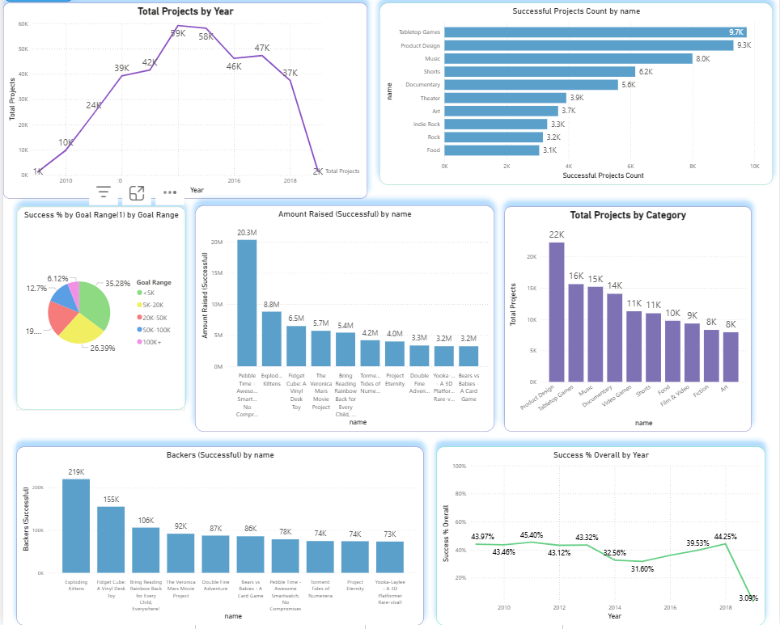

Slide 12
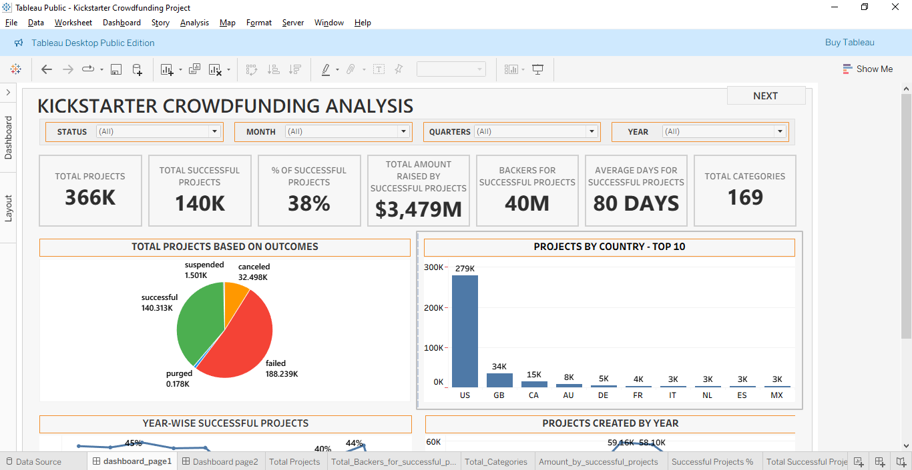
TABLEAU DASHBOARD

Slide 13
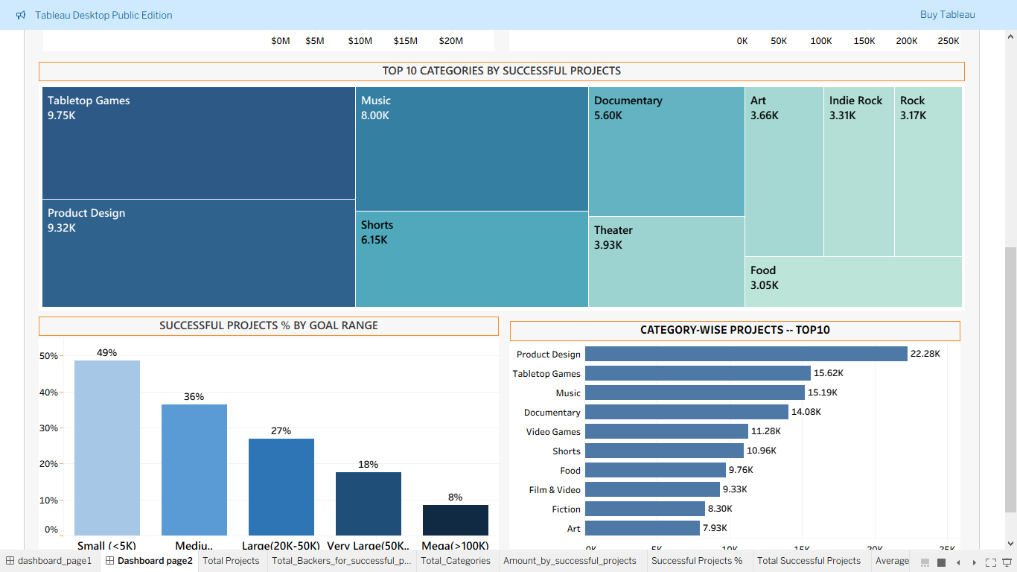

Slide 14
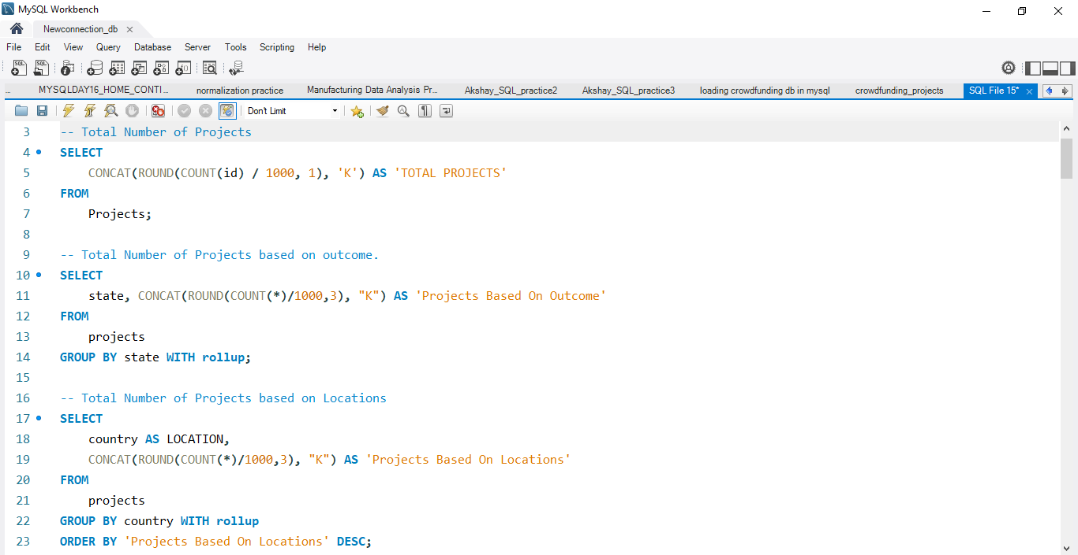
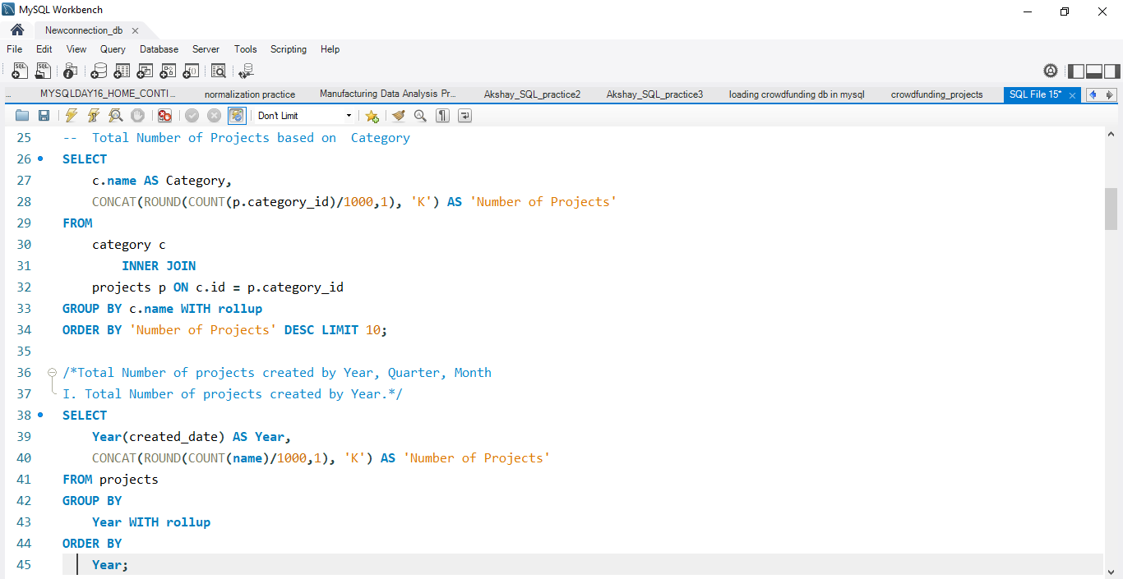
Mysql queries

Slide 15
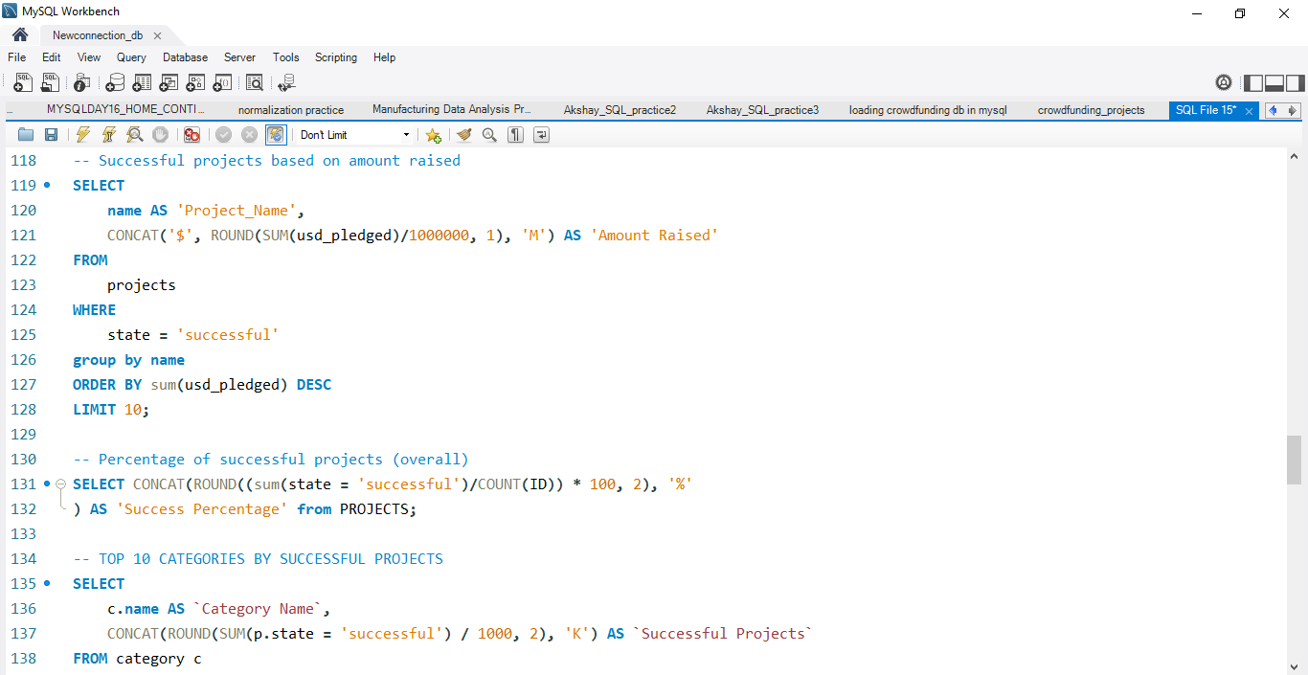

Slide 16
CHALLENGES AND SOLUTIONS
CHALLENGE | DESCRIPTION | WORKAROUND/SOLUTION
Dates in EPOCH format | UNIX/EPOCH timestamps | Converted dates in normal date using formulas.
Currency Conversion | Static USD rate was 1 in the dataset | Considered USD rates for January 26 for currencies in the dataset.
Data Modeling in Excel and Power BI | Total 5 tables— Projects, Creator, Category, Location and Calendar | Created star schema using Projects as Fact table and other tables as Dimension tables.
Large Dataset -- More than 3.5 lakhs records with 4 tables | Excel performance hampered. | Stopped background refreshing with pivot table, deleted unnecessary columns like blurb from Projects table.

Slide 17
CHALLENGE | DESCRIPTION | WORKAROUND/SOLUTION
Data Loading in MySQL | Data import wizard not working due to large dataset and special characters in dataset. | Converted dataset into UTF-8 CSV for special characters. Used LOAD DATA INFILE method to load datasets.
Wrongly converted CSV caused load errors in MySQL | Malformed rows, special characters, misaligned columns | Identified failing line numbers, inspected raw CSV in VS Code, corrected malformed rows manually, ensured consistent column count, re‑saved as UTF‑8 CSV, and successfully reloaded into MySQL.
Large number of visuals | Cluttering of dashboard visuals in Power BI and Tableau | Split dashboard in 2 pages with navigation buttons for each page. Adjusted the canvas sizes to better fit the visuals.
Problems with theme, colors, etc. | Problems with selection of colors, font sizes, background, etc. | AI tools helped a lot in this.

Slide 18
Conclusion
The Kickstarter analysis across Excel, MySQL, Tableau, and Power BI provided a complete end‑to‑end understanding of project performance.
Cleaned and standardized data enabled accurate insights.
Visual dashboards highlighted clear patterns in category performance, funding behavior, and geographic trends.
The multi‑tool workflow ensured accuracy (MySQL), clarity (Excel), interactivity (Tableau), and executive storytelling (Power BI).
Key Findings
Categories with Lower Funding Goals show higher success rates.
High‑goal categories (Tech, Games) attract funding but fail more often.
US, GB, and Canada dominate successful campaigns.
Huge gap between US and GB successful projects.

Slide 19
Recommendations
Guide creators to set realistic funding goals based on category benchmarks.
Highlight creator credibility to build trust with backers.
Promote high‑potential categories with targeted marketing.
Expand global outreach with localized support.
Recommend optimal launch windows based on historical trends.
This analysis helps Kickstarter improve creator success rates, strengthen platform trust, and drive overall growth through data‑driven decision‑making.

Slide 20
THANK YOU

