Slide 1

E-COMMERCE ANALYTICS project
PRESENTED BY GROUP 2
PARTICIPANTS:
KARAN SHARMA SOUNDARYA GOPI
DIPALI BOTE
SUHAS HALWAI
AKSHAYKUMAR SHINDE
P. S. BABU
KIRAN SUTAR

Slide 2
Project: E-Commerce Analytics Project
Contents:
Use Case
Tools and Dataset
The Numbers (KPIs I-V)
Excel Dashboard Overview (Screenshot)
Power BI Dashboard Overview (Screenshot)
Tableau Dashboard Overview (Screenshot)
MySQL Queries (Screenshot)
Challenges Faced and Solutions
Findings and Recommendations
Final Thought.

Slide 3
USE CASE
The Challenge
To know the Earning Trend and Customer Churn (“Where is our money coming from and why are customers leaving?”)
The Objective
Use historical data to find problems to reduce loss.

Slide 4
The Tools and Dataset
Total 9 datasets of olist transaction details from September 2016 to September 2018.
Tools used:
1. MS Excel for cleaning the data with power query, creating data model, pivoting and creating visuals.
2. MySQL for getting results with Exploratory Data Analysis.
3. Power BI and Tableau for creating visuals and “storytelling”.

Slide 5
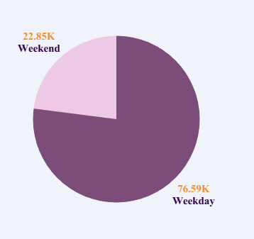

The Numbers (KPIs)
Weekday Vs Weekend (order_purchase_timestamp) Payment Statistics
The Findings: a. Almost 80% of business happened on Weekdays.
b. Average transaction values of Weekend vs Weekdays
are same (R$ 150).
c. Massive revenue from Weekdays (R$ 12.37M).
The Recommendations: Ensure better customer support, timings, sales/offers,
and shipping during the Weekdays.

Slide 6
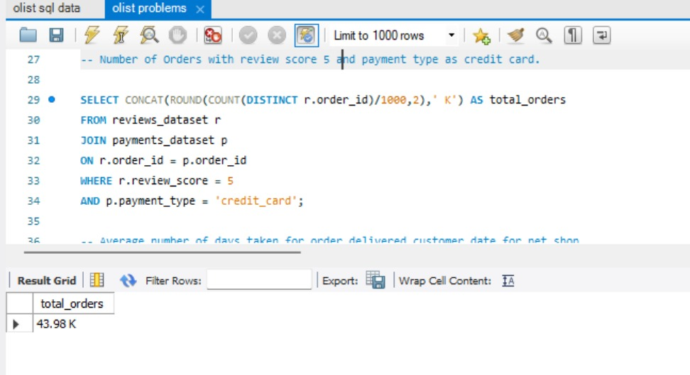

II) Number of Orders with review score 5 and payment type as credit card.
Findings:
43.30 K Orders with Credit Card payment and with 5-Star Ratings.
Happy Credit Card Users are core of the business.
Recommendations:
Encourage Credit Card usage with offers/cashback/reward points.
Study the other payment methods for better output.
Give data security of Credit Card users priority.

Slide 7
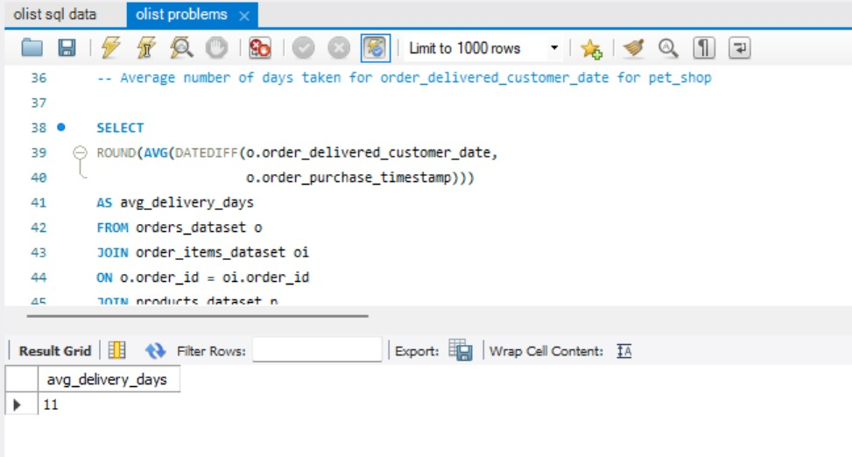

III) Average number of days taken for order_delivered_customer_date for pet_shop
Findings: Average number of days for pet_shop products is 11 days (good).
Recommendations: a . Keep consistency in delivery pattern.
b. Identify high-urgency items in this category and try to deliver before 11-day benchmark.
c. Can introduce “subscription model” for recurring orders.

Slide 8

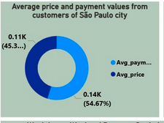
IV) Average price and payment values from customers of Sao Paulo city
Findings: a. Difference between avg price and avg payment is significant due to shipping cost (around R$ 40).
b. Despite high shipping cost customers are buying.
Recommendations: a . Consider “Free Shipping Plans” for large orders.
b. Revisit warehousing policy.
c. Increase “Free Shipping” value limits.

Slide 9
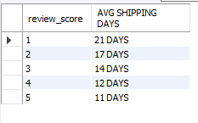
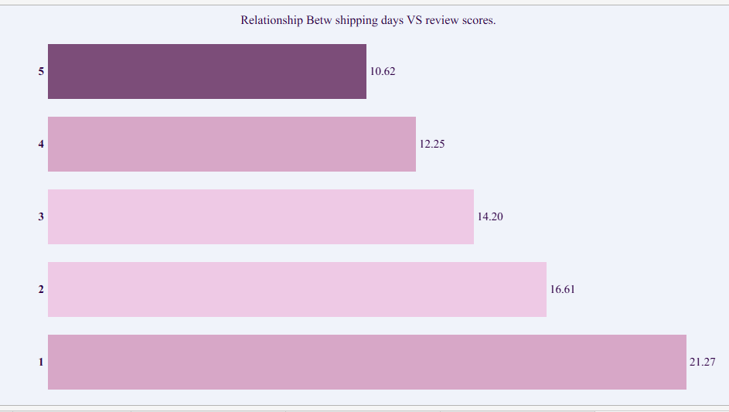
V) Relationship between shipping days Vs review scores.
Findings: a. Review Score shows Stepdown Effect with respect to delivery days.
b. Beyond 14 days review score becomes 3 (neutral) and for 21 days it becomes 1.
b. Delivery within 11 days ensures 5-star.
Recommendations: a . Revisit warehousing policy. Focus on adding storage hubs in regions where ratings are low.
b. Consider penalty for late vendors.

Slide 10
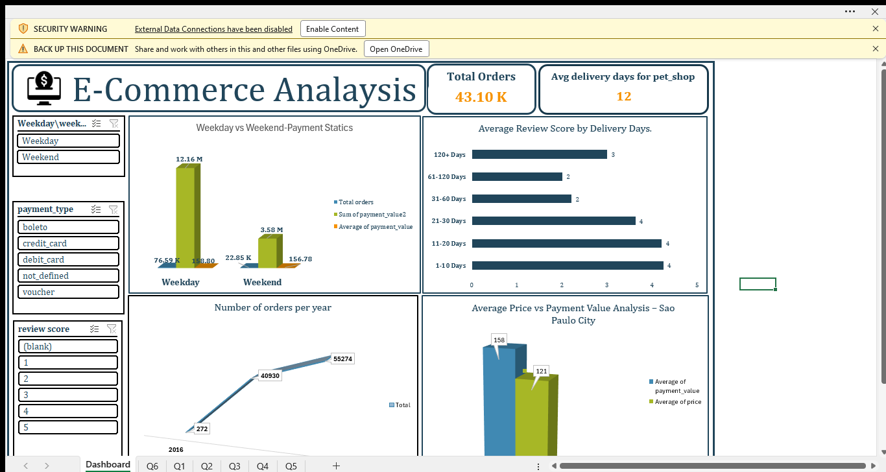
EXCEL DASHBOARD SCREENSHOT

Slide 11
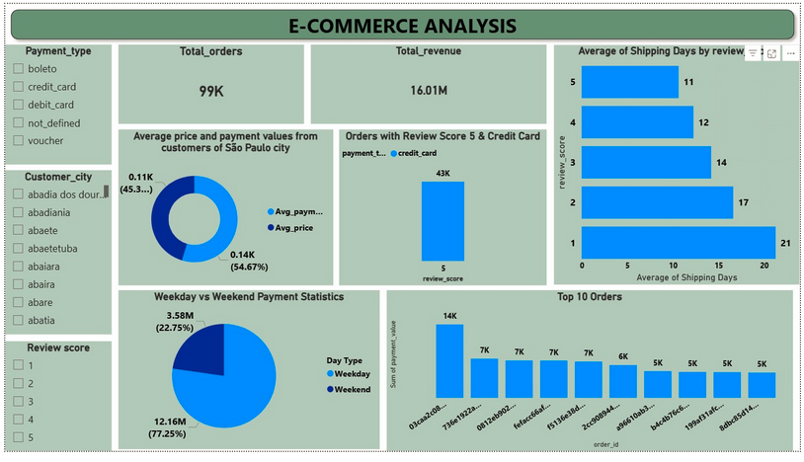
POWER BI DASHBOARD

Slide 12
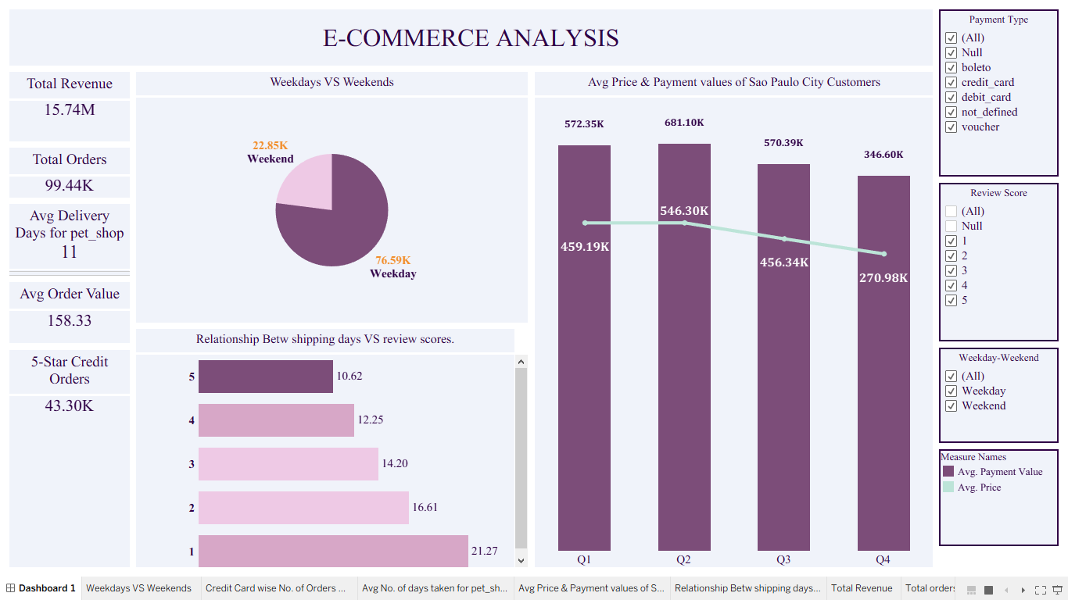
Tableau report

Slide 13
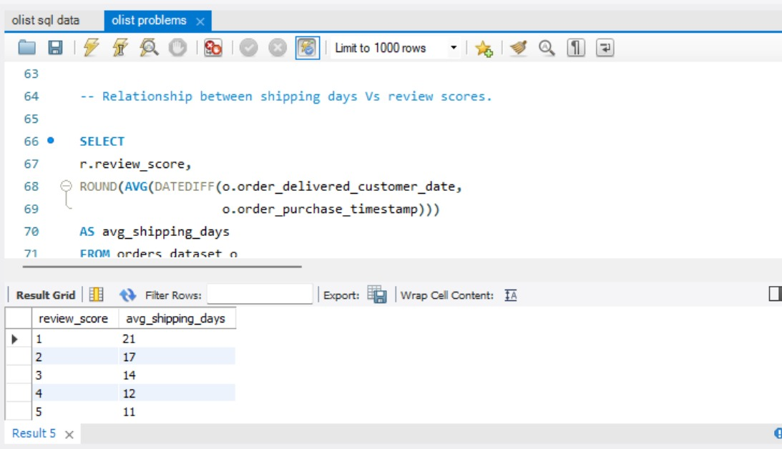
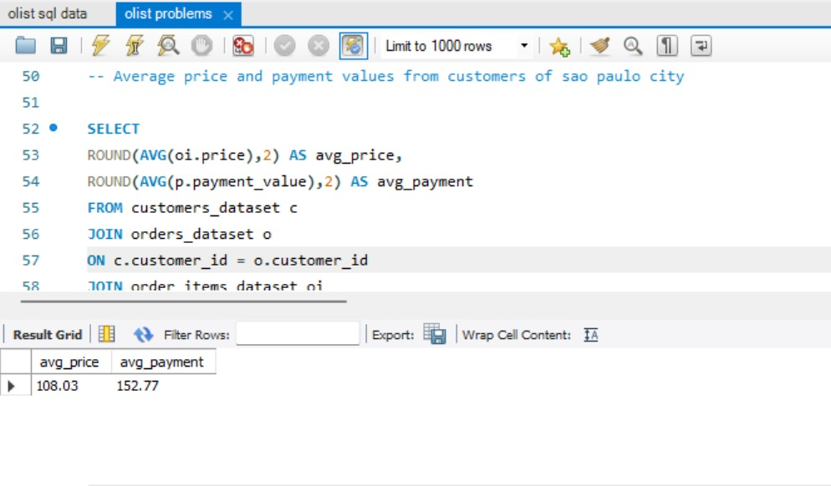
MySQL Queries

Slide 14
CHALLENGES AND WORKAROUND
CHALLENGE | DESCRIPTION | WORKAROUND/SOLUTION
Large Datasets | Excel performance hampered. | Stopped background refreshing with pivot table, deleted unnecessary columns like blurb from Projects table.
Data Modeling in Excel, Power BI and Tableau | Total 9 tables | Created data modeling as per the guideline diagram provided.
Missing information | Entries with missing values, especially in dates | Replaced with appropriate placeholders.

Slide 15

CHALLENGES AND WORKAROUND
CHALLENGE | DESCRIPTION | WORKAROUND/SOLUTION
Data Loading in MySQL | Data import wizard not working due to large dataset and special characters in dataset. | Converted dataset into UTF-8 CSV for special characters. Used LOAD DATA INFILE method to load datasets.
Problems with theme, colors, etc. | Problems with selection of colors, font sizes, background, etc. | AI tools helped a lot in this.
Language barrier | Presence of Portuguese accent city names with special characters. | Used power query tools to normalize the city names.

Slide 16
Key Findings
The “Delivery-Rating” Link: Any delivery crossing 14-day benchmark causes crash in ratings from 5 to 1-2.
Almost 80% business happens on Weekdays, though average product value is same for both Weekdays and Weekend.
Sao Paulo is heart of business, but has high shipping cost.
Credit Card Users are “happy customers” (almost 44K with 5-star review).
For pet shop customers, delivery threshold is 11 days.
Recommendations
Consider introducing subscription model for recurrent customers, for instance, customers for pet food items.
Revisit logistics model, consider increasing storage hub to lessen shipping cost for Sao Paulo area.
Consider marketing plan for increasing early week shopping.
Consider late vendor penalty or late delivery discount.

Slide 17
Final Thought
Olist is healthy and growing marketplace. The only obstacles in earning more is the 11-day shipping gap and high shipping cost for city like Sao Paulo. Addressing these things will help retaining customers and making them “loyal”.

Slide 18
THANK YOU

