Slide 1
CSE435
Lecture Zero
Comprehensive Seminar

Slide 2

L T P
Lecture - 0
Tutorial - 0
Practical - 2
Credits – 1

Slide 3
Course Outcomes
CO1 :: Relate current industry or research trends and technical domains to justify the selection of a seminar topic.
CO2 :: Summarize and synthesize scholarly literature to identify key findings related to the chosen seminar topic.
CO3:: Apply appropriate technical or computational methods relevant to the chosen seminar topic to study the identified problem.
CO4 :: Apply principles of technical communication to deliver a structured and technically sound seminar presentation using appropriate visual aids.
CO5 :: Make use of standard scientific writing and ethical practices to prepare a well- organized technical seminar report.
CO6 ::Explain the relevance and limitations of the chosen seminar topic and outline possible future directions.

Slide 4
Program Outcomes
PO-1 Engineering knowledge::Apply the knowledge of mathematics, science, engineering fundamentals, and an engineering specialization to the solution of complex engineering problems.
PO-2 Problem analysis::Identify, formulate, research literature, and analyze complex engineering problems reaching substantiated conclusions using first principles of mathematics, natural sciences, and engineering sciences.
PO-3 Design/development of solutions::Design solutions for complex engineering problems and design system components or processes that meet the specified needs with appropriate consideration for the public health and safety, and the cultural, societal, and environmental considerations.
PO4: Investigation: Conduct investigations, design experiments, analyze data, and synthesize information.
PO5: Modern Tool Usage: Use appropriate modern tools and IT for engineering activities, understanding their limitations
PO-6 The engineer and society::Apply reasoning informed by the contextual knowledge to assess societal, health, safety, legal and cultural issues and the consequent responsibilities relevant to the professional engineering practice.

Slide 5
Program Outcomes
PO6: Engineer & Society: Recognize professional responsibilities, societal, health, safety, legal, and cultural issues.
PO7: Environment & Sustainability: Understand environmental impact and work towards sustainable development.
PO8: Ethics: Practice engineering ethically and responsibly.
PO9: Individual & Team Work: Function effectively in teams, individual roles, and multidisciplinary settings.
PO10: Communication: Communicate effectively with engineering and non-engineering audiences.
PO11: Project Management: Demonstrate knowledge of engineering and management principles for managing projects, finance, and risk.
PO12: Lifelong Learning: Engage in continuous learning and professional development.
PO-13 Competitive Skills::Ability to compete in national and international technical events and building the competitive spirit

Slide 6
Program Specific Outcomes
PSO1: Apply basic knowledge in areas such as Software Engineering, Networking and Security, Database Management Systems, Intelligent Systems, Operating Systems, and System Architecture for building Software products.
PSO2: Provide effective and efficient real-time solutions using attained knowledge in interdisciplinary domains for societal benefits through projects.

Slide 7
PO-CO Mapping Table
Mapping Scale: 3 – Strong correlation 2 – Moderate correlation 1 – Low correlation – No direct correlation
PO \ CO | CO1 | CO2 | CO3 | CO4 | CO5 | CO6
PO1 – Engineering Knowledge | 2 | 2 | 3 | - | - | 1
PO2 – Problem Analysis | 2 | 3 | 3 | - | - | 2
PO4 – Investigation | - | 2 | 2 | - | - | 1
PO5 – Modern Tool Usage | - | 1 | 2 | 1 | - | -
PO6 – Engineer & Society | 1 | - | - | - | 1 | 2
PO8 – Ethics | - | - | - | - | 3 | 1
PO10 – Communication | - | - | - | 3 | 2 | -
PO12 – Lifelong Learning | 2 | 2 | - | - | - | 2

Slide 8
Course Contents Overview
This course does not follow a fixed unit-wise syllabus. Instead, it focuses on a student-driven seminar process that includes:
Identification of a relevant research or industry topic, review of literature, formulation of a clear problem statement, adoption of an appropriate methodology, and presentation of findings through seminars and reports
The course emphasizes technical communication, scientific writing, ethical practices, and active participation in academic discussions.

Slide 9

Course Evaluations
Compulsory
CA1
CA2
Marks – 45
Marks – 45

Slide 10
Weightage Division
Attendance - 10 marks
Attendance Percentage | Marks
95% -100% | 10
90% - 94.9% | 8
85% - 89.9% | 6
80% - 84.9% | 4
75% - 79.9% | 2
CA - 90 marks
MTP and ETP are not applicable for this course

Slide 11
CA Description for Placed Students
1. Company Technology Stack based Project
Description: Students must prepare a detailed assignment based on the technology stack used by the company they are placed in.
Expected Coverage:
Company overview and domain
Technology stack (Frontend, Backend, Database, Cloud, Tools, etc.)
Purpose of each technology
How these technologies interact within the system
Advantages of the chosen stack

Slide 12
2. Technology & Workflow Presentation
Description: A short presentation explaining:
Development workflow used in the company (Agile, DevOps, CI/CD, etc.)
Software development life cycle followed
Team roles and collaboration tools
Real-world problem-solving approach
3. GitHub & LinkedIn Professional
Description: Students must maintain and update:
GitHub profile with repositories (learning projects, demos, documentation)
LinkedIn profile with placement details, skills, and technologies used
4. Project Report

Slide 13
CA Description for Non-Placed Students
Industry-Ready Project Development / Capstone Project Relevance
Description: Students must design and develop a project aligned with a real industry use case, exploring technologies used in different domains such as:
Healthcare
Finance
Education
E-commerce
AI/ML, Cloud, Web, Mobile, or Data Analytics
Expected Outcomes:
Clear problem statement
Appropriate technology selection
Functional and scalable solution
Basic documentation

Slide 14
Examples:-
Recommendation System for E-Commerce Platforms
Domain: E-Commerce / Data Science Technologies: Python, ML, Collaborative Filtering Description: Develop a recommendation engine that suggests products based on user behavior, preferences, and purchase history.
Industry Relevance: Used by online retail platforms and streaming services.

Slide 15
Object Detection System Using Computer Vision
Domain: Computer Vision / AI Technologies: Python, OpenCV, YOLO / TensorFlow Description: Implement an object detection model for applications such as traffic monitoring, face detection, or safety compliance detection.
Industry Relevance: Surveillance, autonomous systems, and smart cities.

Slide 16
2. GitHub Repository & Version Control
Description: Students must maintain a public GitHub repository for the project including:
Source code
README file
Commit history
Basic project documentation
3. LinkedIn Professional Portfolio
Description: Students must:
Showcase the live demonstration of project on LinkedIn with description, skills, and outcomes
4. Project Report Submission

Slide 17
CA 1 (Presentation): Evaluation Parameters
Student Type | Component | Marks
Placed | Tech Stack Analysis | 25
Placed | Development Workflow Analysis | 20
Placed Total |  | 45
Non-Placed | Industry Project/ Presentation | 25
Non-Placed | Development Workflow Analysis | 20
Non-Placed Total |  | 45
Notes:
Understanding of industry-grade technologies
Ability to analyze real-world systems
Application of theoretical knowledge to practical scenarios
Awareness of current tools, platforms, and best practices
✔ Covers technical knowledge, analysis, and application ✔ Addresses Bloom’s levels: Understand → Apply → Analyze
Parameter 2: Development Workflow Analysis
This parameter evaluates:
Understanding of software development processes
Knowledge of SDLC models and methodologies
Awareness of team roles and collaboration
Real-world problem-solving and delivery approach
✔ Covers process knowledge, professional skills, and teamwork ✔ Addresses Bloom’s levels: Understand → Analyze → Evaluate
Faculties must note that they should complete presentation of at least six students in class

Slide 18
CA 2 (Seminar Report): Evaluation Parameters
Student Type | Component | Description | Marks
Placed | LinkedIn +GitHub | Brief explanation of project workflow and technology stack | 15
Placed | Project Report | Report with GitHub and LinkedIn links/Social media | 30
Placed Total |  |  | 45
Non-Placed | LinkedIn +GitHub | Complete execution and justification of implementation | 25
Non-Placed | Project Report | Report with GitHub repository and LinkedIn links / Social media | 20
Non-Placed Total |  |  | 45

Slide 19
Provision for Certification
Students may opt to complete an approved industry certification (such as AWS, Microsoft Azure, Google Cloud, IBM, Cisco, or equivalent), subject to approval by the standing committee.
Successful completion of the certification, along with the required verification, shall be considered for an 'O' grade subject to minimum attendance of 90% .
For Non-Placed Student
***Students who secure placement after the completion of CA-1 shall be awarded full marks in CA-2, subject to submission and successful verification of valid placement proof.

Slide 20
CA Allocation
CA 1
Allocation Week | Submission
3rd week (By 23 January) | Presentation Should start from 4th week onwards
CA 2
Allocation Week | Submission
10th Week (On or before 13 March ) | First week of April

Slide 21
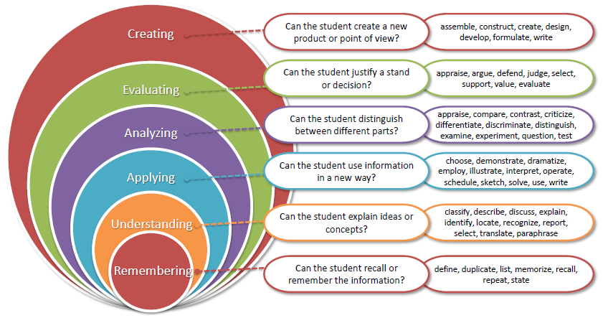
Bloom’s Taxonomy

Slide 22
The course outcomes are designed in accordance with Bloom’s Taxonomy up to Level 3 (Apply), emphasizing understanding and application rather than higher-order analysis or creation.
Bloom’s Taxonomy Example
Seminar Topic: Blockchain Technology in Secure Data Sharing
Remember (Level 1):
The student identifies key concepts such as blockchain, distributed ledger, and consensus mechanisms.
Understand (Level 2):
The student summarizes existing research papers and explains how blockchain is used for secure data sharing.
Apply (Level 3):
The student applies the discussed concepts by presenting a use-case workflow showing how blockchain can be used for secure data sharing in healthcare systems during the seminar.

Slide 23
References & Research Resources
IEEE Xplore Digital Library – https://ieeexplore.ieee.org
ACM Digital Library – https://dl.acm.org
ScienceDirect (Elsevier) – https://www.sciencedirect.com
SpringerLink – https://link.springer.com
Google Scholar – https://scholar.google.com
AWS Whitepapers & Documentation
https://docs.aws.amazon.com/whitepapers
Microsoft Learn / Azure Docs – https://learn.microsoft.com
Google Cloud Architecture Center – https://cloud.google.com/architecture
IBM Research & Redbooks – https://www.ibm.com/redbooks

Slide 24
THANKS
Any Queries!

