Slide 1


WELCOME TO –
STUDENT MANAGEMENT SYSTEM

Slide 2
Powered by-Dipali Shevale
Guided by - Vaishali Mam

Slide 3

Introduction OF PROJECT -
Student Management System is a project which aims in developing a computerized system to maintain the student details.
This project of ours is being developed to help the student system.

Slide 4
Problem Defination
The goal of this project is to develop a website for school and colleges to maintain student details .
Main objective of the website is –
1.Add new students
2.Update student details
3.Delete students

Slide 5
Objective
We will to build a simple Student Management System web application using Spring Boot,Spring MVC,Thymeleaf and Spring Data JPA

Slide 6

Feasibility Study
In this project,we aimed to develop an simple online student management system.
College and schools can keep student records using this website.
Using this website,new student can be added,student details can updated and students can be deleted also.

Slide 7
Programming Languages-
Java
HTML
CSS
Bootstrap

Slide 8
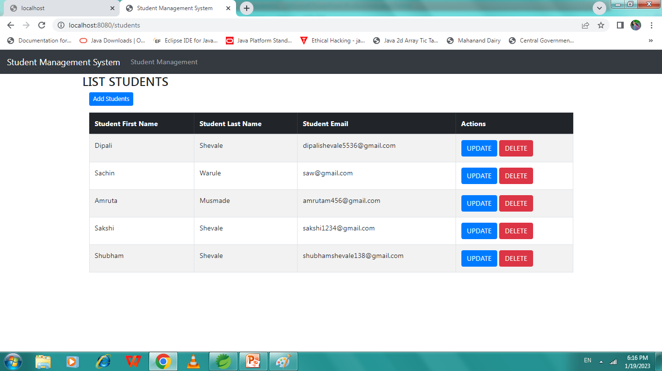

Slide 9
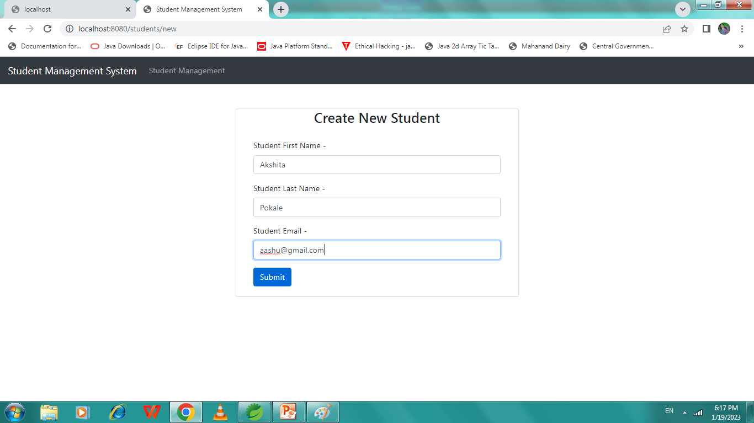

Slide 10
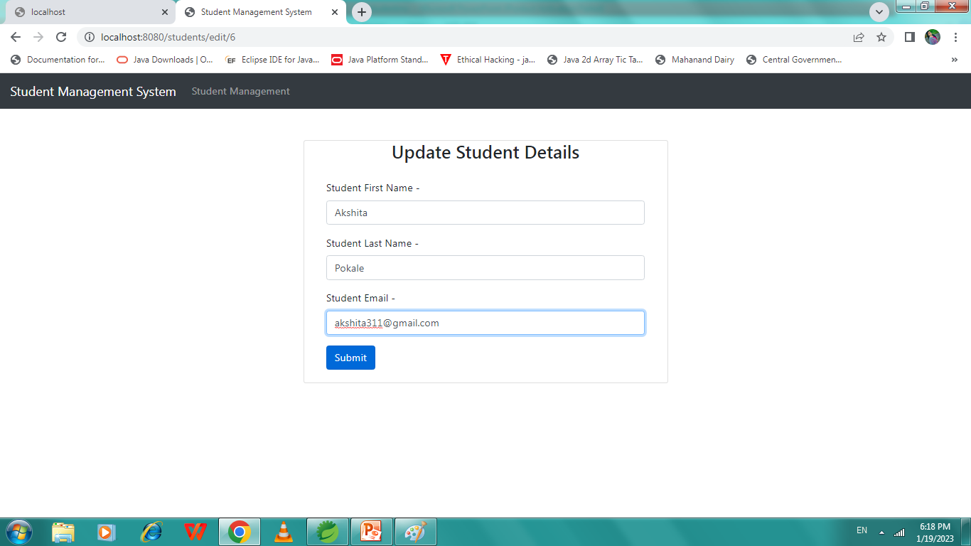

Slide 11
THANK-YOU

