Slide 1
LECTURE-2
Problem Set 2
Linked Lists Fundamentals

Slide 2
Problem 1
Check for Unique Characters in a String

Slide 3
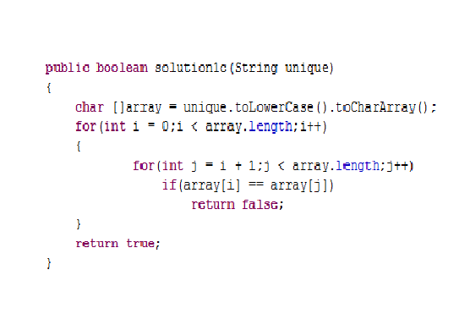
Brute Force

Slide 4
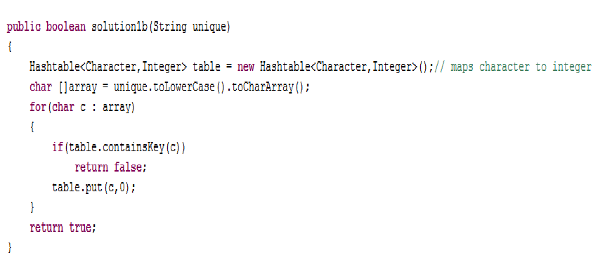
Hash table Solution

Slide 5
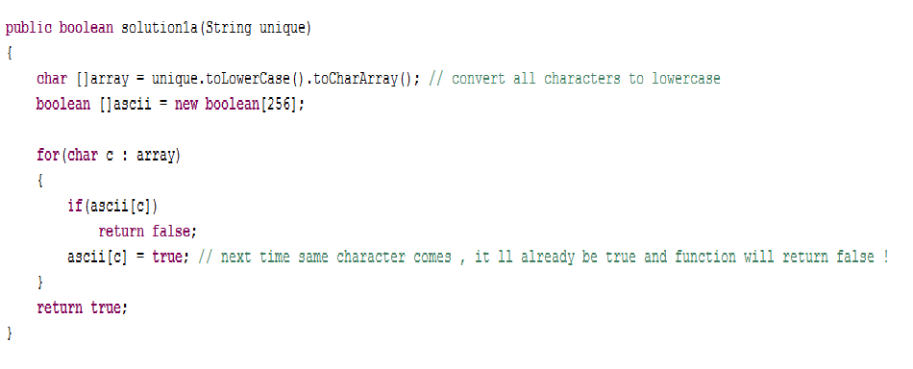
Boolean Ascii Array

Slide 6
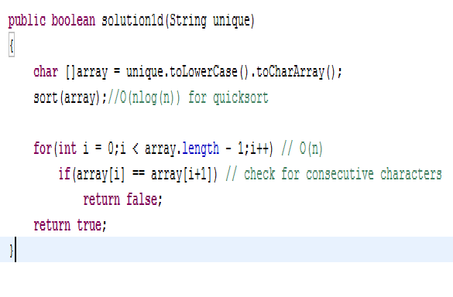
Using nlog(n) sort

Slide 7
WHICH IS BEST ??
Hash table or Boolean Array ?
Brute Force or Sort ?

Slide 8
X Raised to power N
BEST ALGORITHM ??

Slide 9
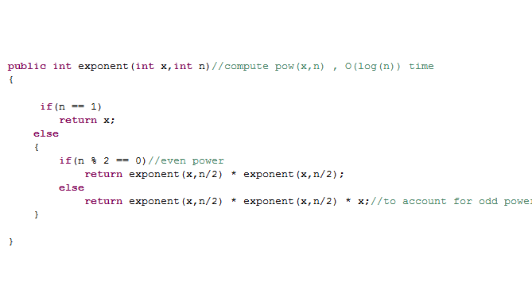
O(log(n)) ALGORITHM

Slide 10
BETTER ALGORITHM ??
ARE WE WASTING SPACE UNNECESSARILY?

Slide 11
Max Element in an Array
GUYS WHO ATTEND PARALLEL COMPUTING DON’T GET TO ANSWER THIS QUESTION !!!! :P

Slide 12
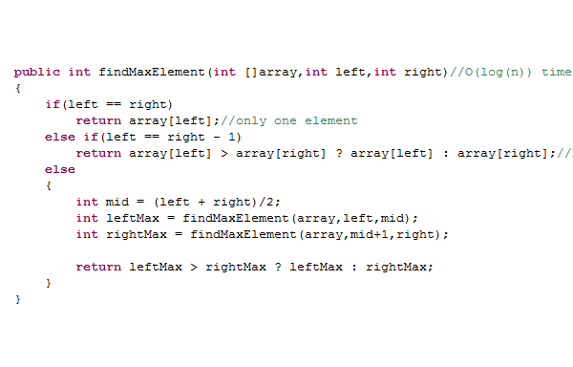
O(log(n)) Solution

Slide 13
RECURSIVE SOLUTIONS
Things to keep in mind :
Think about base cases !
Optimize wherever you can !(Recursion is a costly affair)
Draw the system stack while tracing recursive solutions for better understanding !!
Always learn the iterative version too !! Every recursive solution has an iterative alternative but the converse isn't true!

Slide 14
Problem 2
k^{th} smallest element in a given array

Slide 15
Solution 1:
Sort and return element in Index k
O(nlog(n))
In place !

Slide 16
Solution 2
Using partition algorithm and Recursive searching

Slide 17
Problem 3
Spiral traversal of 2-d Array

Slide 18
Solution 1:
Iterative

Slide 19
Solution 2:
Recursive ???

Slide 20
Problem 4:
Pair with minimal sum in Integer array

Slide 21
Solutions :
Brute Force
Sort and check from left and right

Slide 22
Problem 5:
Check from left and right !

Slide 23
Linked Lists
Fundamentals

Slide 24
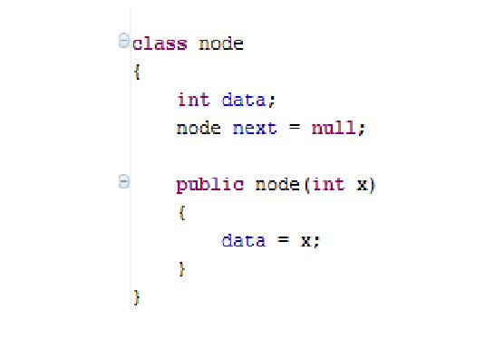
Create the Node

Slide 25
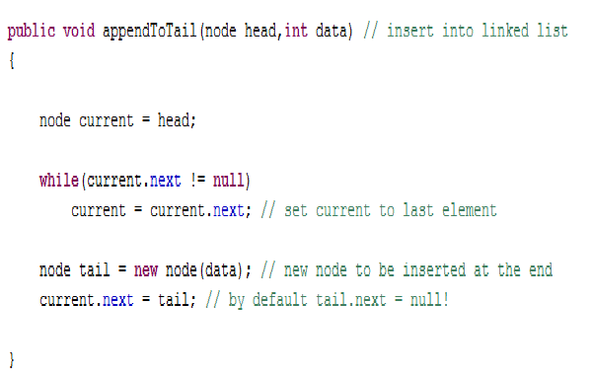
Add to tail

Slide 26
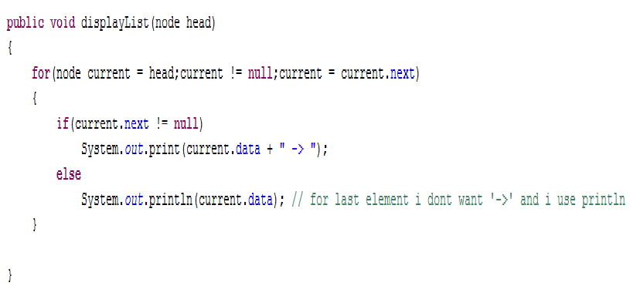
Display Linked List

Slide 27
Brain Teaser
You are given 5 types of pills : A,B,C,D and E.
You have unlimited supply to each of these types of pills.
You are given a digital weighing scale with accuracy up to 2 decimal places.
Four of the types weigh 1 gram/pill and one type weighs 1.1 gram/pill.
How many measurements do you require to find out the type of pill which is slightly heavier than the other four types ???

