Slide 1
LECTURE-3
LINKED LISTS CONTD.

Slide 2
SKILL REQUIRED vs. POPULARITY

Slide 3
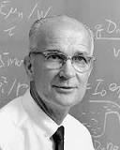

Slide 4
Problem 1
Existence of Loop, Start of Loop, Length of Loop, Removing the loop

Slide 5
Solution 1 : Brute Force
For every node , check if further nodes have next pointing to current node

Slide 6
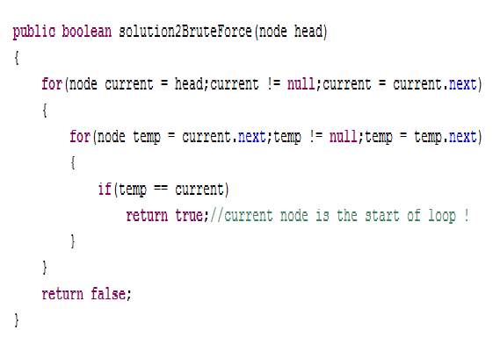

Slide 7
Solution 2 :Hash table
Add current node to hash table , if it already exists in the table , loop exists!

Slide 8
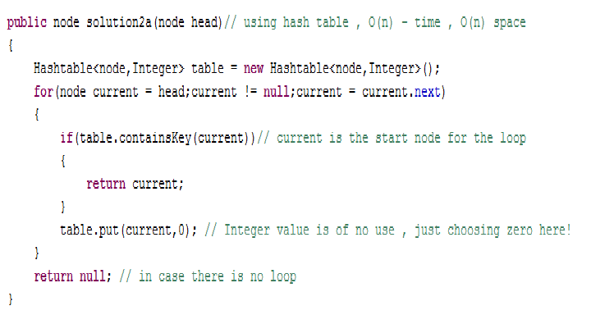

Slide 9
Solution 3:
Floyd’s Cycle Detection Algorithm
See ProblemSet3.java

Slide 10
Problem 2:
Reverse a singly Linked List

Slide 11
Using extra Space:
Either Stack algorithm or recursion(which basically uses system stack)!

Slide 12
In place Algorithm :
Refer ProblemSet3.java

Slide 13
Problem 3:
Intersection of Linked Lists

Slide 14
Solution 1:
BRUTE FORCE

Slide 15
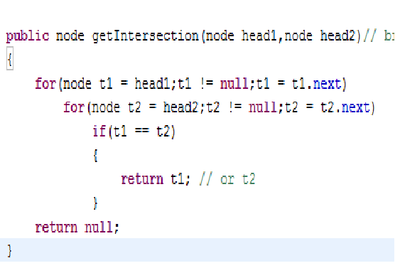

Slide 16
Solution 2:
HASH TABLE(What else did u expect ??)

Slide 17
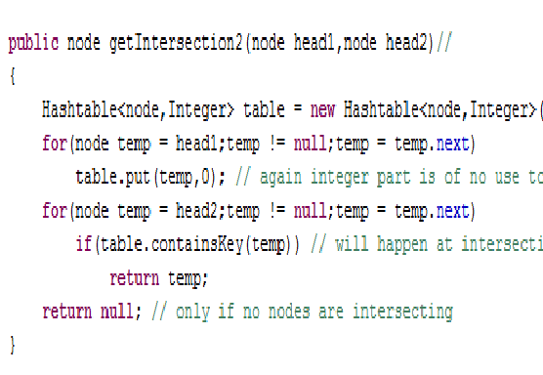

Slide 18
Solution 3 :
USE TWO STACKS

Slide 19
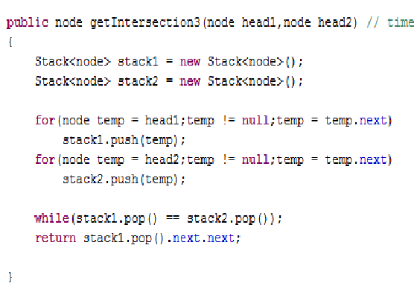

Slide 20
Solution 4:
Get the difference between their lengths !

Slide 21
Problem 4:
Get the middle element of the linked list !

Slide 22
Solution 1 : Brute Force
Find length and go to middle !(Duh!)

Slide 23
Solution 2:
Slow runner – Fast runner Technique
(Single Traversal)

Slide 24
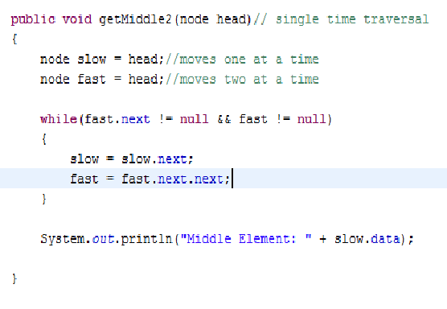

Slide 25
COMP SCI VS ASTRONOMY
CREATIVITY VS TOOLS

Slide 26
Problem 5:
PRINT A LINKED LIST BACKWARDS

Slide 27
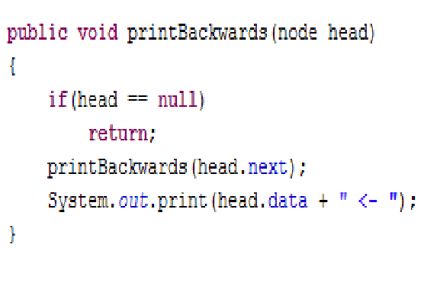

Slide 28
Problem 6(Exclusively for the sport in you!) :

Slide 29
CHECK IF LENGTH OF LINKED LIST IS EVEN OR ODD WITHOUT USING ANY COUNTING MECHANISM!

Slide 30
Solution :
Move ‘Fast’ 2 Nodes at a time,
If fast == null , even
If fast.next == null , odd

Slide 31
Problem 7:
Merge two sorted Linked Lists into a Final Sorted List

Slide 32
Iterative : Exactly like merge in mergesort
You can do it recursively also !

Slide 33
Problem 8:
Reverse a linked list in Pairs

Slide 34
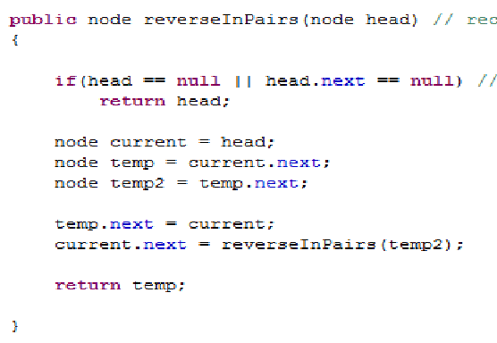

Slide 35
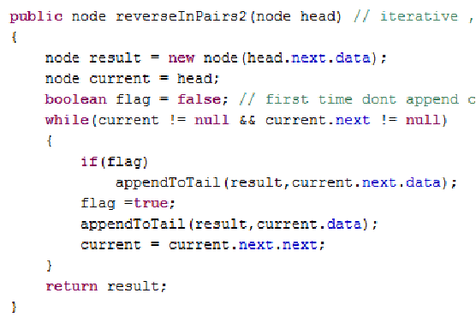

Slide 36
Problem 9 :
Check if Linked List is a palindrome

Slide 37
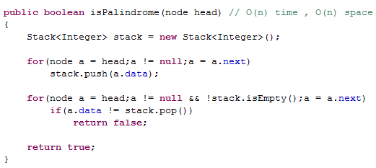

Slide 38
Recursive ???
One more question left in Linked Lists. We’ll see next class! Please remind me..

Slide 39
Chocolate(Read Limited Edition) Brain Teaser
4 TOGGLERS ONE TRUTHTELLER

