Slide 1
LECTURE-4
LINKED LISTS, STACKS AND QUEUES

Slide 2


Slide 3
LOGIC VS IMPLEMENTATION

Slide 4
CHECK IF LINKED LIST IS A PALINDROME
RECURSIVE SOLUTION ??

Slide 5
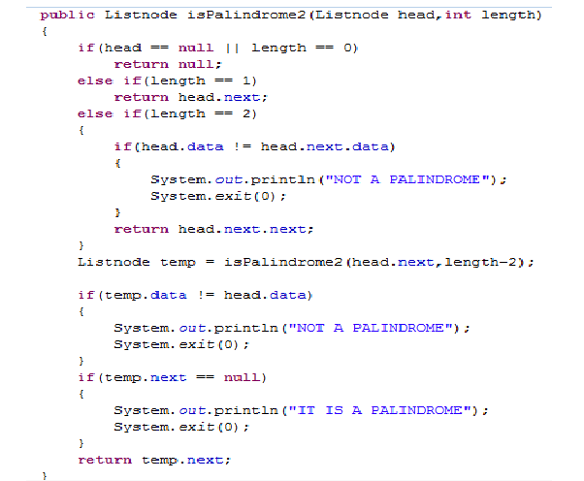

Slide 6
WHAT IF WE WANT TO USE THIS FUNCTION IN SOME OTHER PROBLEM ??
THIS MERELY PRINTS TO THE SCREEN!

Slide 7
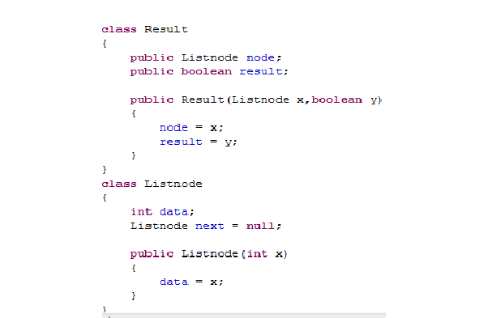

Slide 8
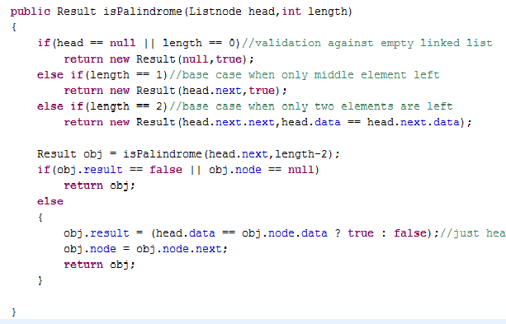

Slide 9
CLONE A LINKED LIST WITH A RANDOM POINTER FOR EVERY NODE

Slide 10
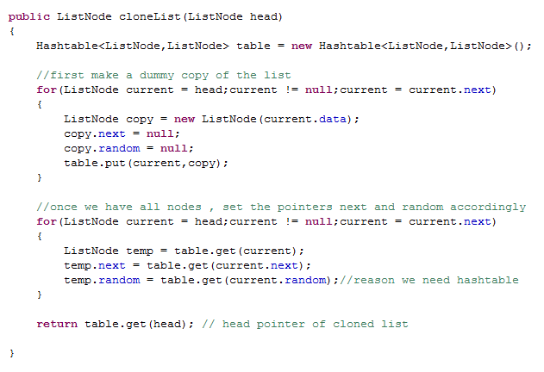

Slide 11
STACKS AND QUEUES
PROBLEM SET 4

Slide 12
BALANCED EXPRESSION CHECK

Slide 13
NEW PUNISHMENT SYSTEM!
YOU GET TO PICK FROM 3 OPTIONS: LD,TS,CB

Slide 14
CONVERT INFIX TO POSTFIX
ONLY ‘()+-*/%’ and integer operands

Slide 15
EVALUATE POSTFIX

Slide 16
REVERSE A STACK
USING ONLY STANDARD STACK OPERATIONS

Slide 17
SOLUTION 1:
USE AN EXTRA STACK!

Slide 18
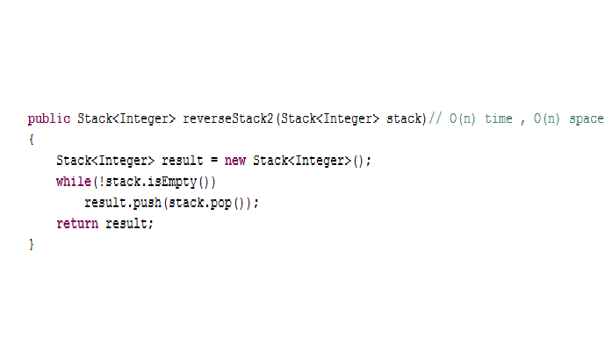

Slide 19
SOLUTION 2:
RECURSIVE ??

Slide 20
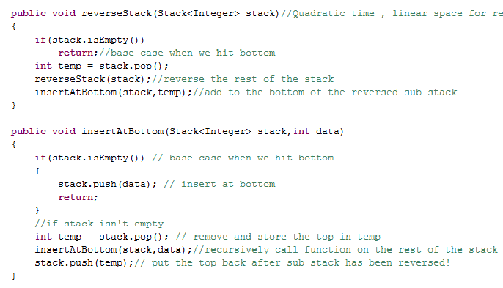

Slide 21
FUN WITH GRAPHS

Slide 22
SORT A STACK
USING ONLY STANDARD STACK OPERATIONS

Slide 23
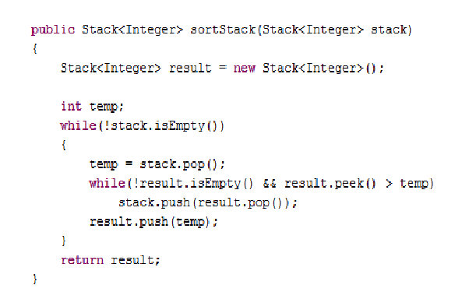

Slide 24
QUEUE USING TWO STACKS

Slide 25
STACK USING TWO QUEUES

Slide 26
BINARY TREES
FINALLY !!

Slide 27
TRAVERSALS
PRE,IN,POST
RECURSIVE,ITERATIVE
LEVEL ORDER

Slide 28
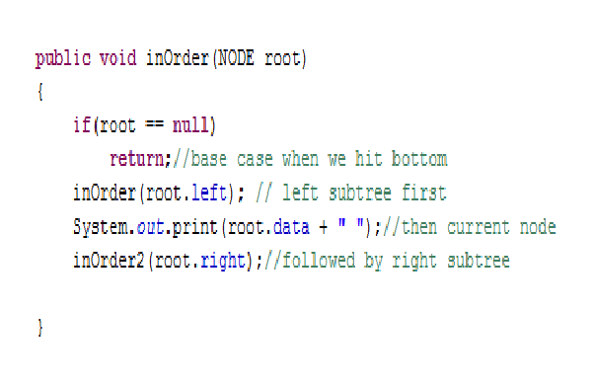

Slide 29
ITERATIVE VERSION ??

Slide 30
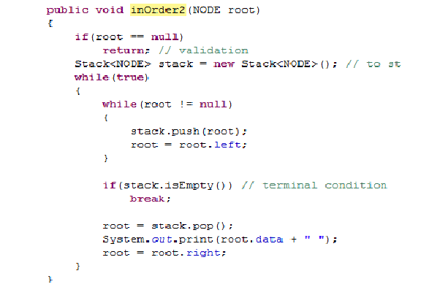

Slide 31
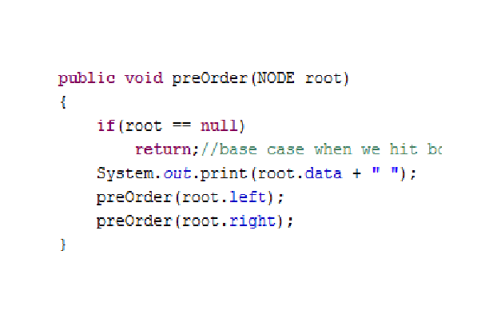

Slide 32
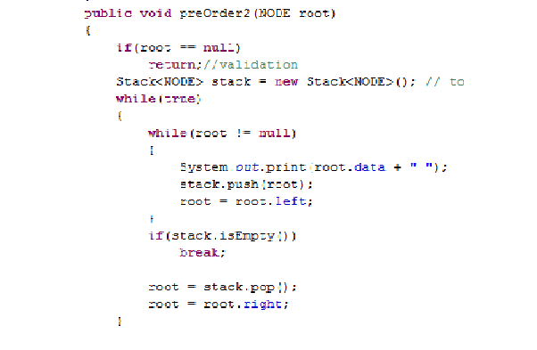

Slide 33
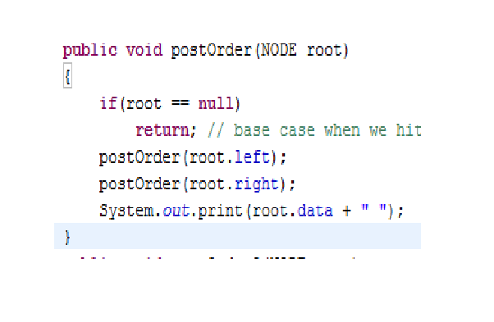

Slide 34
POST ORDER ITERATIVE ??

Slide 35
LEVEL BY LEVEL TRAVERSAL
THE BIGGEST LIFESAVER IN BINARY TREES!!

Slide 36
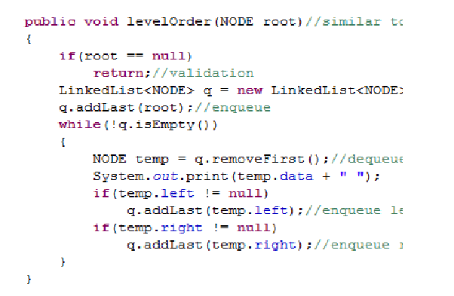

Slide 37
BRAIN TEASER 1:
25 HORSES

Slide 38
BRAIN TEASER 2 :
RED HAT – GREEN HAT

