Slide 1
LECTURE-5
BINARY TREES

Slide 2
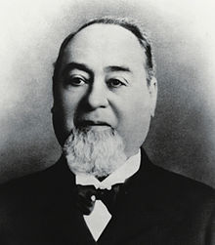

Slide 3
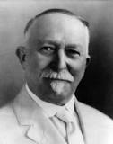

Slide 4
EXTENSIONS FROM PREVIOUS CLASS
REVERSE A QUEUE
Vs
REVERSE A STACK
IN PLACE

Slide 5
Problem 1
POST ORDER ITERATIVE

Slide 6
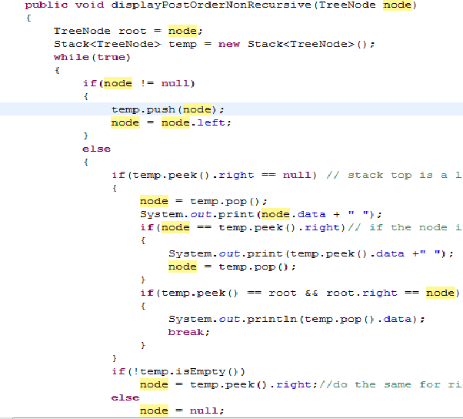

Slide 7
Problem 2
Find Max Element in Binary Tree

Slide 8
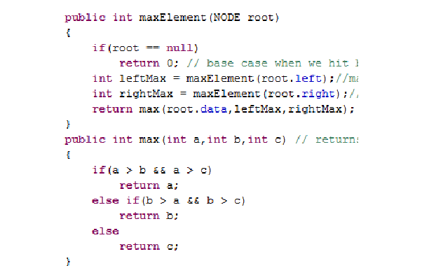

Slide 9
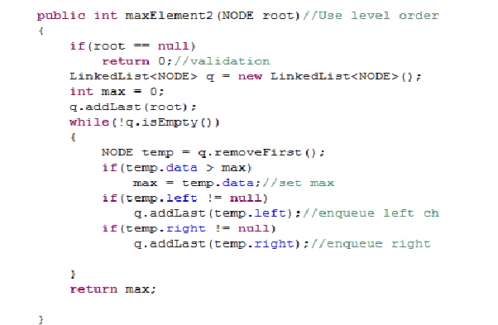

Slide 10
Problem 3
CHECK IF AN ELEMENT EXISTS IN A BINARY TREE

Slide 11
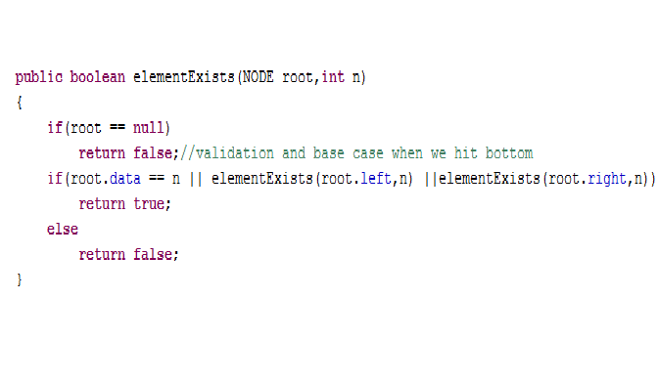

Slide 12
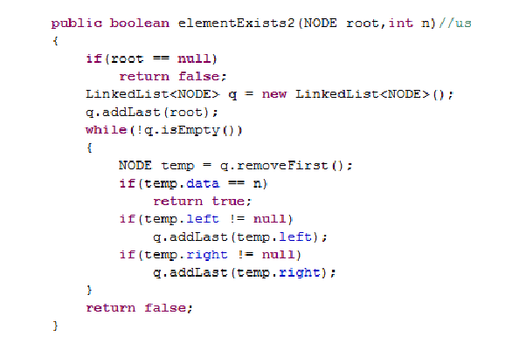

Slide 13
PROBLEM 4
INSERT INTO BINARY TREE

Slide 14
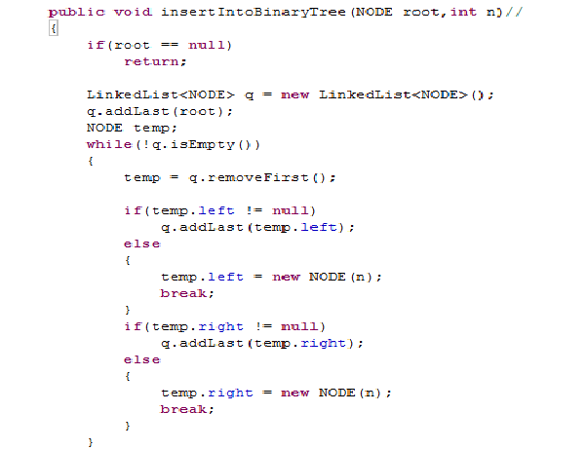

Slide 15
PROBLEM 5
FIND NUMBER OF NODES IN A BINARY TREE

Slide 16
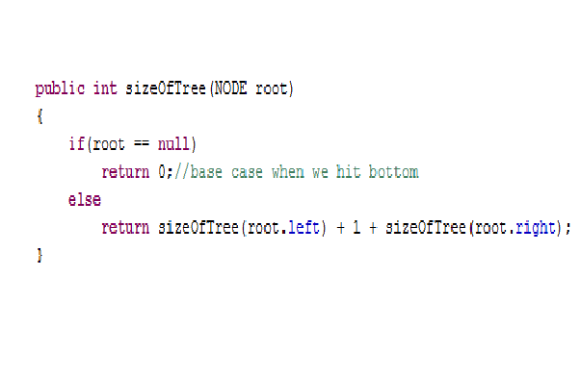

Slide 17
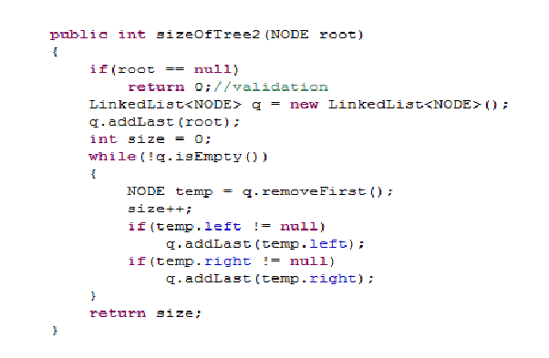

Slide 18
FUN WITH GRAPHS

Slide 19
PROBLEM 6
DELETE A BINARY TREE
WHICH TRAVERSAL TO USE ??

Slide 20
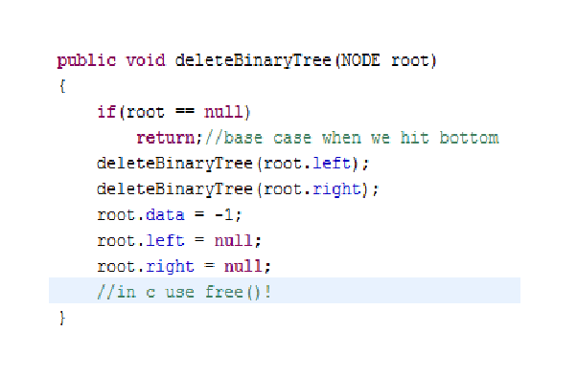

Slide 21
Problem 7
PRINT LEVEL ORDER IN REVERSE ORDER

Slide 22
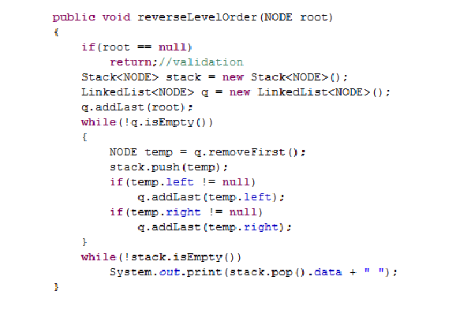

Slide 23
Problem 8
HEIGHT OF THE BINARY TREE

Slide 24
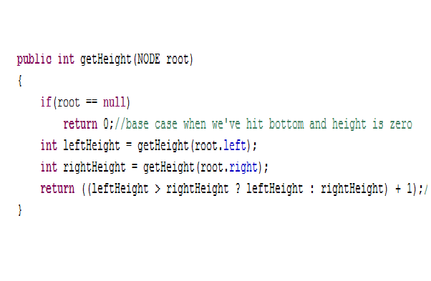

Slide 25
ITERATIVE ?
OBVIOUSLY LEVEL ORDER TRAVERSAL!
MODIFICATION ???

Slide 26
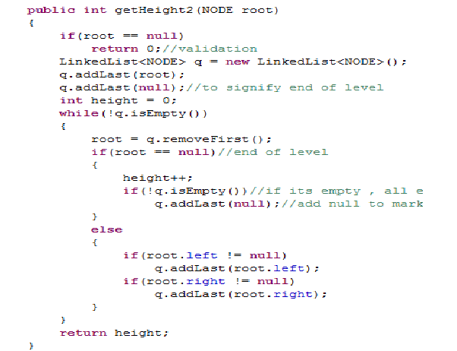

Slide 27
Problem 9
DEEPEST NODE IN A BINARY TREE

Slide 28
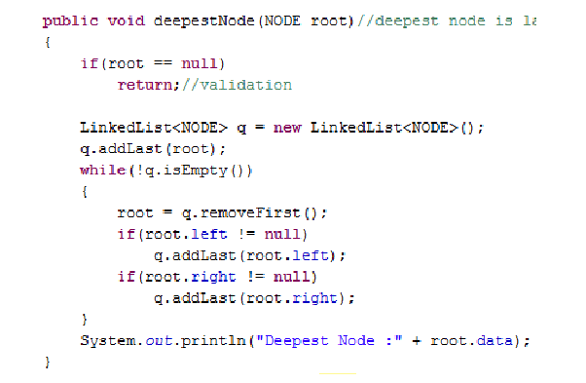

Slide 29
Problem 10
DISPLAY ALL LEAVES,HALF-FULL AND FULL NODES

Slide 30
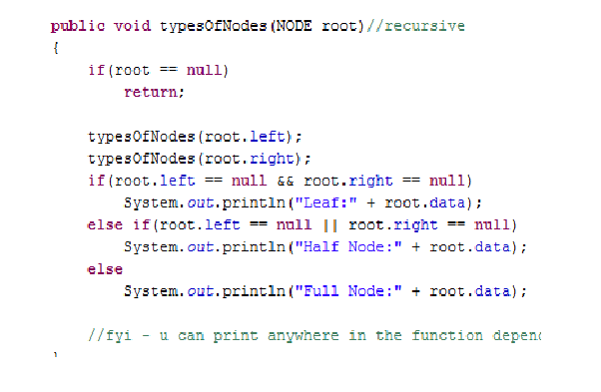

Slide 31
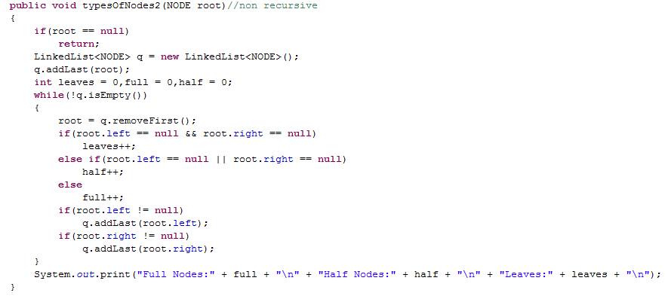

Slide 32
BREAK ! STRICTLY 5 MINUTES !!
PLEASE.. !

Slide 33
Problem 11
CHECK IF TWO BINARY TREES ARE IDENTICAL

Slide 34
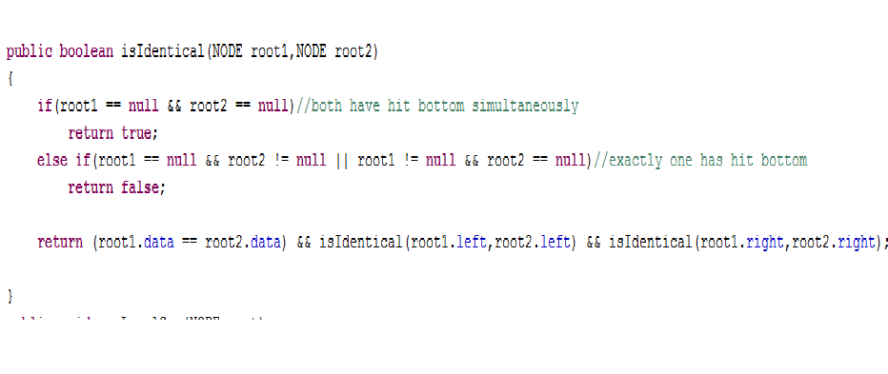

Slide 35
USING LEVEL ORDER TRAVERSAL ??

Slide 36
PROBLEM 12
PRINT ALL PATHS FROM ROOT TO LEAF

Slide 37
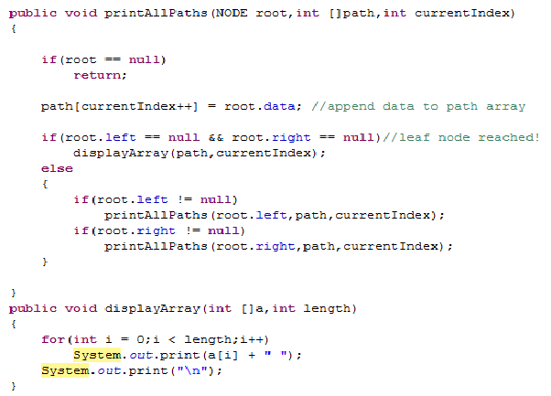

Slide 38
PROBLEM 13
FIND THE LEVEL WHICH HAS MAXIMUM SUM

Slide 39
PROBLEM 14:
CHECK FOR EXISTENCE OF A PATH FROM ROOT TO LEAF FOR A GIVEN SUM

Slide 40
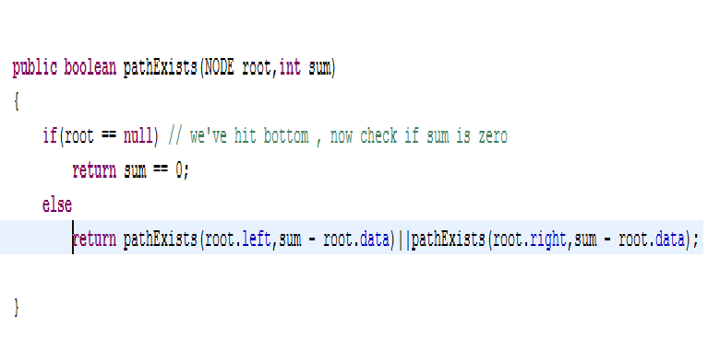

Slide 41
BRAIN TEASER : FYI : ASKED TWICE THIS YEAR IN INTERVIEWS !!
100 Bulbs

