Slide 1
LECTURE-8
BIT MANIPULATION

Slide 2
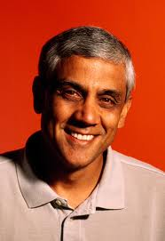

Slide 3
BITWISE OPERATORS
& , | , ^ , << , >> , ~
ADDITION & SUBTRACTION ?

Slide 4
PROBLEM 1
GET THE BIT AT A GIVEN POSITION

Slide 5
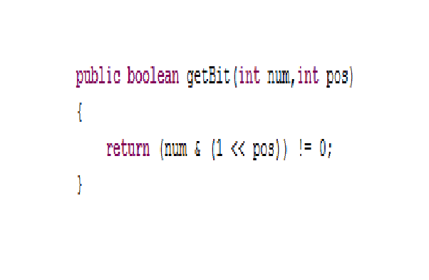

Slide 6
PROBLEM 2
SET THE BIT AT A GIVEN POSITION

Slide 7
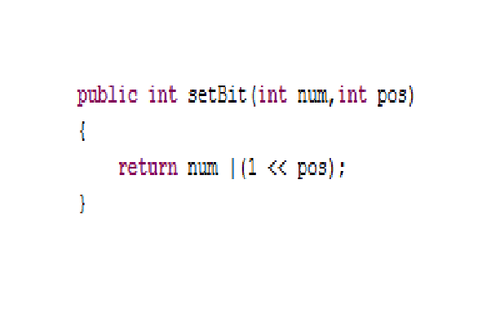

Slide 8
PROBLEM 3
CLEAR THE BIT AT A GIVEN POSITION

Slide 9
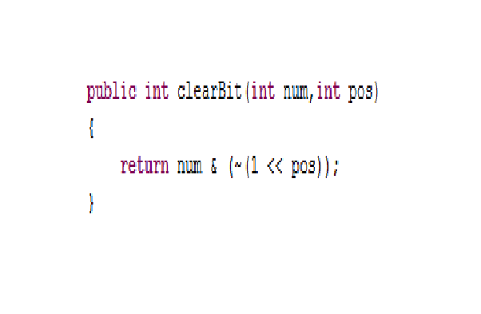

Slide 10
PROBLEM 4
CLEAR ALL BITS FROM MSB TILL A GIVEN POSITION(INCLUSIVE)

Slide 11
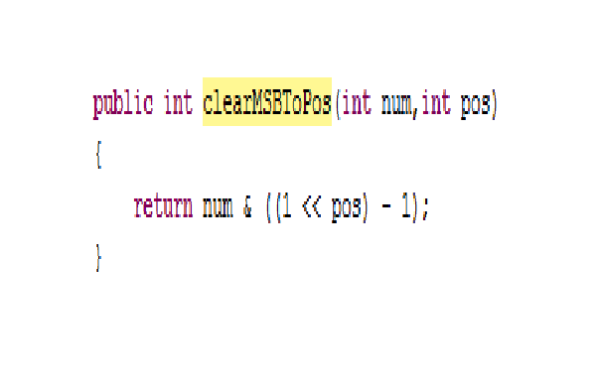

Slide 12
PROBLEM 5
CLEAR ALL BITS FROM A GIVEN POSITION TILL LSB

Slide 13
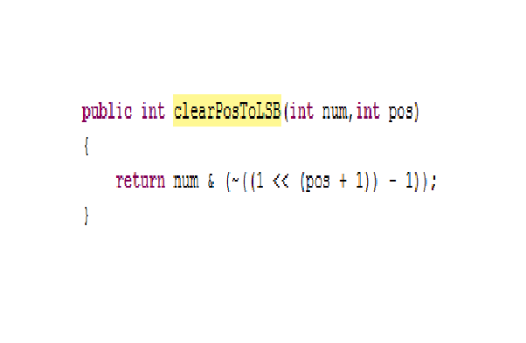

Slide 14
PROBLEM 6
UPDATE BIT AT A GIVEN POSITION

Slide 15
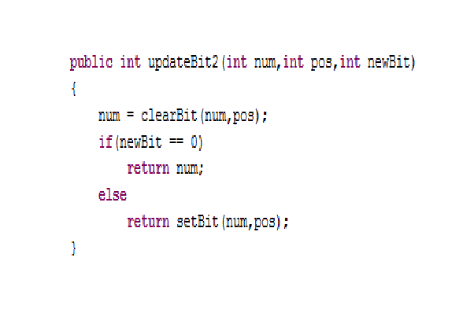

Slide 16
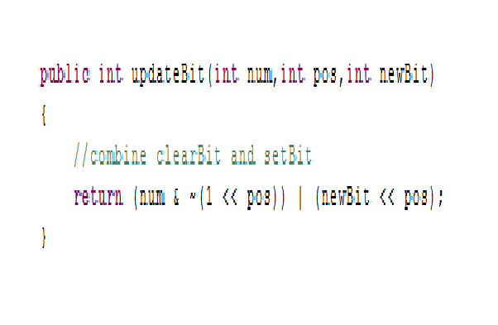

Slide 17
PROBLEM 7
CHECK IF THE BIT IS SET AT A GIVEN POSITION

Slide 18
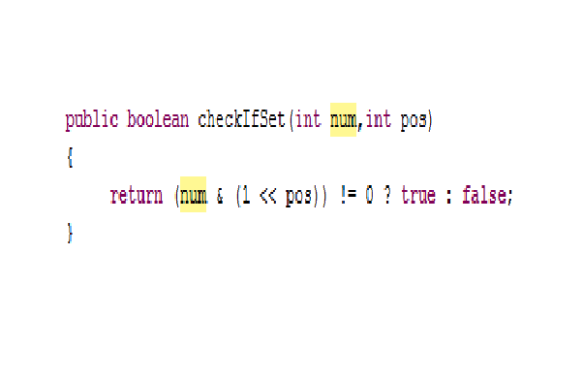

Slide 19
PROBLEM 8
TOGGLE THE BIT AT A GIVEN POSITION

Slide 20
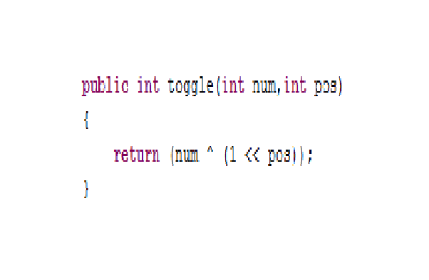

Slide 21
PROBLEM 9
CLEAR THE RIGHTMOST ‘1’ BIT (i.e. SET IT TO ‘0’)

Slide 22
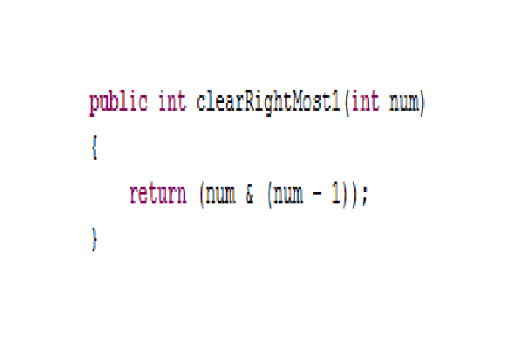

Slide 23
If (n & n-1) == 0
WHAT CAN I SAY ABOUT ‘n’ ??

Slide 24
PROBLEM 10
CHECK IF A NUMBER IS A POWER OF TWO

Slide 25
NORMAL ALGO ??
DIVIDE BY 2 IN A LOOP.
IF YOU GET AN ODD NO. APART FROM 1 AS QUOTIENT , RETURN FALSE ELSE TRUE !

Slide 26
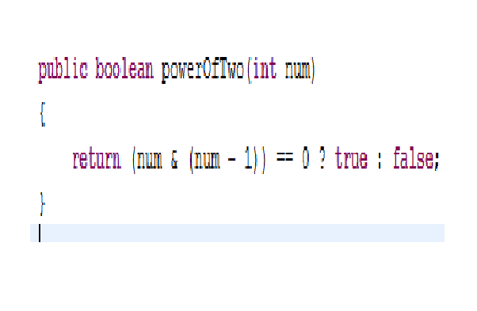

Slide 27
INTERVIEW PREP v2.0

Slide 28
PROBLEM 11
MULTIPLY BY POWER OF 2

Slide 29
SOLUTION : SIMILAR TO BASE 10!
return num << k;

Slide 30
DIVIDE BY POWER OF 2 ??

Slide 31
Return Num >> k;
FOR UNSIGNED : EXTEND 0(s)
IF SIGNED : EXTEND MSB

Slide 32
PROBLEM 12
PRINT THE BINARY REPRESENTATION OF A NUMBER IN REVERSE ORDER

Slide 33
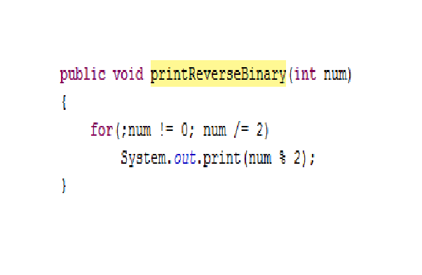

Slide 34
PROBLEM 13
REVERSE THE BINARY REPRESENTATION OF A NUMBER

Slide 35
SOLUTION 1
IF BIT AT POSITION ‘i’ IS SET IN NUM,
SET BIT AT POSITION ‘N-i-1’ IN revNUM
WHERE ‘N’ is number of bits in NUM

Slide 36
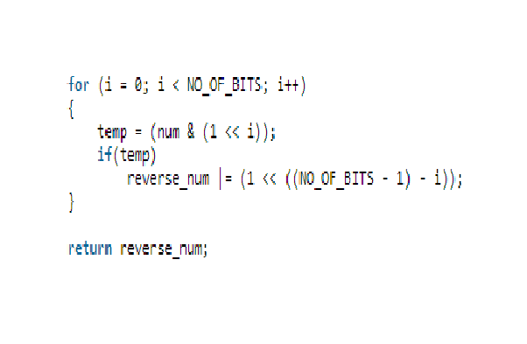

Slide 37
SOLUTION 2
PUT SET BITS OF NUM IN revNUM UNTIL NUM == 0
THEN,
SHIFT REMAINING BITS OF revNUM

Slide 38
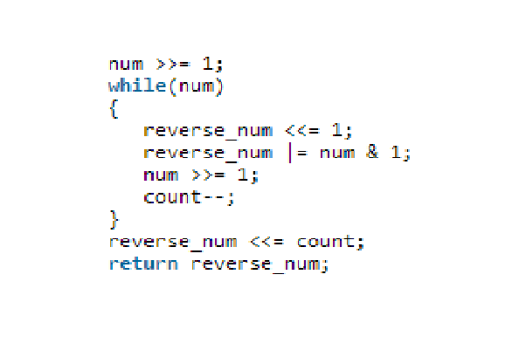

Slide 39
PROBLEM 14
CHECK IF A NUMBER IS DIVISIBLE BY 3 WITHOUT USING “%” or “/”

Slide 40
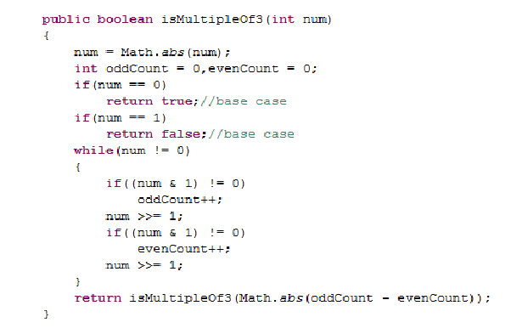

Slide 41
PROBLEM 15
COUNT THE NUMBER OF ‘1’(s) IN THE BINARY REPRESENTATION OF A GIVEN NUMBER

Slide 42
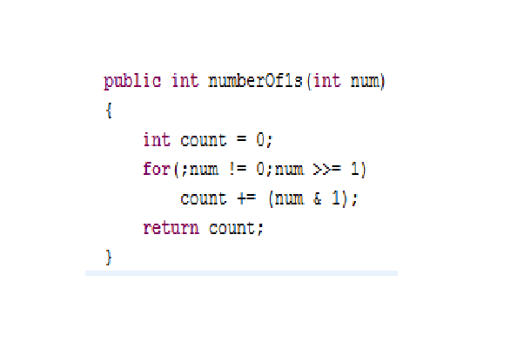

Slide 43
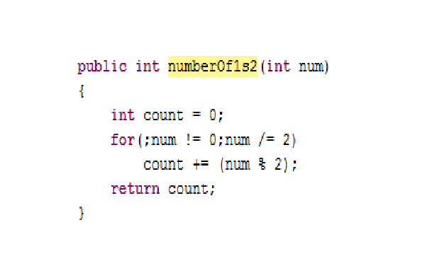

Slide 44
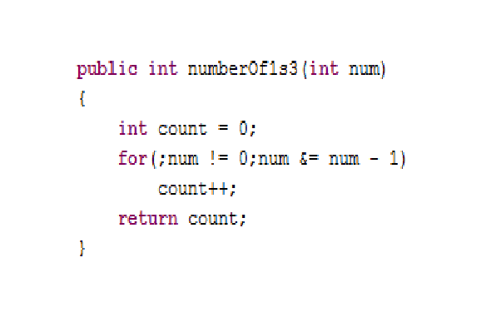

Slide 45
PROBLEM 16
GET MEAN OF TWO NUMBERS WITHOUT USING “/” OPERATOR

Slide 46
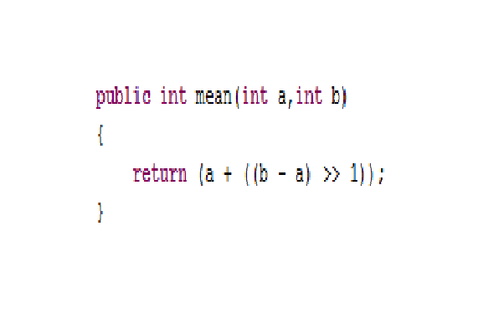

Slide 47
PROBLEM 17
INSERT A SMALLER BINARY NUMBER INTO A LARGER ONE FROM ONE GIVEN POSITION TO THE OTHER

Slide 48
SOLUTION :
CLEAR THE BITS ‘i’ to ‘j’ in ‘n’
SHIFT ‘m’ ACCORDINGLY
MERGE THE TWO!

Slide 49
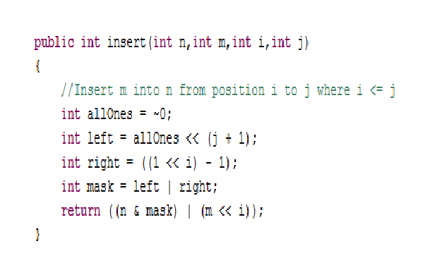

Slide 50
PROBLEM 18
PRINT THE BINARY REPRESENTATION OF A REAL NUMBER BETWEEN 0 & 1

Slide 51
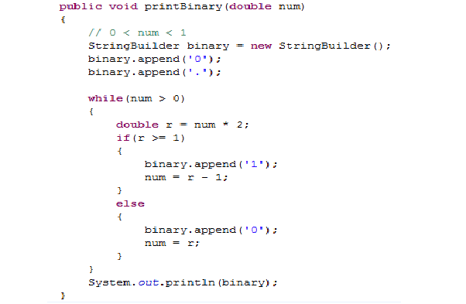

Slide 52
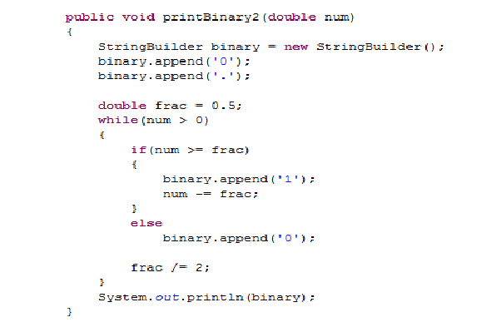

Slide 53
PROBLEM 19
DETERMINE NUMBER OF BITS REQUIRED TO CONVERT INTEGER ‘A’ TO ‘B’
(FAIQ)

Slide 54
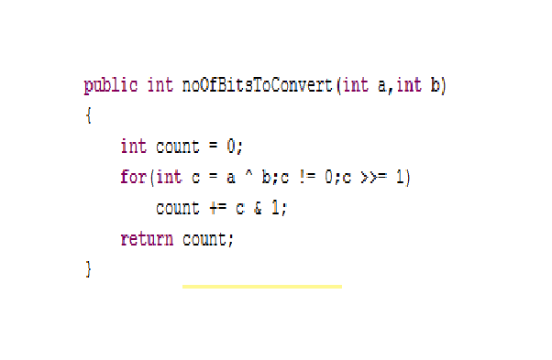

Slide 55
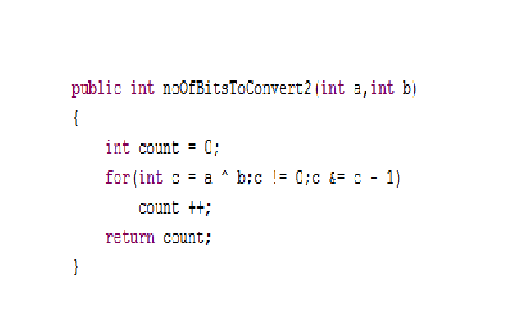

Slide 56
PROBLEM 20
SWAP TWO INTEGERS IN PLACE

Slide 57
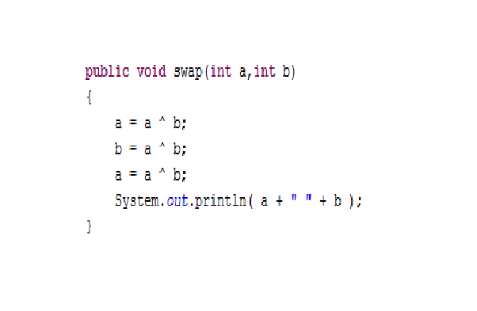

Slide 58
PROBLEM 21
ADD TWO INTEGERS WITHOUT USING ‘+’ or ‘-’ OPERATOR

Slide 59
