Slide 1
Building Web Reports with the Excel Connector
Michael Stone
CISSP® - CTP IBM Security
March 2018

Slide 2
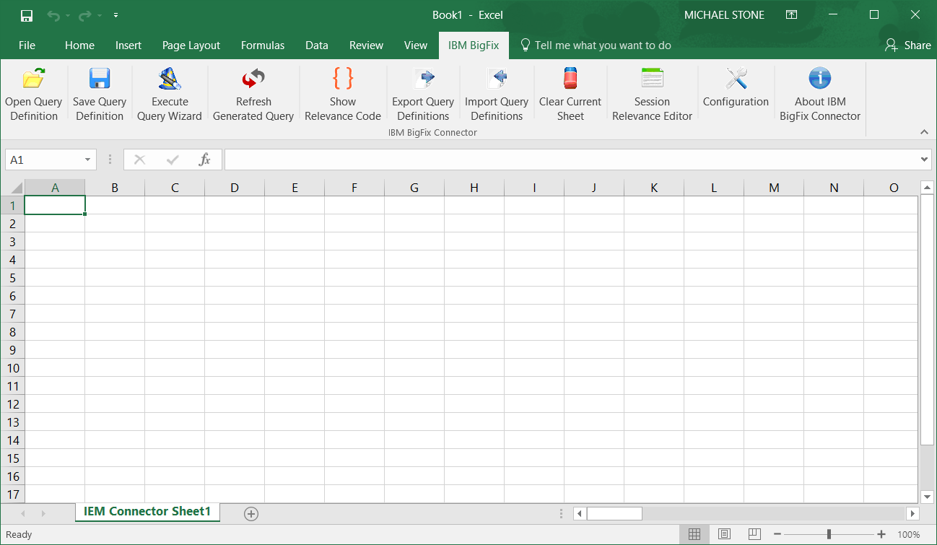
What is the Excel Connector?
Accesses Web Reports and populates a spreadsheet with report data.
Has a Query Wizard and a Session Relevance Tester.

Slide 3
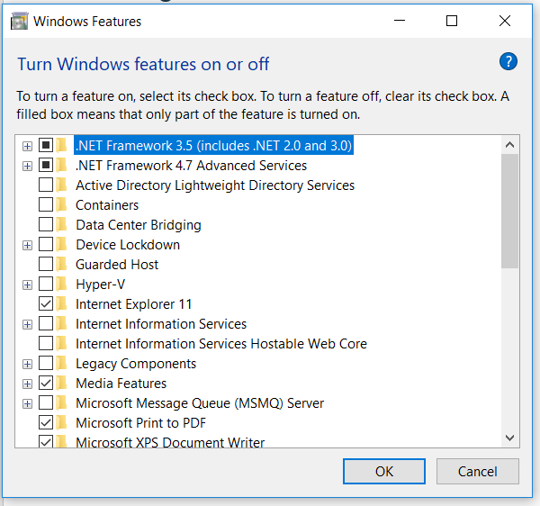
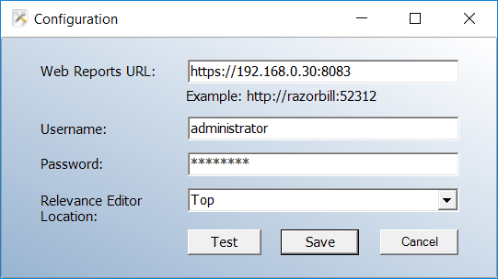
Installing the Connector
Be sure you have .NET 2.0 installed or enabled.
Run the MSI
Yes, this works on Windows 10

Slide 4
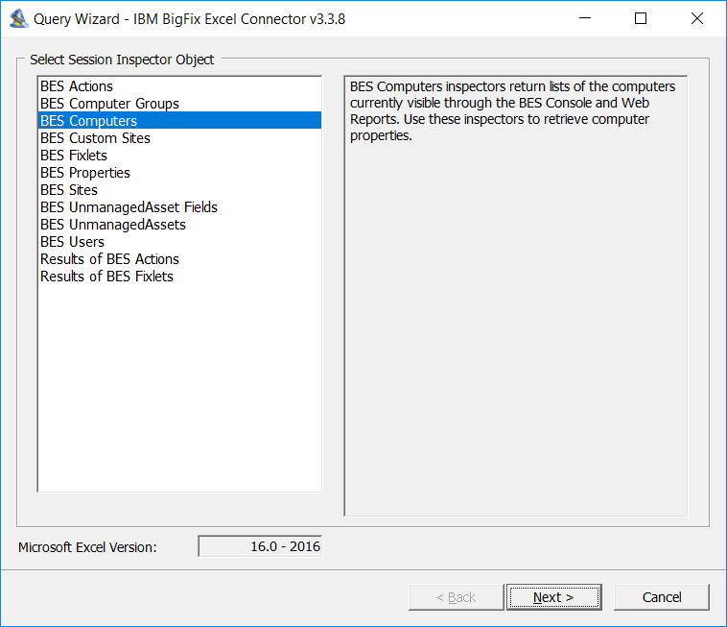
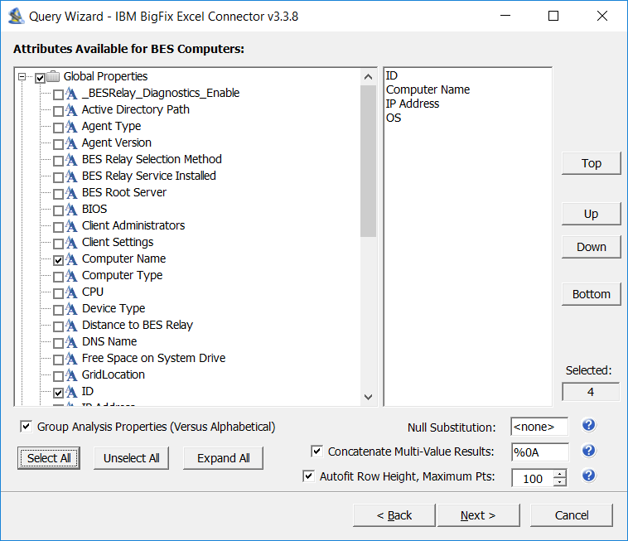
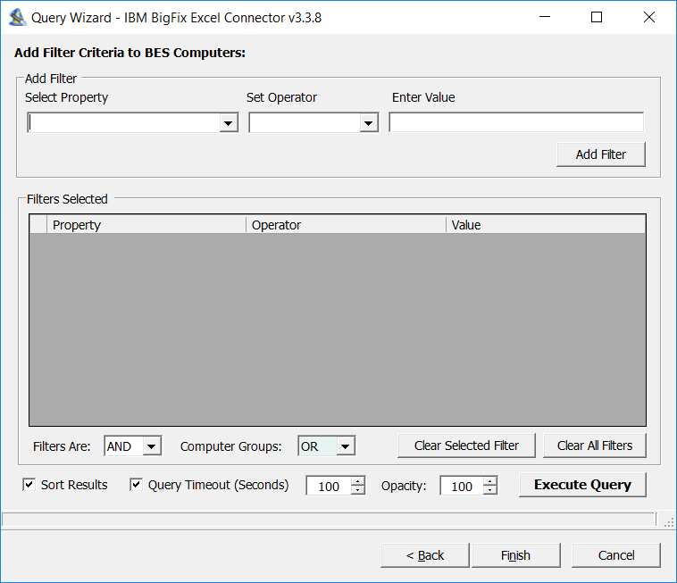
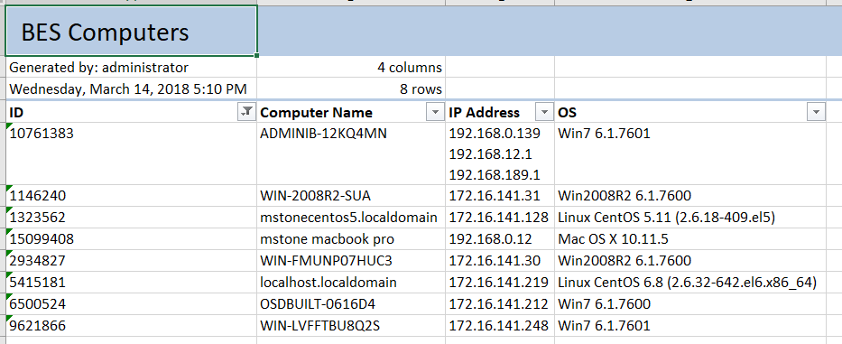
Query Wizard

Slide 5
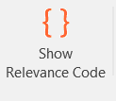
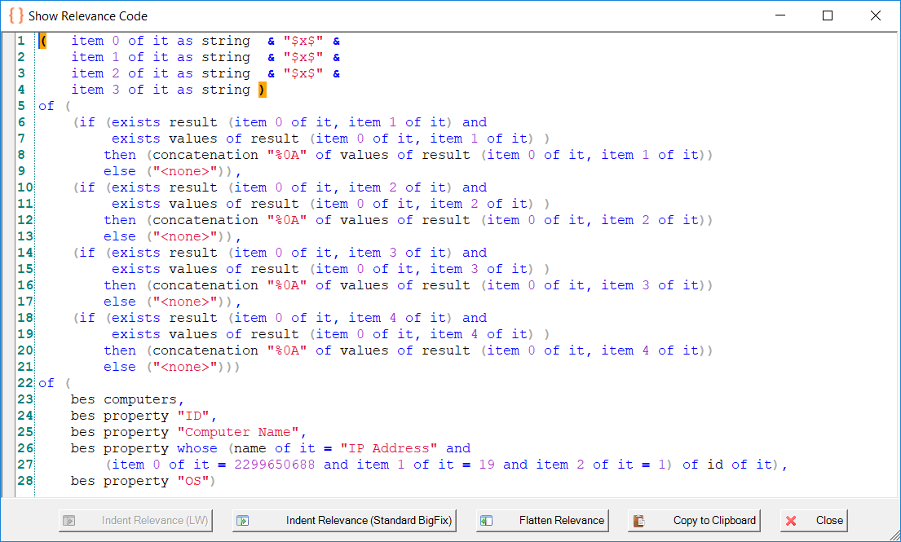
Show Relevance Code

Slide 6
Do Not Panic!
It’s not as complicated as it looks

Slide 7
The Object
( item 0 of it as string & "$x$" & item 1 of it as string & "$x$" & item 2 of it as string & "$x$" & item 3 of it as string ) of ( (if (exists result (item 0 of it, item 1 of it) and exists values of result (item 0 of it, item 1 of it) ) then (concatenation "%0A" of values of result (item 0 of it, item 1 of it)) else ("<none>")), (if (exists result (item 0 of it, item 2 of it) and exists values of result (item 0 of it, item 2 of it) ) then (concatenation "%0A" of values of result (item 0 of it, item 2 of it)) else ("<none>")), (if (exists result (item 0 of it, item 3 of it) and exists values of result (item 0 of it, item 3 of it) ) then (concatenation "%0A" of values of result (item 0 of it, item 3 of it)) else ("<none>")), (if (exists result (item 0 of it, item 4 of it) and exists values of result (item 0 of it, item 4 of it) ) then (concatenation "%0A" of values of result (item 0 of it, item 4 of it)) else ("<none>"))) of ( bes computers, bes property "ID", bes property "Computer Name", bes property whose (name of it = "IP Address" and (item 0 of it = 2299650688 and item 1 of it = 19 and item 2 of it = 1) of id of it), bes property "OS")

Slide 8
The Validation
( item 0 of it as string & "$x$" & item 1 of it as string & "$x$" & item 2 of it as string & "$x$" & item 3 of it as string ) of ( (if (exists result (item 0 of it, item 1 of it) and exists values of result (item 0 of it, item 1 of it) ) then (concatenation "%0A" of values of result (item 0 of it, item 1 of it)) else ("<none>")), (if (exists result (item 0 of it, item 2 of it) and exists values of result (item 0 of it, item 2 of it) ) then (concatenation "%0A" of values of result (item 0 of it, item 2 of it)) else ("<none>")), (if (exists result (item 0 of it, item 3 of it) and exists values of result (item 0 of it, item 3 of it) ) then (concatenation "%0A" of values of result (item 0 of it, item 3 of it)) else ("<none>")), (if (exists result (item 0 of it, item 4 of it) and exists values of result (item 0 of it, item 4 of it) ) then (concatenation "%0A" of values of result (item 0 of it, item 4 of it)) else ("<none>"))) of ( bes computers, bes property "ID", bes property "Computer Name", bes property whose (name of it = "IP Address" and (item 0 of it = 2299650688 and item 1 of it = 19 and item 2 of it = 1) of id of it), bes property "OS")

Slide 9
The Result
( item 0 of it as string & "$x$" & item 1 of it as string & "$x$" & item 2 of it as string & "$x$" & item 3 of it as string ) of ( (if (exists result (item 0 of it, item 1 of it) and exists values of result (item 0 of it, item 1 of it) ) then (concatenation "%0A" of values of result (item 0 of it, item 1 of it)) else ("<none>")), (if (exists result (item 0 of it, item 2 of it) and exists values of result (item 0 of it, item 2 of it) ) then (concatenation "%0A" of values of result (item 0 of it, item 2 of it)) else ("<none>")), (if (exists result (item 0 of it, item 3 of it) and exists values of result (item 0 of it, item 3 of it) ) then (concatenation "%0A" of values of result (item 0 of it, item 3 of it)) else ("<none>")), (if (exists result (item 0 of it, item 4 of it) and exists values of result (item 0 of it, item 4 of it) ) then (concatenation "%0A" of values of result (item 0 of it, item 4 of it)) else ("<none>"))) of ( bes computers, bes property "ID", bes property "Computer Name", bes property whose (name of it = "IP Address" and (item 0 of it = 2299650688 and item 1 of it = 19 and item 2 of it = 1) of id of it), bes property "OS")

Slide 10
The Design
<HTML>
<HEAD>
</HEAD>
<BODY>
<TABLE>
<?relevance
Secret Sauce goes HERE
?>
</TABLE>
</BODY>
</HTML>

Slide 11
The Secret Sauce – Step 1
Remove special separators and add Table Data session relevance tags.
( td of (item 0 of it as string) & $x$ &
td of (item 1 of it as string) & $x$ &
td of (item 2 of it as string) & $x$ &
td of (item 3 of it as string)
)
of (The Validation)
of (The Objects)

Slide 12
The Secret Sauce – Step 2
Concatenate the Table Data into Table Rows. Do not forget to the close parentheses around EVERYTHING.
concatenation of trs of (
( td of (item 0 of it as string) &
td of (item 1 of it as string) &
td of (item 2 of it as string) &
td of (item 3 of it as string)
)
of (The Validation)
of (The Objects)
)

Slide 13
The Secret Sauce – Step 3
Add Table Headers. Replace “…” with column names. Repeat as necessary.
tr of (th of “…" & th of “…" & th of “…" & th of “…") &
concatenation of trs of (
( td of (item 0 of it as string) &
td of (item 1 of it as string) &
td of (item 2 of it as string) &
td of (item 3 of it as string)
)
of (The Validation)
of (The Objects)
)

Slide 14
Demo

Slide 15
Extra Credit
Adding a Border.
<TABLE border=“1”>
Making columns sortable.
Add a <SCRIPT> … </SCRIPT> section to the <HEAD> section of the HTML.
Go find a javascript app that sorts table columns.
https://www.kryogenix.org/code/browser/sorttable/#totalsrows
Paste it in.
Note: Sometimes there are problems with comments.
Add additional HTML to the report.
Headers, Footers, CSS
Filter it
Save filters for re-use
Schedule it
Saved reports and saved filters can be scheduled to run.
Trigger it

Slide 16
Q&A

