Slide 1



DATA ANALYTICS CASE STUDY
From Raw Spreadsheets to
Executive Insights
How I built an interactive Excel Dashboard to solve a retail operational crisis.
Swipe Left

Slide 2
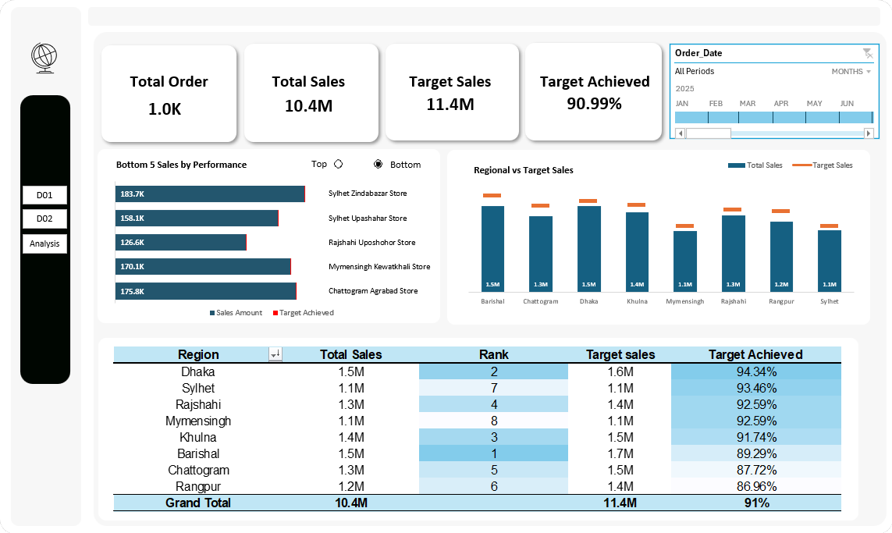
02
Visualizing the Big Picture
Instead of hunting through thousands of sales rows, executives can now monitor overall business health through dynamic KPI cards and timeline slicers.
1.0K
10.4M
90.99%
TOTAL ORDERS
TOTAL SALES
TARGET ACHIEVED

Slide 3
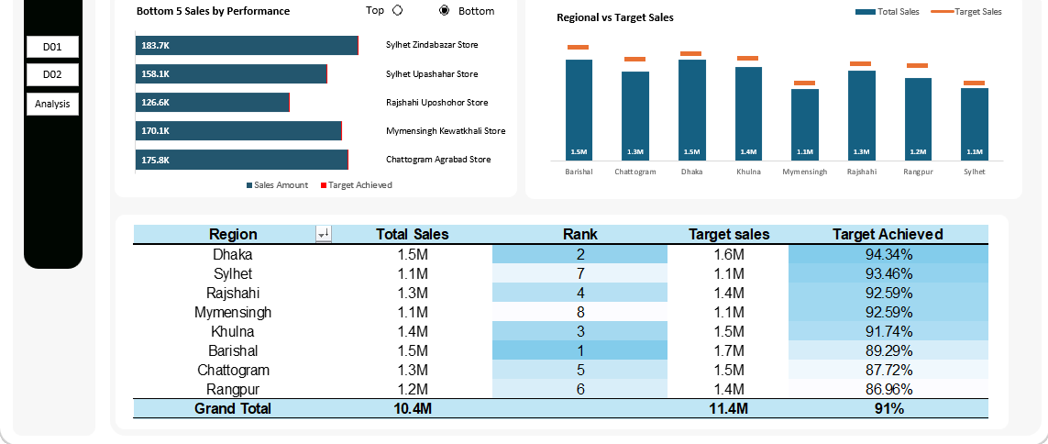
03
Regional vs. Target Sales
Using clustered column charts with target indicators, we can instantly spot which regions are hitting goals. While Barishal leads in total volume, Rangpur clearly falls short of its target line.
TOP PERFORMER
NEEDS ATTENTION
Barishal
Rangpur
1.5M sales · Rank #1 · 89.29% of target
1.2M sales · Rank #6 · 86.96% of target

Slide 4
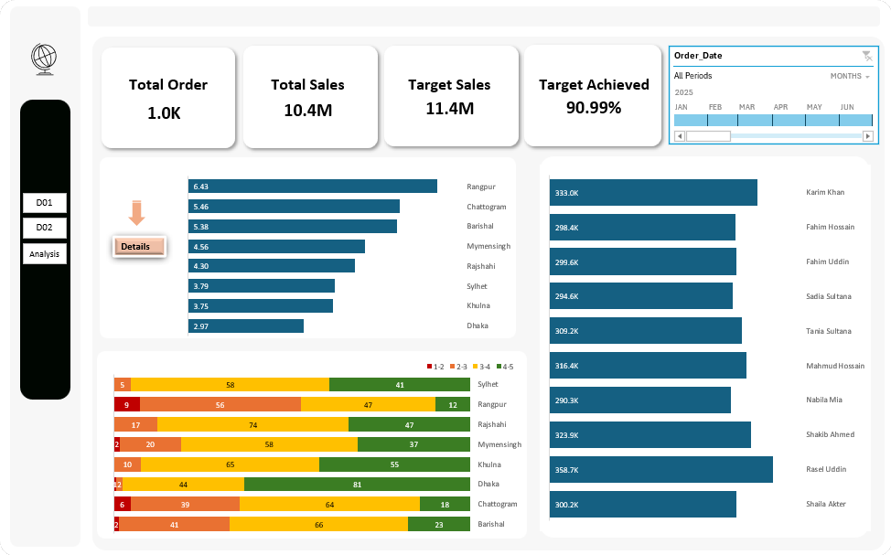

04
Connecting Delivery Delays
to Low Ratings
Switch to our operations view. By aligning average delivery days with customer sentiment metrics, the connection is obvious: Rangpur's massive delivery delay directly drives its high volume of poor customer scores.
6.43 DAYS
Rangpur's avg. delivery time, highest in the network

Slide 5
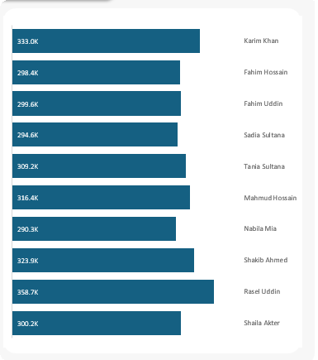

05
Salesperson Performance
Analytics
A data-driven business needs to recognize its growth drivers. Our operations board tracks individual sales contributions to help management replicate the strategies of top performers across other stores.
Top Performer: Rasel Uddin - 358.7K in sales

Slide 6
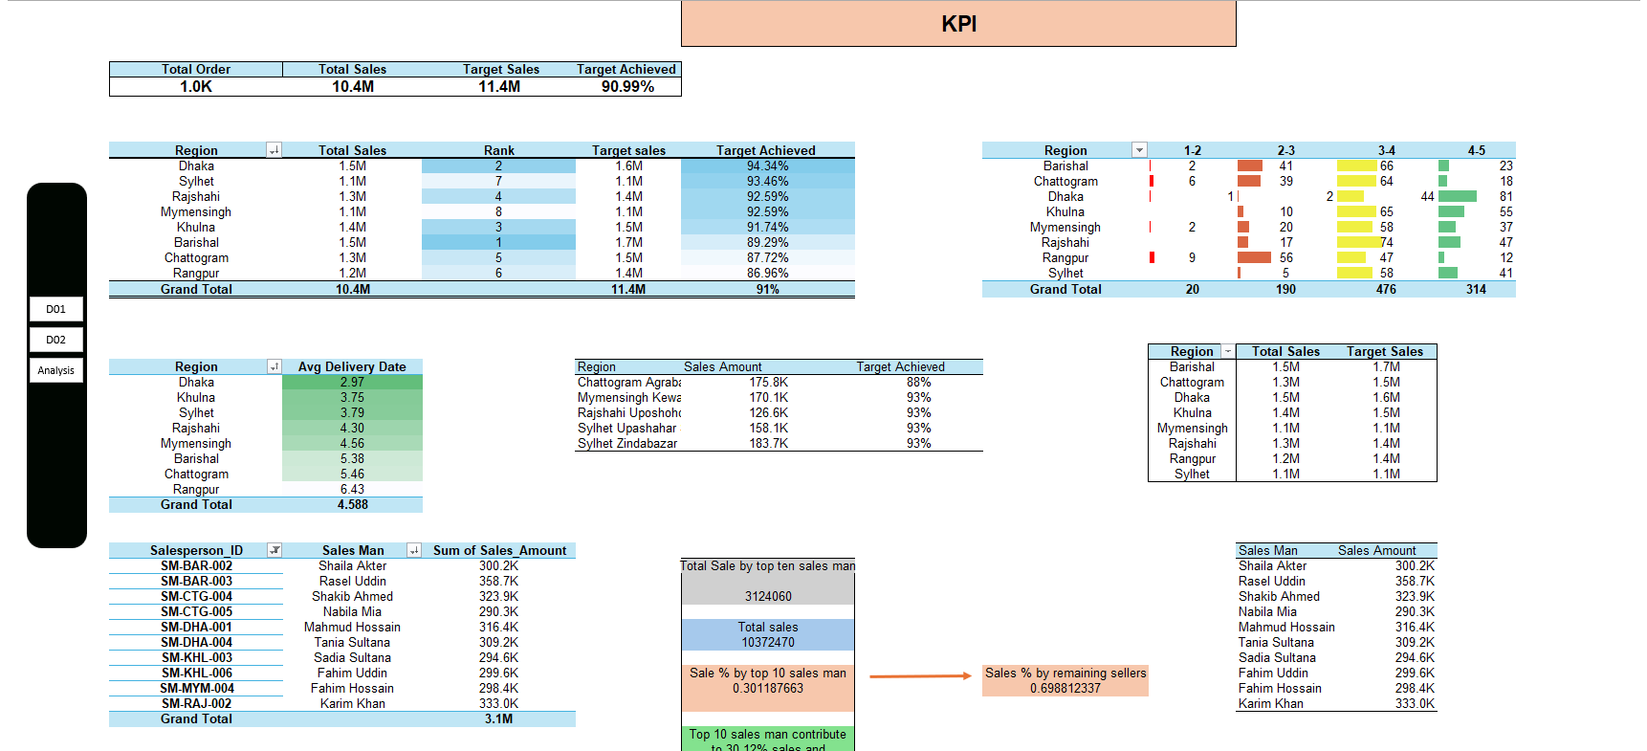



06
The Behind-the-Scenes
Data Architecture
A clean dashboard requires a powerful back-end engine. This is where the heavy lifting happens: automated pivot tables, calculated items, conditional formatting alerts, and database links.
Pivot Tables
Calculated Items
Automated multi-dimensional summaries
Custom KPI formulas & metrics
Conditional Formatting
Visual alerts for target misses

Slide 7


07
True Dashboard Thinking
Clarity over Complexity
Clean layouts guide managers to answers, not more questions.
Interactive Speed
Slicers change data views instantly for agile decisions.
Action-Oriented
Moves businesses from watching problems to solving root causes.

