Slide 1
DATA ANALYTICS CASE STUDY
If Your Business
Hit 91% of
Its Target,
Would You Worry?
Why surface-level numbers lie, and how I used
Excel to find a hidden retail bottleneck.
Swipe Left ➡

Slide 2
SLIDE 2 OF 8
The 9.01% Performance Gap
Total sales reached 10.3M against an 11.3M target. A 90.99% achievement looks okay on paper, but where exactly is the leakage happening?
10.3M
11.3M
Total Sales Achieved
Total Target
90.99%
9.01%
Target Achieved
Performance Gap
90.99% Achieved
9.01% Gap
Swipe to investigate the regions ➡

Slide 3
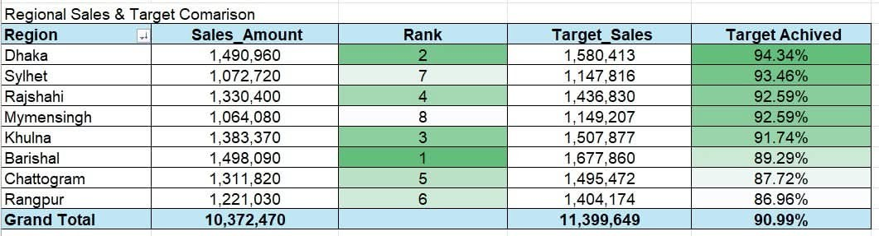
SLIDE 3 OF 8
Not All Revenue is Equal
Barishal generated the most revenue, but Dhaka was most efficient at hitting targets. Rangpur lagged behind at just 86.96%. We isolated Rangpur for a deep-dive.
🏆 Most Efficient
⚠️ Lagging Region
Dhaka - 94.34%
Target Achievement
Rangpur - 86.96%
Lowest Performance
Why did Rangpur fall behind? Checking customer satisfaction... ➡

Slide 4
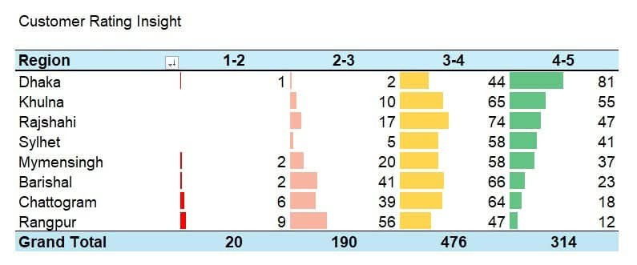
SLIDE 4 OF 8
The Warning Signs in
Customer Ratings
Visualizing customer feedback revealed a troubling pattern. In Rangpur, over half of all ratings , 65 out of 124 dropped below 3 stars. Customers were clearly signaling their dissatisfaction.
Rangpur Alert: 52% of ratings fell below 3 stars — the highest negative rate of all 8 regions.
What caused this dissatisfaction? The next slide holds the answer... ➡

Slide 5
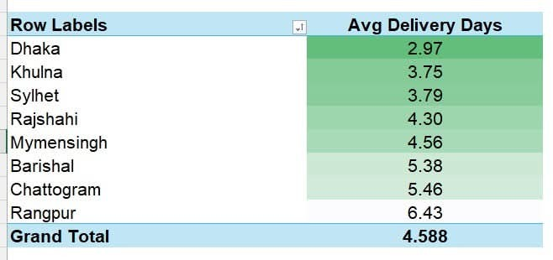
SLIDE 5 OF 8
The Smoking Gun: Delivery Delays
The data is unambiguous. While Dhaka delivers in under 3 days, Rangpur takes nearly 6.5 days. This delay destroys customer trust and kills repeat sales.
2.97 days
6.43 days
Dhaka (Best)
Rangpur (Worst)
Let's pinpoint exactly where to take action... ➡

Slide 6
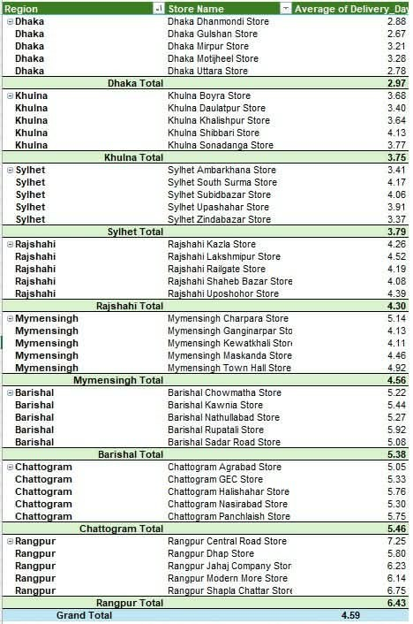
SLIDE 6 OF 8
Store-Level Drill Down
Managers can't fix an entire region overnight. By drilling into store-level data, we isolated the exact culprits, like Central Road Store taking 7.25 days to ship orders.
Rangpur Central Road Store: 7.25 days avg, worst in the entire network.
Looking at the bigger operational picture... ➡

Slide 7
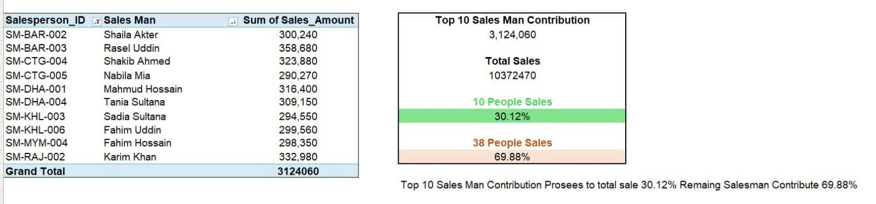
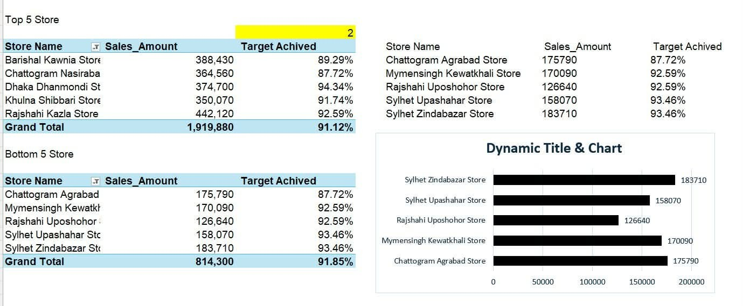
SLIDE 7 OF 8
Top Performers &
Store Contributions
We tracked top salesperson performance and contrasted our top 5 vs bottom 5 stores to identify strategies that can be replicated company-wide.
Final recommendations for management... ➡

Slide 8
SLIDE 8 OF 8 • CONCLUSION
Data-Driven
Recommendations
Fix Rangpur's Supply Chain
Immediately audit logistics & delivery manpower. The 6.43-day avg must be cut to under 4 days to recover customer trust.
Drill Into Central Road Store
At 7.25 days, Central Road Store is the single biggest drag. Audit stock availability, last-mile capacity, and staffing.
Clone Dhaka's Fast-Fulfillment Model
At 2.97 days and 94.34% target achievement, Dhaka's playbook, processes, partners, staffing ratios should be documented and rolled out nationally.
From Rows to Results: My Data Analytics Journey | Thank you for reading!

