Slide 1
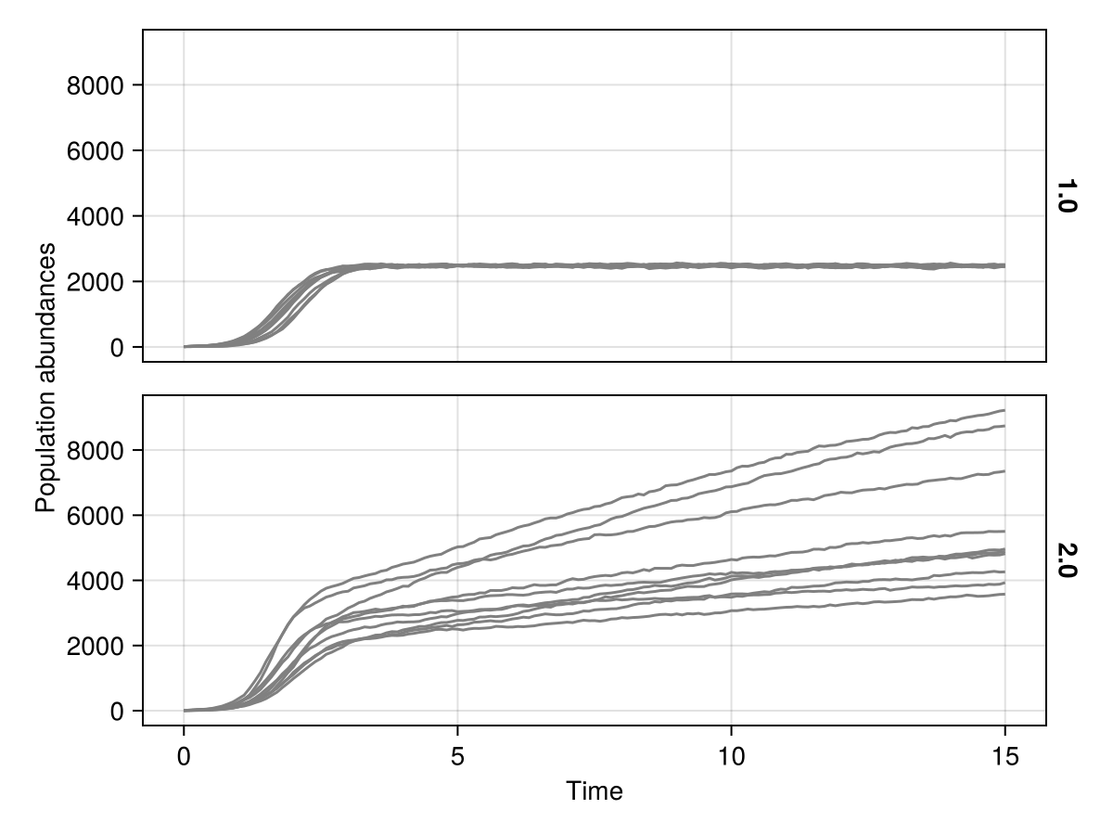
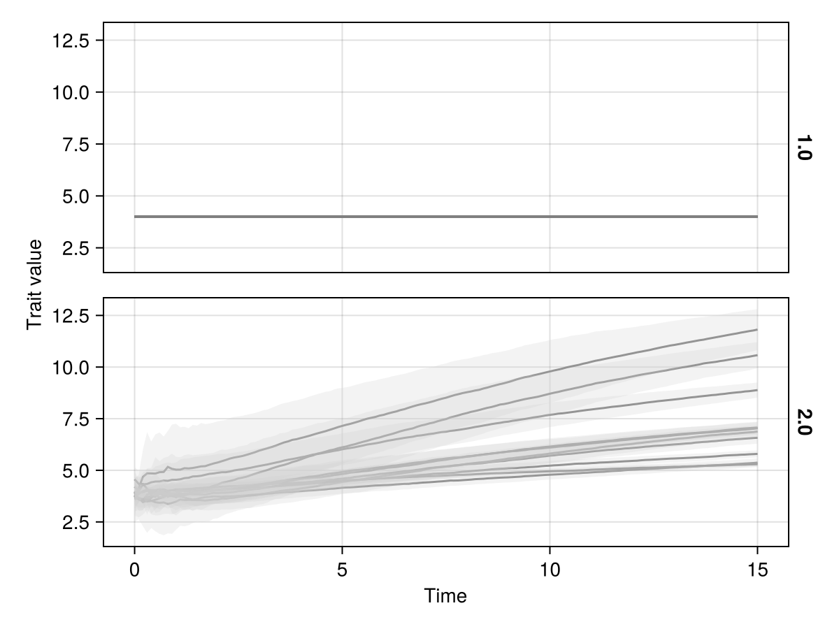
(a) Population through time
birth-death Logistic Model
(b) Trait through time

