Slide 1
CLARK
Our Agenda
Govt Agenda
DATA
PROFILES
CAMPAIGN
UPDATES
Notes:
This is the homepage for clarknation.org. At the top users can sign into their accounts. If you click on the red CLARK banner at the top of every page, then it will bring you back to the home page. On this page there are also five navigation buttons to look at issues, bills, data on an issue or bill, representative and user profiles, and about us. Underneath that is a search bar and at the bottom of the page is a list of what has been recently added to the site.

Slide 2
CLARK
Unsorted
Potential Issues
Timed Issues
TRASH
Timer
FAILED TIMED ISSUES
Timer
Timer
Timer
Timer
Notes:
Clicking on issues on the previous page will lead to this page. At the top is the standard navigation bar that will be seen on every page from here onward. Underneath this are two boxes; locked issues and unlocked issues. Locked issues are the top 7 issues users have decided Congress needs to work on first. These issues will remain in this box until the deadline expires (which users can vote on to extend), or unless users vote to change its status from locked to unlocked (on the next slide).
The unlocked issues are all of the issues submitted, that have not been locked yet. When a locked issue’s deadline expires, it disappears from the locked list (going to the bills page if it has majority support), and the highest ranked Unlocked Issue moves to the Locked list. Users can only vote on 7 unlocked issues at a time, to ensure that some kind of prioritization occurs.
At the bottom of the page, users can click to submit an issue that will have the form shown on the following slide.

Slide 3
CLARK
Media
Background Information
Problem Statement
Requirements

Slide 4
CLARK
Unsorted
Ancestral Solutions
TRASH
Potential Solutions
`
Notes:
Clicking on issues on the previous page will lead to this page. At the top is the standard navigation bar that will be seen on every page from here onward. Underneath this are two boxes; locked issues and unlocked issues. Locked issues are the top 7 issues users have decided Congress needs to work on first. These issues will remain in this box until the deadline expires (which users can vote on to extend), or unless users vote to change its status from locked to unlocked (on the next slide).
The unlocked issues are all of the issues submitted, that have not been locked yet. When a locked issue’s deadline expires, it disappears from the locked list (going to the bills page if it has majority support), and the highest ranked Unlocked Issue moves to the Locked list. Users can only vote on 7 unlocked issues at a time, to ensure that some kind of prioritization occurs.
At the bottom of the page, users can click to submit an issue that will have the form shown on the following slide.

Slide 5
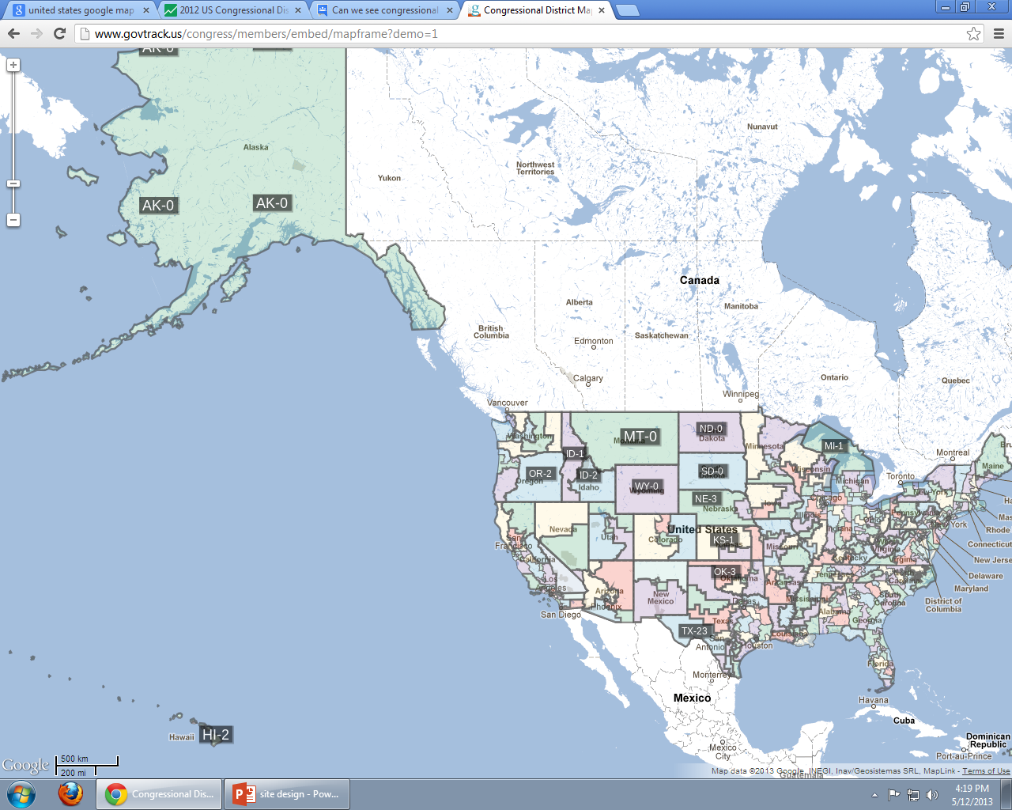
CLARK
ISSUE
BILLS
REPRESENTATIVES
Choose an Issue
Choose a Solution
Choose a Region
Possible Solution
 | ISSUE | SOLUTION
UNITED STATES
Politicians’ Response to this Solution
Friends
District
Congress
President
Justices
Notes:
This is the default data page. On the left is a map of the United States, organized by political districts. On the right, users can select to either see data about an issue or a particular bill. The next slide describes with an example how this page would work.

Slide 6
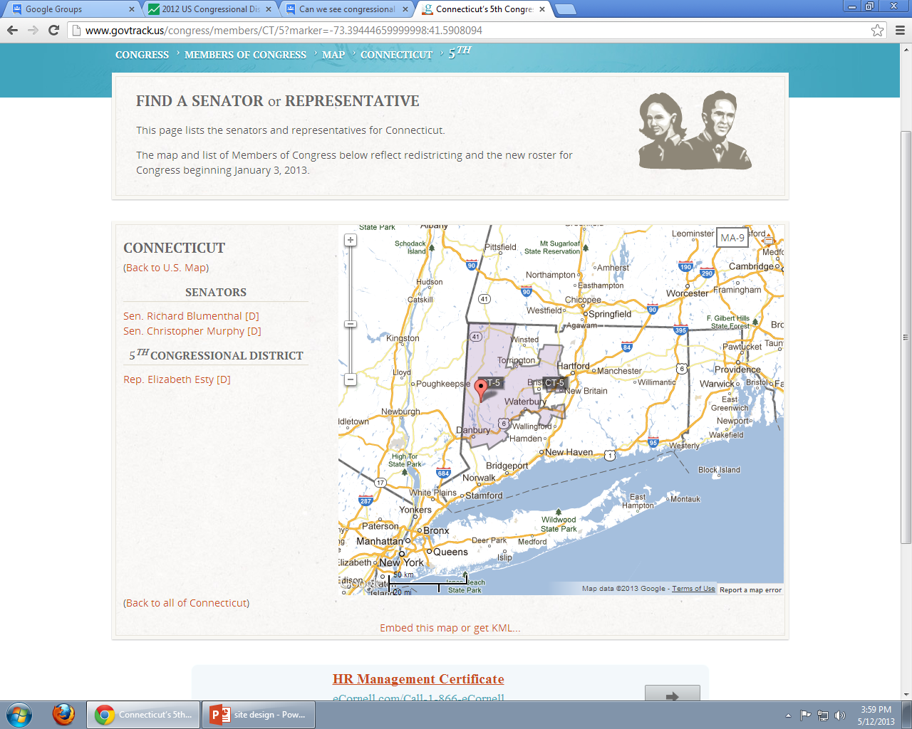
CLARK
ISSUES
DATA
BILLS
PROFILES
ABOUT US
STUDENT DEBT
ISSUE
BILLS
REPRESENTATIVES
Student Debt Bubble
Solution 2-Government Loans/Grants
Connecticut
Reduce the number of government student grants and loans available to colleges with lower job placement rates. Instead offer these loans and grants to colleges with higher job placement rates to ensure students who are talented but cannot afford an education, end up at colleges that will lead them to getting jobs. This solution ensures that colleges take more responsibility in adequately training their students for careers.
 | ISSUE | SOLUTION
CONNECTICUT | 40% | 20%
DISTRICT 5 | 80% | 60%
Sen Blumenthal- Will handle the issue.
Sen Murphy- No comment yet.
Rep Esty- No comment yet.
Friends
District
Congress
President
Justices
Notes:
This is the default data page. On the left is a map of the United States, organized by political districts. On the right, users can select to either see data about an issue or a particular bill. The next slide describes with an example how this page would work.

Slide 7
CLARK
Your Representatives
Position | Name | Latest Activity
House of Representatives | Elizabeth Esty
Senate | Richard Blumenthal
Senate | Christopher Murphy
Other Representatives
Position | State | Name | Latest Activity
House of Representatives | HI | Tulsi Gabbard
Justice | - | John Roberts
Secretary of State |  | Hillary Clinton
President | - | Barack Obama
Senate | AZ | John McCain
Notes:
This page contains a list of the profiles of all Representatives; organized by the user’s specific representatives, followed by other government officials.

Slide 8
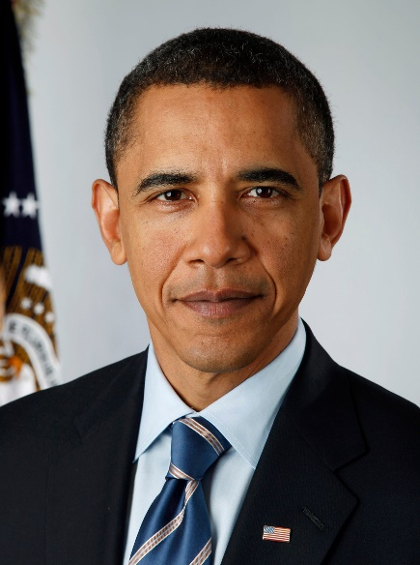
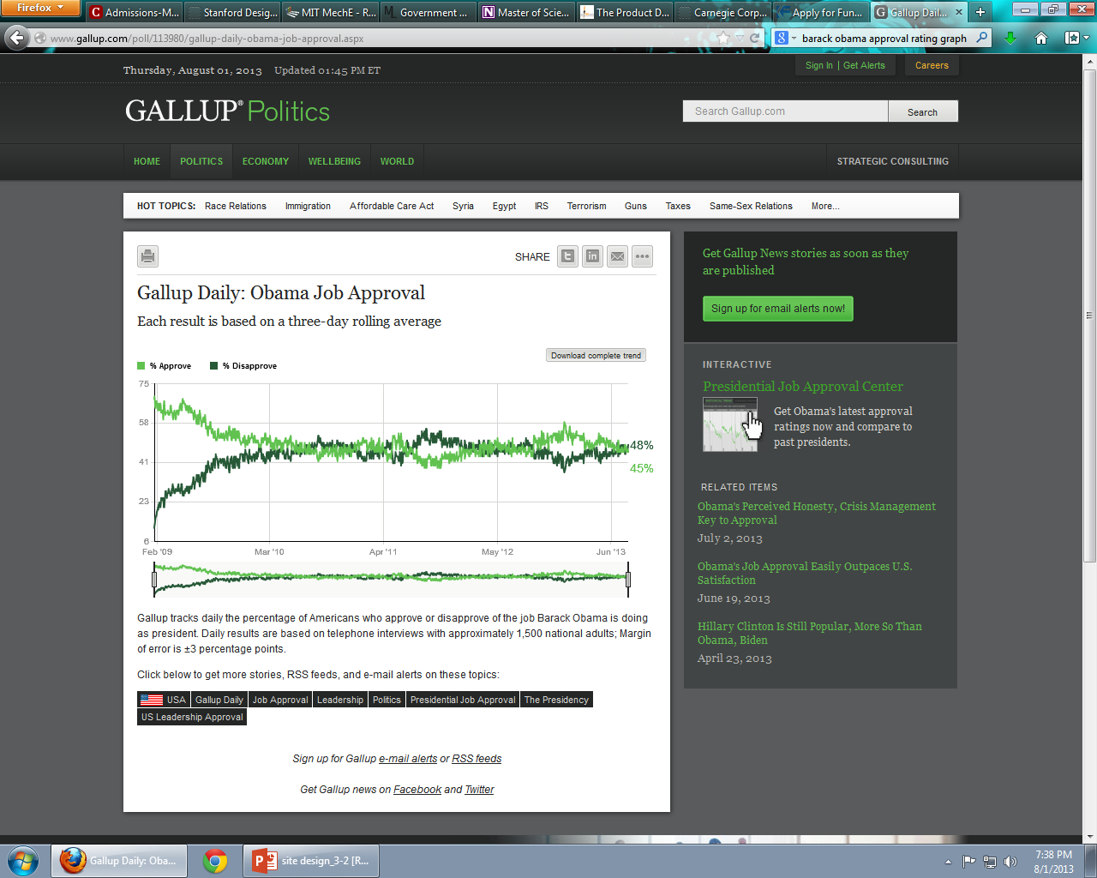
CLARK
Commend
Disapprove
Send a Letter
Recall
Name: Barack Obama
Position: United States Senator from Illinois (2005-2008)
Committees:
Biographical Statement:
Employment History:
Illinois State Senator (1997-2004)
Civil Rights Attorney
Gallup Poll Approval Rating:
CLARK Approval Rating:
Issues Dealt With
Bills Sponsored
Bills Co-Sponsored
Bill Amendments
Social Media Posts
Notes:
This page demonstrates what a Representatives’ Profile would look like. This page would be updated by the Representative themselves and has a format similar to a resume that a prospective employer would see (Political Party would not be displayed here). At the bottom are the CLARK issues that have been dealt with, followed by Bills Sponsored, Co-Sponsored, and Amendments written. Finally, the social media posts of the representative from twitter and facebook can be accumulated under the tab Social Media Posts. Above this, on the right, are polling data from the Gallup Poll and the Commend/Disapprove Data from CLARK users. Above this, users can Commend or Disapprove to contribute to the data mentioned, as well as send a letter to their Representative. The Recall Button generates data as to how many users would support going through a recall election of removing this Representative (clicking on this button generates an “Are you sure you wouldn’t rather disapprove?” prompt since recall elections should not be taken lightly). All of the Data mentioned would also be graphically organized into the Data Maps page. This page has been filled using Barack Obama when he was a US senator as an example.

