Slide 1
Multi-environment testing
We can select dataset for target specific testing.
Zug allows us to have multiple value column in a test suite for a macro
Each value column of the macro sheet is a data set
When running the test suite user can specify a particular value column of the macro sheet of a test suite whose value will be used while running the test suite.

Slide 2
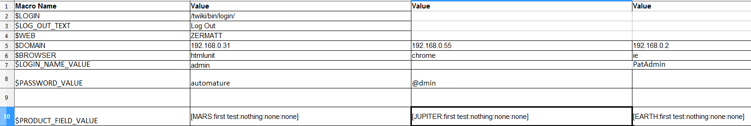
Multi-environment testing
If any cell of the selected column is empty then it takes the value of the default column cell (1st value column )

Slide 3
Multi-environment testing
Select a particular column at runtime using the –macrocolumn command line option.
Syntax for -macrocolumn is
-macrocolumn=file identifier:column number, file identifier:column number
File identifier is the file name or the optional name space provided in the -include option
EX:
E:\testsuites\testMacroColumnNS.xls
-include=IncludeS2.xls,inc#IncludeS1.xls
-macrocolumn=inc:3,testMacroColumnNS.xls:2,IncludeS3.xls:3

