Slide 1
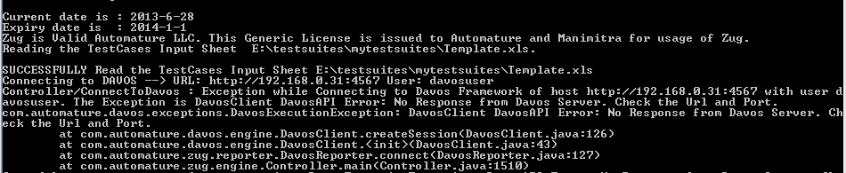
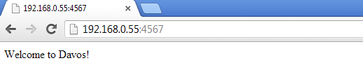
Troubleshooting
Davos connection problem
  Check the IP and port number of Davos.
  Check whether Davos is running in the same port of the given address
  Open a web browser and enter the same URL (IP:PortNO of davos)

Slide 2
Troubleshooting
  Open a web browser and enter the same URL (IP:PortNO of davos)
  If Davos is running then the above response will be visible in the browser

Slide 3
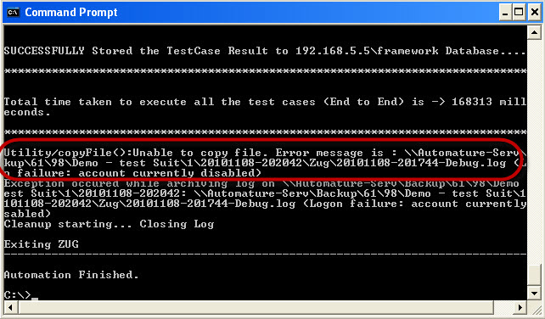
Troubleshooting
Unable to Archive Log Files
  Archiving of Log files are done on location specified in Zermatt Configuration.
  Usually happens if the user don’t have write permission for the location specified

Slide 4
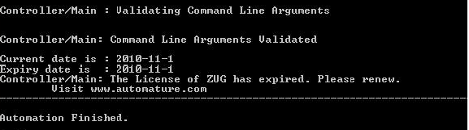
Troubleshooting
License Expired
  License can expire under the two following cases
    You are using an expired license. Each license has a certain validity period and it expires on a particular date as mentioned.
    You are using an improper license. The license may be incorrect or intended for other use.

Slide 5
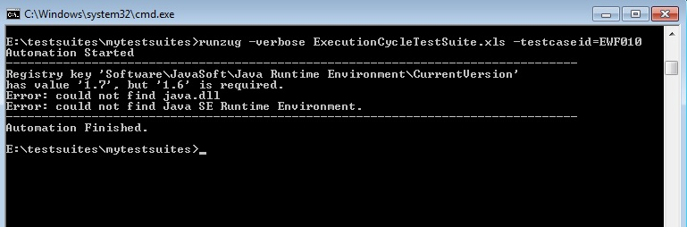
Troubleshooting
JRE Dependency
  If the JRE is updated from java 1.6 to java 1.7 after installing ZUG then ZUG will stop working and it will give an error message similar to the message given below
  Solution: Reinstalling ZUG will fix the problem

Slide 6
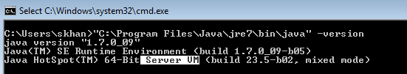

Troubleshooting
Java Heap Error
  Make Sure that you are using the client JRE.
  Type java -version
  If it shows Server VM please install a the client VM (Java).

