Slide 1
ZUG
  Test automation tool.
  Provides an execution environment for tests specified using CHUR test specification language.
  Platform independent, and can be used on any environment that supports the Java Runtime Environment.

Slide 2
Goals/Objectives
You’ll learn
  Basics of ZUG and CHUR
  About work sheets
  Concepts and Terminologies
  Write a simple Test Case

Slide 3
CHUR
A simple spreadsheet based test specification language

Slide 4
Why a new technology?
Limitations of existing languages
  Embedded logic / Reusability
  Specialized staff
  Cost of maintenance
The CHUR advantage
  Spreadsheet based language
  Logic is separated from test case implementation
  Very easy to learn.
  Can be used by non programmers
Notes:
Since most of the available automation software use existing languages such as VB Script and JavaScript, the logic of the test case is embedded into it and is difficult to separate form the code. So, if someone wants to reuse the logic then she has to rewrite the whole script or copy it from the source. The language itself does not promote reusability.
Specialized staff is needed to write and maintain test cases as a result the cost of maintenance increases.
CHUR is spreadsheet based language and is designed in such a way that the logic is kept separate form the test cases so that you can reuse the logic for different test cases.
Also, it is easy to learn and use as anyone with basic knowledge of spreadsheets can learn and write automated test cases in it.

Slide 5
Concepts and Terminologies
Test Suite : Collection of automated test case. Represented in spreadsheet and consists of following worksheets:
  Config Worksheet
  Macro Worksheet
  TestCases Worksheet
  Molecule Worksheet
  Prototype Worksheet
Test Case : A test case is a set of test steps to test certain feature of a product.
Test Step : A test step consists of a action and verification steps. It can also have some property and some clean up steps.
Action : An action is a piece of work that the test case designer wishes to do. Action takes some arguments. An action can be an atom or a molecule and can also have some property.
Verification : Verification steps are used to verify the outcome of the action step. Like action step they also takes arguments and can be a molecule or an atom and may have some property.
Notes:
1.Action and verification takes as many argument as the need.
2.An action can have more than one verification.

Slide 6
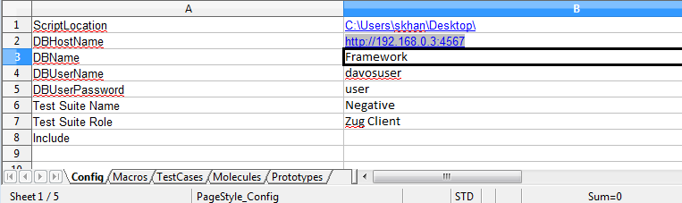
Work Sheets
Config Worksheet
  Contains the environment related information.
  Information is typically used by ZUG to locate supporting programs, and upload results into the database.
  Allows references another CHUR spreadsheet files, which contains Molecules and macros to be included.
Notes:
1.Script location and data base related information are optional. There is a default configuration in the ZUGINI.xml which can be configured .
2.Script location is only required when a test suite uses some supporting programs (Out-process atom).
3. Script location-Here the location of the atoms are specified. ZUG will pick the atoms to execute from the location specified. Multiple location may be provided using ‘;’ after each qualified path.
4.The locations can be a fully qualified path name, or a path relative to the current directory e.g. E:\ZUG\Scripts\ is a valid fully qualified path for ScriptLocation whereas "Scripts\Atoms" is a relative path
5.Data base related information is needed only when the test case results are required to be reported in Zermatt.
6. DBHostName -Host name of the Database server or the Test Management Framework - IP:port<localhost:4567>
7. DBName-Database Name - Framework (not mandatory for davos).
8.Include-ZUG allows more than one such declaration and nested include files. Locations of the files can be a fully qualified path name, or a path relative to the Test Suite.

Slide 7
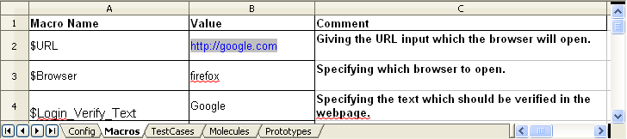
Work Sheets
Macro work sheet
  Contains symbolic names called macros.
  Macro allows user to give shorter name to constants that can be used in the test case or molecules.
  Macros value are substituted at the time of execution.

Slide 8
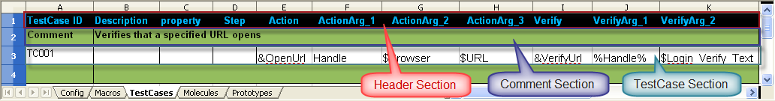
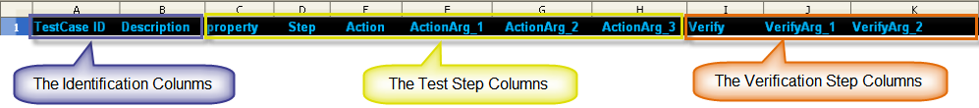
Work Sheets
Test Cases and Molecule Work sheet
  Contains Header Section and Test Cases
  Test Case sections
    The identification group of columns
    The action step group of columns
    The verification step group of columns
The Action Step Columns
Notes:
1.Header Section - The first set of rows in each sheet.
2.The test case section, which lays out the details about steps, actions and verifications about an individual testcase. This section is divided into three logical column groups, viz.
The identification group of columns
The action step group of columns, and
The verification step group of columns
3.The first column contains the test case or the Molecule identifier. This must uniquely identify each test case. This identification is used to locate the row in the test framework database, where results will be stored.
4.The second column should contain a summary description of the testcase in the comment section of Test.

Slide 9
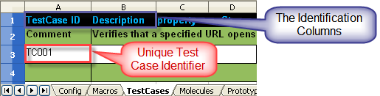
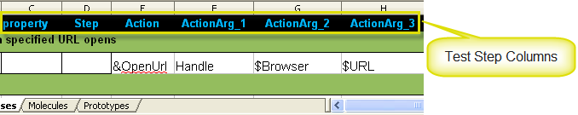
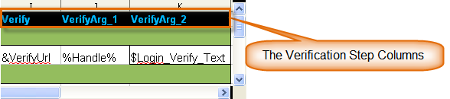
Work Sheets
  Identification group of columns
  The Action Step group of columns
  The Verification Step group of columns
The Action Step Columns
Notes:
Unique identifier or name for a test case, or Molecule. The cell should be left blank if the action on the corresponding row is a part of the same test case or Molecule declared earlier. Init and Cleanup are reserved names interpreted by the ZUG in a special way.
2. If a test case is named Init, ZUG will execute this test case before any test case is executed from the test case worksheet. The result of init is not stored in the database.
3. Init fails then ZUG looks for a test case named cleanup .Cleanup test case is the clean up for the entire test suite. Result of is not stored in the database.
5.Property can be GCE,REM or Negative,neg-action,neg-verify for negative testing or Ignore ,ROS and ROF (ROS and ROF for molecule sheet only).
6. STEP is optional, unless two steps are supposed to be executed in parallel, or are used to pair an initialization step with a cleanup step within a test case or Molecules
7.A test is expected to consist of one or more actions. Actions may be performed in sequence or in parallel. The step identifier allows the designer to designate several steps to be executed in parallel. Each action step allows the specification of input arguments.
8.Action and verification can have atom or Molecule call.
Molecule call starts with &
Atom-
Out Process Atom starts with @

Slide 10
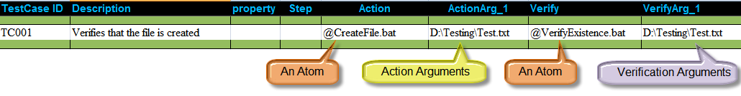

A Simple Test Case
Command Line execution
Notes:
How to run ZUG from command prompt

