Slide 1
Exception Handling
Limitations of Test cases:
  If test cases fail in way that it affects the next test cases, it becomes difficult to run the next test case
Purpose:
  Some steps are required to perform certain tasks if any failure occurs such as closing the opened files.
  Cleanup is a good idea to restore the state of the system, so that subsequent tests can execute from a clean state, and not be affected by previous errors.
Notes:
Test cases have certain limitations. If a test case fails for any reason then it becomes difficult for the next test case to run
Hence exception handling is used to come out of the test case which is not ale to run so that the next test case can be run

Slide 2
Exception Handling
Initialization & Cleanup for
Test Case/Molecule
Initialization & Cleanup for Test Suite
Notes:
Exception handling can be done by Initialization and Cleanup steps.
Initialization & cleanup are available for Test case , molecule and Test suite.
When the initialization step fails the cleanup step is executed and comes out of the test case.
Also it is possible to set a time limit for each step so that it does not wait for it indefinitely to finish.

Slide 3
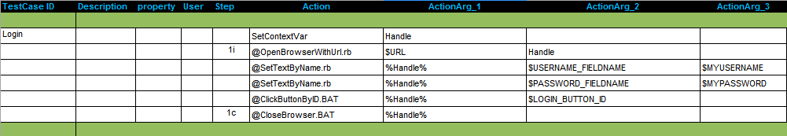
Exception Handling : Test Case
Initialization and cleanup steps are designated in pairs, both having the same step index
Cleanup actions are matched with their corresponding “initialization” actions using a step index.
For a given pair, the initialization action is a numeral, post fixed by an "i" and the cleanup action is a numeral, post fixed with a "c“.
Initialization & Cleanup steps

Slide 4
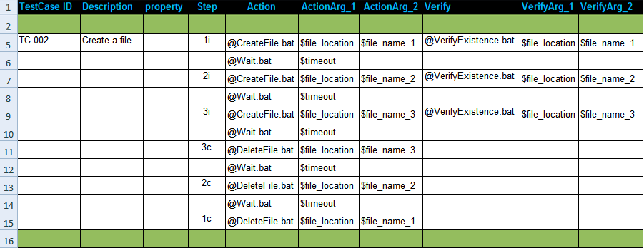
Exception Handling : Test Case
Whenever an initialization step fails the corresponding cleanup action (bearing the same index) is executed.

Slide 5
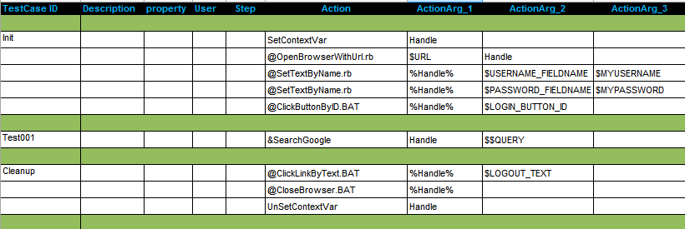
Initialization & Cleanup Test Case
Ability to initialize the test suite, prior to executing any test case.
Cleanup the environment after all test cases have been executed.
Initialization and clean up are not reported to the database.
Initialization & Cleanup Test Case
Notes:
A test suite can have a initialization and cleanup test cases, initialization case is executed automatically and then the other test cases in the suite.
The cleanup test case is executed even if all the cases fail so that the clean up for the test suite is done.
Both initialization and clean up are not reported to the database.

Slide 6
Exercise : Exception Handling
Write a test case that uses initialization and cleanup steps for searching in google.

Slide 7
Negative Testing
Negative Test Step
Negative Action
Negative Verification

Slide 8
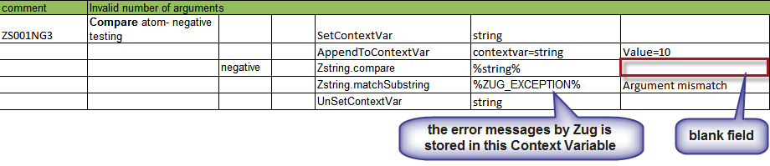
Negative Testing
Negative Test Step
  To use negative testing feature on any test step put the word “negative” in property column
  Action and verification must fail in order to pass the test step.
  ZUG_EXCEPTION context variable will be set with the Exception message and the test step will pass

Slide 9
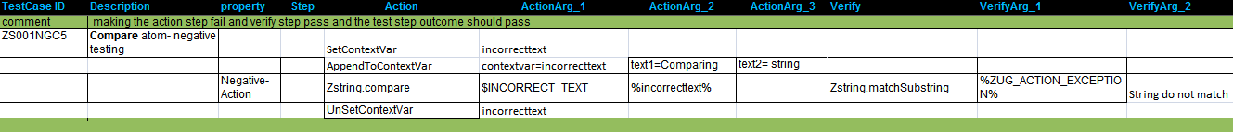
Negative Testing
Negative Action
  To use negative testing feature on any action put the word “neg-action” or Negative-Action in property column
  Action must fail and verification must pass in order to pass the test step
  ZUG_ACTION_EXCEPTION context variable will be set with the Exception message and the test step will pass

Slide 10
Negative Testing
Negative Verification
  To use negative testing feature on any verification put the word “neg-verify” or Negative -Verify in property column
  Action must pass and verification must fail in order to pass the test step
  ZUG_VERIFY_EXCEPTION context variable will be set with the Exception message and the test step will pass

Slide 11
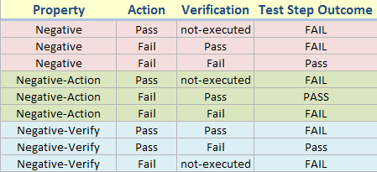
Negative Testing
  Figure shows the various outcomes of a test step for different properties of Zug.

Slide 12
Conditional Execution
Executing a set of test step based on some condition
ROS (Return on Success)
ROF (Return on Failure)

Slide 13
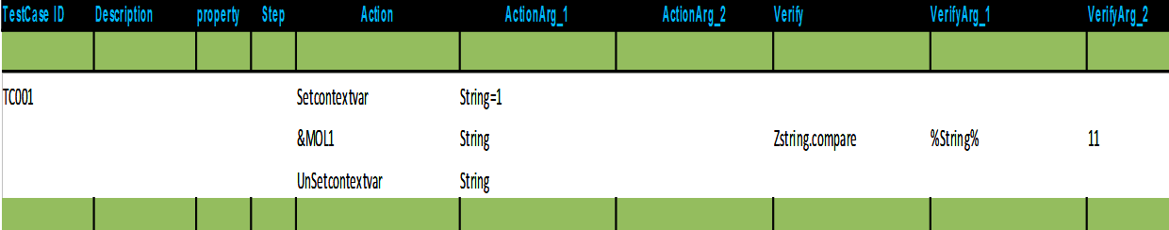
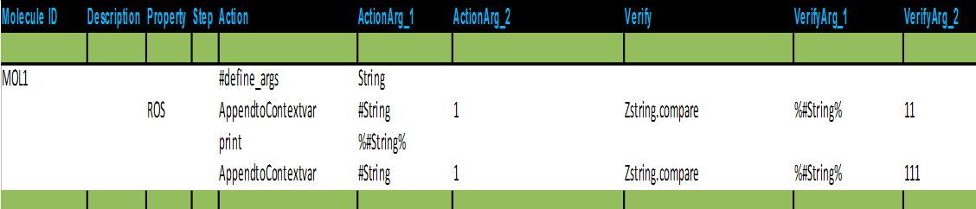
Conditional Execution
ROS (Return on Success)
  Used in the property of a test step in a molecule.
  If that test step executes successfully then ZUG skips the rest of the test steps of that molecule
  Execution is returned to the caller of the molecule.

Slide 14
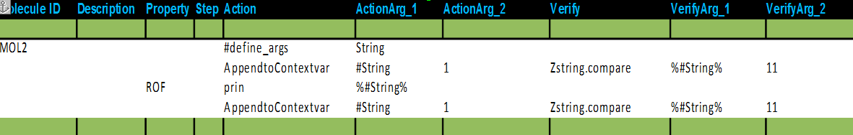
Conditional Execution
ROF (Return on Failure)
  Used in the property of a test step in a molecule.
  If that test step fails it gives a exception message where the failure occurs stating the reason of failure of the test step.
  ZUG skips the rest of the test steps of that molecule
  The failure of the that test step does not affects the outcome of the test case
  Execution is returned to the caller of the molecule.

Slide 15
External Sheets
Limitation of using Test Suite:
  Cannot use molecules that are defined in some other test suite
  Copy and paste is difficult to maintain
Purpose:
  Reuse the existing molecules/Macros and maintain a single copy.
  Common testing logic can be shared between test suites.

Slide 16
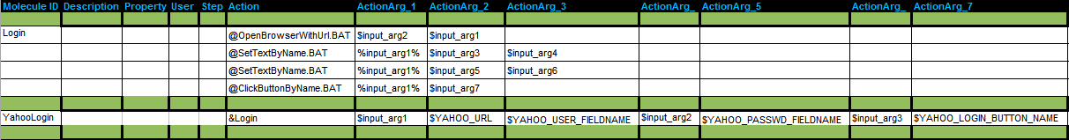
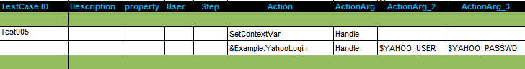
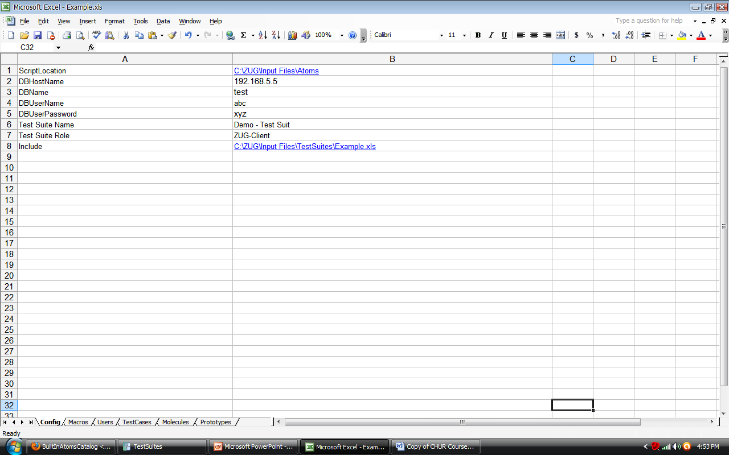
Example : External Molecules
These molecules are in a file named Example.xls
Filename - Namespace
File path of Example.xls needs to be mentioned in the config sheet
Notes:
ZUG also allows the test suite designer to reference molecules and macros defined in files, other than the current input file. This promotes reusability of existing design molecules.
Since each external file is assumed to contain unique names, but name uniqueness cannot be guaranteed between all referenced files, the concept of namespaces are used. The filename is used as the namespace to call the molecules and Macros in it.

Slide 17
Exercise : External Molecules
Login to Gmail and YahooMail using external molecules.

