Slide 1
Topics
Environment sensors
Concurrent execution
Zug command lines
Troubleshooting
Multi-environment testing
Maintainability & design

Slide 2
Environment sensors
Zug can automatically sense the environment on which it is running.
  ZEnv_Sensor Molecule
  ZEnv_Values Context Variable

Slide 3
Environment sensors
ZEnv_Sensor molecule is defined with this name to sense the environment in which the tests are being run
User don’t have to call this Molecule.
Invoked implicitly after running the Init test case or after running the first test case of the test suite

Slide 4
Environment sensors
ZEnv_Values context variable is defined by ZUG to store some environment related information.
Initially ZUG populates it with the values of
  OS Name
  Java version
  LOGON SERVER
  COMPUTER NAME
  USER NAME
  APPDATA
  USERDOMAIN
  PROCESSOR_ARCHITECTURE
  NUMBER_OF_PROCESSORS
  RAM SIZE

Slide 5
Environment sensors
The values are stored as key=value pair and as a comma separated list i.e,
OS Name=Windows 7,Java Version=1.6,User Name=Ellora
Test Case designer can use this ZEnv_Values CV’s values inside the ZEnv_Sensor molecule.
Can further add some more details in the ZEnv_Values context variable in ZEnv_Sensor molecule which may be needed i.e, name and version of the browser.
These values can further be reported to the Test Management Frame work (Zermatt).

Slide 6
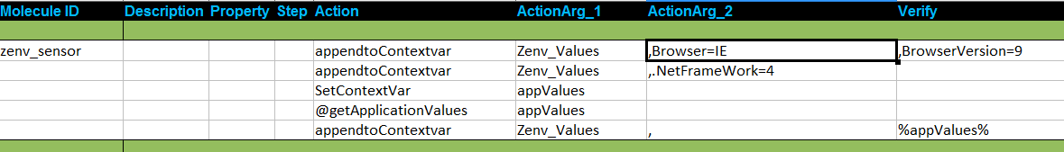
Example-Environment sensors

Slide 7
Concurrent Execution
Concurrency in
  Test Case
  Molecules
  Test Step
Notes:
Concurrent execution enables users to execute multiple test steps concurrently.
Concurrent execution can be applied to both the test cases and the molecules
If two or more different actions of a test case/molecule has the same step number, then these different steps would be executed concurrently by ZUG.

Slide 8
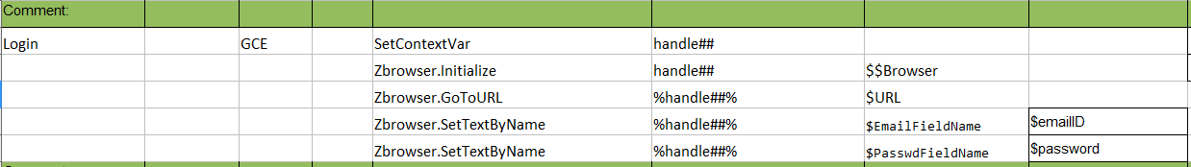
Test Case Concurrency
Test Case
  Concurrency achieved by using MVM or MVCV and GCE property.
  Test Case or Molecule is expanded for each combination of the MVMs or MVCV.
  Expanded Test cases or Molecules are then run Concurrently(parallel Execution).
Notes:
In this slide there is a test case
Considering the test case
Usually one action would be executed after another
In this case as there is a similar number mentioned on the step column for two of the actions , hence both the actions would be executed concurrently however different the actions may be.

Slide 9
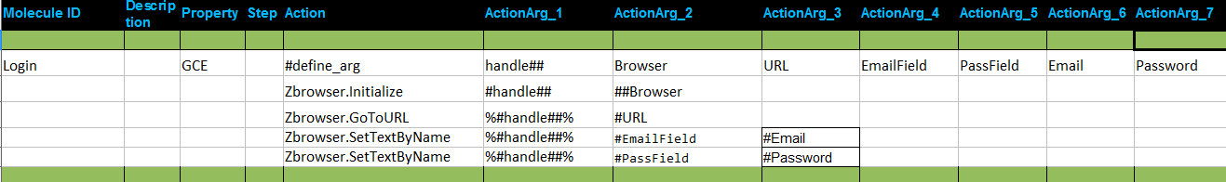
Molecule Concurrency
Molecule
Notes:
Considering the molecules
Usually one action would be executed after another
However in this case as there is a similar number mentioned on the step column for two of the actions , hence both the actions would be executed concurrently

Slide 10
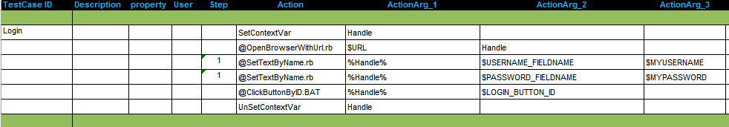
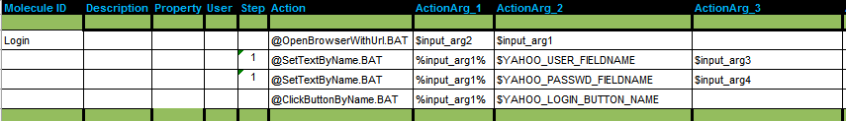
Example : Test Step Concurrency
Achieved by putting same number in the step field of the test steps
Test Case
Molecule

Slide 11

Thread Safe Context Variable
Different test cases or molecules running concurrently if create or update a context variable with the same name then there will be a conflict.
CHUR supports the notion of a thread specific instance of a context variable.
Responsibility of the Test Suite designer to create and use thread specific context variables
A ## (double hash) appended to the name of a context variable
Thread Safe Context variable

Slide 12
Exercise : Concurrent Execution
Write a test case to concurrently search in Google in different browser.

Slide 13
ZUG Command Line
-Include=<location>
  This option specifies the location from where ZUG will pick up molecules and macros sheet
  Provides a dynamic way of including test suites
  test suites mentioned in the -include option must be separated by a comma. For example
    runzug E:\testsuites\testCMDInclude.xls -verbose -include=IncludeS2.xls,IncludeS1.xls
  The files included from command line has a higher priority over the files included from the config sheet.

Slide 14
ZUG Command Line
  powerful feature of this option is to provide name spaces to the test suite included from command line(run time).
  We can override the default name space (file name) of a test suite included at run time using the -include option.
  The syntax for giving name space in the -include option is
      include=namespace1#filename1,namespace2#filename2
-LogFileName=<AlphaNumeric>
  Creates log files with the specified names
  <logfilename>-Result.log , <logfilename>-Error.log.

Slide 15
ZUG Command Line
-$<macroname>=<value>
-$$<macroname>={<value1>,<value2>}
  Overrides the value of a macro specified in the chur sheet
  If the macro name is not written in the macro sheet of the chur spread sheet then it will create a new macro.

Slide 16
ZUG Command Line
-AtomPath=<location>
  Location from where ZUG will pick up atoms for Test Automation/Execution.
  This should be a fully qualified location.
  We can give multiple locations by ; separator.
  Example: -Atompath=C:\Tests\Atoms
-verbose option is used to display the execution result of the test suite in the console.
-TestCaseID=Test001,Test002
  If specified Zug will execute only specific test cases as listed and will ignore the rest

Slide 17
ZUG Command Line
-Verify | -NoVerify
  -Verify specifies Zug to execute the test case without verification.
  By default -Verify is selected means ZUG will run verifications for each test case unless explicitly -NoVerify is specified
-TestCycleID=<integer>
  Searches in Zermatt for the specified TestCycleID.
  If it is not provided then Zug will generate a new ID and update the results under it.
Notes:
-TestCycleId, TestPlanID and -TopologySetId is used for reporting test result to zermatt.

Slide 18
ZUG Command Line
-TestPlanID=<integer>
  Uploads test Suite execution results in Zermatt under a particular Test Plan.
  Example: -TestPlanID=84
-TopologySetID=<integer>
  Required by Zug to register results in a test cycle for the specified Topology Set.
  Example: -TopologySetID=79
For More information please refer to ZUG user manual

Slide 19
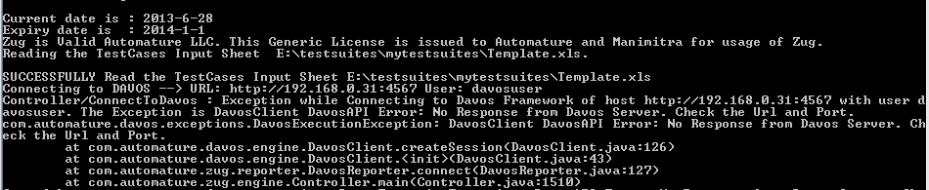
Troubleshooting
Davos connection problem
  Check the IP and port number of Davos.
  Check whether Davos is running in the same port of the given address

Slide 20
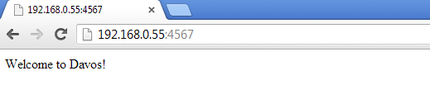
Troubleshooting
  Open a web browser and enter the same URL (IP:PortNO of davos)
  If Davos is running then the above response will be visible in the browser

Slide 21
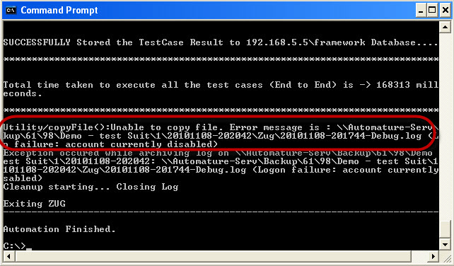
Troubleshooting
Unable to Archive Log Files
  Archiving of Log files are done on location specified in Zermatt Configuration.
  Usually happens if the user don’t have write permission for the location specified

Slide 22
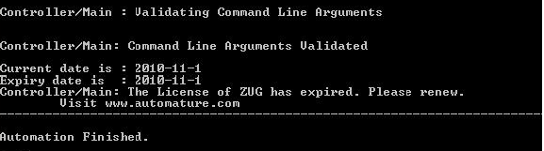
Troubleshooting
License Expired
  License can expire under the two following cases
    You are using an expired license. Each license has a certain validity period and it expires on a particular date as mentioned.
    You are using an improper license. The license may be incorrect or intended for other use.

Slide 23
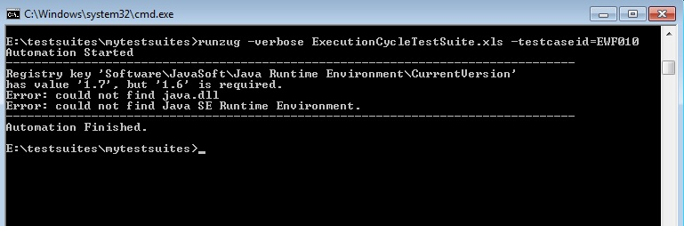
Troubleshooting
JRE Dependency
  If the JRE is updated from java 1.6 to java 1.7 after installing ZUG then ZUG will stop working and it will give an error message similar to the message given below
  Solution: Reinstalling ZUG will fix the problem

Slide 24
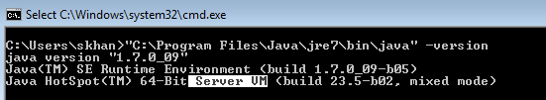

Troubleshooting
Java Heap Error
  Make Sure that you are using the client JRE.
  Type java -version
  If it shows Server VM please install a the client VM (Java).

Slide 25
Multi-environment testing
We can select dataset for target specific testing.
Zug allows us to have multiple value column in a test suite for a macro
Each value column of the macro sheet is a data set
When running the test suite user can specify a particular value column of the macro sheet of a test suite whose value will be used while running the test suite.

Slide 26
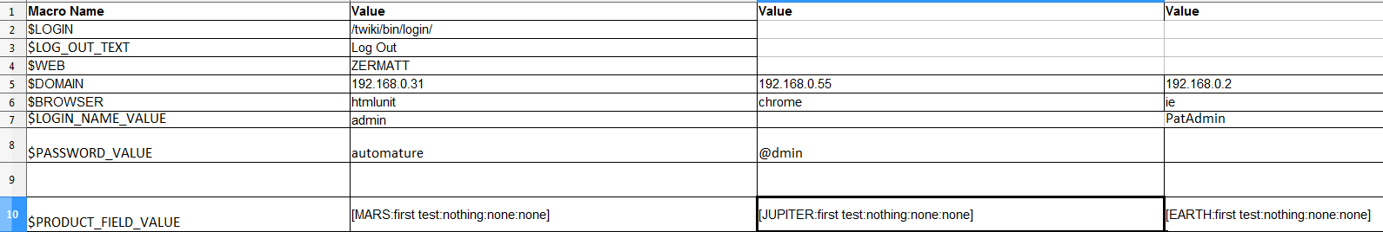
Multi-environment testing
If any cell of the selected column is empty then it takes the value of the default column cell (1st value column )

Slide 27
Multi-environment testing
Select a particular column at runtime using the –macrocolumn command line option.
Syntax for -macrocolumn is
-macrocolumn=file identifier:column number, file identifier:column number
File identifier is the file name or the optional name space provided in the -include option
EX:
E:\testsuites\testMacroColumnNS.xls
-include=IncludeS2.xls,inc#IncludeS1.xls
-macrocolumn=inc:3,testMacroColumnNS.xls:2,IncludeS3.xls:3

Slide 28

Maintainability & design

