Slide 1
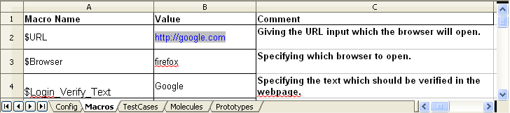
Macros
Shorter Name given to Constants
Macro name starts with a $
Macro name can contain letters, numbers or underscores ( _ )
Values substituted at runtime.

Slide 2
ContextVars
Limitations of Macros:
  Cannot change the values of Macros at run time
  Atoms cannot alter the values of Macros
Purpose
  Can change the value of ContextVar at runtime
  Atoms can access and modify the Content
Notes:
Limitations of Macros
Cannot change the values of Macros at run time
Since the values of Macros are defined before the execution of the test suite, it is not possible to change during execution
Atoms cannot alter the values of Macros
ZUG does not allow the atoms to change the values of Macros so it is difficult to alter the values
Purpose
Can change the value of ContextVar at runtime
ZUG has inbuilt feature to update the value of a ContextVar at any point of time during the execution
Atoms can access and modify the Content
Since it may be required to change the value of the temporary variable at any point ZUG allows atoms to access and change the value of ContextVar

Slide 3
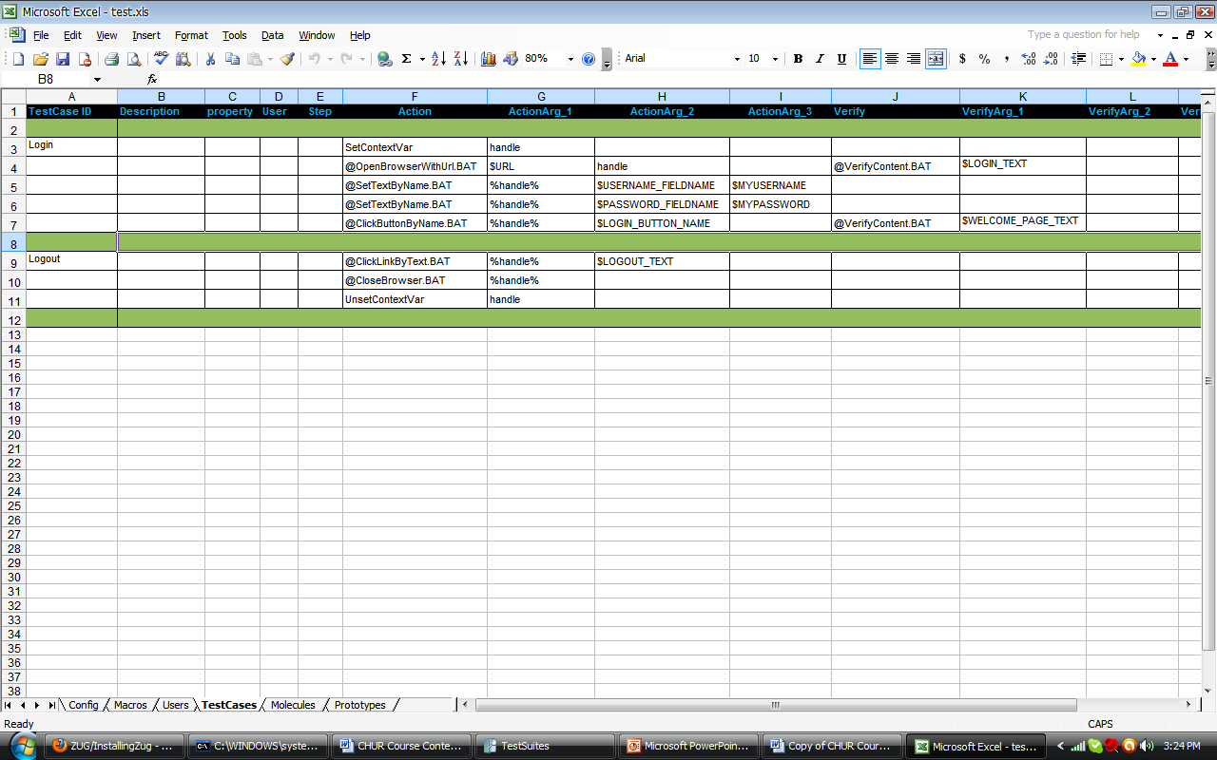
ContextVars
Set/UnSet ContextVars
Passing ContextVars by reference and by value
By Reference
By Value
Notes:
Set/UnSet ContextVars
SetContextVar declares the ContextVar and also updates the value if called for an existing ContextVar, UnSetContextVar deletes the ContextVar. The values assigned to ContextVars are stored as strings and can be converted to other types inside the atoms as required.
Passing ContextVars by reference and by value
A ContextVar can be passed to atoms or molecules by value or by reference.
When passed as value, atoms can read the content but cannot modify it. The syntax to pass the ContextVar as value is %ContextVar_Name%.
And when passed as reference atoms can access and modify the content of the ContextVar. The syntax to pass the ContextVar as reference is ContextVar_Name.

Slide 4
ContextVars and Atoms
Reading And Altering Context Variable values from Atoms ( HarnessAPI.DLL)
  Log: void Log("loglevel", "message")
  AlterContextVar: void AlterContextVar(name, value)
  GetContextVar: value = GetContextVar(name)
Notes:
HarnessAPI.Dll is a COM DLL which exposes functionality related to retrieving and updating Context Variable. It also contains functionality to log diagnostic messages from atoms.
The Log function sends a diagnostic message to the Atom Log. The syntax for log is - Log("loglevel", "message") where “loglevel” can be debug, error or fatal, info.
When log level is debug message is printed on Debug and Primitive log files.
When log level is error or fatal message is printed on Debug, Error and Primitive log files.
When log level is info message is printed on Debug, Primitive and PrimitiveErrors log files.
AlterContextVar alters the value of the context variable. It accepts two arguments, the ContextVar name and the value to be updated with.
GetContextVar retrieves the context variable value. It accepts one argument, the ContextVar name for retrieving its value.

Slide 5
Exercise : ContextVars
Write a test case to write a macro value to file and then read the content of the file and store it in a ContextVar, and verify the content of the file.
More at
http://www.automature.com/twiki/bin/view/ZUG/ChurBasicConcepts

Slide 6
AppendToContextVar
Concatenates multiple values
Built-in feature
Any number of values can be appended
Notes:
AppendToContextVar is similar to string concatenation, it will combine all the values sent to it as argument to form a single string.
It is a built-in feature so it is fast and can be called between any two test steps.
AppendToContextVar can be called in the action column or the verification column, any number of values can be appended to it.

Slide 7
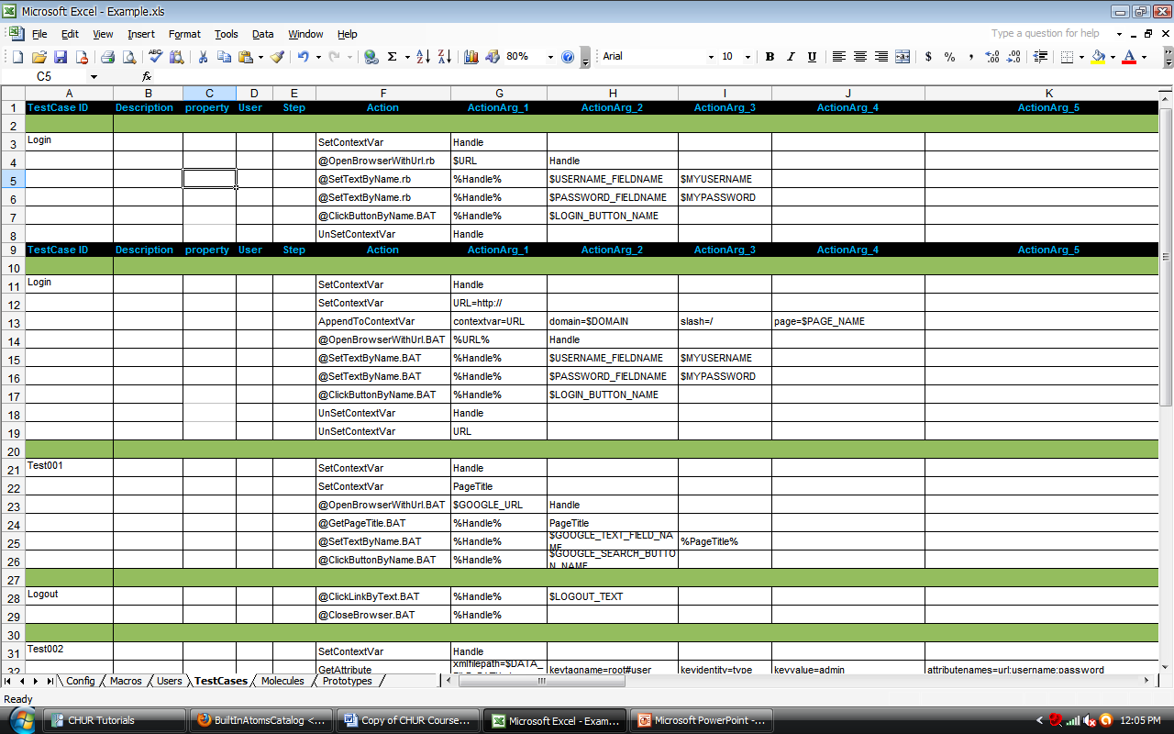
Example : AppendToContextVar
Creating a URL by appending the domain name and the page name.
Notes:
All should be in key=value pair or none.. Their can be multiple "key=value" pair if user wants different value to be append. Each pair will be different ActionArg or VerifyArg.
For ex. Action can be "AppendToContextVar" and its Action arguments can be contextvar=URL, domain=$DOMAIN, slash=/, page=$PAGE_NAME respectively. Then contextvar “URL" value will be modified to a complete url.

Slide 8
Exercise : AppendToContextVar
Write a test case to create refined search query by appending values to it.
  For example if the first query is “test” then the second query can be “test automation”
More at
http://www.automature.com/twiki/bin/view/ZUOZ/BuiltInAtomsCatalog

