Slide 1

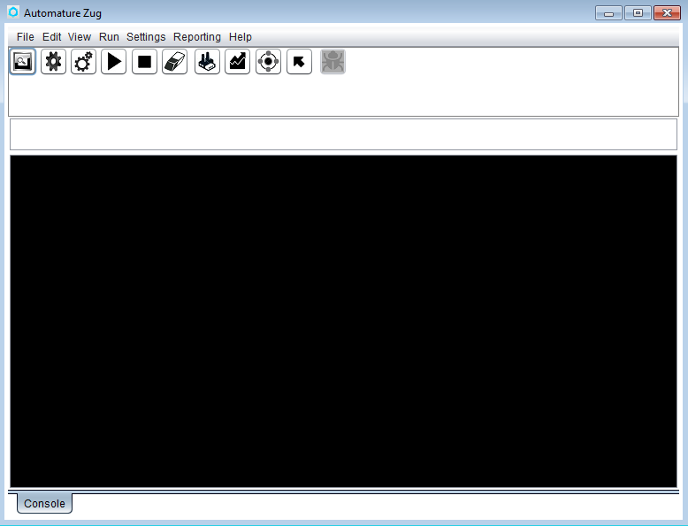
GUI MODE
Running in GUI mode
  Type runug –gui and press enter
  The graphical user interface of ZUG
  will appear

Slide 2
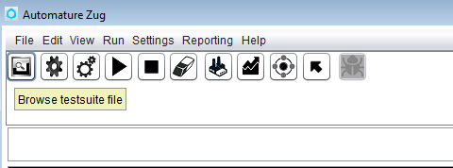
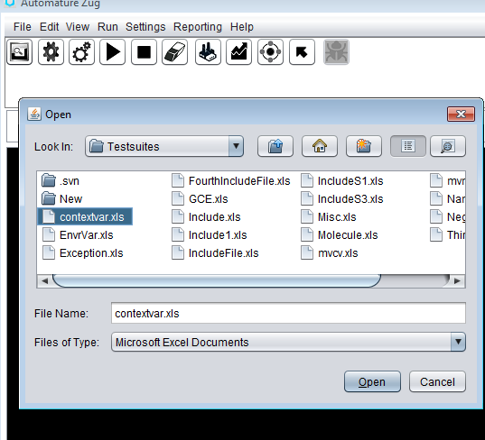
Running a Test Suite
Choosing a Test Suite
  Click on icon
  A choose box will open
  Select the file and click open

Slide 3
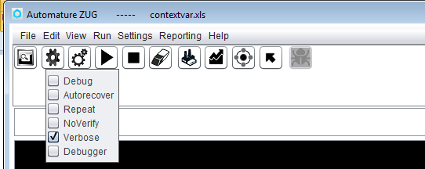
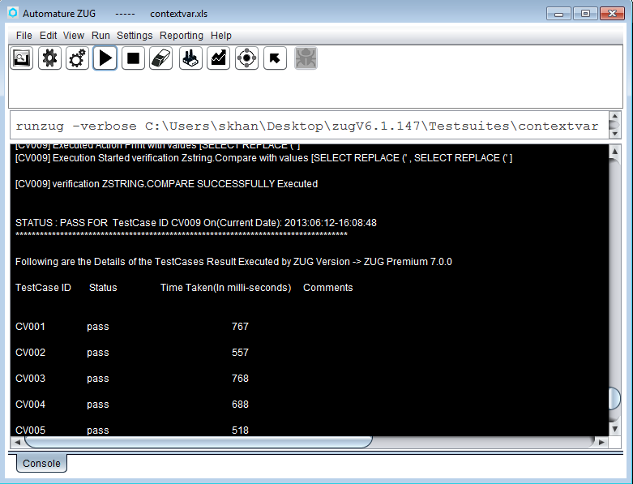
Running a Test Suite
Selecting options
  Click on the button
  Choose the options
  Click on the execute button
  The Test suite will execute

Slide 4
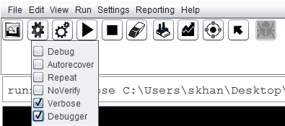
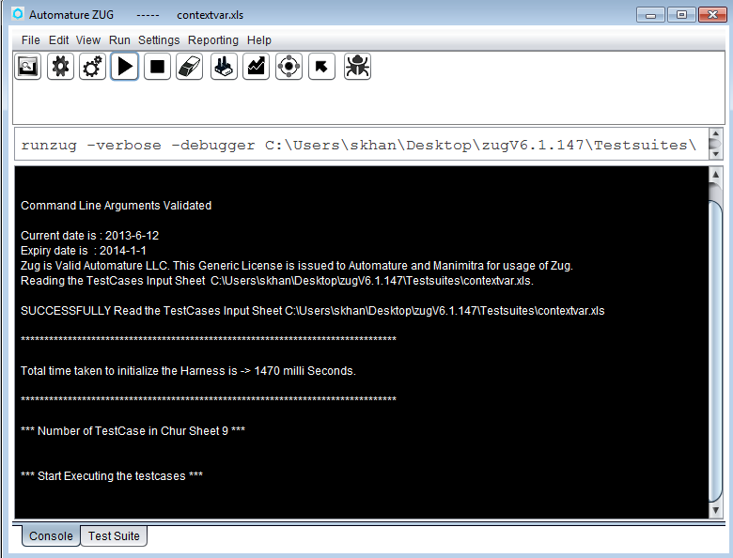
Debugger
Using the GUI Debugger
  Run the test suite with Debugger option
  The execution will start.
  After few seconds following screen will
  appear and the debugger icon is activated.

Slide 5
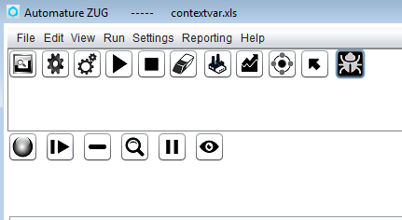
Debugger
Using the GUI Debugger
  Click on the debugger icon
  Following pane will appear in the GUI

Slide 6
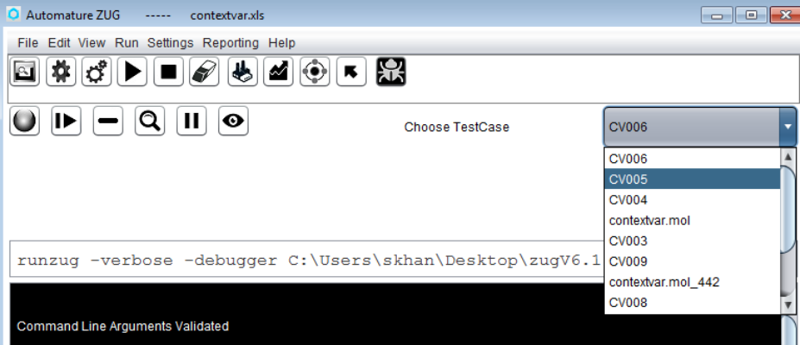
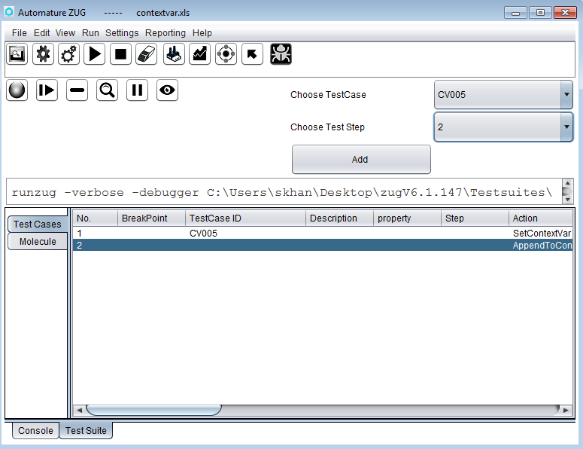
Debugger
Adding Break Points
  Click on the button
  Choose the Test Case
  or Molecule.
  Choose the test step
  Click on the add button

Slide 7

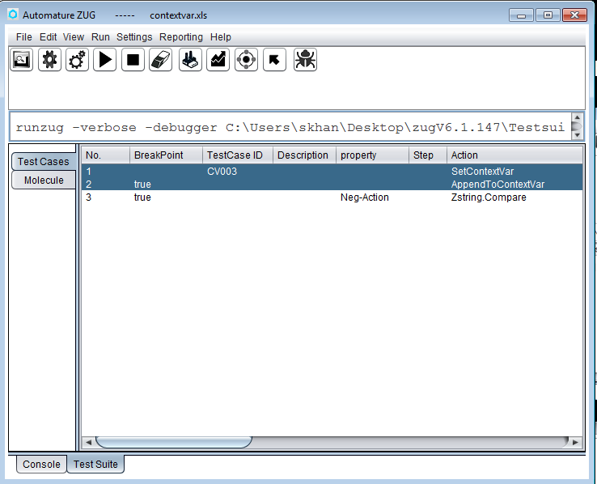
Debugger
  Click on the resume button to resume execution
Notes:
The execution will halt at the break point.
Click resume button to resume the execution of test suite.

Slide 8
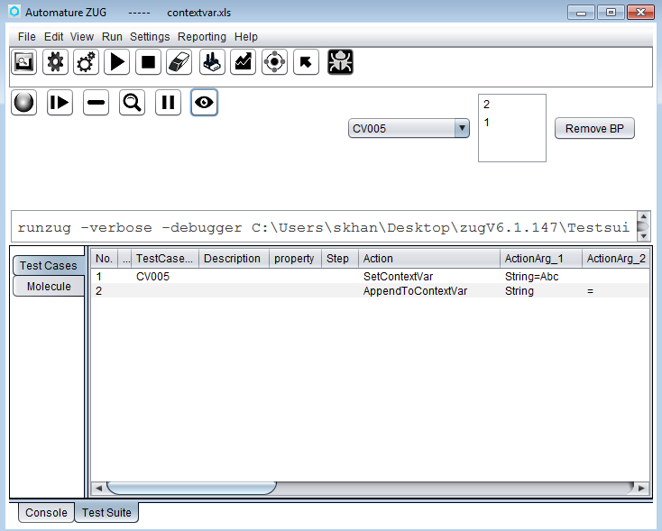
Debugger
View and Remove Break Points
  Click on the button
Notes:
We’ll be able to see a drop down which contains test cases and molecules id which contains a break point.
The list box contains the test step no to which the break point is added.
User can select a test case or molecule from the drop down and can remove one or more break points by selecting the steps in the list box.

Slide 9
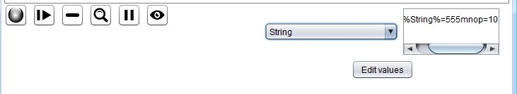
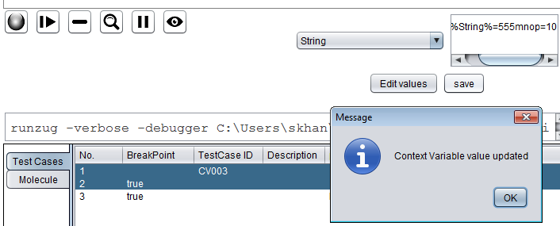
Debugger
View or Edit Context Var
  Click on the button in the debugger pane
  The following pane will appea.
  Choose the context variable from the drop down
  To Edit click on the edit button.
  After editing click on the save button.
Notes:
We’ll be able to see a drop down which contains test cases and molecules id which contains a break point.
The list box contains the test step no to which the break point is added.
User can select a test case or molecule from the drop down and can remove one or more break points by selecting the steps in the list box.

Slide 10

Debugger
Single step Execution
  Executes a single step (test step).
  Click on the single step button
Pausing
  Any point of execution we can pause execution of the Test suite
  Just click on the pause button
Notes:
Single step executes a test step and waits for the user’s response. To resume the execution normally user should press the resume button.
At any point of execution we can use any of the functionality of the debugger

