Slide 1
Goals/Objectives
You’ll learn to
  Install ZUG
  Upgrade ZUG
  Configure ZugINI.xml

Slide 2
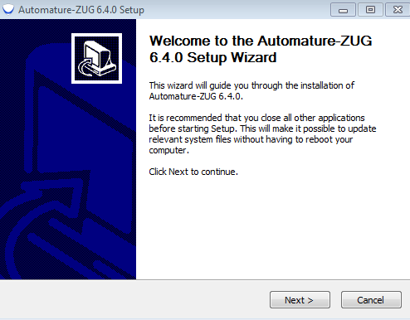
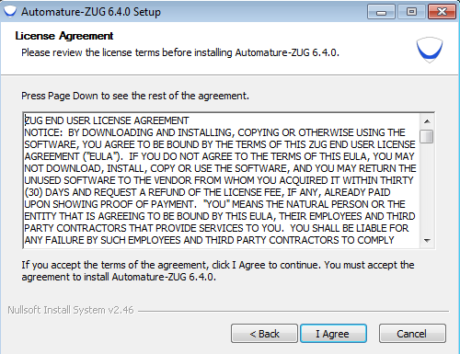
ZUG installation
Download the Set up file of the latest ZUG, from the Automature FTP site.
Double Click on the Zug installer icon.
The set up starts automatically and
the given screen will appear.
Click on the next button.
The below window will appear then
click on the I Agree button

Slide 3
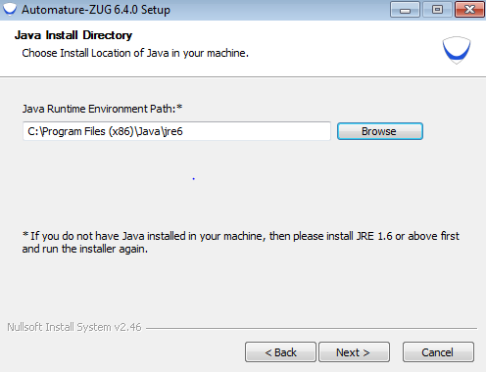
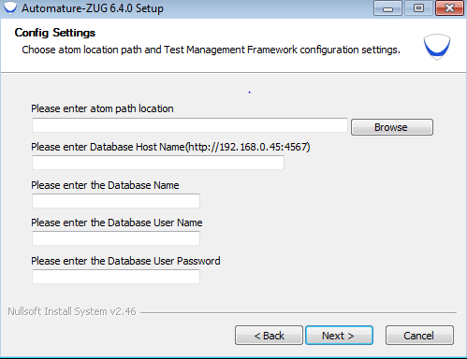
After clicking on the I Agree button
choose the JRE and click next.
Enter the location of the supporting
programs(out process atoms)
Enter the Data base related
information (Host name with
port, DB name and
DB credentials)
(Note: You can skip the above to points and this can be
configured later in the ZUGINI.xml file)

Slide 4
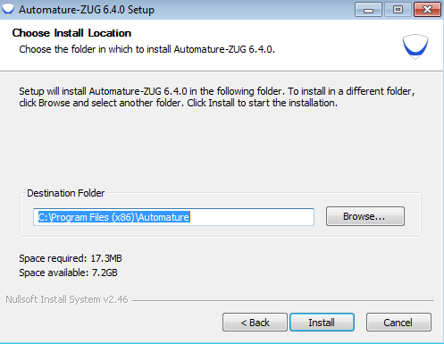
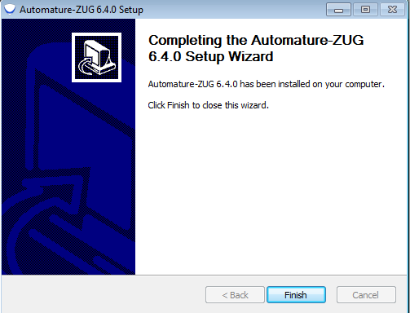
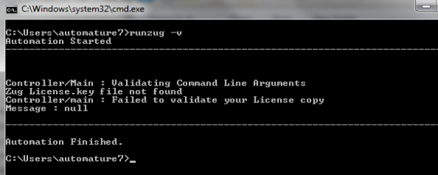
Choose the Destination path for
installation of Zug.
The set up is automatically
installed from this point.
The screen will appear once the
installation is complete
Open a command prompt
Type runzug –v
It will promt for No License.key.
Notes:
Please refer to the license activation.

Slide 5
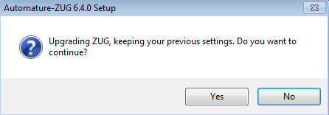
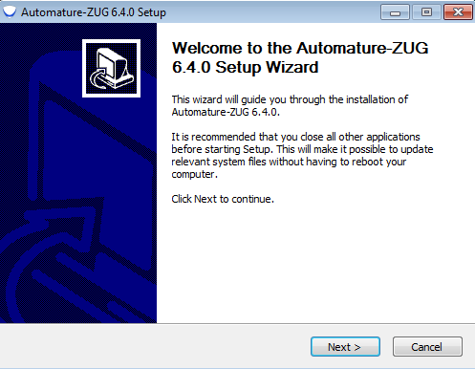
Upgradation
Download the Set up file of the latest ZUG, from the Automature FTP site.
Double Click on the Zug installer icon .The following prompt will appear.
Click on Yes.
Following window appears.
Click Next .
Notes:
Once you have successfully installed Zug in your machine, you will have to activate your License in order to use Zug.

Slide 6
Upgradation
The window will appear.
Click on the I Agree button
The set up is automatically
installed from this point.
The screen will appear once the
installation is complete

Slide 7
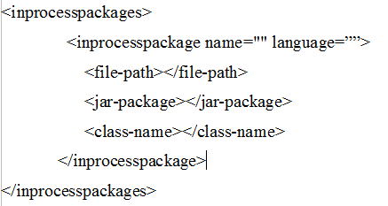
Configuration-ZugINI.xml
Inprocess atoms configuration
  Can call external jar and COM dll files as In-process atom.
  Need to configure details of those in ZugINI.xml

Slide 8
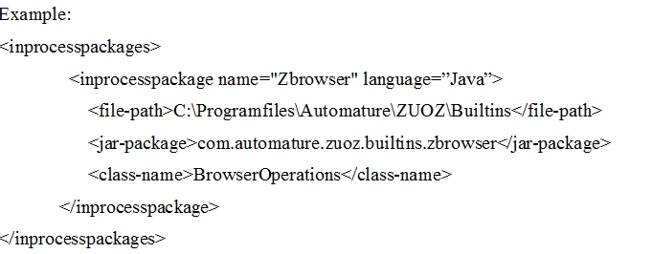
Configuration-ZugINI.xml
  For java In-process atoms

Slide 9
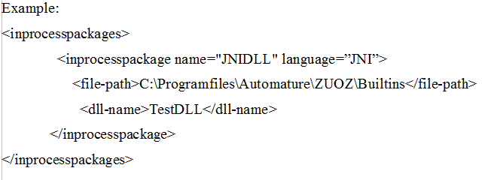
Configuration-ZugINI.xml
  For C++ dll In-process atoms
Notes:
The language tag’s value will be “JNI” for C++ dll.
The file-path tag will specifies the dll .
The dll-name tag specifies the name of DLL file.

Slide 10
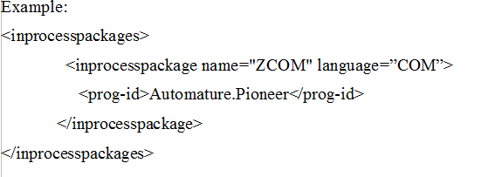
Configuration-ZugINI.xml
  For COM dll In-process atoms
    For any COM dll atoms the Program ID is needed
Notes:
1.Language attribute value will be “COM” .
2.There will be one additional tag as prog-id.

Slide 11
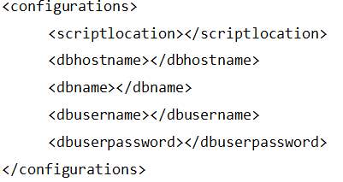
Configuration-ZugINI.xml
Data Base and Script configuration
Notes:
1.Inside the Configurations tag we mention the data base configuration.
2.These are the default configurations for ZUG.
3.Data base related configurations are over ridden by the test suite if these values are mentioned in the config sheet of the test suite.
4.Script location is the default script location for Out-Process atoms.
5.First the script location of the test suite is looked for the atoms then the default location is searched.

Slide 12
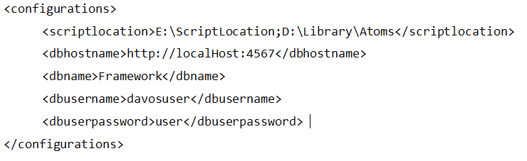
Configuration-ZugINI.xml
  Example
Notes:
1.Script location can have multiple semi colon separated directory list

Slide 13
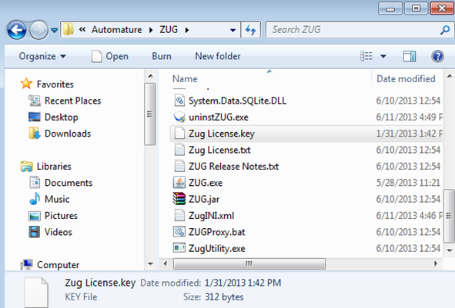
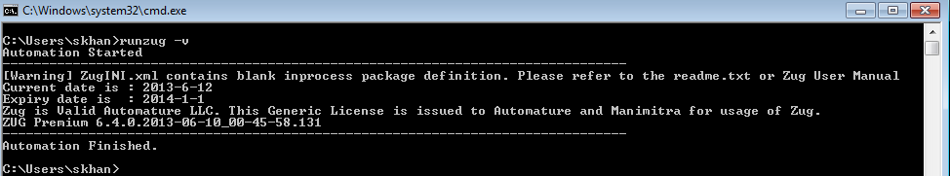
License Activation
Download the file Zug license.key, which is provided to you in the email.
Place the file in the Zug folder
where ZUG is installed.
Check the version

