Slide 1
CHEMICAL PARADIGM
Molecule
Atom
Notes:
Zug uses the paradigm of atoms and molecules, each of which encapsulates some logic – the difference being that molecules are written in the spreadsheet and interpreted by Zug, and molecules in turn can invoke other molecules or atoms.
1.Molecule-Molecules are special type of test case that can be called by a test a test case or a Molecule.

Slide 2
Molecules
Limitations Test cases
  Difficult to reuse the test case logic
  Difficult to maintain
Purpose
  Reusability of the test case logic
Notes:
Test Case logic once implemented cannot be reused by another test case.
As the logic is embedded in the test case so if we want to use the same logic we need copy and paste to another test case.
Molecules are basically the reusable logic that can be used by multiple test cases without making any change in the design of the molecules.

Slide 3
Molecules
Collection of several steps
Has a name it can be referenced by
Can be invoked by a test case, or another molecule
Accept input arguments, and can also pass data back to the caller
May invoke another molecule, an external, or a "built-in" atom
Notes:
Molecules are collections of test steps which contains several atoms or other molecules.
Each molecule can be referred by a name so that it can be called from a test case or another molecule.
A molecule can take in multiple input arguments which can be ContextVars, Macros or Texts.
A molecule can invoke another molecule, external molecule from a different Test suite or a built-in atom. ZUG can handle hierarchy of molecule calls (nested calls).

Slide 4
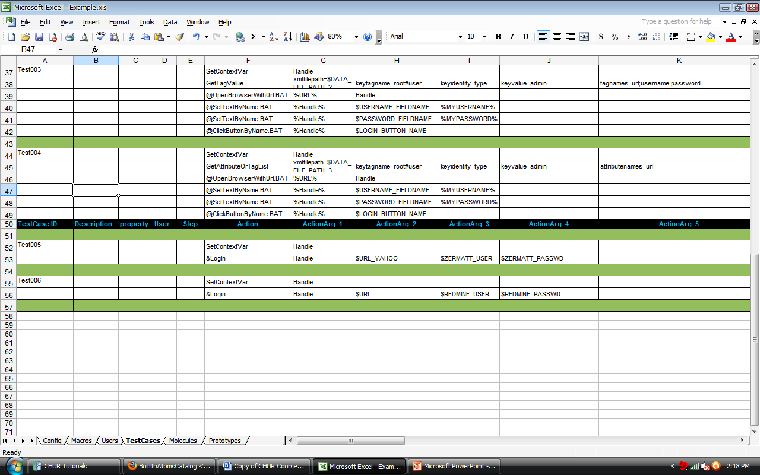
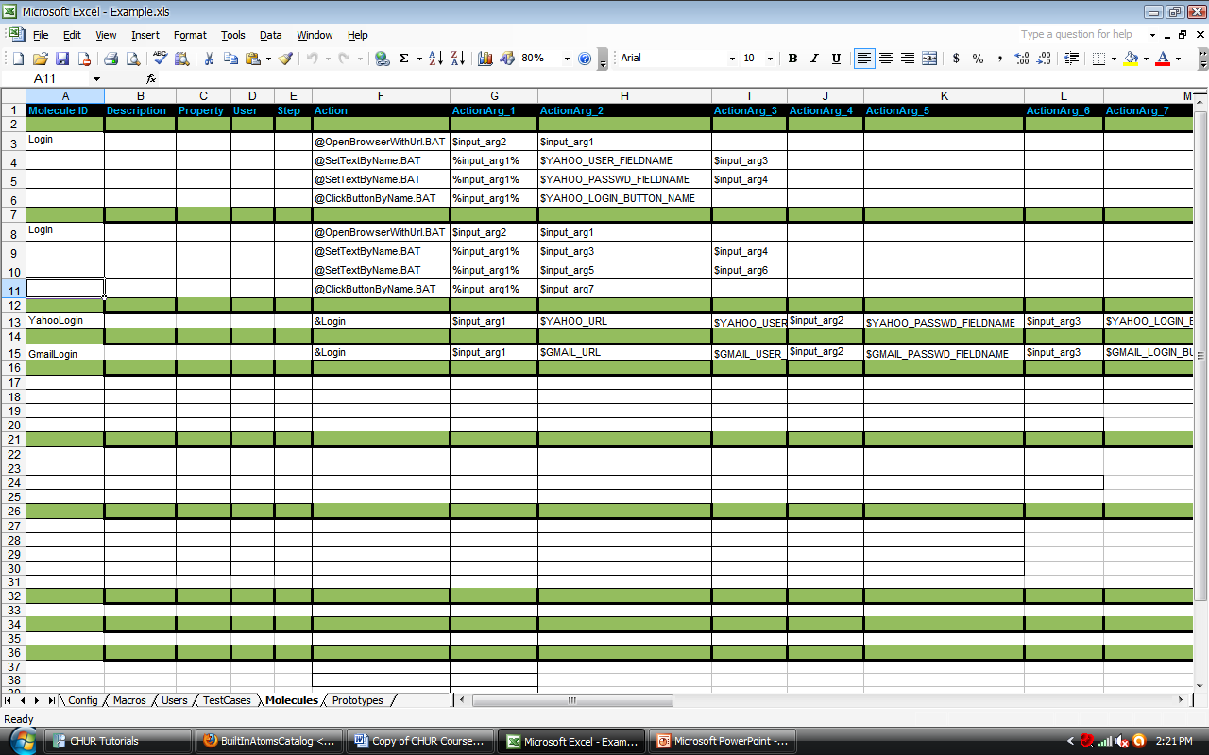
Example : Molecule
Notes:
Passing arguments to molecules
Passing values to molecules is similar to passing values to atoms.
Calling molecules in test cases
Molecules can be called in test cases appending ‘&’ sign in front of the molecule name.

Slide 5
Molecule
Argument Passing
  Positional argument passing
  Named argument passing

Slide 6
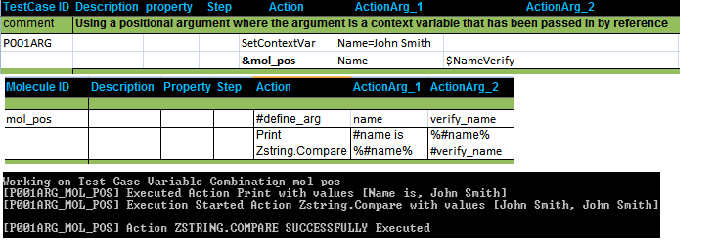
Molecule
Positional argument Passing
Notes:
Positional argument passing is the simpler way of passing arguments to a Molecule where you just specify a text value, the name of a Macro or a context variable.
The Molecule can access these arguments by their positional index in the argument list.
The first row of the Molecule body must contain #define_arg as its Action step and the name of the formal arguments of the Molecule

Slide 7
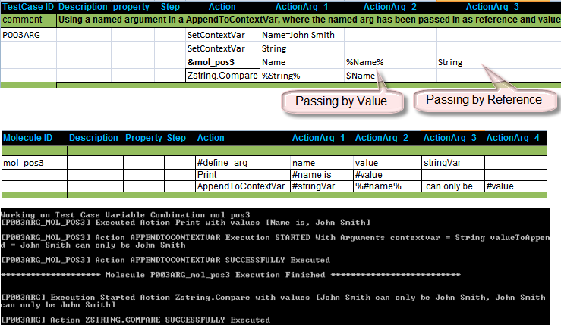
Molecule
Positional argument Passing
  Passing by value and reference
Notes:
Returning values from molecules
ContextVar sent as input argument can used to return values form the molecules.

Slide 8


Molecule
Named argument Passing
  Arguments passed as Key=Value pair
Notes:
Named argument passing is more descriptive than positional argument passing as the arguments are passed as key-value pairs .
It increases the readability and maintainability of the test case and the Molecule.
The first row of the Molecule body must contain #define_arg as its Action step and the name of the formal arguments of the Molecule in the Action argument column
The formal argument names should be used as the key in the key-value pair.

Slide 9
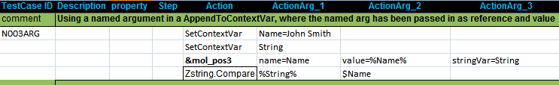



Molecule
Named argument Passing
    Passing by value and reference
Pass by Value
Pass by Ref

Slide 10



ATOMS
  In-Process
  Out-Process
  Build-In
Built-In
In-Process
Out-Process
Notes:
1.Atoms are small computer programs which are used to perform certain activity e.g.: Click a button, fill a text box, open a browser etc.
2.It can be executable or code libraries (JAR, DLL, LIB, etc...) written in the language of the user's choice.
3.In-Process atoms are those which run within ZUG’s own process. ZUOZ is a Repository of implemented atoms.
4.Out-Process atoms are those which run in separate process.@ is the prefix for using out Process atom in CHUR.
5.ZUG provides some atoms which are called Built-In atoms

Slide 11
Exercise : Molecules
Write test cases using a single login molecule to login to various sites with different username and password
Call the molecule using
  Named argument passing.
  Positional argument passing.
More at
http://www.automature.com/twiki/bin/view/ZUG/ChurBasicConcepts

