Slide 1
CSE 4128 Image Processing and Computer Vision Laboratory Week 3: Histogram Equalization
Dr. Sk. Md. Masudul Ahsan
Professor
Dept. of CSE, KUET
Dipannita Biswas
Lecturer
Dept. of CSE, KUET

Slide 2
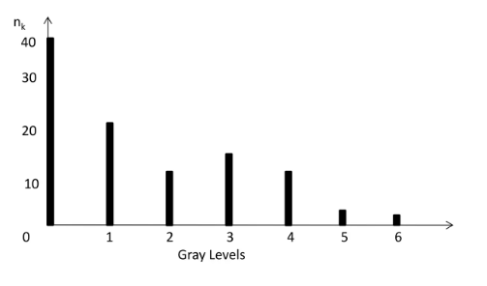

Histogram
The histogram of an image consists of the x-axis representing the intensity levels r_{k} and the y-axis denoting the h(r_{k}) or the p(r_{k}) functions.
$h(r_{k})=n_{k}$

Slide 3
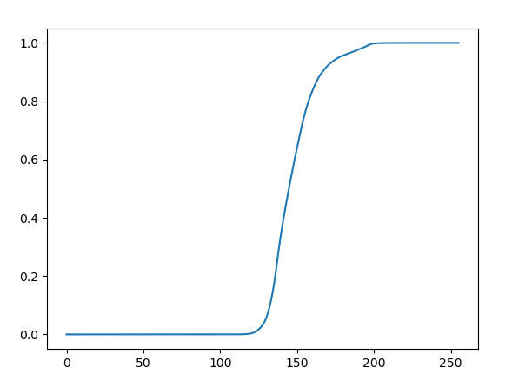
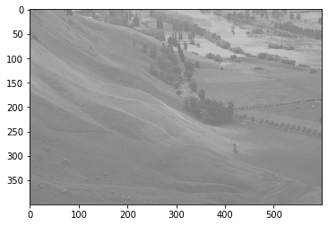
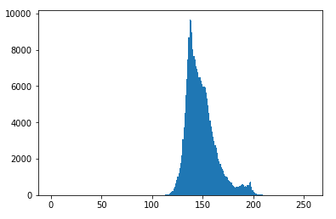
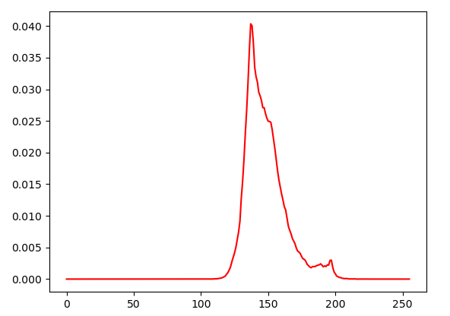
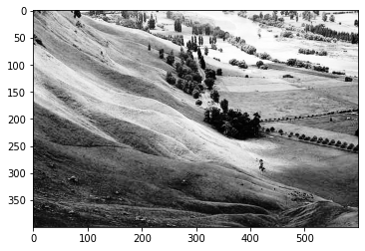
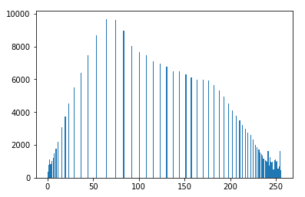
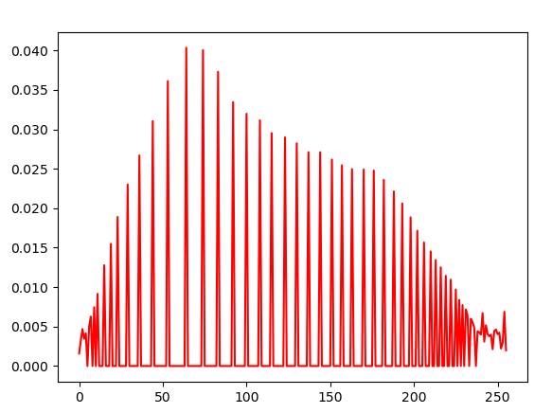
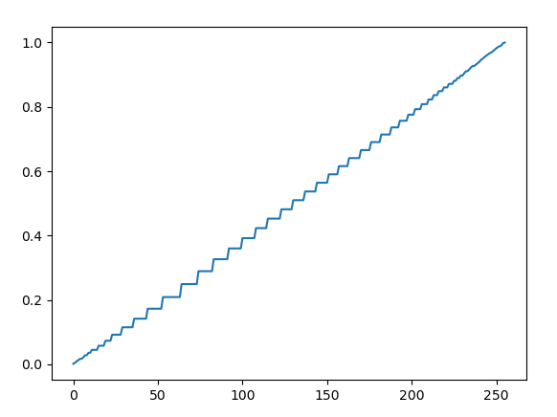
Histogram Equalization
Histogram equalization is used to enhance contrast.
Input Image
Histogram of the Input Image
PDF of the Input Image
CDF of the Input Image
Equalized Image
Histogram of the Equalized Image
PDF of the Equalized Image
CDF of the Equalized Image

Slide 4
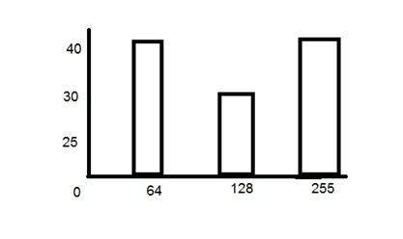
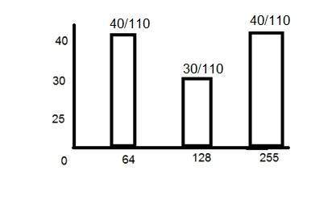


PDF
PDF stands for probability density function. It's a function where you can think of the x values as the range of possible occurring values and y values as their probability of occurrence.
$p\left(r_{k}\right)=\frac{n_{k}}{MN}$ $k=0,1,2……L−1$ $$n_{k}\text{: }\text{the} \text{number} \text{of} \text{pixels} \text{in} \text{the} \text{image} \text{of} \text{size} \text{M}×\text{N} \text{with} \text{intensity} r_{k}$$
$$n_{k}$$
PDF

Slide 5
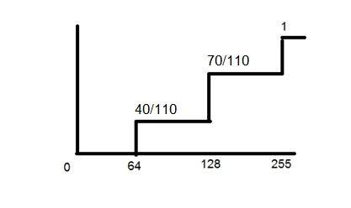
CDF
CDF holds the probability of a probability distribution less than or equal to a particular value.
It is a function that calculates the cumulative sum of all the values that are calculated by PDF.
PDF
CDF

Slide 6
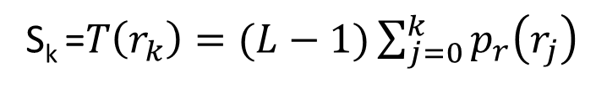
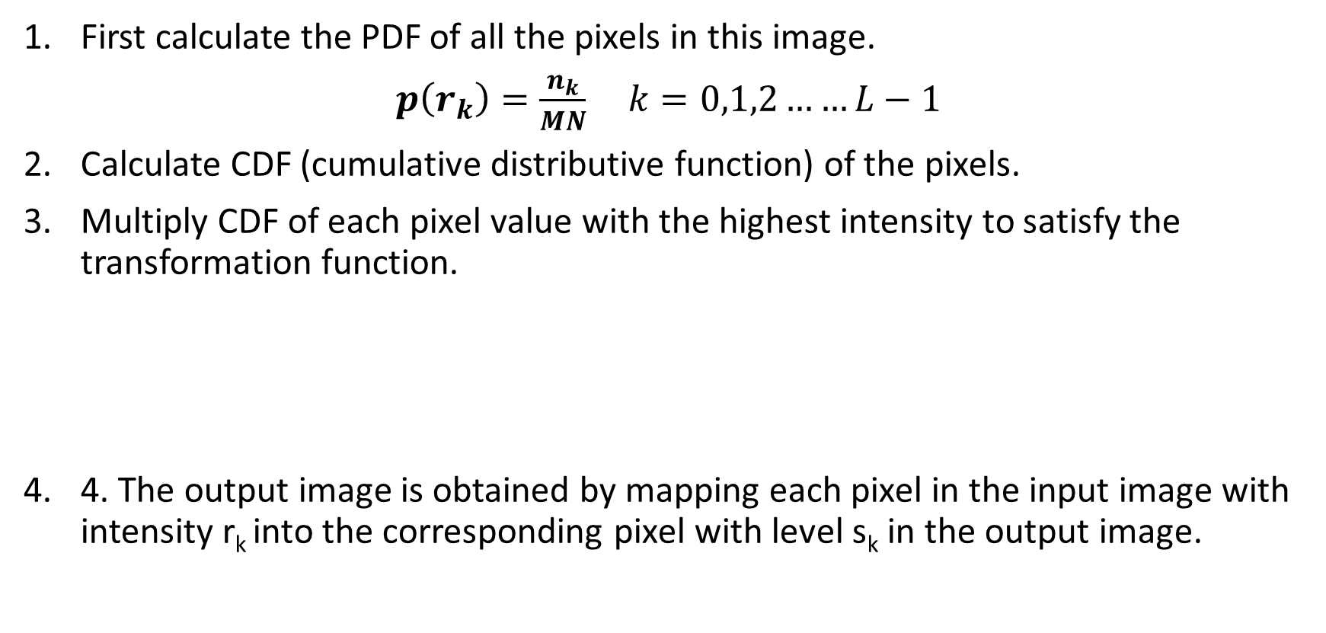
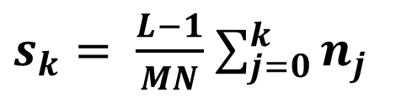
Histogram Equalization
First calculate the PDF of all the pixels in this image.
$p\left(r_{k}\right)=\frac{n_{k}}{MN}$ $k=0,1,2……L−1$
Calculate CDF (cumulative distributive function) of the pixels.
Multiply CDF of each pixel value with the highest intensity to satisfy the transformation function.
4. The output image is obtained by mapping each pixel in the input image with intensity r_{k} into the corresponding pixel with level s_{k} in the output image.
S_{k} =$T\left(r_{k}\right)=(L−1)\sum_{j=0}^{k}{p_{r}\left(r_{j}\right)}$
$s_{k}= \frac{L−1}{MN}$ $\sum_{j=0}^{k}{n_{j}}$

Slide 7
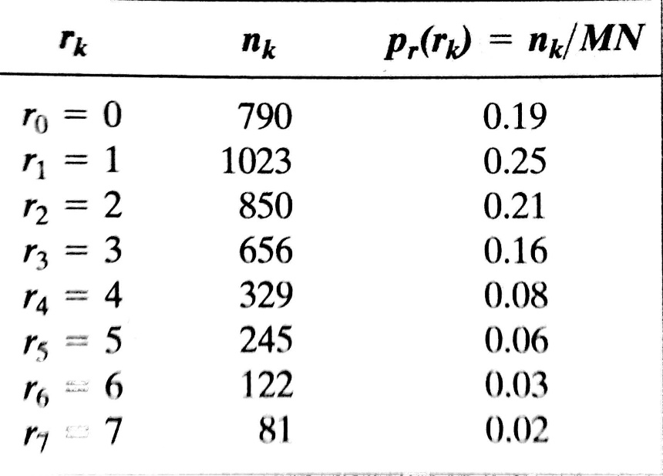
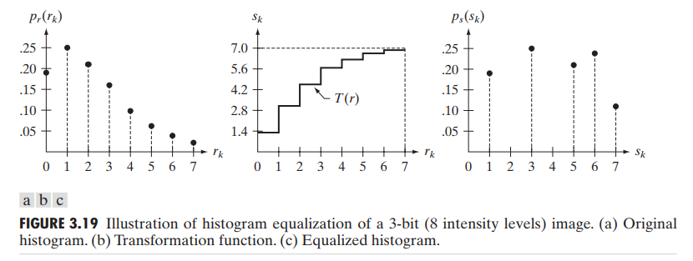
Map s_{k} to its r_{k}
s_{k}
S₀ = 1.33 = 1
S₁ = 3.08 = 3
S₂ = 4.55 = 5
S₃ = 5.67 = 6
S₄ = 6.23 = 6
S₅ = 6.65 = 7
S₆ = 6.86 = 7
S₇ = 7.00 = 7

Slide 8
Classwork
Take an input image and apply histogram equalization to enhance contrast.
Show the histogram of input and the equalized image
Show the histogram of CDF and PDF calculated from the input and output images.

Slide 9
Python Functions
Using openCV:
cv2.calcHist(images, channels, mask, histSize, ranges[, hist[, accumulate]])
histr = cv2.calcHist([img],[0],None,[256],[0,256]) plt.figure(1)
plt.plot(histr)
plt.show()
Using Matplotlib:
import matplotlib.pyplot as plt
plt.hist(img.ravel(),256,[0,256])
plt.show()

Slide 10
Assignment
Histogram Matching (Specification)
-- where the target histogram follows a double Gaussian distribution.
Instructions:
Generate the target histogram using Gaussian distribution and plot it for visualization.
Apply histogram matching to update the histogram of an input grayscale image to the target one.
Show the input and output image.
Plot the Histogram, PDF, and CDF of both input and output images.

Slide 11
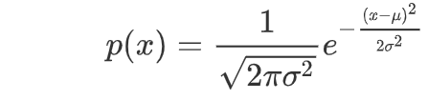
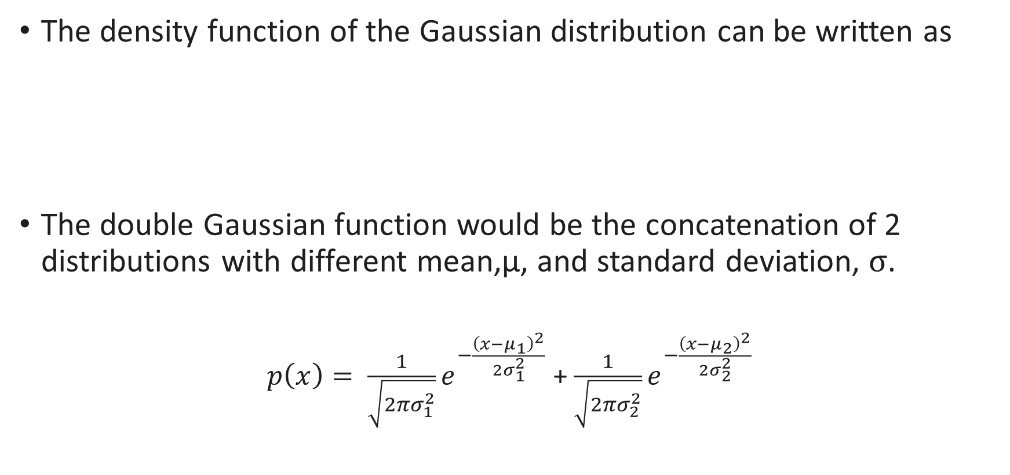
Gaussian Distribution
The density function of the Gaussian distribution can be written as
The double Gaussian function would be the concatenation of 2 distributions with different mean,µ, and standard deviation, σ.
$p\left(x\right)= \frac{1}{\sqrt{2πσ_{1}^{2}}}e^{−\frac{{\left(x−μ_{1}\right)}^{2}}{2σ_{1}^{2}}}$ + $\frac{1}{\sqrt{2πσ_{2}^{2}}}e^{−\frac{{\left(x−μ_{2}\right)}^{2}}{2σ_{2}^{2}}}$

Slide 12
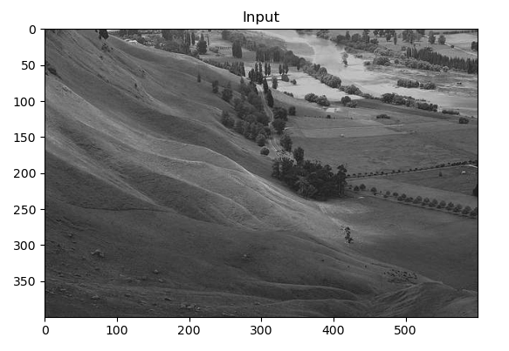
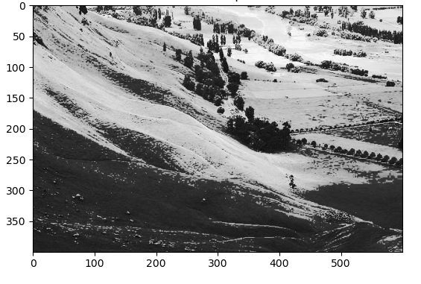
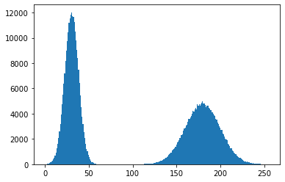
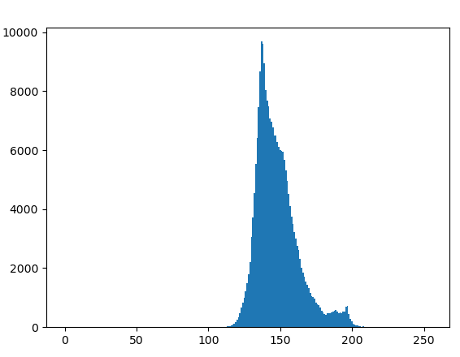
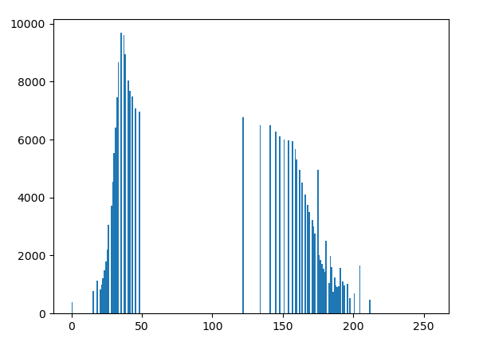
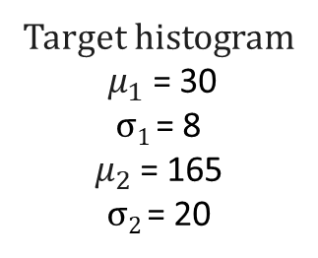
Histogram Matching with Double Gaussian Distribution
Input Image
Output Image
Target histogram
${ μ}_{1}$= 30
σ₁ = 8
$μ_{2}$= 165
σ₂ = 20
Histogram of the Input Image
Histogram of the Output Image

