Slide 1
Introduction to .NET Technology
Notes:
© Accenture 2006
Course Code Z16828
ATS Application Programming: C# .Net Programming
2.1 Introduction to .NET Technology

Slide 2
What is .NET ?
Microsoft.NET is a Framework
  Microsoft .NET is a Framework which provides a common platform to Execute or, Run the applications developed in various programming languages.
  Microsoft announced the .NET initiative in July 2000.
Notes:
© Accenture 2006
Course Code Z16828

Slide 3
.NET Framework Objectives
The .NET Framework is designed to fulfill the following objectives:
  Provide object-oriented programming environment
  Provide environment for developing various types of applications, such as Windows-based applications and Web-based applications
  To ensure that code based on the .NET Framework can integrate with any other code
Notes:
© Accenture 2006
Course Code Z16828
ATS Application Programming: C# .Net Programming
2.1 Introduction to .NET Technology
Faculty Notes:

Slide 4
Visual Studio IDE
  Microsoft has introduced Visual Studio.NET, which is a tool (also called Integrated Development Environment) for developing .NET applications by using programming languages such as VB, C#, VC++ and VJ#. etc.
Notes:
© Accenture 2006
Course Code Z16828
ATS Application Programming: C# .Net Programming
2.1 Introduction to .NET Technology

Slide 5
C# (C Sharp)
Microsoft C# (pronounced C Sharp) developed by Microsoft Corporation, USA
Programming language that runs on the .NET Framework
C# is simple, modern, type safe, and object oriented
Combines the best features of Visual Basic, C++ and Java
Notes:
© Accenture 2006
Course Code Z16828
ATS Application Programming: C# .Net Programming
2.1 Introduction to .NET Technology
Faculty Notes:
C# code is compiled as managed code, which means it benefits from the services of the common language runtime. These services include language interoperability, garbage collection, enhanced security, and improved versioning support.

Slide 6
Introduction to Web Based Applications
Notes:
© Accenture 2006
Course Code Z16828
ATS Application Programming: C# .Net Programming
2.1 Introduction to .NET Technology

Slide 7
Introducing Web Applications
Web Page
Static web page
This type of web page consists of HTML code typed directly into text or a web page editor
It is saved as an .htm or .html file
Static
Dynamic
The content (text, images, hyperlinks, and so on) and appearance of a static web page is always the same.
These web pages do not utilize any database or any other technology that dynamically builds up pages or content at runtime based on their visitors input.
Notes:
.NET: Software Engineering II
4.1 Introduction to ASP.NET
© Accenture 2006 All Rights Reserved
http://www.visualbuilder.com/aspnet/tutorial/pageorder/2/

Slide 8
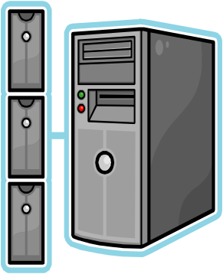
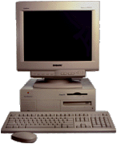
How Are Static Web Pages Served ?
WEB SERVER
3. Web Server locates .html file
Author writes
HTML
4. HTML stream( from the .html page) returned to the browser
2. Client requests the web page
5. Browser processes
HTML and displays
page
CLIENT
Notes:
.NET: Software Engineering II
4.1 Introduction to ASP.NET
© Accenture 2006 All Rights Reserved
1. Author writes HTML.
2. The Web browser sends a request for a particular Web page of a Web site to the Web server hosting that site.
3. The Web server searches for the page in directory containing Web pages for the Web site.
4. On finding the requested page, the Web server collects the HTML of the Web page.
5. The Web server sends the HTML to the requesting browser which then parses it to develop the visual presentation of the page.

Slide 9
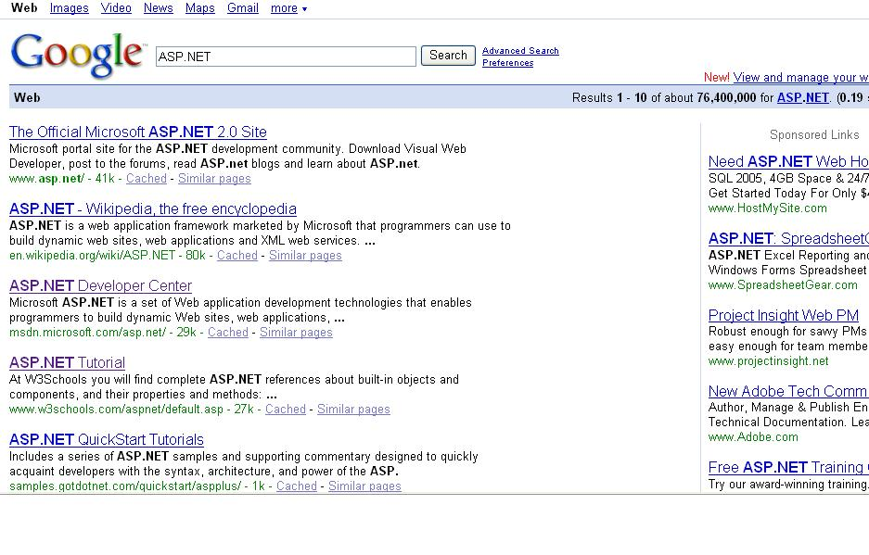
Dynamic web page
Dynamic Web sites provide its visitors to modify the content of the web page based on their input.
They utilize databases and other mechanisms that enable to
  identify their visitors
  present them with customized greeting messages
  restructure the content according to user input etc..
Examples:
  Online shopping stores,
  search engines
  email
  chat, community portals etc.

Slide 10
Dynamic web page
Dynamic Web sites make use of “server-side technology”.
Server-side technologies add an extra layer to the static web page that enables the Web Server to generate HTML on the fly.
The web server will first
  interpret the server-side code present in web pages,
  generate the appropriate HTML and then
  send the response to the web browser.
Notes:
.NET: Software Engineering II
4.1 Introduction to ASP.NET
© Accenture 2006 All Rights Reserved
Web servers are software that manage Web pages and make them available to client browsers – via a local
network or over the Internet. In the case of the Internet, the Web server and browser are usually on two
different machines, possibly many miles apart. However, in a local situation you can set up a machine
that runs the Web server software, and then use a browser on the same machine to look at its Web pages.

Slide 11
How Are Dynamic Web Pages Served?
Web Server collects the contents (code + HTML) of the web page and parses the contents to produce HTML.
WEB SERVER
2. The Web Server searches for the requested page
4. The HTML stream is sent back to the requesting browser
1. The Web browser sends a request
5. Browser processes
HTML and displays
page
CLIENT
Notes:
.NET: Software Engineering II
4.1 Introduction to ASP.NET
© Accenture 2006 All Rights Reserved
1. The Web browser sends a request for a particular Web page of a Web site to the Web server hosting that site.
2. The Web server searches for the page in directory containing Web pages for the Web site.
3. On finding the requested page, the Web server collects the content (code + HTML) of the Web page.
4. The Web server then parses the content to produce HTML.
5. The HTML stream is sent back to the requesting browser which then parses it to develop the visual presentation of the page.

Slide 12

Introduction to ASP.NET
Notes:
© Accenture 2006
Course Code Z16828
ATS Application Programming: C# .Net Programming
2.1 Introduction to .NET Technology

Slide 13
Introduction to ASP.NET
ASP.NET is part of the Microsoft .NET framework
ASP.NET is an effective and flexible technology for creating interactive and dynamic web pages.
It is a convergence of two major Microsoft technologies:
  Active Server Pages (ASP)
    Active Server Pages is Microsoft’s server side scripting technology for building dynamic web pages.
  .NET Framework
    The .NET Framework is a suite of technologies designed by Microsoft where program development takes place.
Notes:
.NET: Software Engineering II
4.1 Introduction to ASP.NET
© Accenture 2006 All Rights Reserved
Faculty Notes
ASP.NET applications can be written in any .NET compatible language like Visual Basic .NET, C#, and JScript .NET.

Slide 14
What is an ASP.NET File?
An ASP.NET file is just the same as an HTML file
An ASP.NET file can contain HTML, XML, and scripts
Scripts in an ASP.NET file are executed on the server
It is programmable using any of the .NET languages (VB.NET, C#, VJ# etc).
The ASP.NET pages are saved with the .aspx extension.

Slide 15
Working of an ASP.NET Application
To execute an ASP.NET file, the following steps are followed:
A web browser sends a request for an ASP.NET file to the web server by using a URL.
The web server receives the request and retrieves the appropriate ASP.NET file from the disk or memory.
The web server forwards the file to the ASP.NET script engine for processing.
ASP.NET
Script
Engine
WEB SERVER
CLIENT

Slide 16
Working of an ASP.NET Application
4. The ASP.NET script engine reads the file from top to bottom and executes it.
5. The processed ASP.NET file is generated as an HTML document and the ASP.NET script engine sends the HTML page to the Web server.
6. The Web server then sends the HTML code to the client which interprets the output and displays it.
ASP.NET
Script
Engine
WEB SERVER
CLIENT

Slide 17
How Does ASP.NET Work?
When a browser requests an HTML file, the server returns the file
When a browser requests an ASP.NET file, IIS passes the request to the ASP.NET engine on the server
The ASP.NET engine reads the file, line by line, and executes the scripts in the file
Finally, the ASP.NET file is returned to the browser as plain HTML

Slide 18
Run IIS server
Goto “Control Panel”.
Select “Programs and Features”.
Click “Turn Windows features on or off”.
Check “Internet Information Services”.
Check “Internet Information Services Hostable Web Core”.
Ok.
Check “C:\Inetpub\wwwroot”.

Slide 19
Creating Virtual directory in IIS?
Enables us to make a local directory as server directory
Can directly access that directory as localhost
Lets see how we can create virtual directory:
Go to administrative tools=>IIS services
Then expand “local computer”
Then expand “Sites”
Then right click on the “Default Web Site”
Click on “Add Virtual Directory”
Finally complete the wizard with required information
  Give an alias name for the virtual directory
  Locate the path of the actual directory

Slide 20
How to create asp.net Website in MS Visual Studio (cont…)
Run MS Visual Studio as an administrator.
  If not an administrator, right click on the shortcut of MS Visual Studio.
  Goto properties, select “advanced” and check “Run as administrator”.
Then “File→New→Web Site
  Template (Visual C#)
  ASP.NET Empty Web site
  Web Location (HTTP)
  Browse to the virtual directory

Slide 21
Now some Examples
We will use visual studio 2012 as our editor
We will see some basic commands of asp.net
We will see how data are sent and receive from and to the pages.(using POST and GET methods)

Slide 22
ASP Forms and User Input
Run page temp.html
Here we will see how the GET and POST methods works

Slide 23
Self processing pages
Run page selftemp.aspx
Here runat="server" defines the action on the self page and set method POST for requesting , if not explicitly defined

Slide 24
Label and Button
Run pages label_date.aspx and button.aspx

Slide 25
Create a web site using MS Studio IDE
Create a web site using MS Studio IDE

Slide 26
Questions and Comments
???
Notes:
.NET: Software Engineering II
4.1 Introduction to ASP.NET
© Accenture 2006 All Rights Reserved
Faculty Notes:
Ask participants if they have any questions about the content covered in this presentation.

