Slide 1

Seasonal Agriculture Performance Analysis
Dipanshu Bhardwaj
World College of Technology and Management
AICTE STU ID : STU6a2bb2a6004e11781248678

Slide 2

PROBLEM STATEMENT
Agricultural productivity and profitability vary widely across the Kharif, Rabi, and Zaid seasons due to differences in rainfall, temperature, soil moisture, and resource usage. Farmers and policymakers currently lack a clear, data-driven understanding of which season performs best and why, making it difficult to plan crop choices, resource allocation, and investment decisions effectively.

Slide 3
Project Description
This project analyzes a dataset of 4,000 farm records across 8 Indian states to study how season (Kharif, Rabi, Zaid) affects agricultural yield, production, revenue, and profit. The workflow covers data cleaning, exploratory data analysis, and correlation analysis of environmental and resource factors to identify the most productive and profitable season, and to compare performance across crops and regions.

Slide 4

WHO ARE THE END USERS?
Farmers and farming cooperatives planning crop and season choices
Agricultural policymakers and government agriculture departments
Agri-tech companies and researchers studying crop performance
Banks and crop insurance providers assessing seasonal risk

Slide 5

Technology Used
Python – core programming language for analysis
Pandas & NumPy – data cleaning and numerical analysis
Matplotlib & Seaborn – data visualization and charts
Jupyter Notebook – interactive development environment

Slide 6
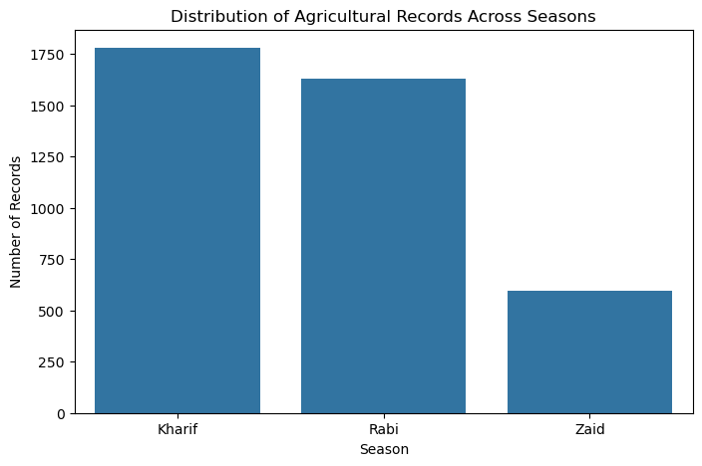
RESULTS
Distribution of Farm Records Across Seasons

Slide 7
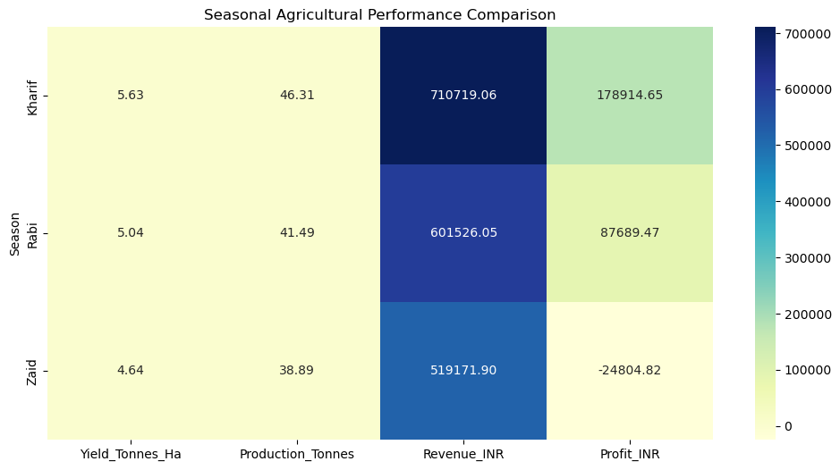
RESULTS
Seasonal Performance Heatmap – Yield, Production, Revenue & Profit

Slide 8
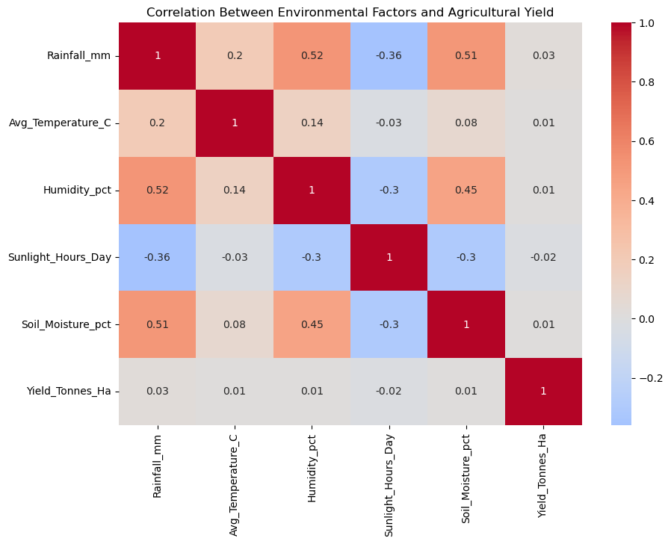
RESULTS
Correlation Between Environmental Factors and Yield

Slide 9
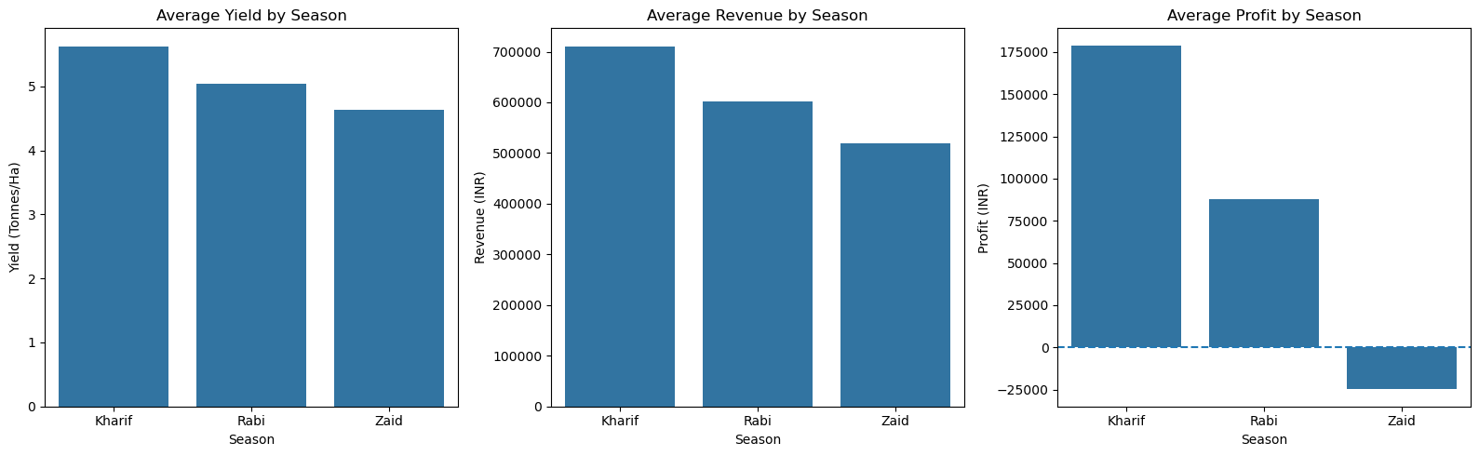
RESULTS
Final Seasonal Comparison – Yield, Revenue & Profit

Slide 10
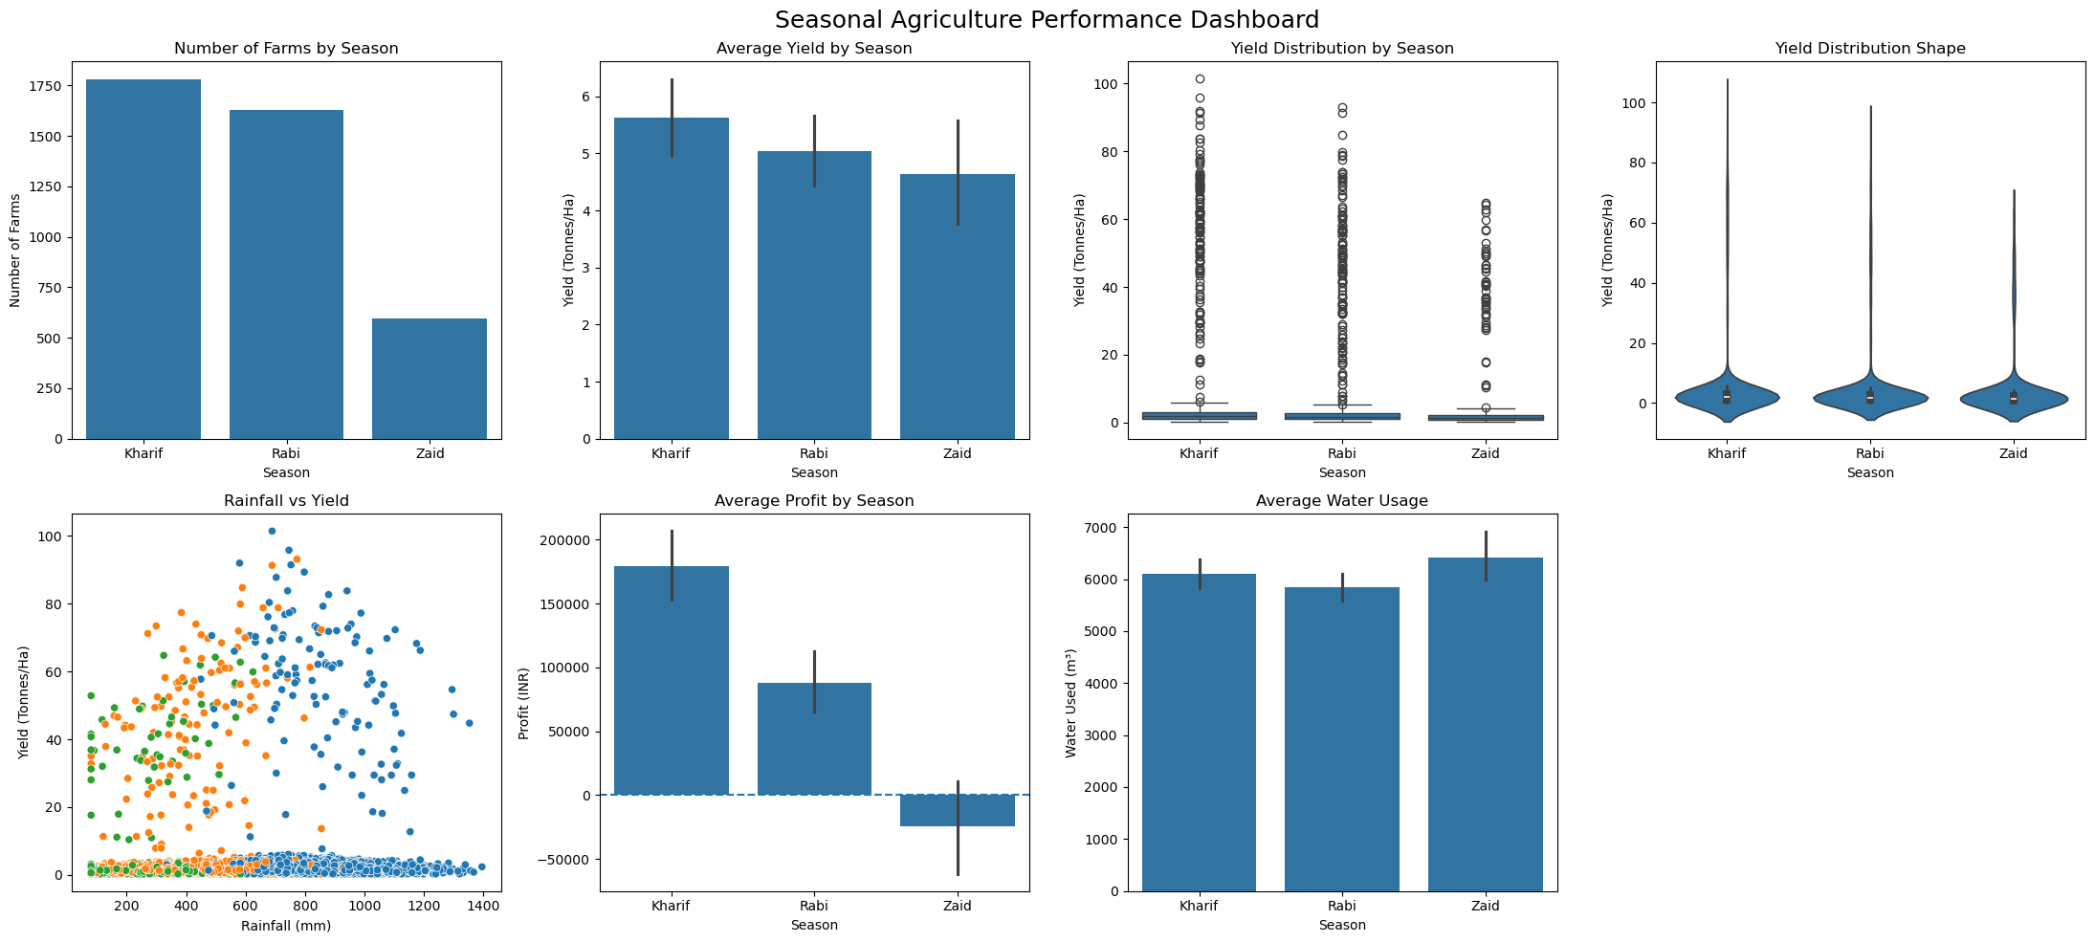
RESULTS
Seasonal Agriculture Performance Dashboard

Slide 11
Future scope
Predictive Yield Modeling
Real-Time Data Integration
Build a machine learning model to predict crop yield from rainfall, soil, and resource-usage data
Integrate live weather and market-price feeds for up-to-date seasonal recommendations
Extend the analysis to more states, districts, and crop varieties for broader coverage
Develop an interactive dashboard so farmers and policymakers can explore results directly

Slide 12
GitHub Link
Repository
https://github.com/dipanshu1225/Seasonal-Agriculture-Performance-Analysis

Slide 13
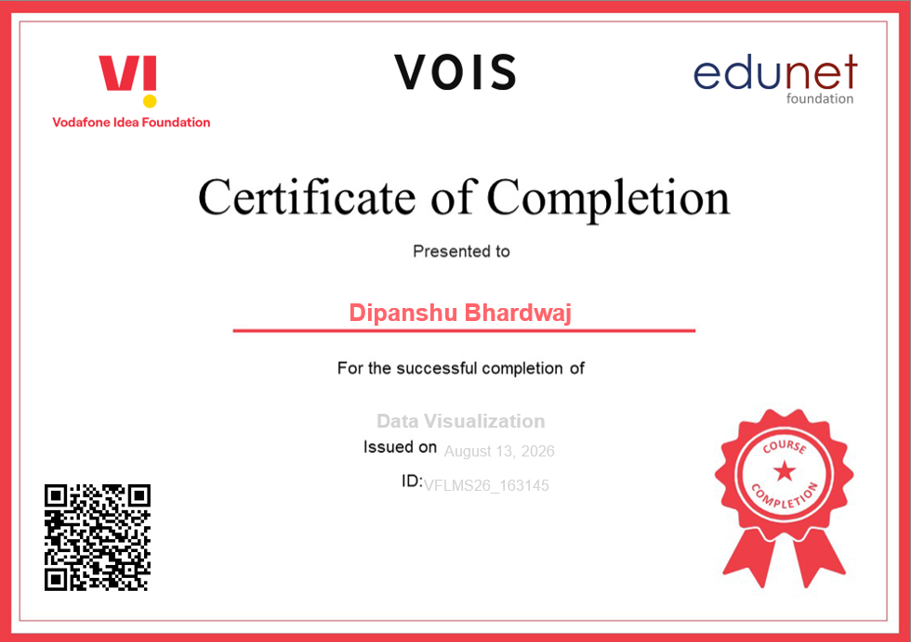
VOIS Course completion certificate - Course name- Data Visualization

Slide 14
Thank you
Sincerely, Dipanshu Bhardwaj
.
.

