Slide 1
Machine Learning
Dipanshu Verma
SWE Microsoft
BTech IIT Mandi
Part 2 – Supervised Learning

Slide 2
Recap
What is machine learning
Machine Learning already a game changer industry
Types of Machine learning – supervised and unsupervised
Jupyter Notebook – A companion to rely on

Slide 3
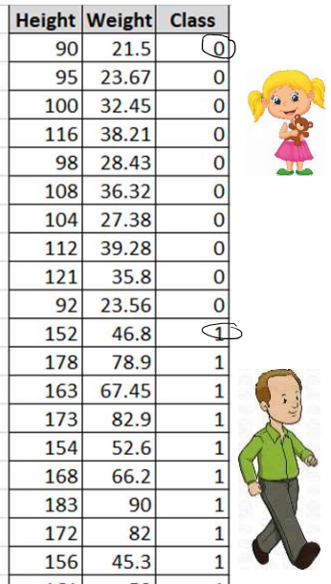
Supervised Learning
What is supervised ML ?
Labelled dataset
Data representation using features/attributes
Learning relationships between these features and labels (classes)
Going beyond: predictions

Slide 4
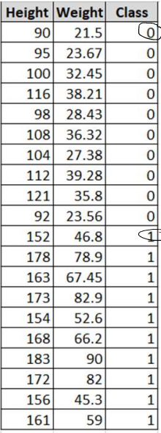
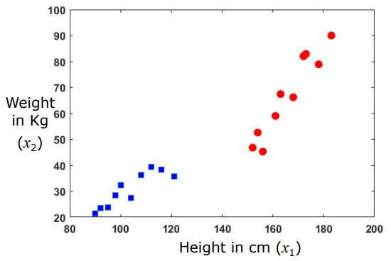
Visual Representation of Labelled Dataset
Atrributes in the representation:
Weight
Height
Class here represents a label for the information
2D representation of data
We can have N-Dimensional data similarly, though we might be able to understand the hyperdimensional representation

Slide 5
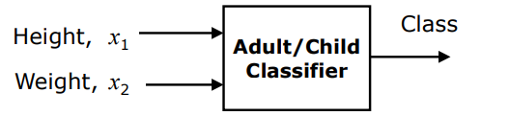
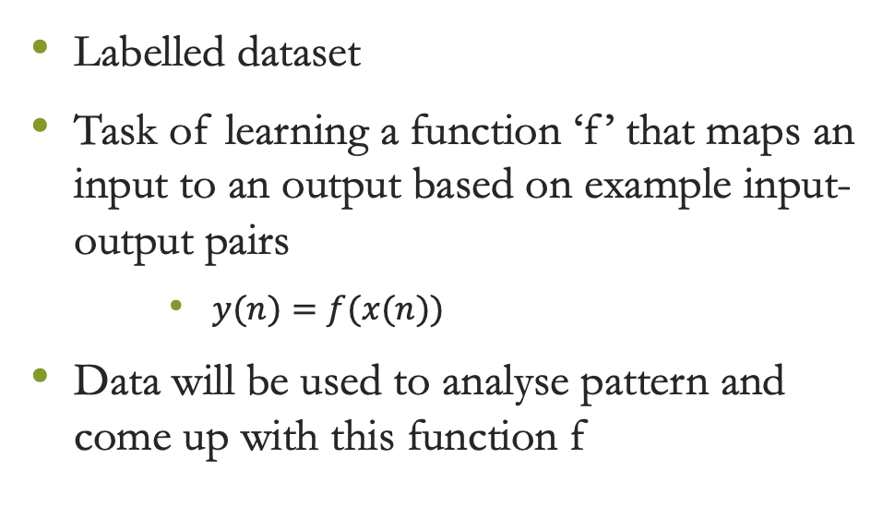
Supervised Learning
Labelled dataset
Task of learning a function ‘f’ that maps an input to an output based on example input-output pairs
$y(n)=f(x(n))$
Data will be used to analyse pattern and come up with this function f

Slide 6
Supervised Learning
Can be categorized into
Regression
Output variable is a continuous value (Something measurable)
Not restricted to binary values 1 or 0, can have infinite values in between 2 numbers
Output might be multidimensional ([1.34, 5.676, 23.34])
Classification
Categorical output (1 or 0 or not for scale, 1 and -1 serve the same basis)
Categorical output can have more than 2 values (0,1,2)
Categorical output can have more than 1 dimension as well ([0,0],[0,1],[1,0],[1,1])

Slide 7

Demo

Slide 8
Why are functions hate their callers ?
- Because some of them throw arguments at them ☹

Slide 9


