Slide 1
Machine Learning
Dipanshu Verma
SWE Microsoft
BTech IIT Mandi

Slide 2
What is Machine Learning
Simplest – Machine Learning is making the machine learn
Data is the fuel to the learning, just like humans
Mathematical at roots is not approximate but a well defined function with hint of randomness
1, 2, 3, 4, 5, ?, …, 24, 25, 26, 27, ?
1, 3, 5, 7, 9, ?, …, 25, 27, 29, 31, ?
2, 3, 5, 7, 11, ?, …, 29, 31, 37, 41, ?

Slide 3




Applications

Slide 4
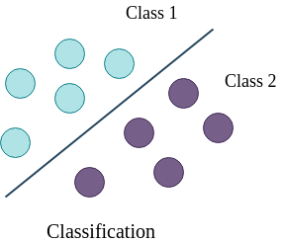
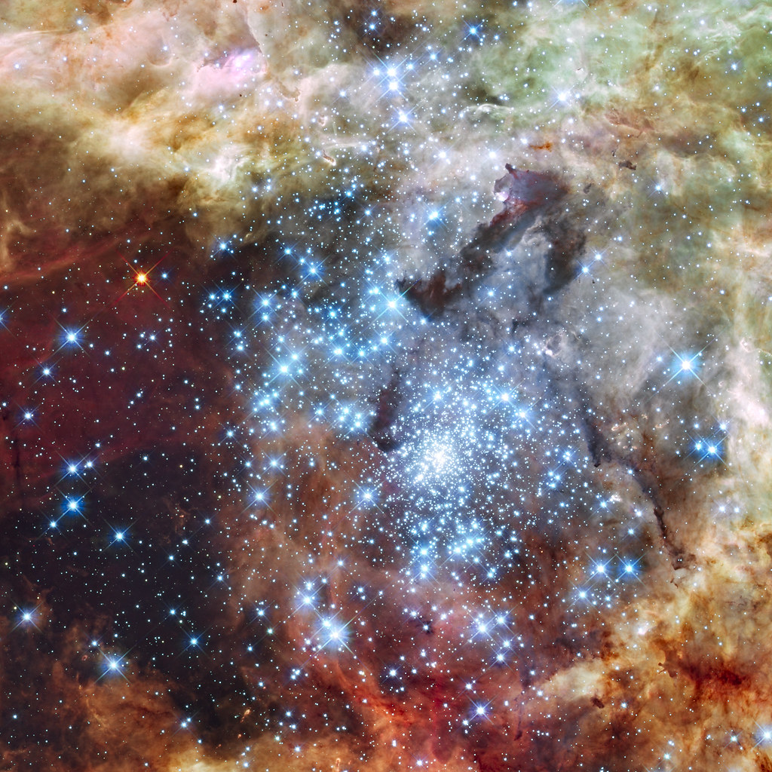
Types of Machine Learning
Supervised Learning
Labelled data
Regression, classification
SVM, Linear Regression, Decision Trees, …
Unsupervised Learning
Unlabelled data
Clustering, associations
KNN, DBScan, …
This Photo by Unknown Author is licensed under CC BY

Slide 5

Jupyter Notebook
Boils down to coding
Python to the rescue, jupyter notebook a great tool for data science

Slide 6
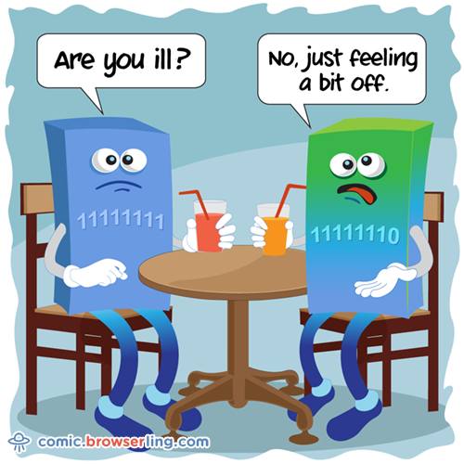

Slide 7


