Slide 1
Machine Learning
Dipanshu Verma
SWE Microsoft
BTech IIT Mandi
Part 3 – Unsupervised Learning

Slide 2
Recap
What is supervised learning, labelled dataset
Visual representation of labelled dataset
Mathematical representation for supervised learning
Types of supervised learning – Regression, Classification
Python code to represent labelled dataset

Slide 3
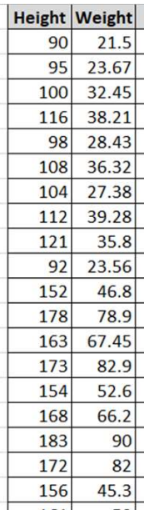
Unsupervised Learning
What is unsupervised ML ?
Unlabeled dataset
Data representation using features/attributes
Learning similarities between data points and differentiate between these groups
Formation of – Clusters and Associations

Slide 4
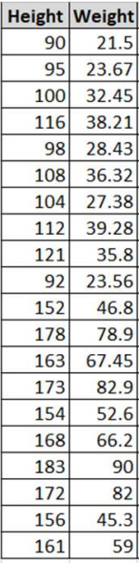
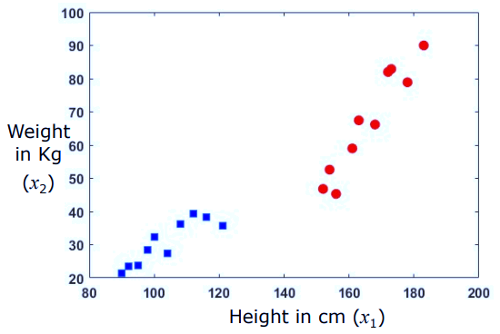
Visual Representation of Unlabeled Dataset
Attributes in the representation:
Weight
Height
No class is represented here, that is we have no labels
2D representation of data, same as previous time
We can have N-Dimensional data similarly, though we might be able to understand the hyperdimensional representation

Slide 5
Unsupervised Learning
Can be categorized into
Clustering
Partition the dataset on the basis of similarities. Similarities are usually distance based.
Different machine learning models that have iterative approach to find similarities with some exit criterion. (ex – number of clusters, min/max similarity, number of iterations)
Association
It is a rule-based machine learning to discover the interesting variables in a data set
Finding products that are often bought together in E commerce websites.

Slide 6
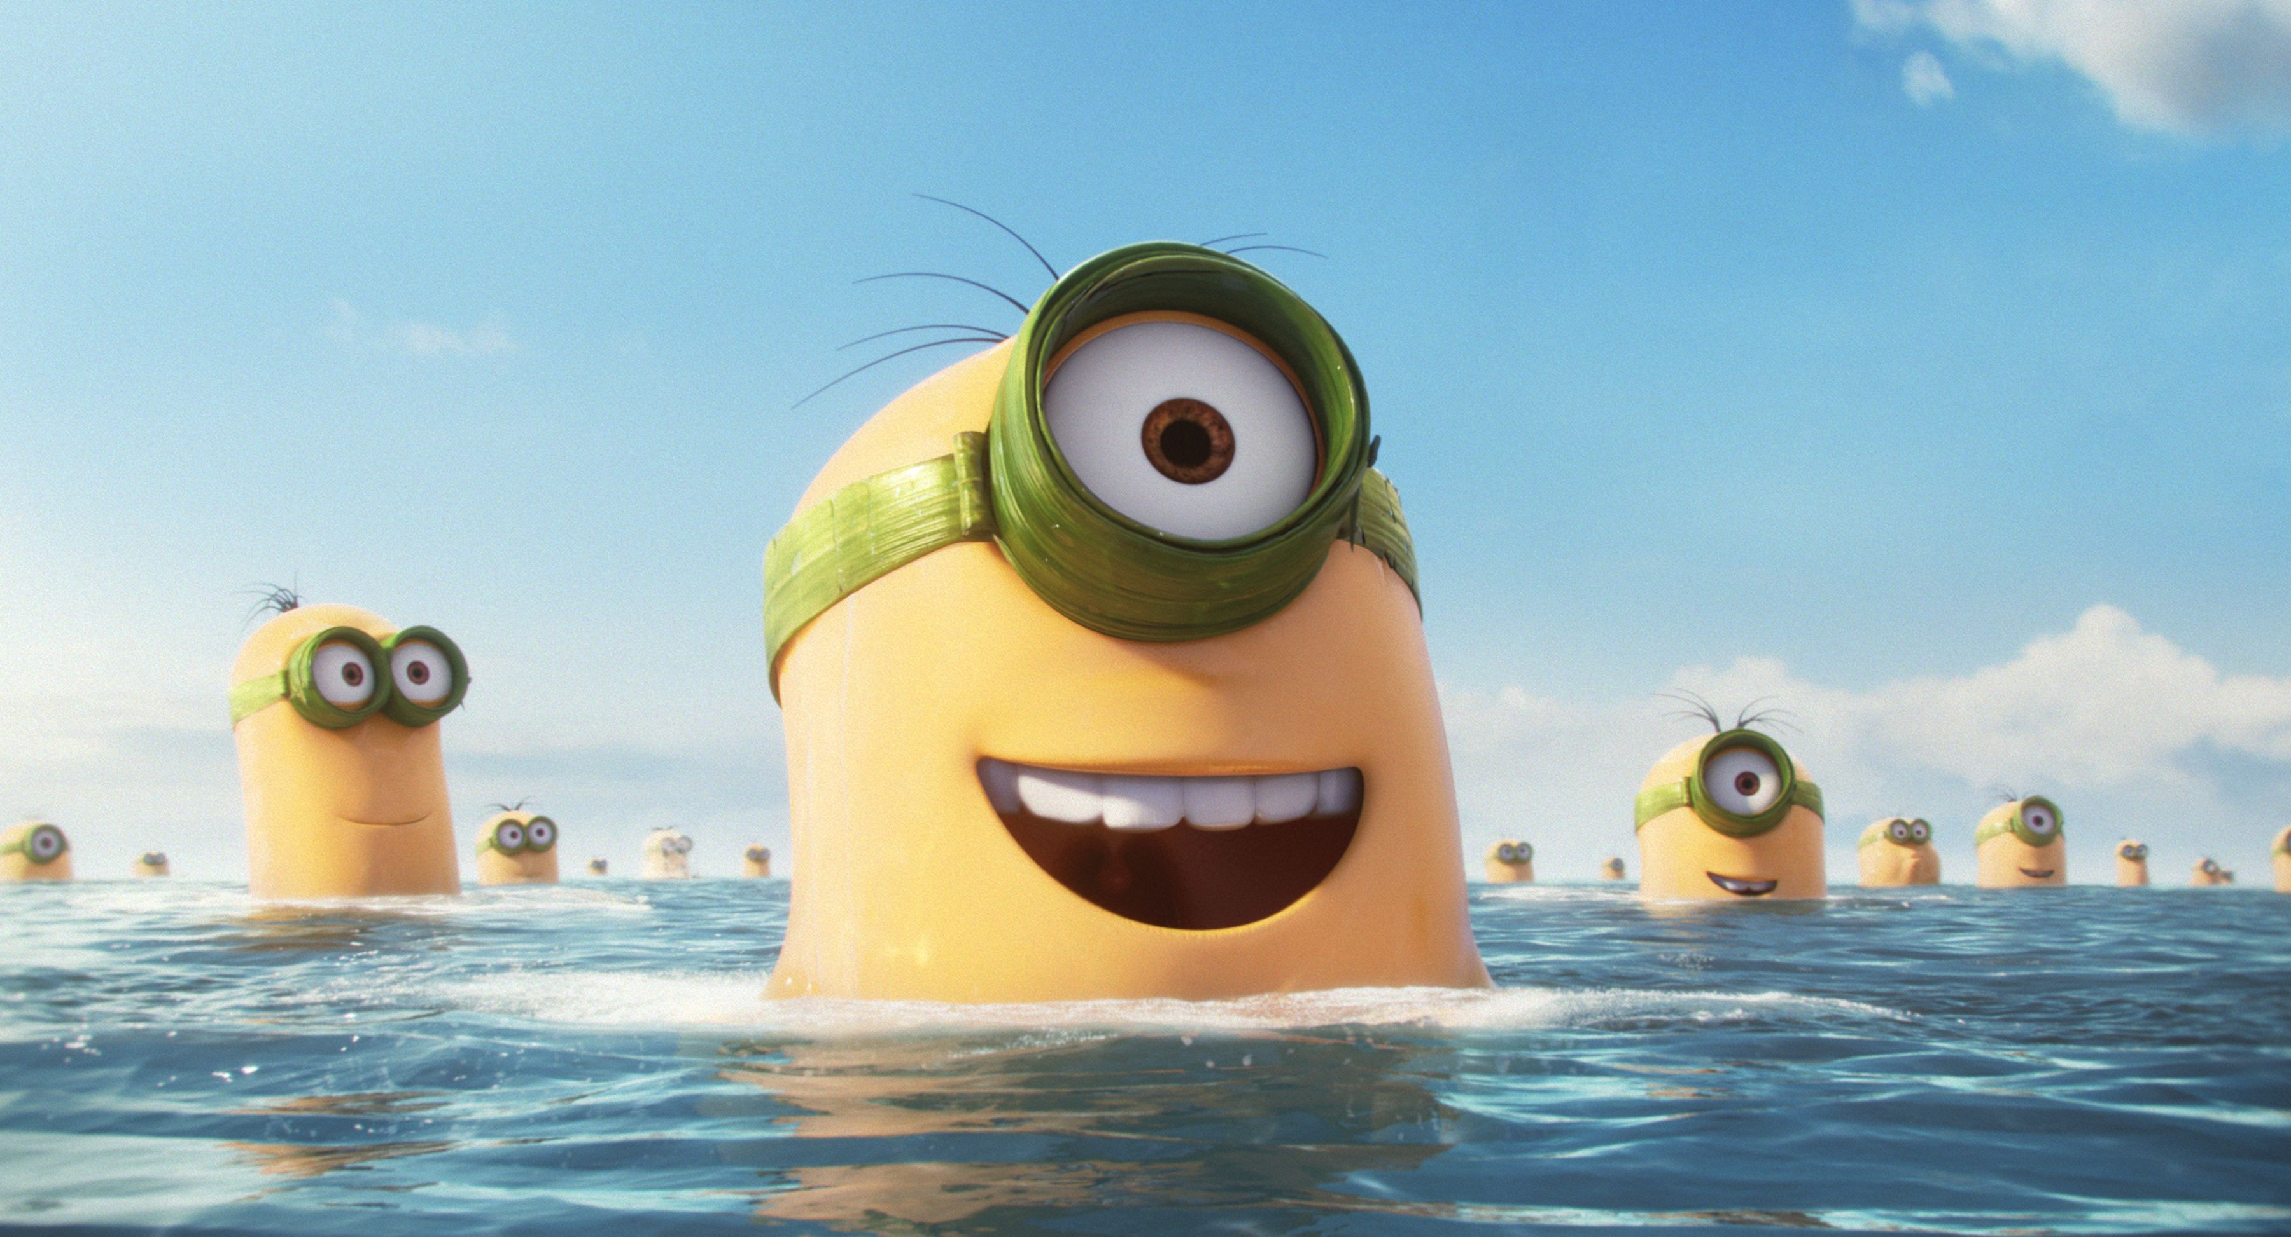
Demo

Slide 7
