Slide 1
WELCOME TO OUR PRESENTATION

Slide 2
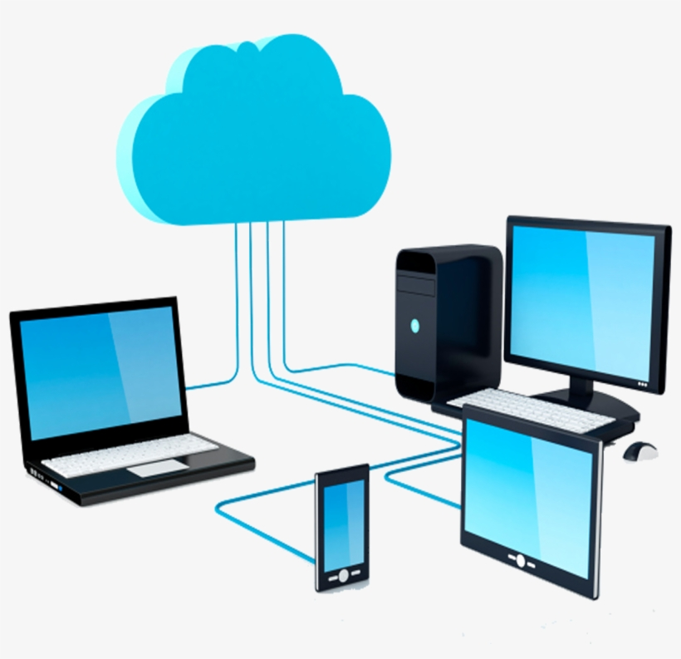
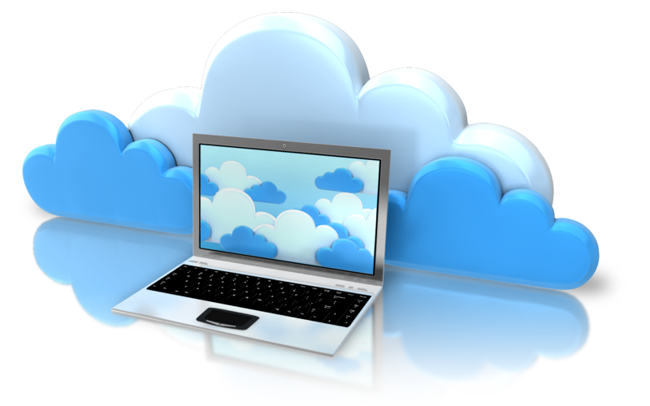
PRESENTATION TOPIC :
CLOUD COMPUTING

Slide 3
TEAM MEMBERS:
1) DIPANITA MONDOL ( 201-15-13617)
2) SUMAYA ISLAM ( 201-15-13675)
3) TUSHAR AHMED NIRMA ( 201-15-13701)
COURSE TEACHER:
MD. ZABIRUL ISLAM
Lecturer of software project
Daffodil international university

Slide 4
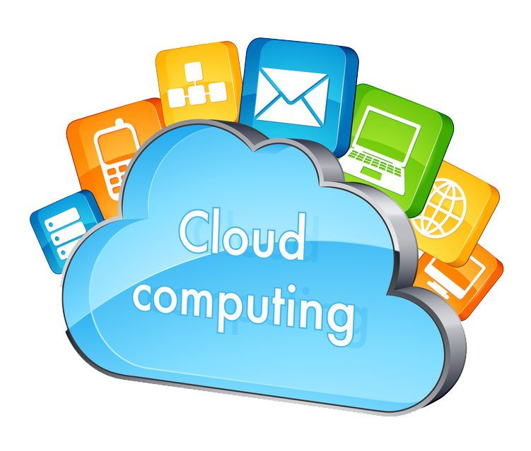
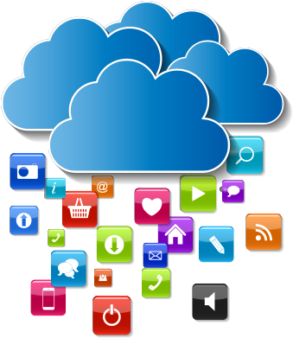
WHAT IS CLOUD COMPUTING ?
Cloud computing is the on-demand availability of computer system resources, especially data storage and computing power, without direct active management by the user. Large clouds often have functions distributed over multiple locations, each location being a data center.

Slide 5
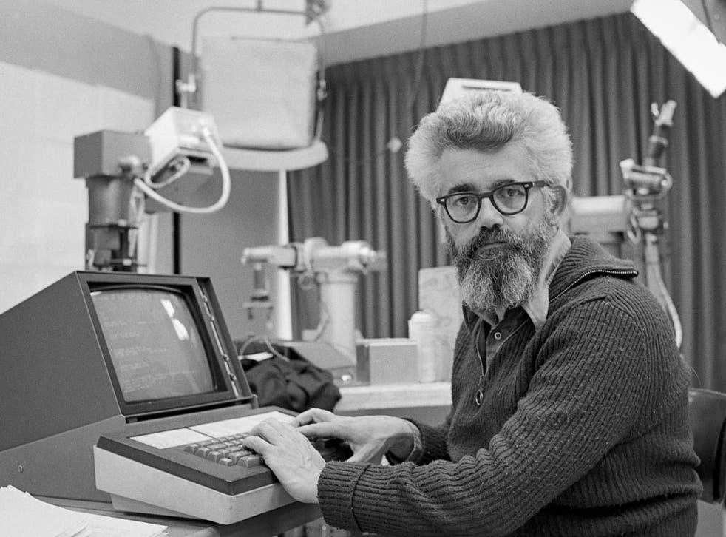
HISTORY:
An American Computer Scientist named John Mc Carthy stated that computing will become a publicly available service in the future.He claimed that computing might be sold in future in the same way as utilities.

Slide 6
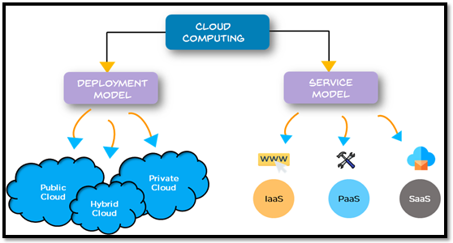
TYPES AND SERVICES :

Slide 7
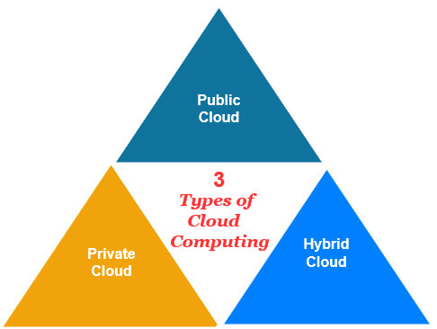
CLOUD DEPLOYMENTS :
There are three types of cloud deployments. They are Public Cloud, Private Cloud, Hybrid Cloud. Now I will Describe one by one .

Slide 8
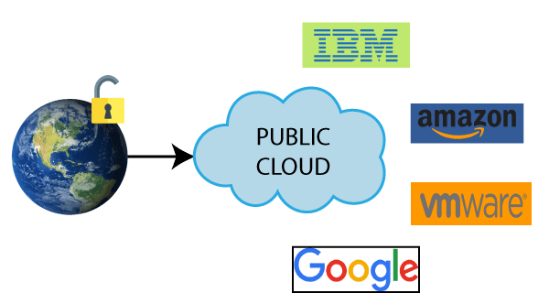
PUBLIC CLOUD :
The public cloud is defined as computing services offered by third-party providers over the public Internet, making them available to anyone who wants to use or purchase them. They may be free or sold on-demand, allowing customers to pay only per usage for the CPU cycles, storage, or bandwidth they consume.

Slide 9
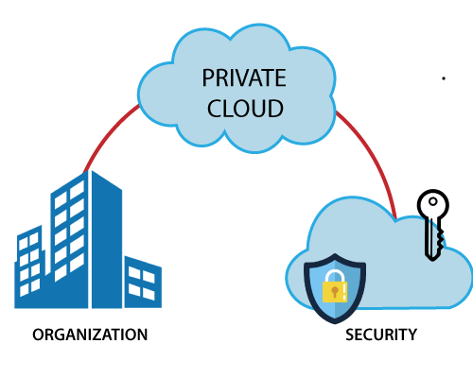
PRIVATE CLOUD :
Private cloud is a type of cloud computing that delivers similar advantages to public cloud, including scalability and self-service, but through a proprietary architecture. A private cloud, also known as internal or corporate cloud, is dedicated to the needs and goals of a single organization whereas public clouds deliver services to multiple organizations.

Slide 10
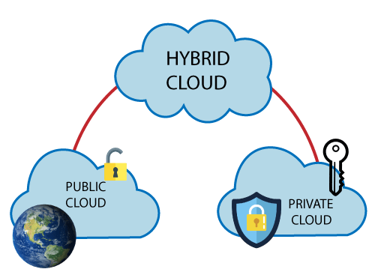
HYBRID CLOUD :
A hybrid cloud is a cloud computing environment that uses a mix of on-premises, private cloud and third-party, public cloud services with orchestration between these platforms. This typically involves a connection from an on-premises data center to a public cloud. The connection also can involve other private assets, including edge devices or other clouds.

Slide 11
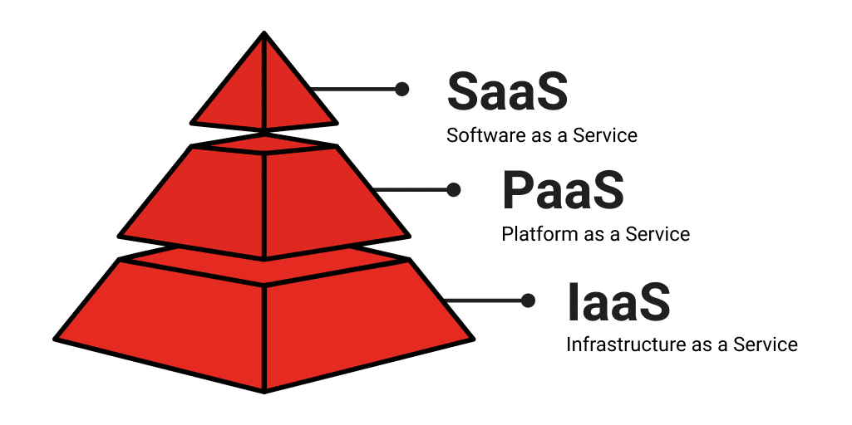
SERVICE MODEL:

Slide 12
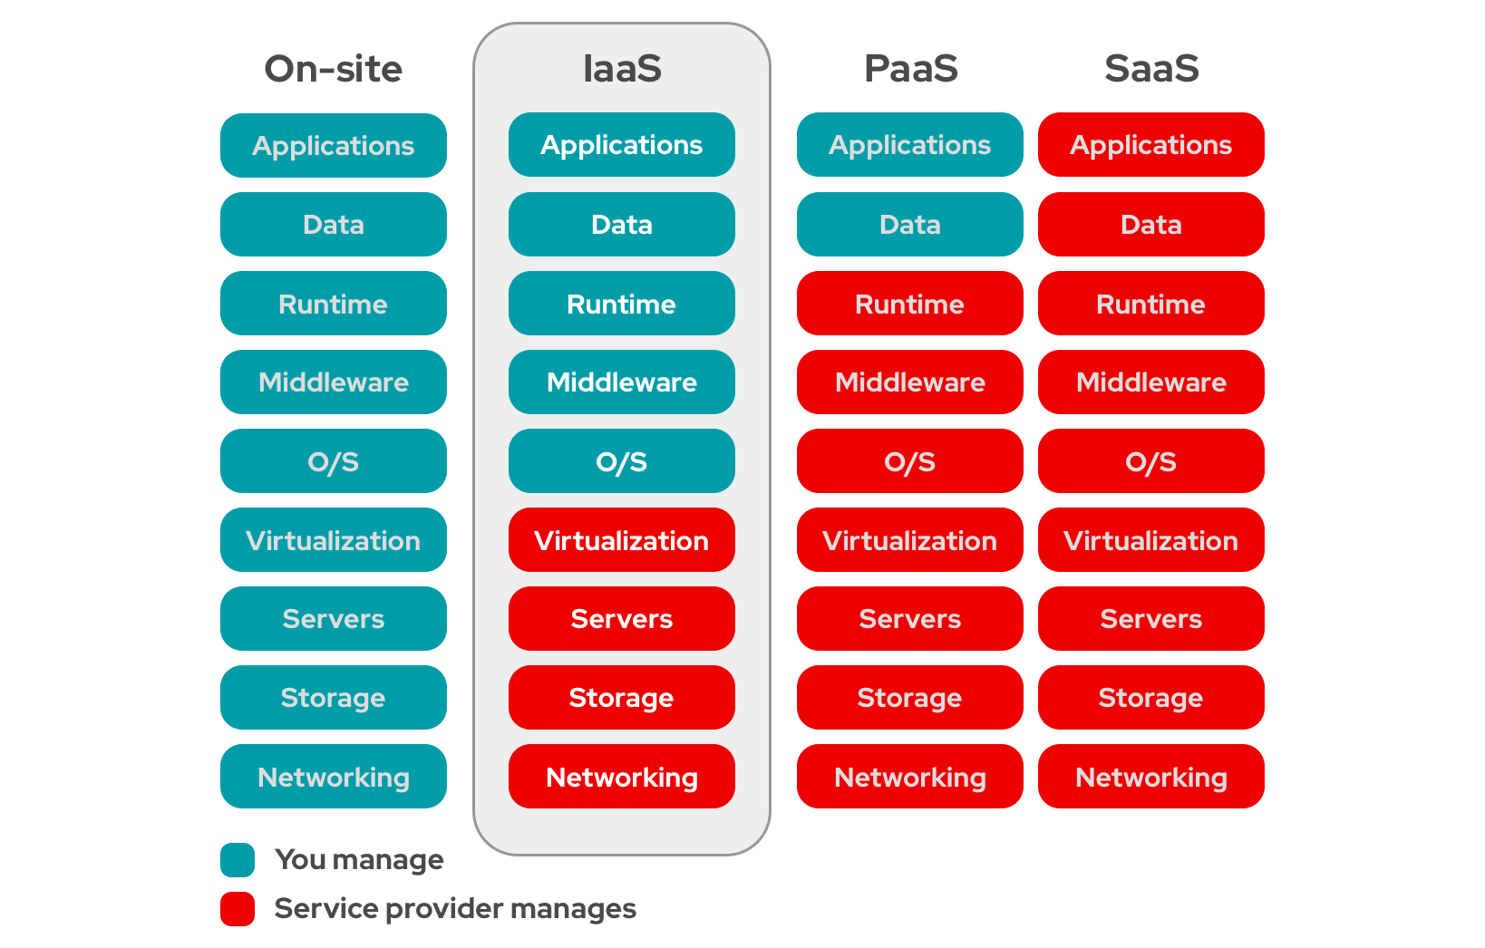
SaaS , PaaS , Iaas :

Slide 13
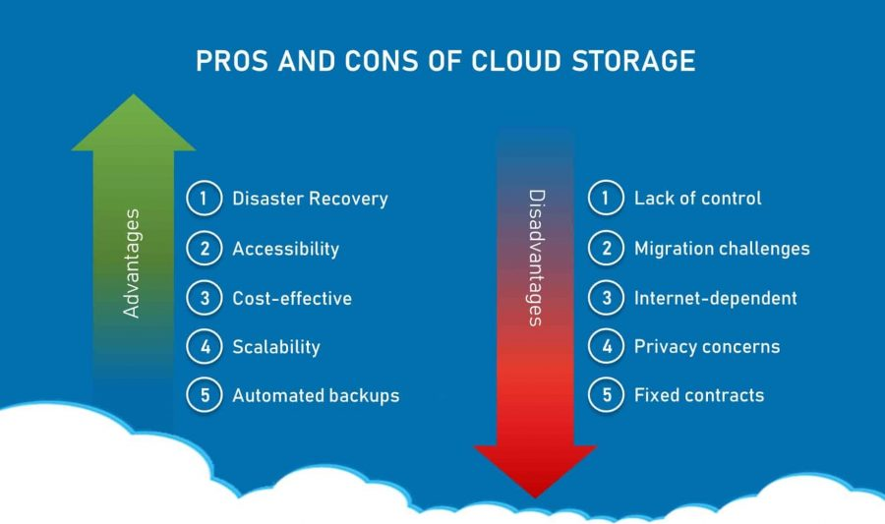
ADVANTAGES AND DISADVANTAGES :

Slide 14
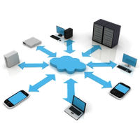
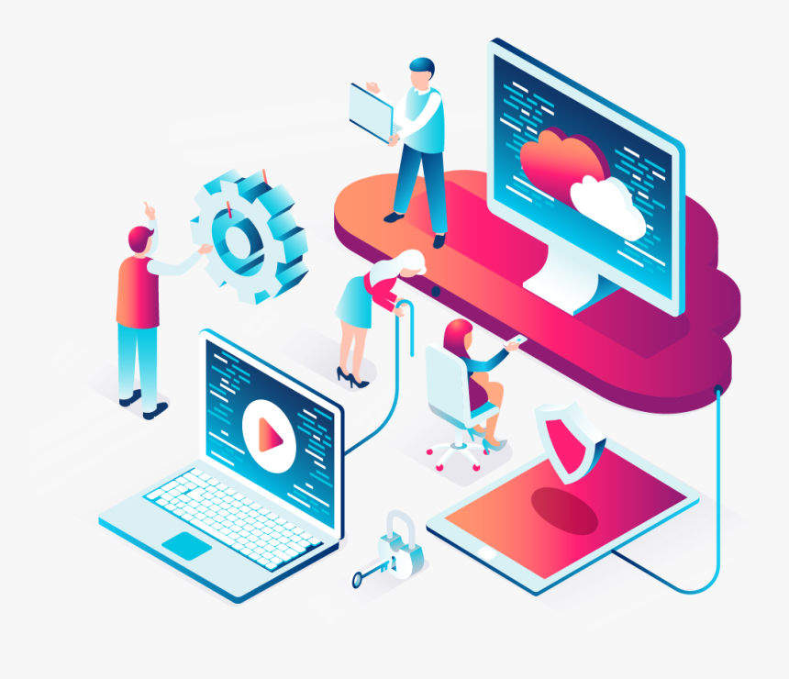
FUTURE OF CLOUD COMPUTING:
It can be possible in the future that data processed in an hour today can be done in just a minute .Faster preprocessors and connection will be the main proponents of this improvement.
As faster computer and largest virtual storage area become available , cloud computing will also continuously improve with it.

Slide 15
THANK YOU SIR

