Slide 1


Project Coordinator
Amruta Deore Represented By:
Dipali Sampat Wale
dipawale6@gmail.com
Placement Management System

Slide 2
Content
Abstract
Objectives
Introduction
What is Placement Management System ?
System Design
ER Diagram
Snapshots
Features and Advantages
Conclusion

Slide 3
Abstract
The project is aimed at developing an application for the “Placement Management System” of the college.
The system is an application that can be accessed and effectively used through out the organization.
This system can be used as an application for the placement officers in the collage to manage the student information

Slide 4
Objectives
The main objective of Placement Management System is to develop a student and company information system.
Easy to find out the list of eligible students attending the drive
It manages the details of student records, placement training, different placements happening in and out of the college.
Saves the time of placement officer and faculties.
Reduces the manual works.
This system makes student information more secure

Slide 5
Introduction
t is a platform where students can view and assess their opportunities
Placement Management System manages student information in the college with regard to placement.
It has the facility of maintaining the details of the student, thereby reducing the manual work.
It will save time and energy which are spending in making reports and collecting data.
A profile for each student is created with the necessary credentials for the portal.
The system uses MySQL for database management and will sort the data of the student.

Slide 6
What is Placement Management System ?
Placement Management System manages student information in the college with regard to placement.
It has the facility of maintaining the details of the student, there by reducing the manual work.
It will save time and energy which are spending in making reports and collecting data.

Slide 7
SYSTEM DESIGN
Student Module
Add Student: 1)Name
2)Student Details
View Student: 1)Delete
2)Update

Slide 8
SYSTEM DESIGN
Company Module
Add Company : 1)Name
2)Company Details
View Company : 1)Delete 2)Update

Slide 9
How do I prepare for a placement drive?
Find out the history of placement drives in college
Start preparing for the aptitude tests
Start working on your resume
Start preparing for the Group Discussion
Prepare for personal interview process

Slide 10
System Specification
Operating System - Windows 10.
Platform – Eclipse.
JDK-1.8,1.16.
Server-Tomcat 8.5,10.
Language – HTML,CSS, Hibernate, Java,
Jsp, MySQL, SQLyug

Slide 11
ER Diagram
Company
Login
Company profile
View student details
Maintain company profile details

Slide 12
ER Diagram
Student
Login
View Company details
Verify company details
Student registration

Slide 13
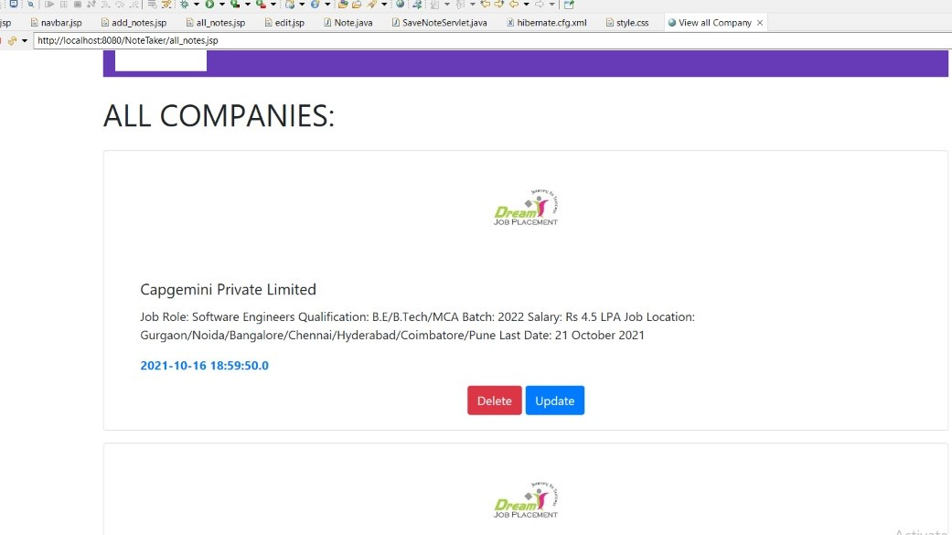
Snapshots

Slide 14
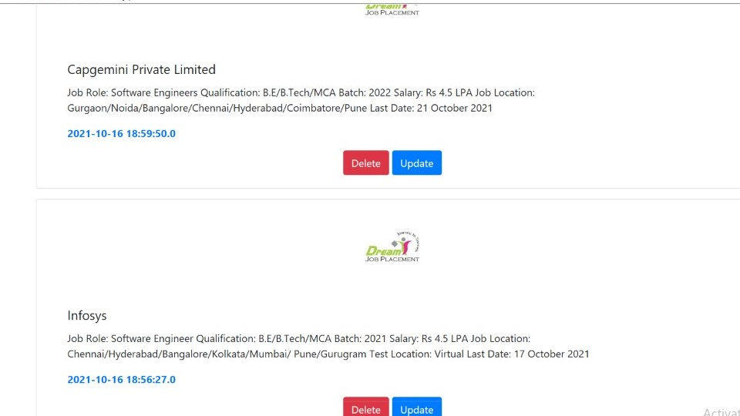
Snapshots

Slide 15
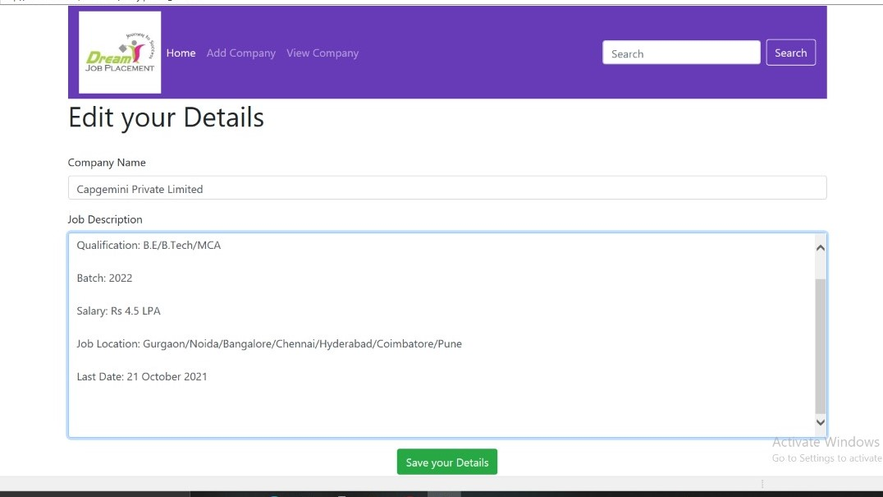
Snapshots

Slide 16
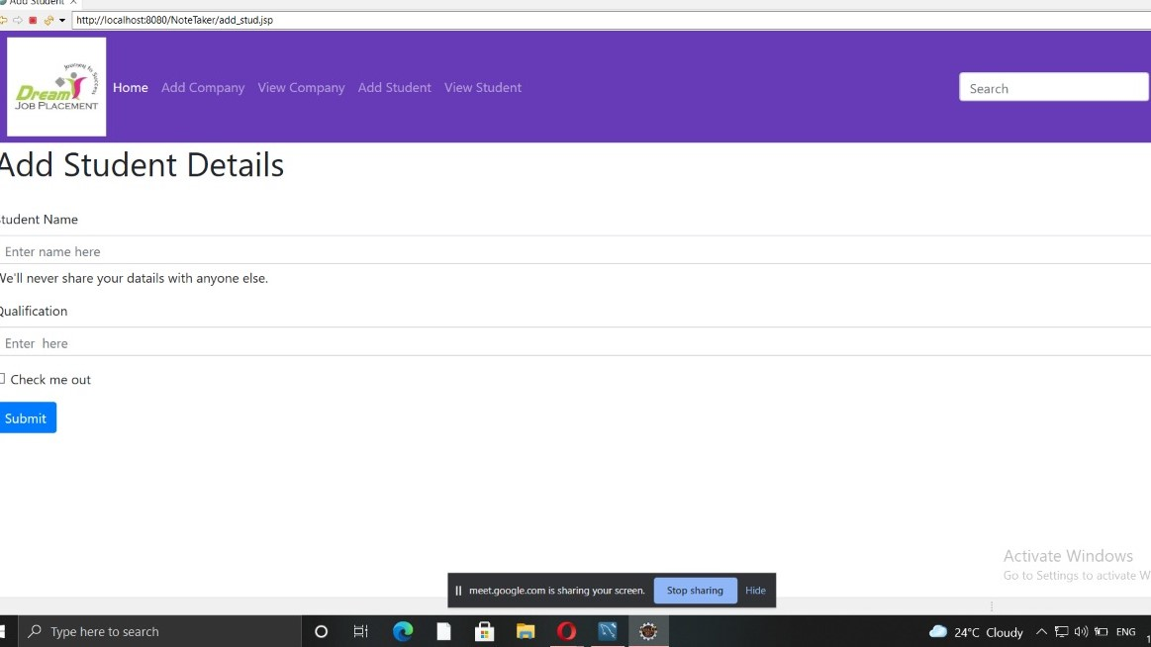
Snapshots

Slide 17
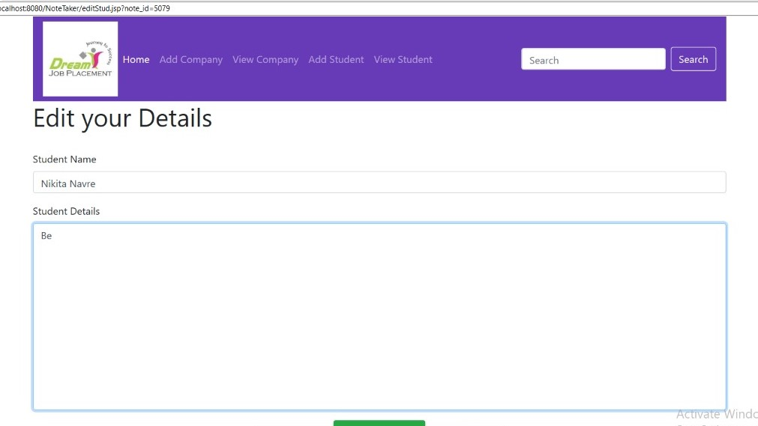
Snapshots

Slide 18
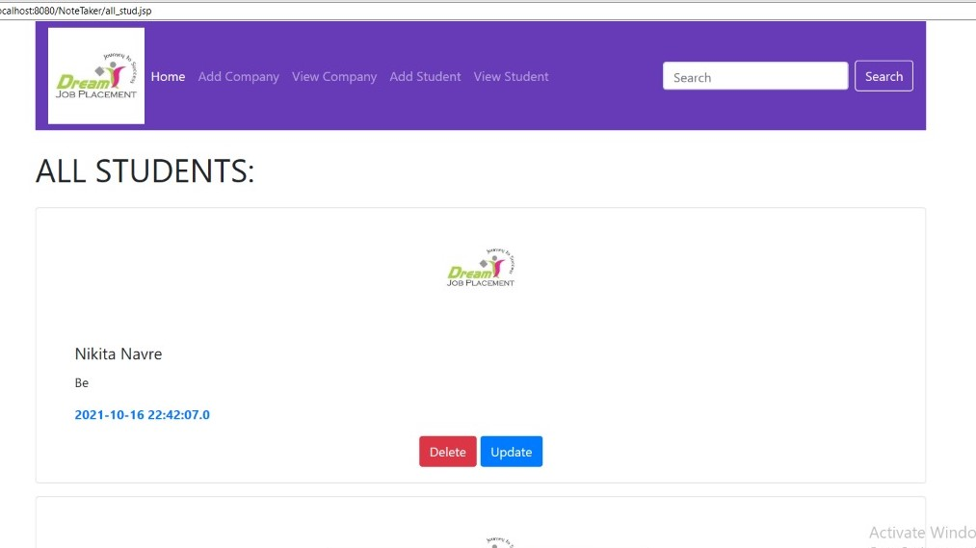
Snapshots

Slide 19
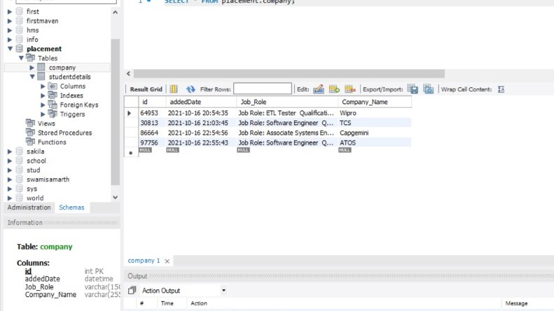
Snapshots

Slide 20
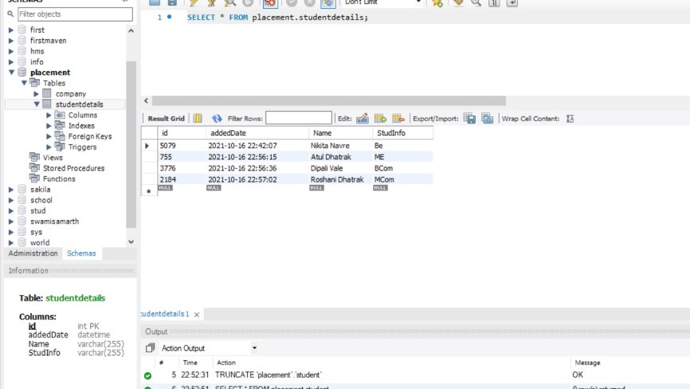
Snapshots

Slide 21
Features and Advantages
The project is easily extensible and can be improved by further incremental releases of the same.
We can extend this project by sending emails to companies and students information regarding placement dates ,other eligibility criteria also.
New modules can be easily added as it requires only an addition of a new package on button click.

Slide 22
Conclusion
It has the facility of maintaining the details of the student, there by reducing the manual work.
It will save time and energy which are spending in making reports and collecting data.
This project has been completed successfully to college Web based placement management system by maintaining the student details related to placement in an efficient manner.

Slide 23
Refferences
www .Edubridgeindia.Com
www. Google. com

Slide 24
Github Link-
https://github.com/dipawale6/proj.git

Slide 25
Thank You!

