Slide 1
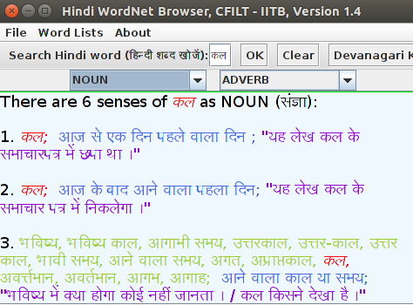
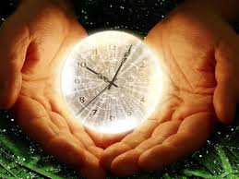

Building Tempo-HindiWordNet: A Resource for Temporal information access

Slide 2
Problem Statement
Hindi
Wordnet
+
Time annotation
to each synset
Past
Tempo-
HindiWordnet
Future
Future

Slide 3
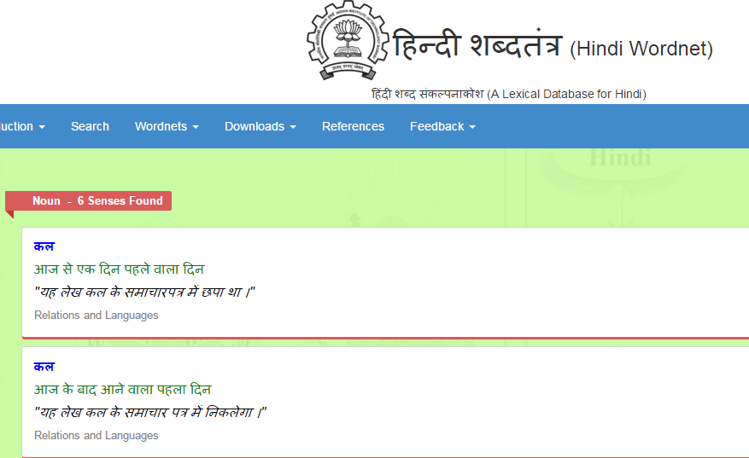
Challenge
Past
Future

Slide 4
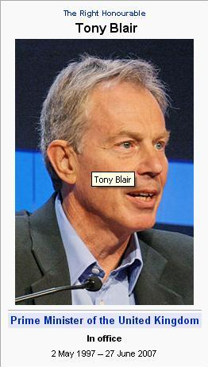
Temporal Information Retrieval
Document relevance
Time relevance
e.g.
Query: PM United Kingdom 2000

Slide 5
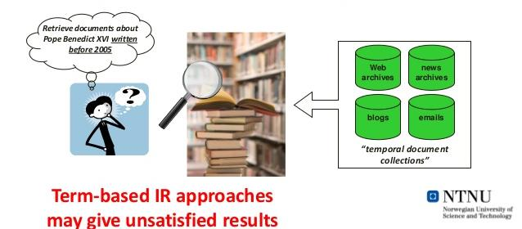
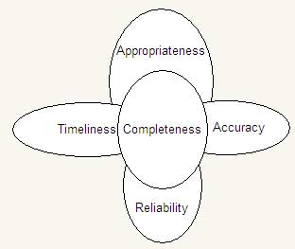
Is time really so much important ?
Causes
i. Increase in availability of information
ii. Need to assess credibility of information
iii. Time is one of key five parameters to assess credibility of information
iv. Need for T-IR
Applications highlighting growing importance of time
i. Recorded future
ii. Yahoo's time explorer
iii. Google's Ngram viewer

Slide 6
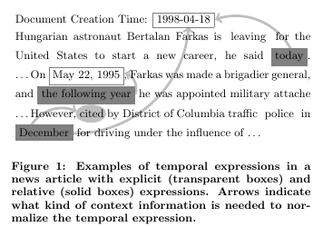
Motivation
Absence of temporal lexical resource for Hindi
Absence of techniques making use of time information present in language
Importance of Hindi in India

Slide 7
Ultimate aim
Remove the need of presence of explicit timexes in order to
identify presence of time sense in context
Facilitate research in T-IR & may even give rise to new research
trends In Temporal information access

Slide 8
Methodology
Two approaches
Two step classification
Step 1 : Temporal-Atemporal classification
Step 2 : Past, present, future, neutral classification
One step classification
Step : Past, present, future, neutral, aneutral
classification

Slide 9
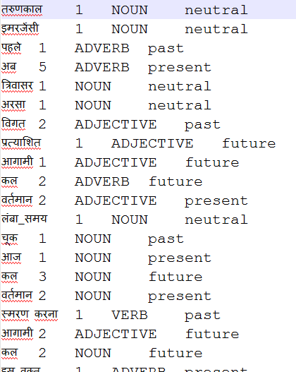
Basic steps in both classification approaches
Seed word set – Set consisting of words representing desired
classes ( past, present, future, neutral,
atemporal)
e.g.

Slide 10
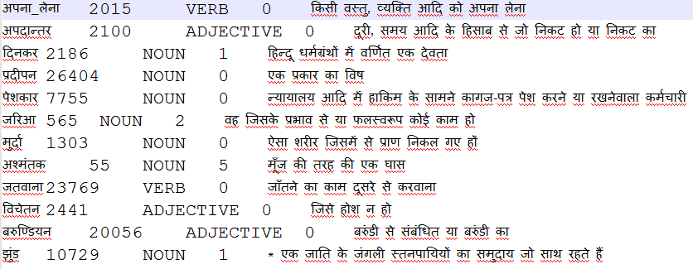
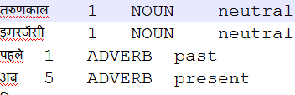
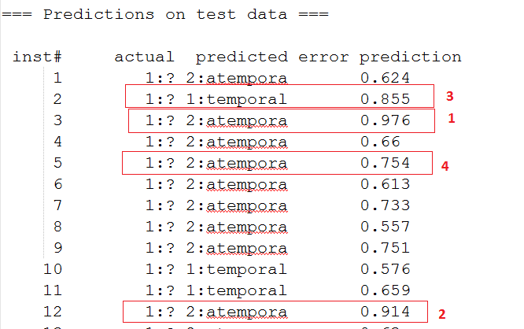
Basic steps in both classification
Confidence based expansion
Current seed word set
Apply model
on test set
Learn the classifier
Obtain
prediction
+
Expanded
Train
set

Slide 11
Two step classification approach
Step1 : Atemporal-Temporal classification
Select seed words
representing temporality
& atemporality
1. Divide whole Hindi
wordnet in 10 folds to
prepare test set
2. Set i=1
Learn classifier on current
set of seed words
No
If i<11
Stop
Start
yes
1. Test learned classifier on i^{th}
fold of test set & obtain
predictions
2. Increment i by 1
No Of Temporal Instances
to be added(t1)= 15 % of total no. of Temporal
Instances in current seed word set
No Of Atemporal Instances
to be added(t2)= 20 % of total no. of Atemporal
Instances in current seed word set
Select t1 no temporal & t2 no of atemporal
Instances on the basis of confidence based
Expansion from ith fold of Test set & expand
Current seed word set with them.

Slide 12
Past, present, future, neutral
classification
Step 2 :
Select seed words
representing classes
Past, present, future,
neutral
1. Extract instances classified
as temporal in step 1 to
prepare test set & divide
resultant test set in 8 folds.
2. Set i=1
No
Train model on current
set of seed words
If i<9
Stop
Start
yes
1. Test trained model on i^{th}
fold of test set & obtain
predictions.
2. Increment i by 1
Select t1, t2, t3 no past, present, future & t4
no of neutral Instances on the basis of confidence
Based expansion from ith fold of Test set & expand
Current seed word set with them.
No Of past(t1), present(t2), future(t3) Instances
to be added= 15 % of total no. of respective
classes Instances in current seed word set
No Of neutral Instances
to be added(t4)= 20 % of total no. of neutral
Instances in current seed word set

Slide 13
Results on training set
i. Two step classification approach
Results of 1st step
SVM | Cycle 1 | Cycle 2 | Cycle 3 | Cycle 4
Precision | 0.863 | 0.944 | 0.989 | 0.993
Recall | 0.845 | 0.934 | 0.989 | 0.993
F-measure | 0.847 | 0.935 | 0.989 | 0.993
Results of 2nd step
SVM | Cycle 1 | Cycle 2 | Cycle 3 | Cycle 4
Precision | 0.512 | 0.734 | 0.886 | 0.994
Recall | 0.536 | 0.743 | 0.887 | 0.944
F-measure | 0.495 | 0.724 | 0.885 | 0.993

Slide 14
Results on training set
ii. One step classification approach
SVM | Cycle 1 | Cycle 2 | Cycle 3 | Cycle 4
Precision | 0.611 | 0.879 | 0.968 | 0.993
Recall | 0.541 | 0.873 | 0.968 | 0.993
F-measure | 0.566 | 0.867 | 0.968 | 0.993

Slide 15
Results on Gold Standard test set
Two step classification
1st step
 | Precision | Recall | F-measure
Temporal | 0.927 | 0.77 | 0.841
Atemporal | 0.803 | 0.94 | 0.866
Avg | 0.865 | 0.85 | 0.853
2nd step
 | Precision | Recall | F-measure
Past | 0.117 | 0.1 | 0.108
Present | 0.333 | 0.5 | 0.399
Future | 0.333 | 0.25 | 0.285
Neutral | 0.277 | 0.25 | 0.263
Avg | 0.265 | 0.275 | 0.264

Slide 16
ii. One step classification
 | Precision | Recall | F-measure
Past | 0.267 | 0.2 | 0.228
Present | 0.136 | 0.15 | 0.142
Future | 0.142 | 0.05 | 0.073
Neutral | 0.182 | 0.1 | 0.129
Atemporal | 0.48 | 0.6 | 0.533
Avg | 0.241 | 0.22 | 0.230

Slide 17
Conclusion
We have developed two approaches to construct temporal resource for Hindi language.
We believe that this temporal resource will remove the need of presence of explicit timexes in order to identify presence of time in given context and facilitate research in temporal-IR.

Slide 18
Future work
Enhancement of expansion strategy
Incorporate dependency parser in expansion strategy

Slide 19
thanks!
Any questions?

