Slide 1
Modeling State Transition in Heterogeneous System

Slide 2
Motivation
Current state transition systems are based on heuristic
We need to design a mathematical model which captures relationship between resource usage ( which might serve as a proxy for performance) and frequency(which can be used to predict power)

Slide 3
Key Question
Characterizing the relationship
Does there exist a relationship between resource utilization and frequency
Does resource usage has any auto-correlation or seasonal behavior
Does external parameters impact the behavior

Slide 4
Motivation
Characterize the state transition based on the interplay among different resources
Formal modeling helps us devise a metric which helps us to quantify and optimize the process

Slide 5
Research Question
How efficient are the current state transition methods?
Can the current and past state and workload help predict the appropriate state?
Is the relationship among different parameters linear or non-linear?

Slide 6
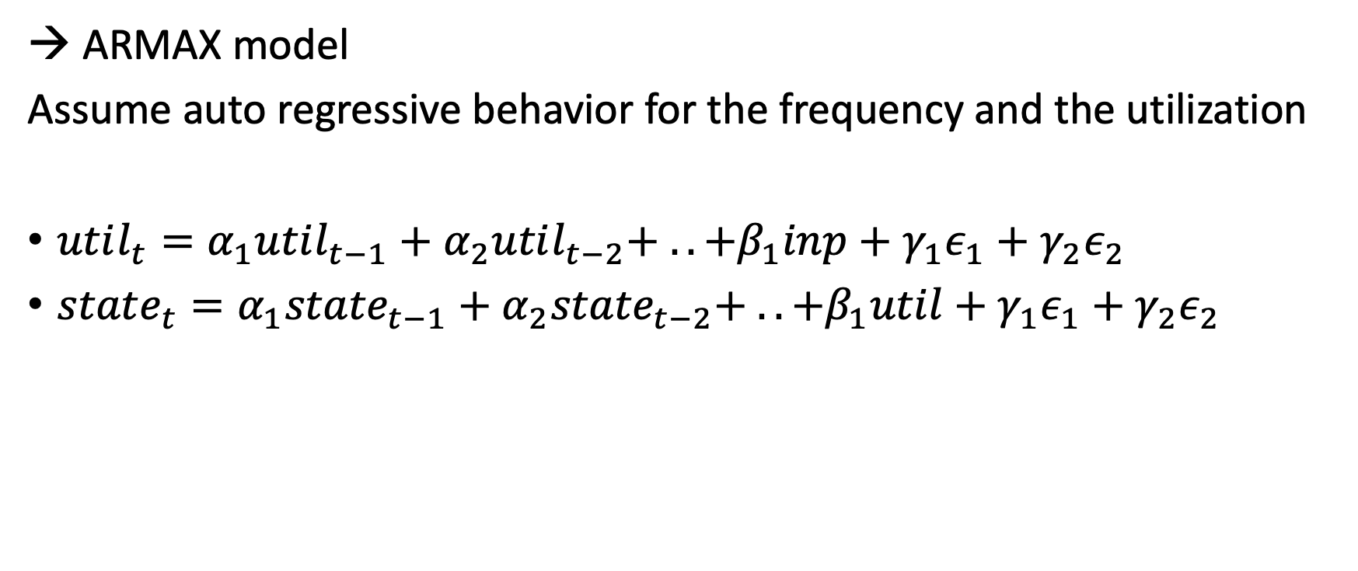
Approach
→ ARMAX model
Assume auto regressive behavior for the frequency and the utilization
$util_{t}=α_{1}util_{t−1}+α_{2}util_{t−2}+ .. +β_{1}inp+γ_{1}ε_{1}+γ_{2}ε_{2}$
$state_{t}=α_{1}{state}_{t−1}+α_{2}{state}_{t−2}+ .. +β_{1}util+γ_{1}ε_{1}+γ_{2}ε_{2}$

Slide 7
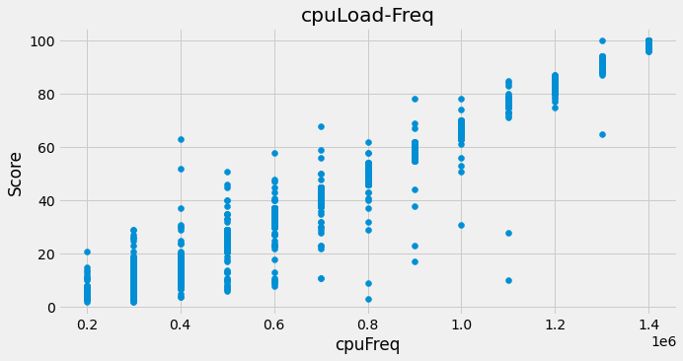
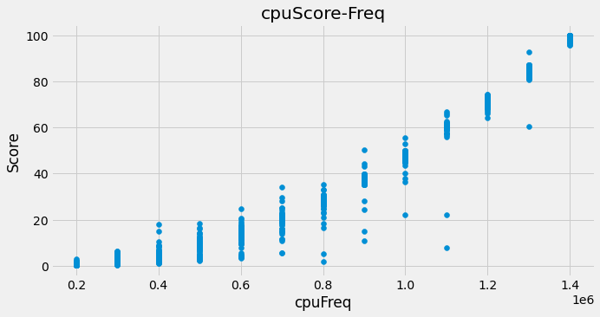
Data Coverage
We collected data by extracting the utilization and frequency of CPU and memory during a sample run with idle and heavy workload

Slide 8
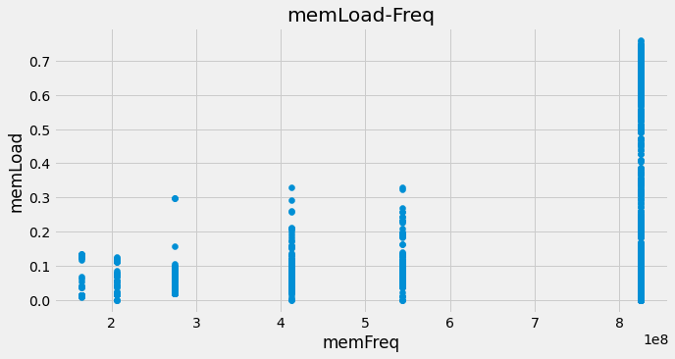
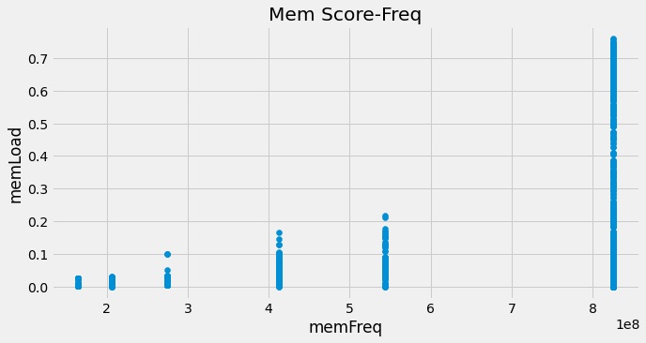
Data Coverage

Slide 9
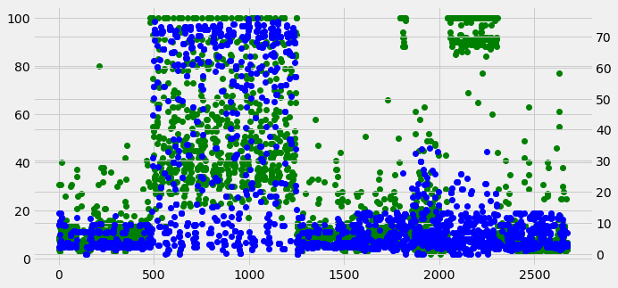
Timeline of load across the system
Mem: Blue , CPU: green

Slide 10
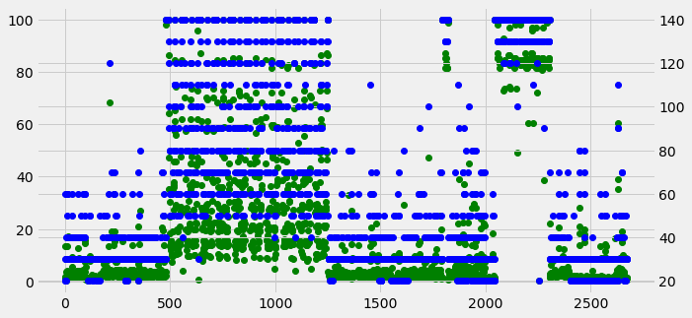
Relationship between load and frequency
cpuF : blue , cpuScore : green

Slide 11
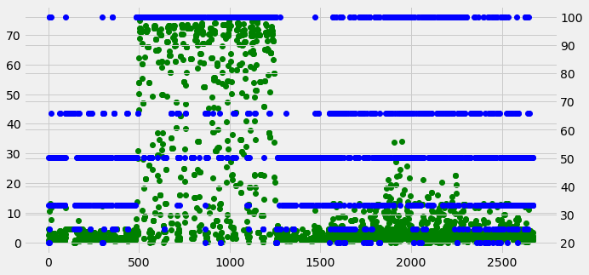
Relationship between load and frequency
memF : blue , memScore : green

Slide 12
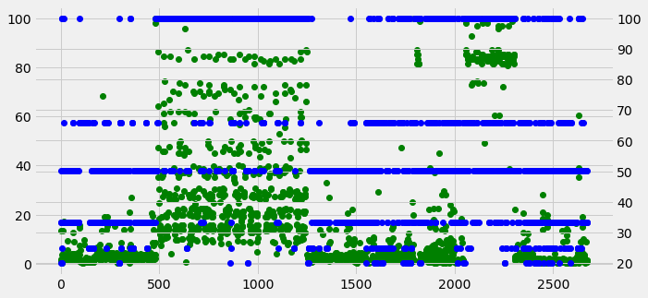
Relationship between CPU and memory

Slide 13
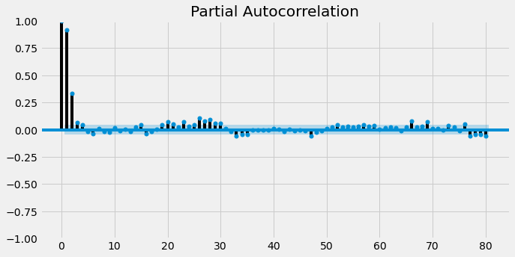
Autocorrelation of Frequency: CPU

Slide 14
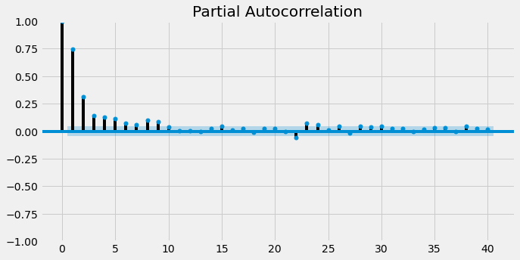
Autocorrelation of Frequency Mem

Slide 15
How are we modeling
We are going to estimate various auto-correlation lags and moving average parameters to check if we get good model
Order = (p,d,q) → where p : auto-correlation lag, q = moving average of errors, d = order of differentiation for the data to be stationary over time

Slide 16
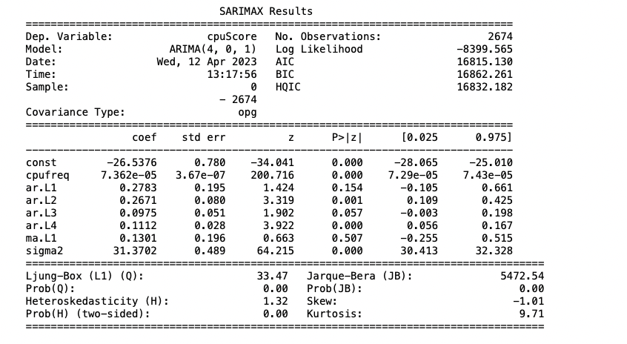
Some introductory result

Slide 17
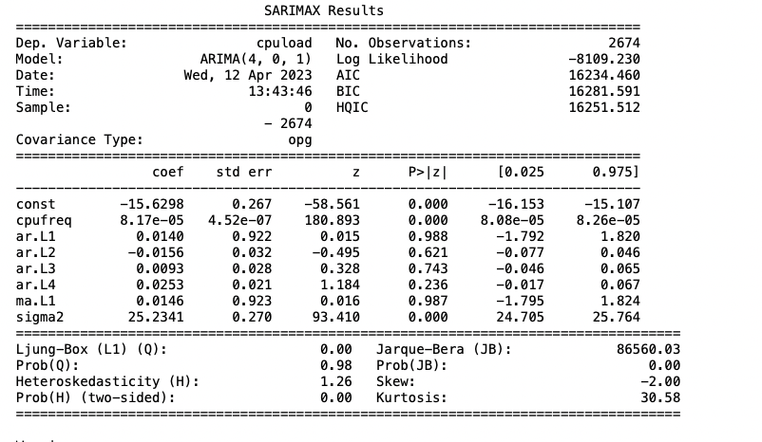
Introductory Results

Slide 18
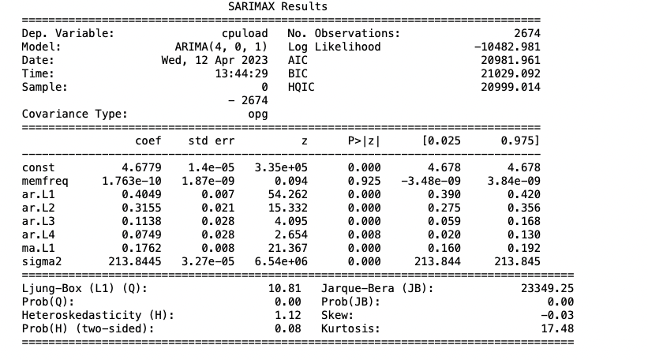
Introductory results

Slide 19
Next Steps
Does a simple one or multi-dimensional model a good fit for this problem
We are going to try a PD and PID controller system to see if we can set the utilization to certain levels say (0.8)
Then use the controller to ensure that the frequency levels are pushed up and down based on the direction. We can also utilize the velocity of change determine how many levels we should switch

Slide 20
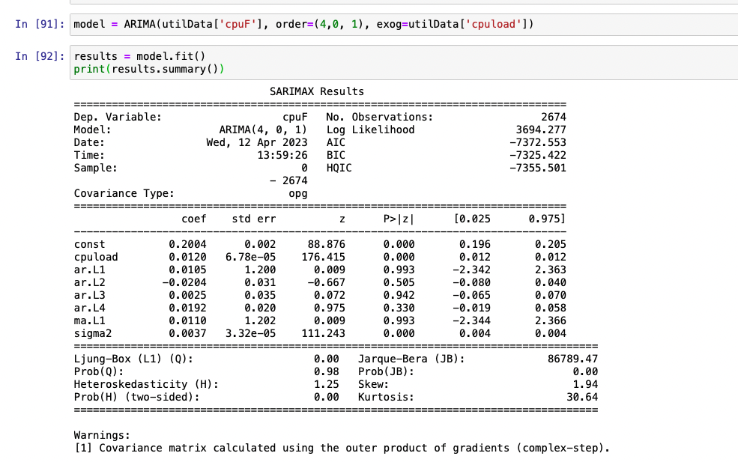
Updated Observations
If we switch the dependent variable to frequency and using the utilization as the controller, we see improved results based on the log-likelihood.

Slide 21
Re-modeling our approach
Use C-means clustering of the CPU load using the differential value
This allows us to create models for different type of load and create model for each of them
Use the observed values for creating state transitions
Use ARMA or Fuzzy logic to calculate the predicted value for each cluster
Use the probabilities for weighing the outcome and then create a average prediction values

Slide 22
Model Architecture
weight[0]
Model 0
prediction[0]
Cluster Prediction
weight[1]
Model 1
weight[2]
Model 2

