Slide 1
Modeling the State Transition in Heterogeneous System

Slide 2
Motivation
Current state transition systems are based on heuristic
We need to design a mathematical model which captures relationship between resource usage ( which might serve as a proxy for performance) and frequency(which can be used to predict power)

Slide 3
Key Question
Characterizing the relationship
Does there exist a relationship between resource utilization and frequency
Does resource usage has any auto-correlation or seasonal behavior
Does external parameters impact the behavior

Slide 4

Approach 1
Assume the the utilization follow an Auto regressive behavior with frequency and the control parameter
$$util_{t}=α_{1}util_{t−1}+α_{2}util_{t−2}+ .. +β_{1}inp+γ_{1}ε_{1}+γ_{2}ε_{2}$$

Slide 5
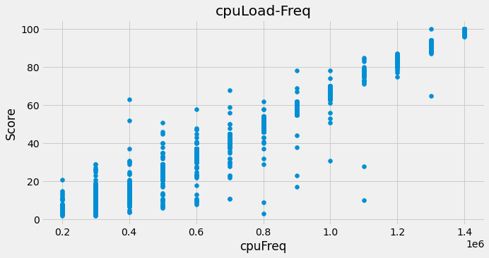
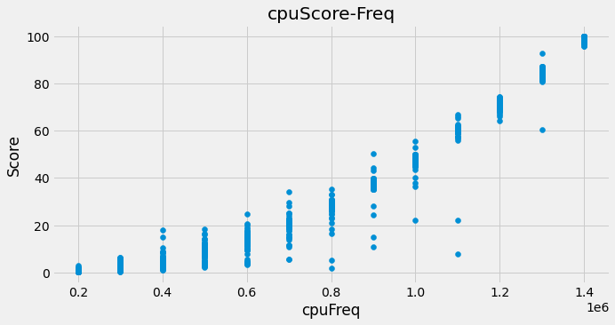
Data used for modeling
We collected data by extracting the utilization and frequency of CPU and memory during a sample run with idle and heavy workload

Slide 6
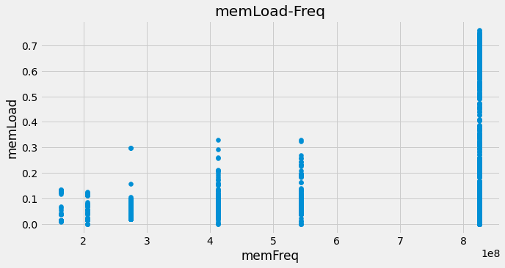
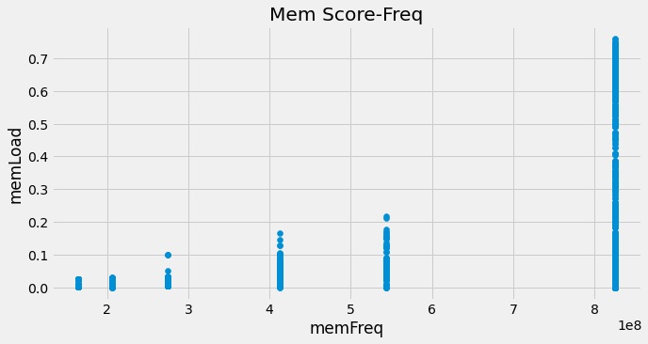
Data used for modeling

Slide 7
How are we modeling
We are going to estimate various auto-correlation lags and moving average parameters to check if we get good model
Order = (p,d,q) → where p : auto-correlation lag, q = moving average of errors, d = order of differentiation for the data to be stationary over time

Slide 8
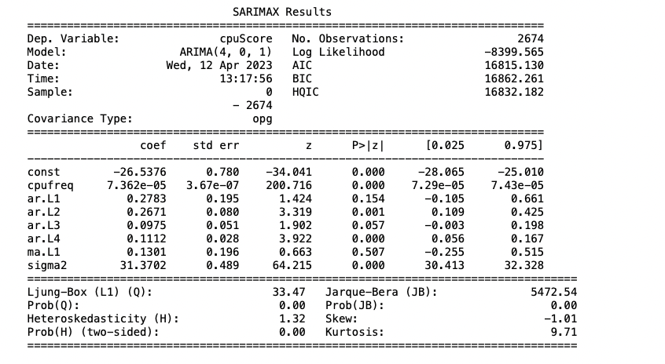
Some introductory result

Slide 9
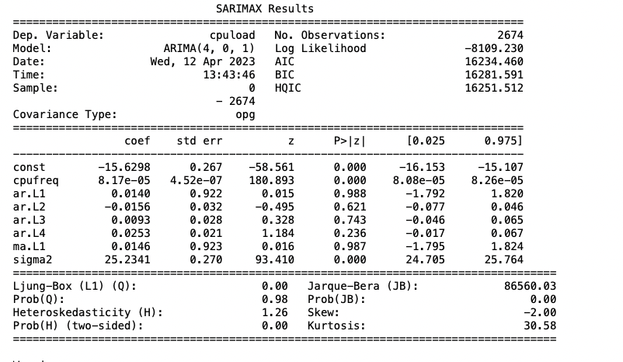
Introductory Results

Slide 10
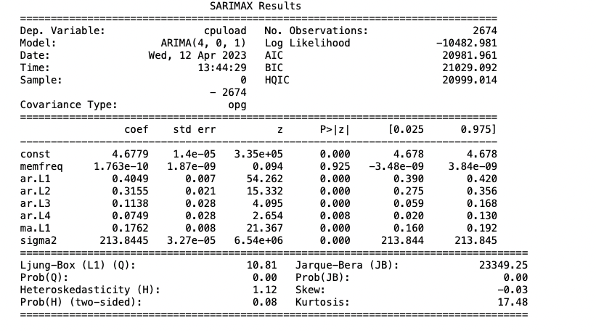
Introductory results

Slide 11
Next Steps
Does a simple one or multi-dimensional model a good fit for this problem
We are going to try a PD and PID controller system to see if we can set the utilization to certain levels say (0.8)
Then use the controller to ensure that the frequency levels are pushed up and down based on the direction. We can also utilize the velocity of change determine how many levels we should switch

Slide 12
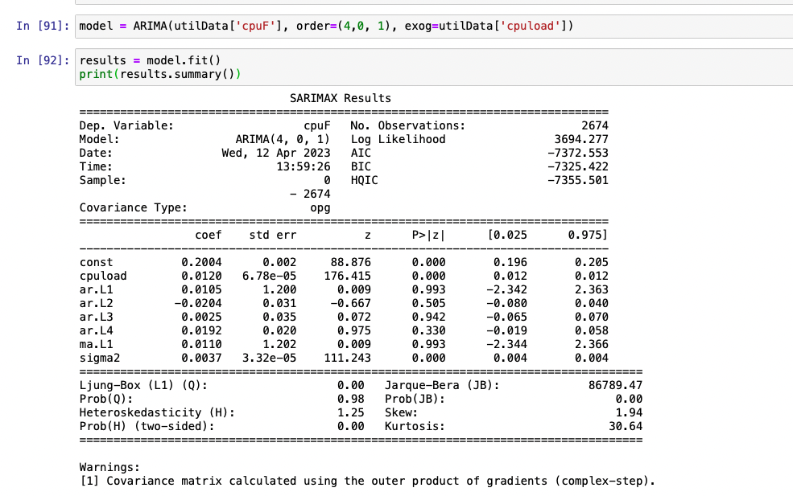
Updated Observations
If we switch the dependent variable to frequency and using the utilization as the controller, we see improved results based on the log-likelihood.

